Slide 1
What Explains our Marks?
S Anand, CEO, Gramener

Slide 2
Analysis patterns
“What are the top 10 X”
Most analysis is based on a common pattern of questions.
For example, the question “What are the top 10 items” can be expressed in a variety of different ways – that covers most common types of analysis.
This is a standard process:
Identify the entity, e.g. product, branches, etc
Identify the metric, e.g. sales, growth, etc
Sort entities by the metric (e.g. branches by sales)
Get the top 10 rows
Which are my top products?
Which are my top branches?
Who are my best sales people?
Which vendors have the highest cost per unit?
Which divisions are spending the most money?
In which hours does the under 12 segment watch TV most?
Which customer segment has the highest revenue per user?

Slide 3
Let’s take one day cricket data
Country | Player | Runs | ScoreRate | MatchDate | Ground | Versus
Australia | Michael J Clarke | 99* | 93.39 | 30-06-2010 | The Oval | England
Australia | Dean M Jones | 99* | 128.57 | 28-01-1985 | Adelaide Oval | Sri Lanka
Australia | Bradley J Hodge | 99* | 115.11 | 04-02-2007 | Melbourne Cricket Ground | New Zealand
India | Virender Sehwag | 99* | 99 | 16-08-2010 | Rangiri Dambulla International Stad. | Sri Lanka
New Zealand | Bruce A Edgar | 99* | 72.79 | 14-02-1981 | Eden Park | India
Pakistan | Mohammad Yousuf | 99* | 95.19 | 15-11-2007 | Captain Roop Singh Stadium | India
West Indies | Richard B Richardson | 99* | 70.21 | 15-11-1985 | Sharjah CA Stadium | Pakistan
West Indies | Ramnaresh R Sarwan | 99* | 95.19 | 15-11-2002 | Sardar Patel Stadium | India
Zimbabwe | Andrew Flower | 99* | 89.18 | 24-10-1999 | Harare Sports Club | Australia
Zimbabwe | Alistair D R Campbell | 99* | 79.83 | 01-10-2000 | Queens Sports Club | New Zealand
Zimbabwe | Malcolm N Waller | 99* | 133.78 | 25-10-2011 | Queens Sports Club | New Zealand
Australia | David C Boon | 98* | 82.35 | 08-12-1994 | Bellerive Oval | Zimbabwe
Australia | Graeme M Wood | 98* | 63.22 | 11-01-1981 | Melbourne Cricket Ground | India
England | Ian J L Trott | 98* | 84.48 | 20-10-2011 | Punjab Cricket Association Stadium | India
India | Yuvraj Singh | 98* | 89.09 | 01-08-2001 | Sinhalese Sports Club Ground | Sri Lanka
Ireland | Kevin J O'Brien | 98* | 94.23 | 10-07-2010 | VRA Ground | Scotland
Kenya | Collins O Obuya | 98* | 75.96 | 13-03-2011 | M.Chinnaswamy Stadium | Australia
Netherlands | Ryan N ten Doeschate | 98* | 73.68 | 01-09-2009 | VRA Ground | Afghanistan
New Zealand | James E C Franklin | 98* | 142.02 | 07-12-2010 | M.Chinnaswamy Stadium | India
Pakistan | Ijaz Ahmed | 98* | 112.64 | 28-10-1994 | Iqbal Stadium | South Africa
South Africa | Jacques H Kallis | 98* | 74.24 | 06-02-2000 | St George's Park | Zimbabwe

Slide 4
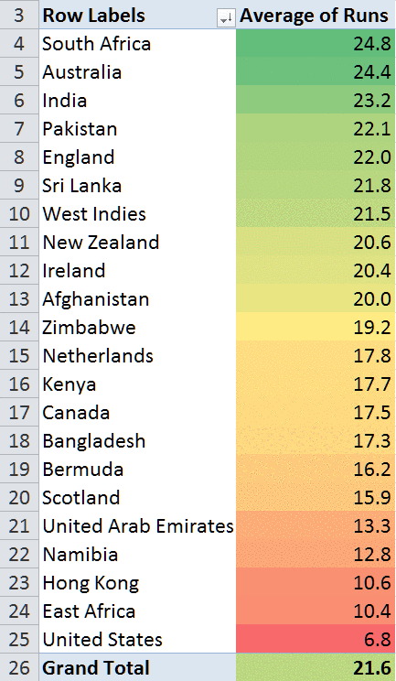
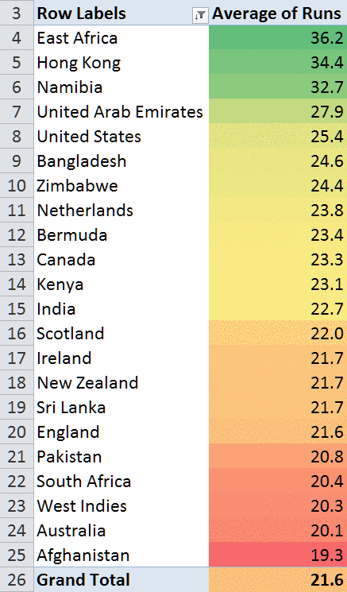
Which countries’ players score more per match?
Against which countries are higher averages scored?

Slide 5
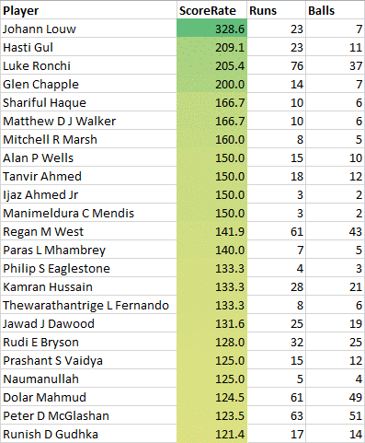
The player with the highest strike rate is an obscure South African whose name most of us have never heard of.
In fact, this list is filled with players we have never heard of.
Which player scores the most per ball?

Slide 6
This question can be answered systematically
Take every column in the data
Country | Player | Runs | ScoreRate | MatchDate | Ground | Versus
Australia | Michael J Clarke | 99* | 93.39 | 30-06-2010 | The Oval | England
Australia | Dean M Jones | 99* | 128.57 | 28-01-1985 | Adelaide Oval | Sri Lanka
Australia | Bradley J Hodge | 99* | 115.11 | 04-02-2007 | Melbourne Cricket Ground | New Zealand
India | Virender Sehwag | 99* | 99 | 16-08-2010 | Rangiri Dambulla International Stad. | Sri Lanka
New Zealand | Bruce A Edgar | 99* | 72.79 | 14-02-1981 | Eden Park | India
Pakistan | Mohammad Yousuf | 99* | 95.19 | 15-11-2007 | Captain Roop Singh Stadium | India
West Indies | Richard B Richardson | 99* | 70.21 | 15-11-1985 | Sharjah CA Stadium | Pakistan
West Indies | Ramnaresh R Sarwan | 99* | 95.19 | 15-11-2002 | Sardar Patel Stadium | India
Zimbabwe | Andrew Flower | 99* | 89.18 | 24-10-1999 | Harare Sports Club | Australia
Zimbabwe | Alistair D R Campbell | 99* | 79.83 | 01-10-2000 | Queens Sports Club | New Zealand
Zimbabwe | Malcolm N Waller | 99* | 133.78 | 25-10-2011 | Queens Sports Club | New Zealand
Australia | David C Boon | 98* | 82.35 | 08-12-1994 | Bellerive Oval | Zimbabwe
Australia | Graeme M Wood | 98* | 63.22 | 11-01-1981 | Melbourne Cricket Ground | India
England | Ian J L Trott | 98* | 84.48 | 20-10-2011 | Punjab Cricket Association Stadium | India
India | Yuvraj Singh | 98* | 89.09 | 01-08-2001 | Sinhalese Sports Club Ground | Sri Lanka
Ireland | Kevin J O'Brien | 98* | 94.23 | 10-07-2010 | VRA Ground | Scotland
Kenya | Collins O Obuya | 98* | 75.96 | 13-03-2011 | M.Chinnaswamy Stadium | Australia
Netherlands | Ryan N ten Doeschate | 98* | 73.68 | 01-09-2009 | VRA Ground | Afghanistan
New Zealand | James E C Franklin | 98* | 142.02 | 07-12-2010 | M.Chinnaswamy Stadium | India
Pakistan | Ijaz Ahmed | 98* | 112.64 | 28-10-1994 | Iqbal Stadium | South Africa
South Africa | Jacques H Kallis | 98* | 74.24 | 06-02-2000 | St George's Park | Zimbabwe
Find the top value by that column
Country South Africa has the highest strike rate of 76%
Player Johann Louw has the highest strike rate of 329%
Runs 164 runs has the highest strike rate of 156%
MatchDate 12-03-2006 has the highest strike rate of 136%
Ground AC-VDCA Stadium has the highest strike rate of 98%
Versus United States has the highest strike rate of 104%

Slide 7
Derived data can add lead to more interesting avenues

Slide 8
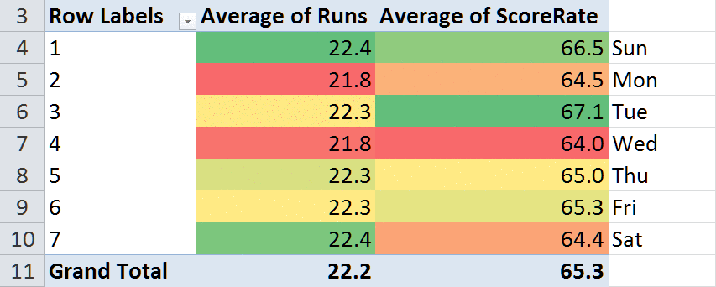
What is the Score Rate by day of the week?
The runs distribution is not statistically significant.
But the score rate distribution is significant.
We don’t know why.
(Australia & South Africa are playing unusually more matches on Tuesdays, though Sundays are most popular. We don’t know why that is either.)

Slide 9
This is in a library called Autolysis
https://github.com/gramener/autolysis

Slide 10
Process for automating insights from ODI cricket data
Find the groups and numbers
Groups: Country, Player, MatchDate, Ground, Versus
Numbers: Runs, ScoreRate
For every number
Runs
ScoreRate
For every group
Country, Player
MatchDate (Day, Month, Weekday)
Ground, Versus
Calculate groupwise average
SA has the highest average scores; US has the least
East Africa are scored against the highest; Afghanistan lowest
Tuesdays have highest strike rate; Wednesdays the lowest
Saturdays have highest runs scored; Wednesdays the lowest
Show it only if t-test probability < 0.01
SA has the highest average scores; US has the least
East Africa are scored against the highest; Afghanistan lowest
Tuesdays have highest strike rate; Wednesdays the lowest
Saturdays have highest runs scored; Wednesdays the lowest

Slide 11
Extending groups and numbers
From existing data, you can always create new groups that may provide insight. Intelligently doing so is one of the most important roles that human analysts play.
Let’s discuss groups that can be created from some common types of data.
Geography
Time
Text
Numbers
PIN / ZIP
City
State
Country
Latitude range
Longitude range
Lat-long in region
Day of the week
Day of the month
Month of the year
Hour of the day
Day of the year
Week of the year
Minute of the hour
Contains a string
Length of the text
Number of words
Compare with a value
Group by quantiles
Group into equal intervals
Group by number ranges
Separate round numbers
Separate cutoff / boundary

Slide 12
Extending groups and numbers
Numbers are often transformed in a way that can show more / different kinds of insights.
Let’s discuss some types of ways of creating new metrics from numbers.
Scales
Transforms
Summaries
Time series
Linear
Proportions
Comparisons
Powers
< 1 (de-emphasises)
> 1 (emphasises)
Logarithms
Sort
Show unique values
Frequencies (histogram)
Averages
Mean
Median
Ranking
Ranges
Min
Max
Moving averages
Growth
Steady rises

Slide 13
There is a tool gap in automated pattern-based analytics space
Tougher
problems
Deep insights
R
Theano
SAS
TensorFlow
SPSS
Caffe
Torch
?
Spotfire
Tableau
Microstrategy
Excel
Qlik
Cognos
Manual exploration
Automated insights
More
problems

Slide 14
This gap leaves a critical space open
Tougher
problems
I need deep insights
in focused core areas
R
Theano
SAS
TensorFlow
SPSS
Caffe
Torch
Target market: Business managers without an analytics team. Autolysis is an alternative to hiring & KPO services
Spotfire
Tableau
Microstrategy
Excel
Qlik
Cognos
Autolysis
I have enough talent
Every problem is different
More data than talent
Problems are often similar
More
problems

Slide 15



What do the children in schools know and can do at different stages of elementary education?
Have the inputs made into the elementary education system had a beneficial effect or not?

Slide 16
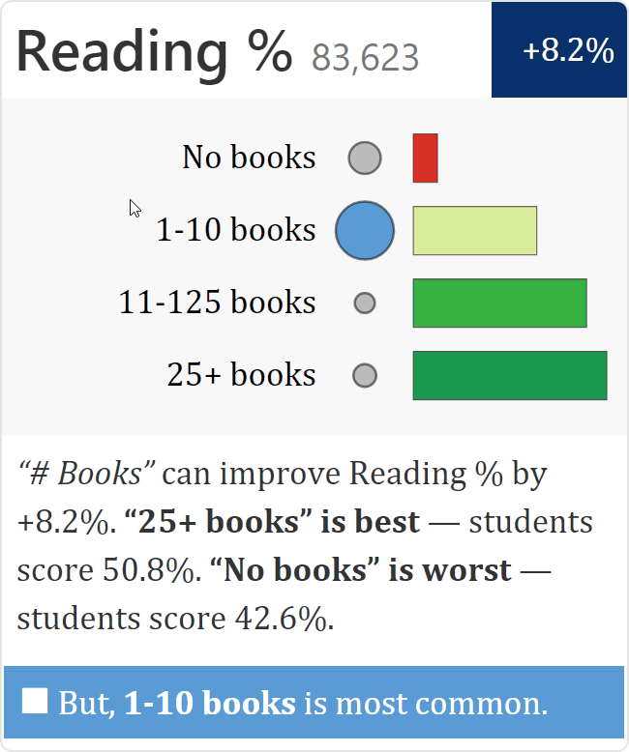
Having books improves reading ability
Having more books at home improves the performance of children when it comes to reading. (But children typically only have only 1-10 books at home)
Number of students sampled
What is the impact? How many more marks can having more books fetch?
Circle size indicates number of students with this response. Few students have no books.
The most common response is marked in blue. This is also the circle.
Is this response (“25+ books”) good or bad? Small red bars indicate low marks. Large green bars indicate high marks. Students having 25+ books tend to score high marks.
The graphic is summarized in words
Indicates whether the best response is the most popular. Blue means that it is not. Green means that it is. Red means that the worst level is the most popular response.

Slide 17
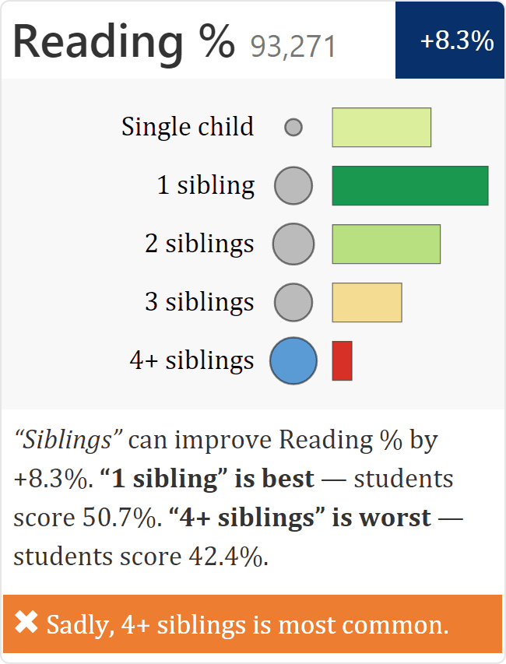
Having more siblings doesn’t help reading
Children with 1 sibling do much better than children with many siblings

Slide 18
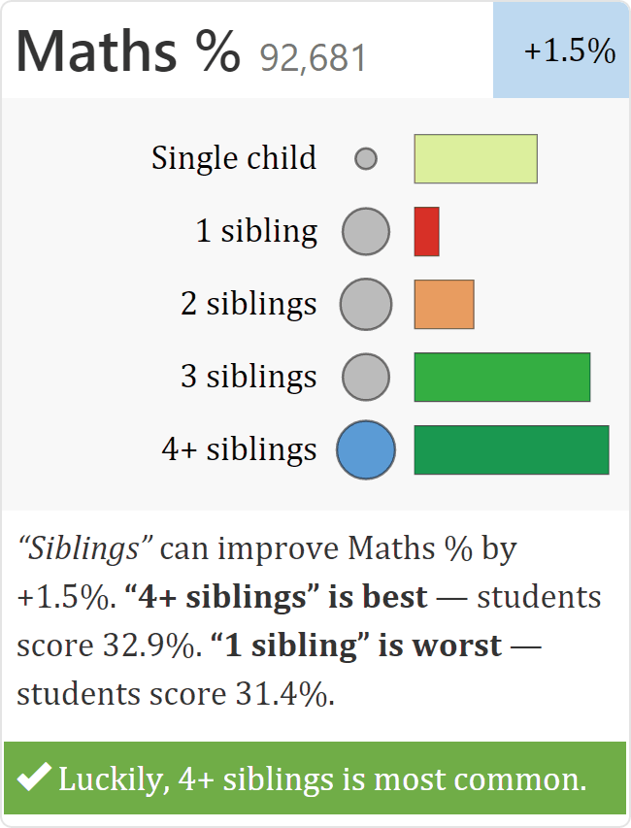
… but helps a lot in mathematics
Children with 4+ siblings do very well, children with 1 sibling fare poorly

Slide 19
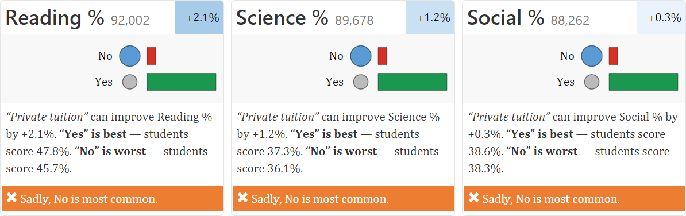
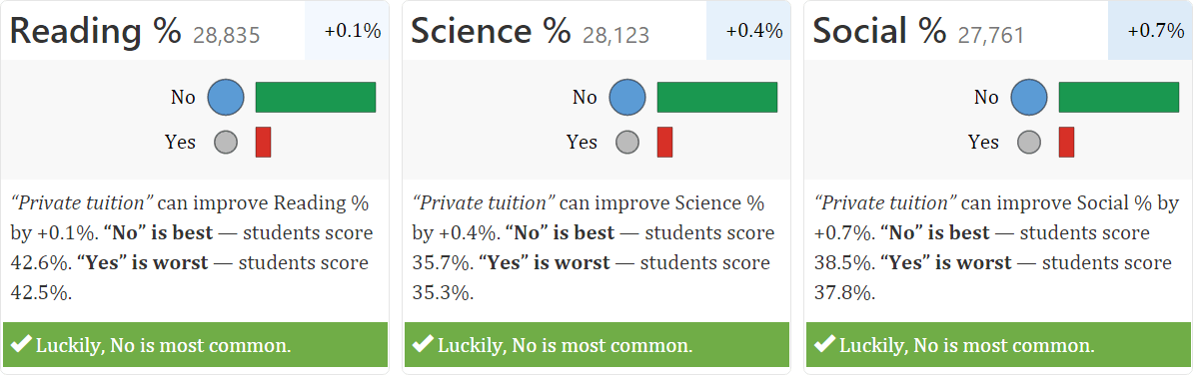
Tuitions help a little
… but not children with 4+ siblings

Slide 20
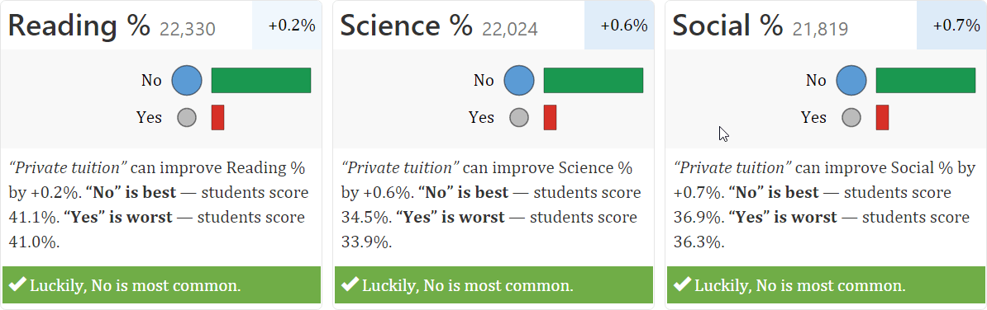
Tuitions help a little
… but not children of illiterate parents

Slide 21
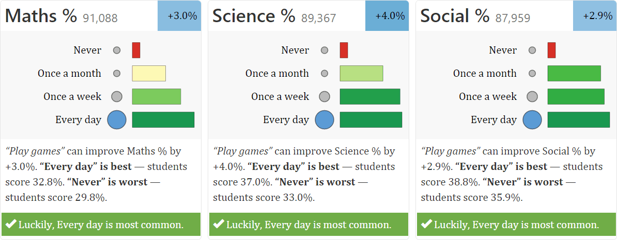
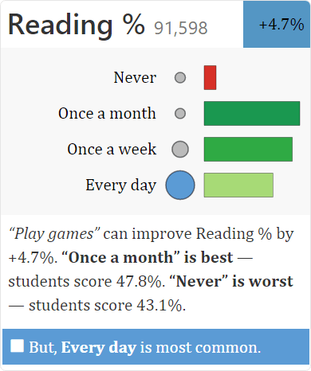
Children like games, and they’re good
… but playing daily hurts reading ability

Slide 22
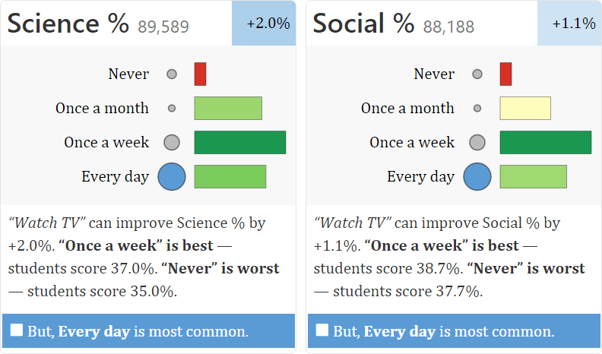
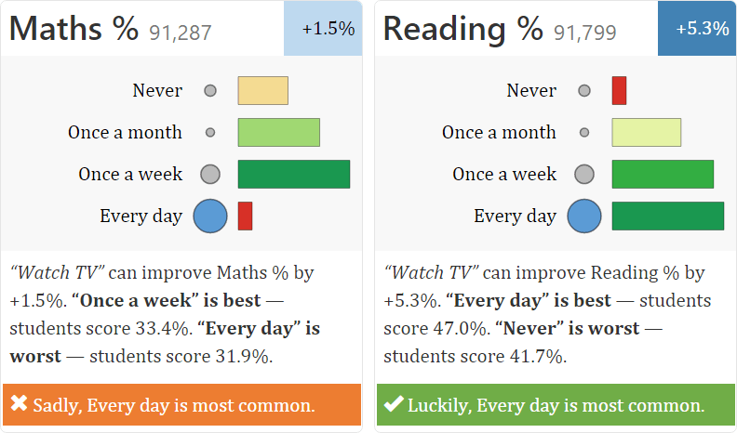
Watching TV occasionally is good
Children who watch TV every day don’t do as well as children who watch TV only once a week.
But children who never watch TV fare the worst.
Watching TV every day helps improve children’s reading ability a little bit more…
… but mathematical abilities fall dramatically at that point

Slide 23
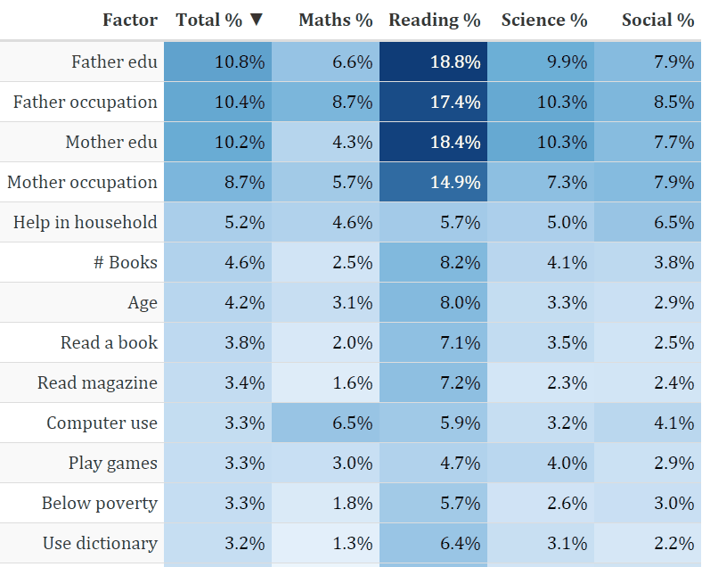
But having educated parents helps most
This table shows the % improvement in score due to each factor

Slide 24
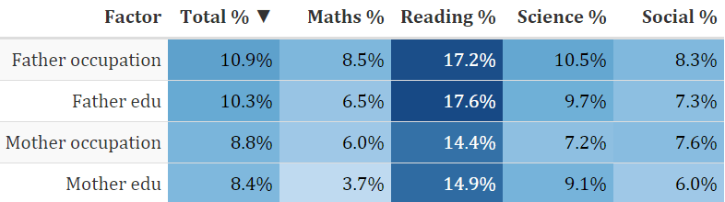
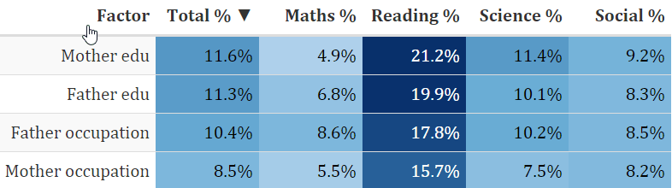
Fathers help their boys study
… but mothers help the girls
… except in mathematics

Slide 25
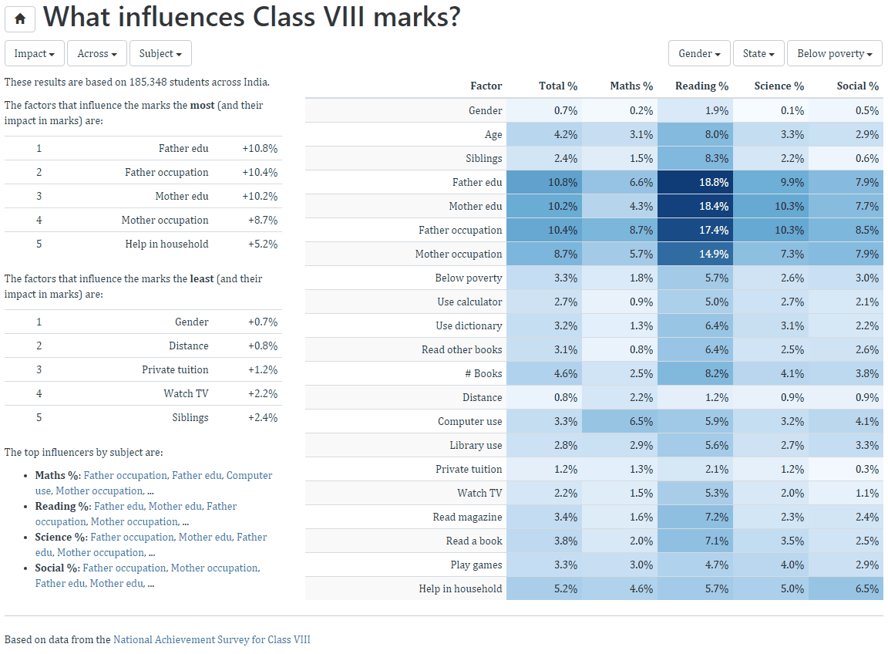
We have a website that you can explore
Gramener.com/nas

