Slide 1
OTP Verification System
Python Capstone Project
By: Aishwarya Pathak

Slide 2
Problem Statement
The project involves developing a secure OTP verification system using Python.
This system will:
- Generate a 6-digit OTP
- Send the OTP to the user’s email
- Verify the OTP entered by the user
- Provide retry options on incorrect OTP input.

Slide 3
Project Objectives
Generate a random OTP.
Simulate sending OTP to the user's email.
Validate the OTP entered by the user.
Provide clear user interaction with error handling.

Slide 4
System Design Overview
The system is designed with the following functions:
1. Generate OTP (Random 6-digit number)
2. Simulate Email Sending (via SMTP)
3. Verify OTP entered by the user
4. Retry mechanism for incorrect OTP input
Error handling for invalid email addresses.

Slide 5
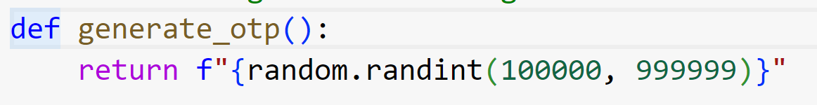
Code Walkthrough - OTP Generation
OTP is generated using Python's `random.randint()`.
A 6-digit random number between 100000 and 999999 is created.
This OTP is returned and used for verification.

Slide 6
Code Walkthrough - Sending OTP
OTP is sent via email using Gmail's SMTP server.
Email validation is done using `email_validator`.
An app password is used for Gmail authentication.
Error handling for invalid email addresses and other exceptions.

Slide 7
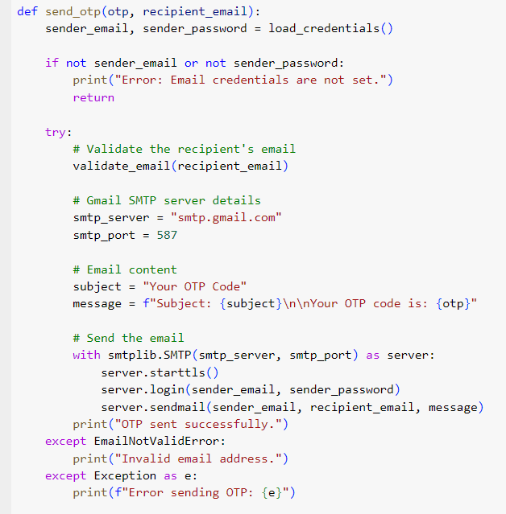

Slide 8
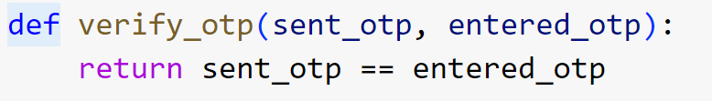
Code Walkthrough - OTP Verification
The user is prompted to enter the OTP.
OTP entered by the user is compared with the generated OTP.
Access is granted if the OTP matches, else user is allowed retries.
Max 3 attempts to enter the correct OTP.

Slide 9
Error Handling and User Interaction
Invalid email address is handled with a clear error message.
Incorrect OTP entries result in retry prompts.
User is informed if maximum attempts are reached.

Slide 10
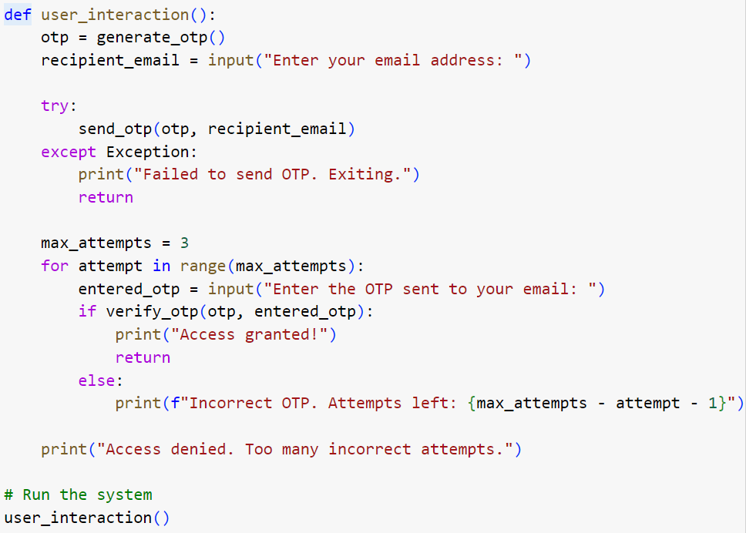

Slide 11
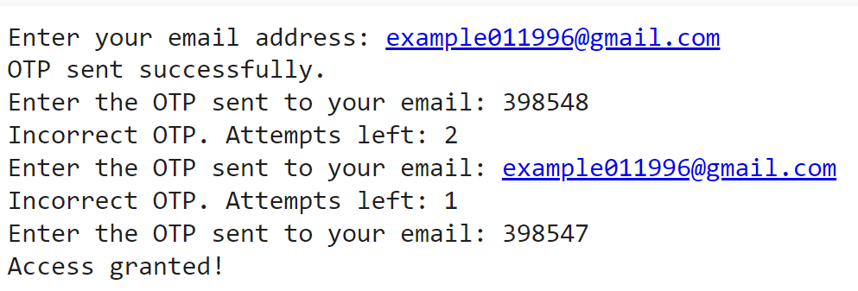
Test Cases
Correct OTP entry: Access granted.
Incorrect OTP entry: Retry up to 3 attempts.
Invalid email: Error message displayed.
Max attempts exceeded: Access denied.

Slide 12
Conclusion
The OTP Verification System provides a secure method for verifying user access.
Random OTP generation.
Simulated email sending.
Effective OTP validation and retry mechanism.
Future improvements: Secure email integration, better UI.

