Slide 1
OTP Verification System
Python Capstone Project
By: Aishwarya Pathak

Slide 2
Problem Statement & Objectives
Problem Statement:
Build a secure system to verify users via email.
Key features: OTP generation, email delivery, verification, and retry options.
Objectives:
Generate a random 6-digit OTP.
Simulate email delivery using Gmail’s SMTP server.
Validate OTP entered by the user.
Provide error handling and retry options for incorrect inputs.

Slide 3
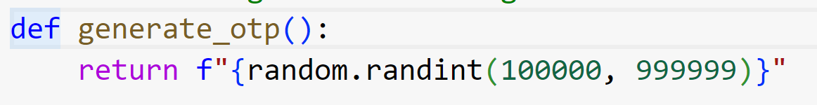
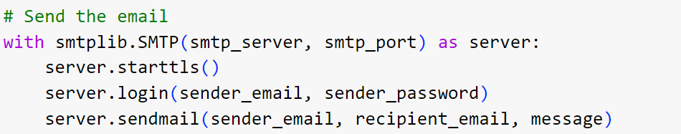
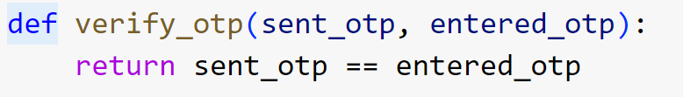
Code Walkthrough
OTP Generation:
Random 6-digit number using Python.
Sending OTP:
Validate email using email_validator.
Secure Gmail login with app password.
OTP Verification:
Compare user input with generated OTP.

Slide 4
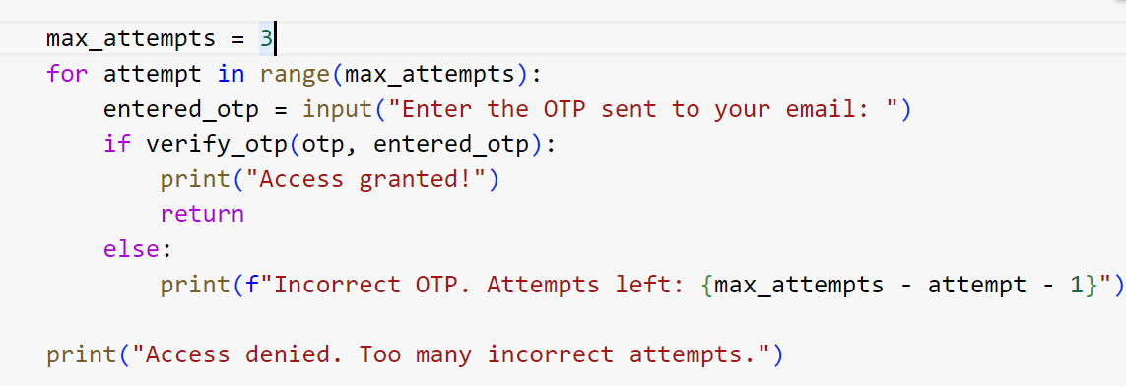
Error Handling and test cases
Error Handling:
Invalid email – Show error message.
Incorrect OTP – Retry prompts (max 3 attempts).
Too many attempts- Deny access.
Test Cases:
Correct OTP – Access granted.
Incorrect OTP – Retry allowed.
Invalid Email – Error displayed.
Max attempts exceeded – Access denied.

Slide 5
Conclusion & Future Improvements
Conclusion:
Random OTP generation.
Simulated email delivery.
Secure, user-friendly verification.
Future Improvements:
Use a secure email API.
Build a user-friendly interface.

Slide 6
Thank you
Ensuring secure access, one OTP at a time!

