Slide 1





ONLINE BANKING PORTAL

Slide 2


Agenda
1
Introduction
2
Actors
3
Use Case Diagram
4
Sequence Diagram
5
Output Snippets
6

Slide 3


Introduction
Online Banking, is a digital service that allows customers to conduct financial transactions via the internet. It offers convenience and accessibility, enabling users to manage their bank accounts, transfer funds, avail loan, and perform various other banking activities

Slide 4
Actors
ADMIN
CUSTOMER
View Account Details
Apply & View Debit card
Apply & Pay Loan
Add, Search & List Payee
Transfer Money
View Statement
Register Customer
View Customer Details
Approve Loan
Approve Debit Card

Slide 5
Actors
1
Admin
2
Customer

Slide 6
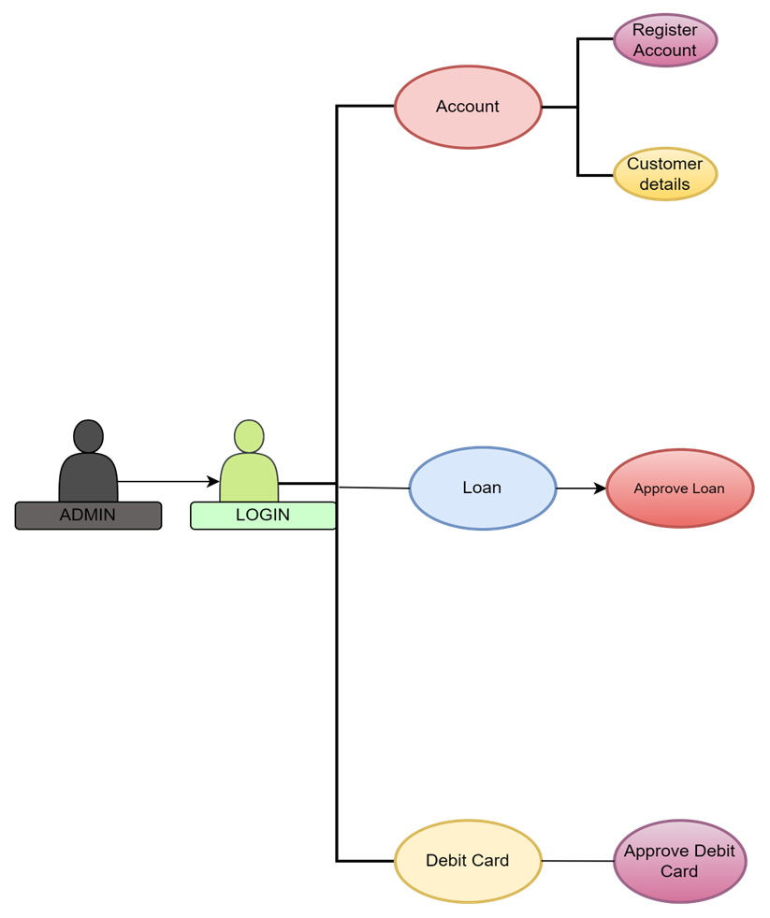
Use Case Diagram (Admin)

Slide 7
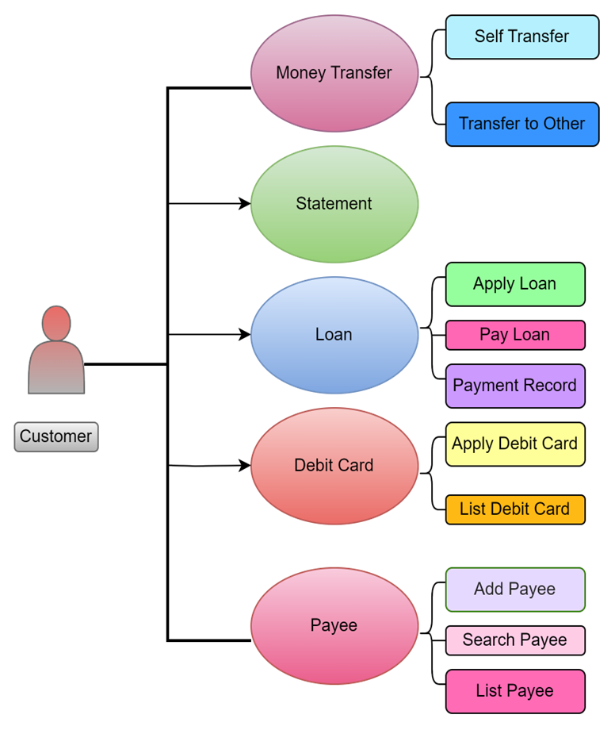
Use Case Diagram (Customer)

Slide 8
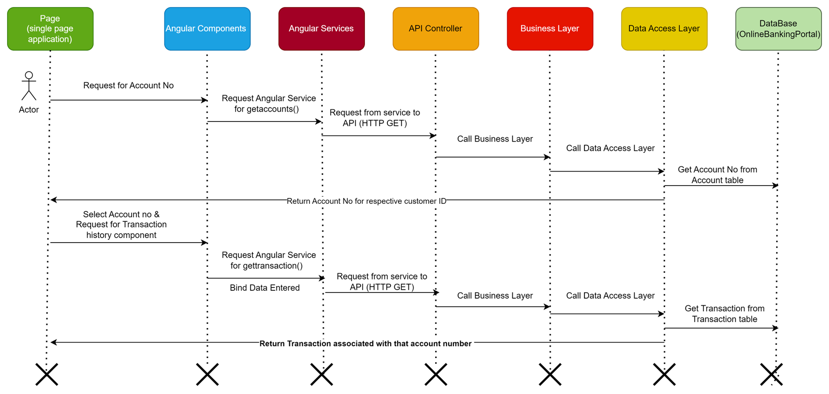
Sequence Diagram:

Slide 9
OutPut
Snippet

Slide 10

Thank You!

