Slide 1
Vibe to
Visuals
A live build-along workshop
0:08
ONE
MESSAGE
One idea becomes a website, a social image, and a short video.
Notes:
0:00–0:01 — Open with the outcome: today the room will create one store and three connected artifacts. Keep the opening practical. Do not tour tools or front-load theory.

Slide 2
Today’s finish line
Three usable outputs and one small system that keeps them consistent
01
02
03
STORE
SOCIAL
VIDEO
A small storefront people can browse
One clear message in one frame
A 6–8 second sequence with a payoff
Evidence gate: Store Kit + reference + website + social + video + consistency check
Notes:
0:01–0:03 — Name the evidence gate: one Store Kit, one product-family reference, website, social image, short video or animatic, and consistency check. Finished means coherent, working, and saved together.

Slide 3
The build path
One Store Kit becomes the written source of truth for every artifact
1
2
3
4
5
6
CREATE
CHOOSE
REFERENCE
STORE
CAMPAIGN
CHECK
Answer three detailed questions
Select one visual direction
Make one product-family image
Build and publish with Sites
Choose a tool for social and video
Repair one cross-format mismatch
Soft Hours is the demonstration and fallback. Your store uses one Store Kit and the same checkpoints.
Notes:
0:03–0:04 — Show one workflow and one evidence gate. ChatGPT Sites is the core website route. The supplied HTML stays in the recovery path. The Store Kit, product reference, dimensions, three-beat structure, and consistency check remain unchanged. Apply the two-minute switch rule if Sites or another optional tool is unavailable.

Slide 4
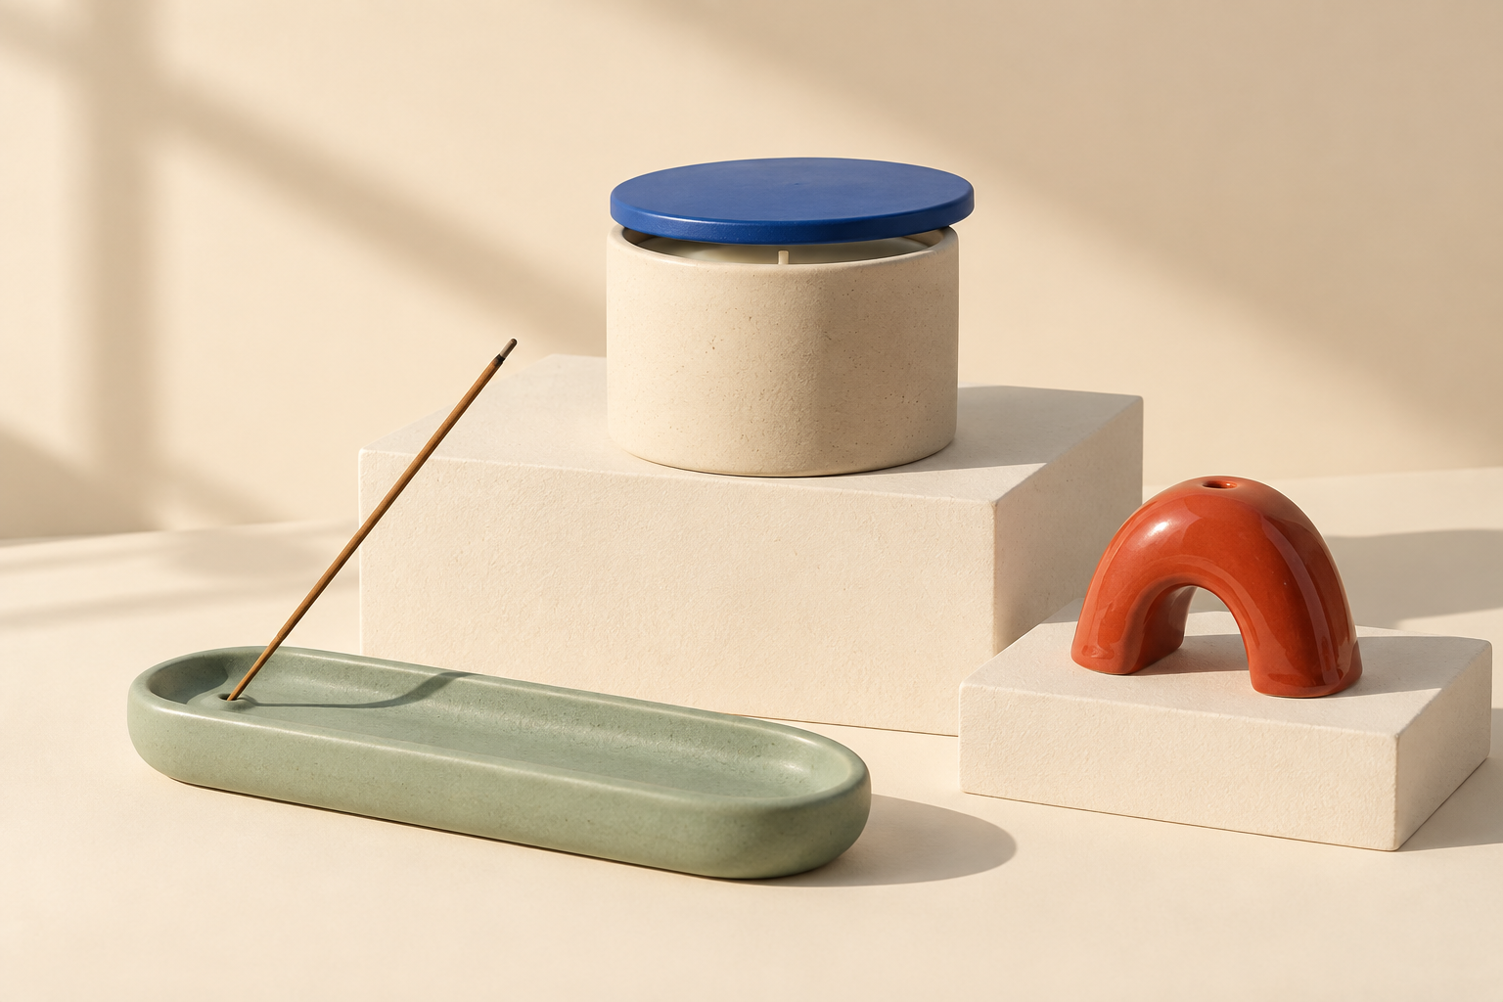
Instructor example: Soft Hours
A fictional store with a visual world that is easy to reproduce across formats
STORE
Small objects for
a slower evening
CUSTOMER
Apartment dwellers who want an evening ritual without wellness clichés
VIBE
Late-afternoon · tactile · playful
PALETTE
Warm cream · oat · cobalt · sage · tomato red
AVOID
Spa imagery · dried flowers · beige minimalism · hard sell
Notes:
0:04–0:05 — Introduce Soft Hours as the instructor example and recovery route. The products have simple geometry, a fixed palette, and an explicit light rule. Promise: small objects for a slower evening. Avoid spa clichés, dried botanicals, all-beige minimalism, and luxury cosmetics styling.

Slide 5
Concept 1: three useful inputs
Three detailed answers give the system enough context to make expert recommendations
PRODUCT SET
Which three visible objects will the store sell?
1
Useful: A timer, pen rest, and catch-all tray.
CUSTOMER
Who is it for, what is happening, and what should change?
2
Useful: Students resetting a crowded desk before working late.
TASTE
What should the store preserve and avoid?
3
Useful: Considered, tactile, calm; avoid gaming imagery.
Do not ask beginners to choose fonts, hex codes, lenses, or a full catalog without context.
Notes:
0:05–0:08 — Compare a weak answer with a useful answer. Lifestyle products for Gen Z gives neither objects nor a moment. A timer, pen rest, and tray for students resetting a crowded desk before late study provides usable constraints. The taste boundary adds commercial position, one quality to preserve, and one thing to avoid.

Slide 6
Build 1: create your Store Kit
The guided interview produces three directions, then waits for your choice
Codex: $vibe-to-store. ChatGPT Project: continue here.
My product set: [three visible objects]
My customer moment: [person, situation, desired change]
My taste boundary: [commercial position, preserve, avoid]
Propose three different visual directions. Explain what each communicates, why it fits, the type, light, composition, materials, motion, and one risk. Then wait for me to choose.
CHECKPOINT
Lock one route. Save one written source: STORE-KIT.md.
7 MINUTES
WATCH 2 MIN
BUILD 4 MIN
CHECK 1 MIN
Notes:
0:08–0:15 — WATCH 2: Enter the Soft Hours inputs. BUILD 4: Students use the Project instructions or skill and receive three visual directions. CHECK 1: Confirm the routes differ in more than colour. Allow one revision. Recovery: use the Soft Hours Store Kit if setup or choice runs long.

Slide 7
Concept 2: choose a system, not an adjective
A direction connects the customer moment to repeatable visual decisions
1
QUIET EDITORIAL
Soft side light · expressive serif · controlled space
2
PLAYFUL OBJECT THEATRE
Graphic shadows · geometric type · stacked forms
3
DARK CINEMATIC
Pools of light · close details · slow reveal
The route must change type, light, composition, materials, and pace—not only colour.
Notes:
0:15–0:16 — Ask students to choose and lock one direction. Confirm exactly three complete products inside one STORE-KIT.md. Students do not need pre-existing typography or photography knowledge because the routes explain the consequences before they choose.

Slide 8
Build 2: make the product-family reference
Approve the three products once before using them in the website, social image, and video
Read STORE-KIT.md. Create one landscape image containing exactly the three specified products.
Preserve each silhouette, material, and colour. Apply the chosen light and composition. No text, packaging, extra objects, people, or unsupported claims.
10 MINUTES
WATCH 2 MIN
BUILD 6 MIN
CHECK 2 MIN
Notes:
0:16–0:26 — WATCH 2: Generate the complete Soft Hours product family. Name the identity checks: silhouette, material, colour, and count. BUILD 6: Students make one family image. CHECK 2: Partners point to all three Store Kit products and name any mismatch. Recovery: use a plain surface and one light source.

Slide 9
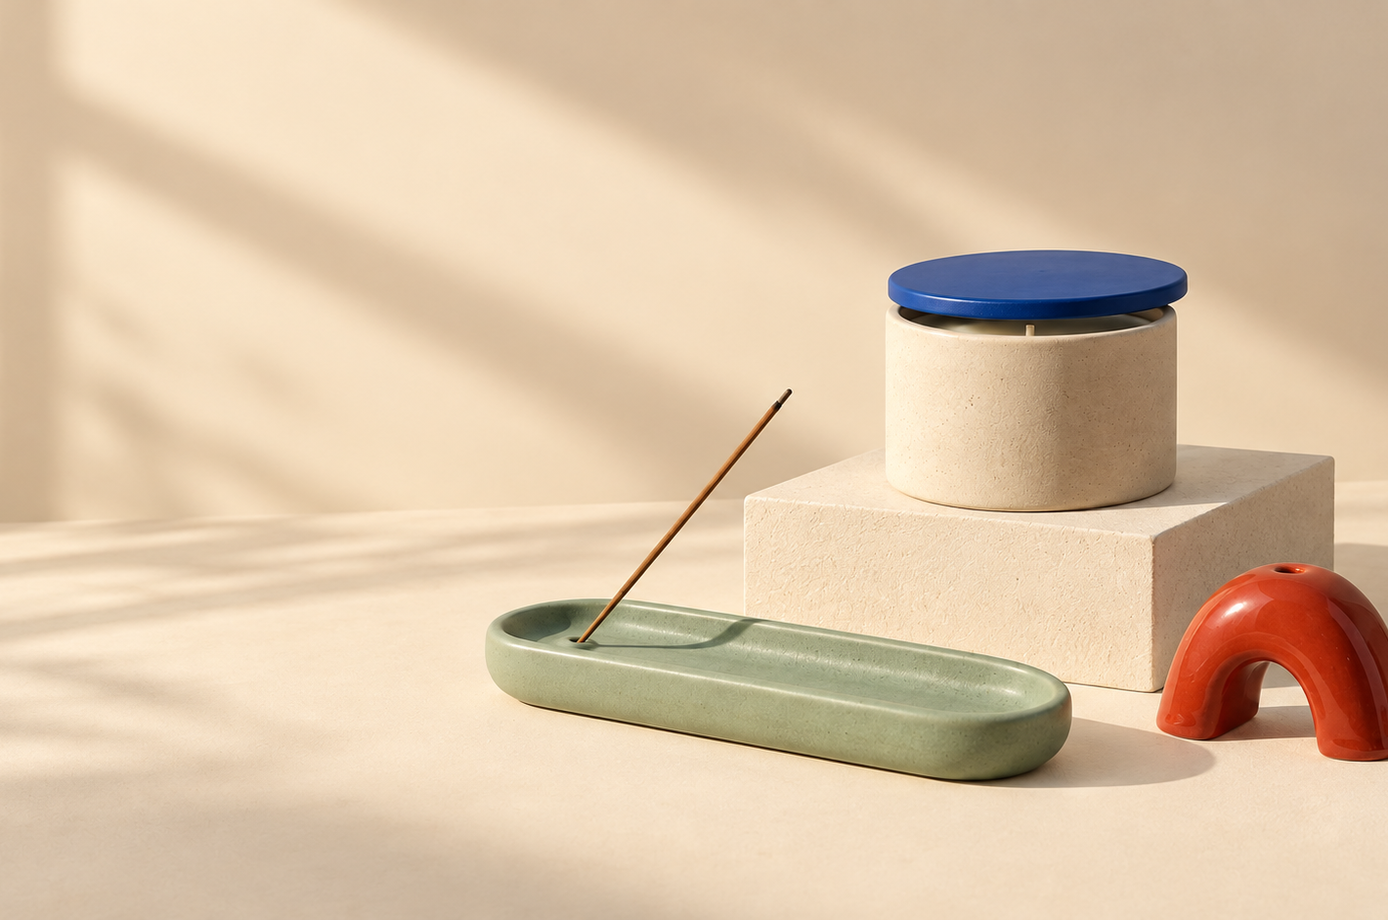
Concept 3: the visual world becomes a store
A believable storefront answers three questions without adding more scope
WHAT IS THIS?
One exact store promise
WHAT CAN I BUY?
Three catalog products and prices
HOW DO I BUY?
Product view, add to cart, visible total
One page · one collection · one tested cart
Notes:
0:26–0:30 — Demonstrate the three-question test on the Soft Hours site. Payment processing, accounts, testimonials, and additional pages stay outside the core route. The goal is a coherent shopping flow that the room can test.

Slide 10
Build 3: create and publish the store
Use ChatGPT Sites and the exact decisions in STORE-KIT.md
1
PROMISE
2
PRODUCTS
3
CART
A visitor can describe the store.
Names, descriptions, and prices match.
One item produces the correct total.
Read STORE-KIT.md and use product-family.png. In ChatGPT Sites, build a responsive one-page store with the exact promise, three products, product view, add-to-cart action, visible cart count, and total. Do not add pages, products, claims, discounts, or checkout. Test desktop and mobile, then publish privately.
16 MINUTES
WATCH 3 MIN
BUILD 10 MIN
CHECK 3 MIN
Notes:
0:30–0:46 — WATCH 3: In the ChatGPT Project, ask Sites to build the Soft Hours store from STORE-KIT.md and product-family.png. Test a product view, add one item, confirm the count and total, inspect mobile, and publish privately. BUILD 10: Students create and test their Sites. CHECK 3: A partner repeats the same checks. Recovery: if Sites is unavailable or a repair request fails, use website-starter/index.html with the same bounded prompt and omit publishing. New Sites remain private unless the student explicitly changes the audience.

Slide 11
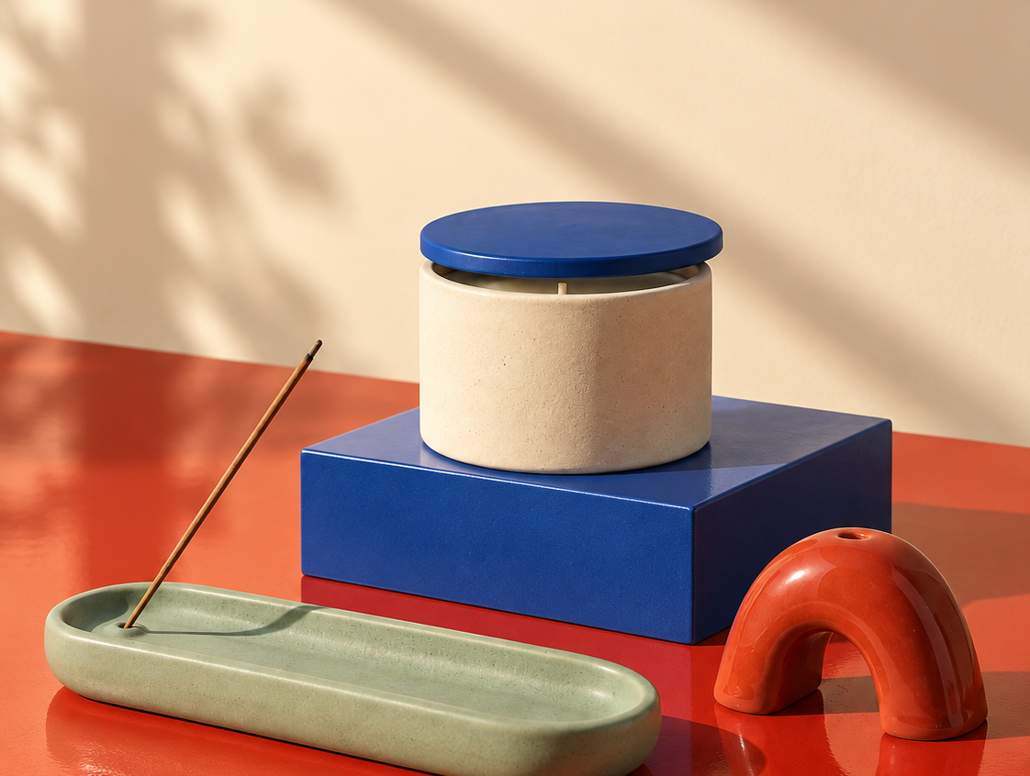
Build 4: one product, one message, one frame
Use a prompt, a public Sites URL, or a free editor
Attach product-family.png and read STORE-KIT.md.
Create one 1080 × 1350 image with one dominant product and the approved social line. Preserve its shape, material, and colour. Change only crop, scale, setting, shadow, and type. No packaging, new products, or claims.
12 MINUTES
WATCH 3 MIN
BUILD 7 MIN
CHECK 2 MIN
Notes:
0:46–0:58 — WATCH 3: Demonstrate the prompt-plus-reference social route. BUILD 7: Students may use the same route, Pomelli with a publicly accessible Sites URL, or a free editor such as Adobe Express. CHECK 2: Compare product identity and the approved social line against STORE-KIT.md and product-family.png. Do not change a private Site's audience only to keep pace with the class. If public sharing is not allowed, use another social route. Pomelli reference: https://blog.google/innovation-and-ai/models-and-research/google-labs/pomelli/ . Adobe Express plans: https://www.adobe.com/express/pricing .

Slide 12
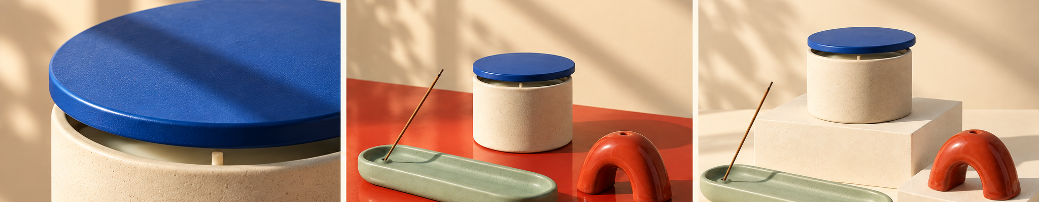
Concept 4: a short video needs three different beats
Each scene changes what the viewer knows
01 HOOK 0–2.5s
02 PRODUCT SET 2.5–5.2s
03 PAYOFF 5.2–8s
Detail earns attention · product provides information · collection lands the promise
Notes:
0:58–1:01 — Play the Soft Hours storyboard as three static frames first. Ask what new information appears at each beat. A moving poster does not count as progression. The core route is silent and lasts 6–8 seconds.

Slide 13
Build 5: replace the three scenes
Use Flow, a free editor, or the prepared 9:16 loop
Read STORE-KIT.md. Use product-family.png and the chosen social image. Create a silent 1080 × 1920 sequence lasting 6–8 seconds: hook, product, payoff. Use the approved lines and exact product name and price. Do not add products, claims, spinning objects, or extra scenes.
12 MINUTES
WATCH 2 MIN
BUILD 8 MIN
CHECK 2 MIN
Notes:
1:01–1:13 — WATCH 2: Demonstrate one three-beat route. BUILD 8: Students may use Google Flow with reference images, assemble three stills in CapCut or Adobe Express, or replace the assets in the browser loop. CHECK 2: Play muted; a partner names the store, product, and ending. Preflight the exact Flow accounts because access and credits evolve; current official help describes daily non-subscriber credits, peak-hour limits, country availability, and a visible watermark in India. References: https://support.google.com/flow/answer/16526234?hl=en and https://support.google.com/flow/answer/16353544?hl=en . CapCut editor reference: https://www.capcut.com/features/free-ai-video-editor . Recovery: accept the browser loop or a three-frame animatic.

Slide 14
Check the system, then repair one mismatch
Compare every artifact with STORE-KIT.md and product-family.png
1
PROMISE
Same core idea
2
PRODUCT SET
Same names, prices, shapes, colours, materials
3
DIRECTION
Same palette, type, light, composition, pace
4
TRUTH
No invented products or unsupported claims
5
ACTION
Clear next step
10 MINUTES
WATCH 2 MIN
BUILD 6 MIN
CHECK 2 MIN
Notes:
1:13–1:23 — WATCH 2: Find one deliberate mismatch and show how STORE-KIT.md or product-family.png identifies it. BUILD 6: Students score the three artifacts and repair the lowest item. CHECK 2: A partner verifies the repair. Stop after one meaningful change.

Slide 15
Show the system working
A 30-second share
01
IDEA
One sentence from STORE-KIT.md
02
OUTPUTS
Website, social image, video
03
JUDGMENT
One choice that improved the set
SUBMIT Store Kit · reference · website · social · video · check
Notes:
1:23–1:30 — Use the remaining time for 30-second shares and submission. If the room is slower, skip shares and preserve the evidence gate. Students save STORE-KIT.md, product-family.png, website, social image, video or animatic, and the completed consistency check together.

