Slide 1

ELECTION DATA
ANALYSIS
By AtliQ Media

Slide 2
Problem Statement
Tools used & Data overview
Agenda
Analysis & Findings
Observations
Recommendations

Slide 3
Problem Statement
AtliQ Media, a private media company wants to telecast a show on Lok Sabha elections in 2024 in India.
Unlike other channel they do not want to have debate on who is going to win the elections, they rather wanted to present the insights from 2014 and 2019 elections without any bias.
They also want to discuss the less explored themes like voter turnout percentage in India.

Slide 4

Tools used
Data sets used
Programming Language: Python
Libraries: Pandas, Numpy, Matplotlib, Seaborn
IDE: Jupyter Notebook
Constituency wise results 2014 file.
Constituency wise results 2019 file.
State codes file

Slide 5

Data overview

Slide 6

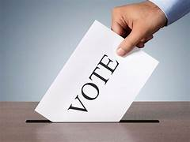
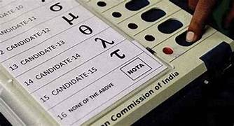
Voter turnout ratio
Postal ballot
NOTA

Slide 7


Analysis & Findings

Slide 8
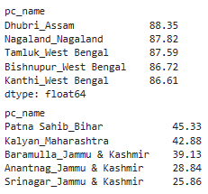
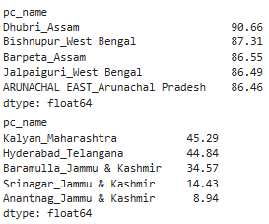
1. Top 5/bottom 5 constituencies of 2014 and 2019 in terms of voter turnout ratio

Slide 9
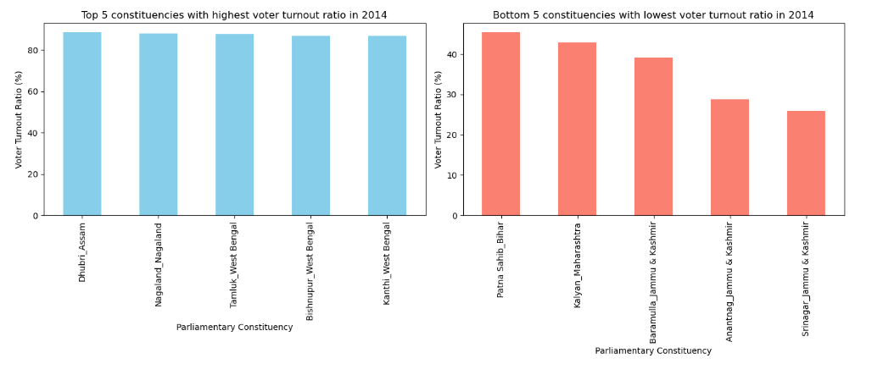

Slide 10
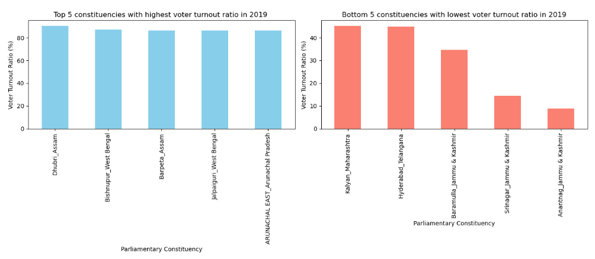

Slide 11
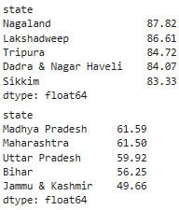
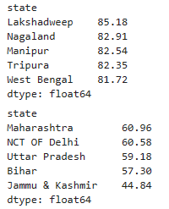
2. Top 5/bottom 5 states of 2014 and 2019 in terms of voter turnout ratio

Slide 12
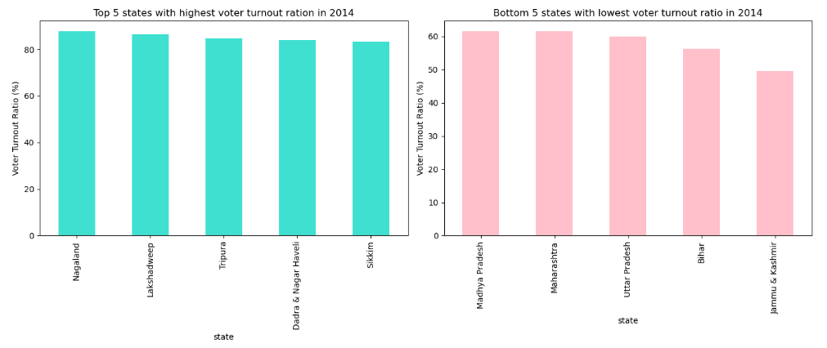

Slide 13
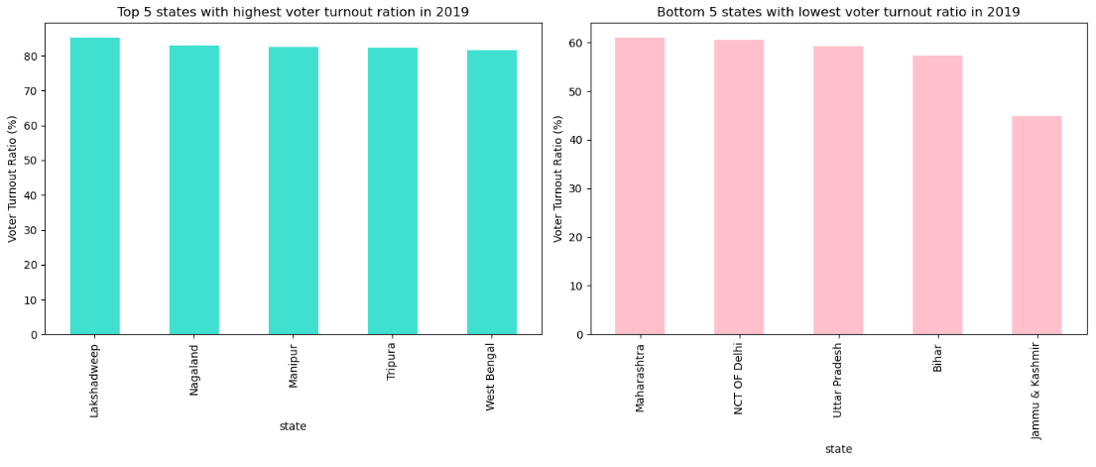

Slide 14
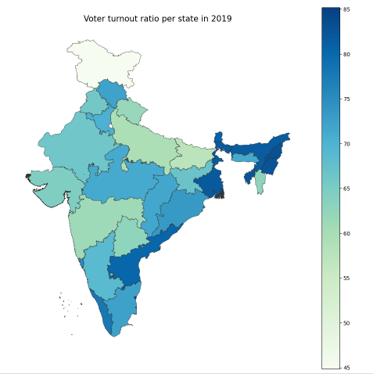

Slide 15
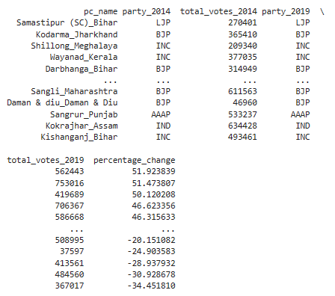
3. Constituencies which elected the same party for two consecutive elections, rank them by % of votes to that winning party in 2019

Slide 16
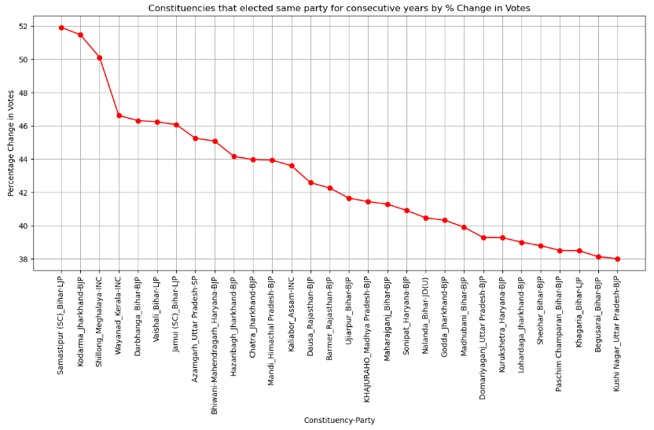

Slide 17
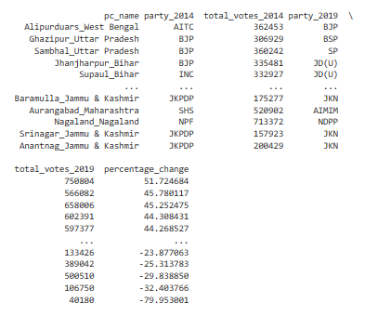
4. Constituencies which voted for different parties in two elections (list top 10 based on the difference (2019-2014) in voter percentage in two elections)

Slide 18
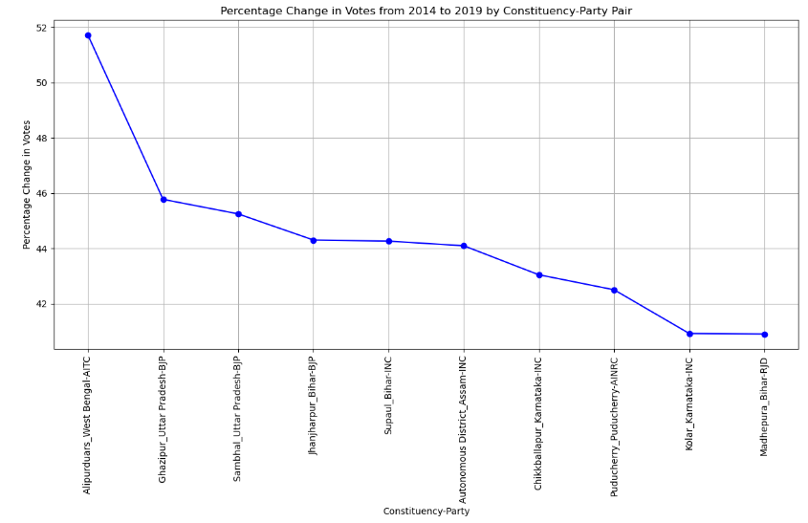

Slide 19
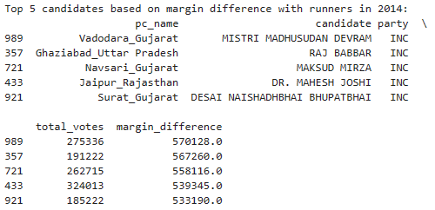
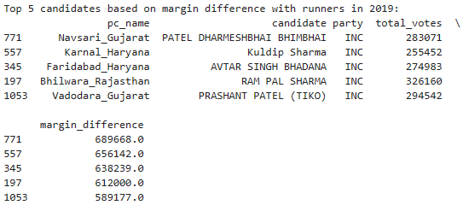
5. Top 5 candidates based on margin difference with runners in 2014 and 2019

Slide 20
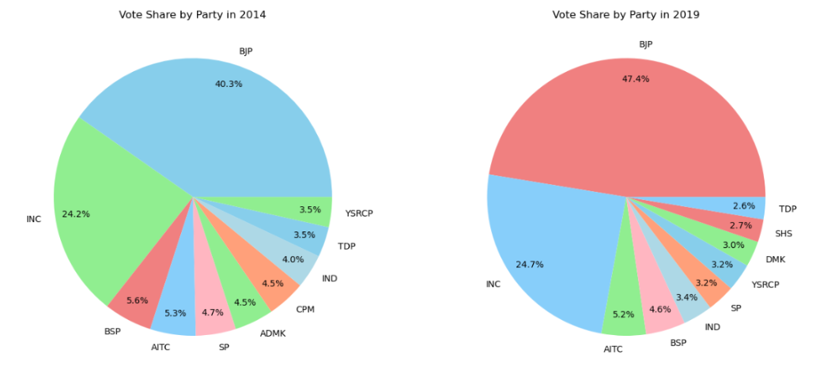
6. % Split of votes of parties between 2014 vs 2019 at national level

Slide 21
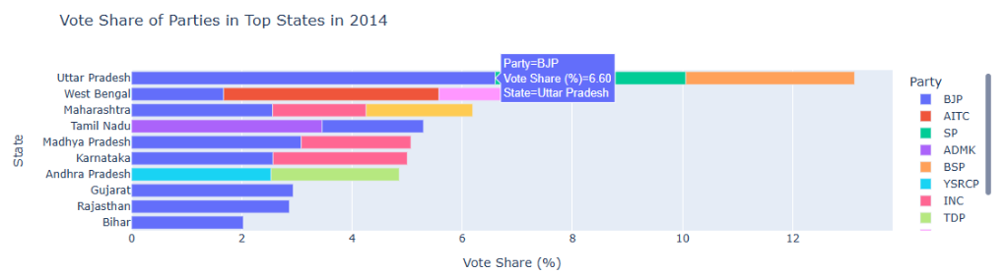
7. % Split of votes of parties between 2014 vs 2019 at state level

Slide 22
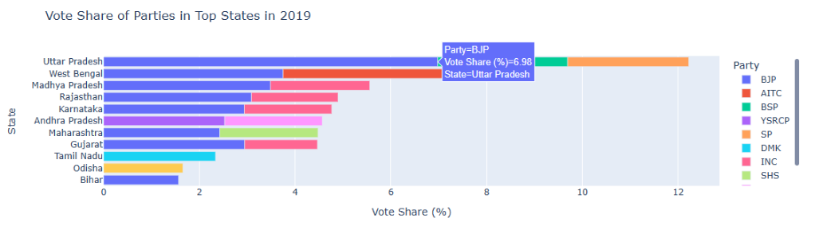

Slide 23
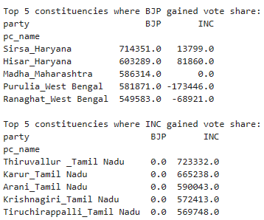
8. Top 5 constituencies for two major national parties where they have gained vote share in 2019 as compared to 2014

Slide 24
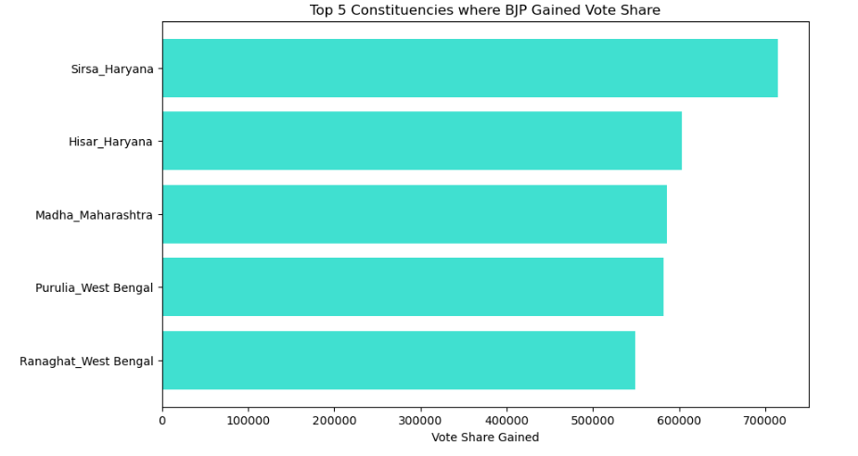

Slide 25
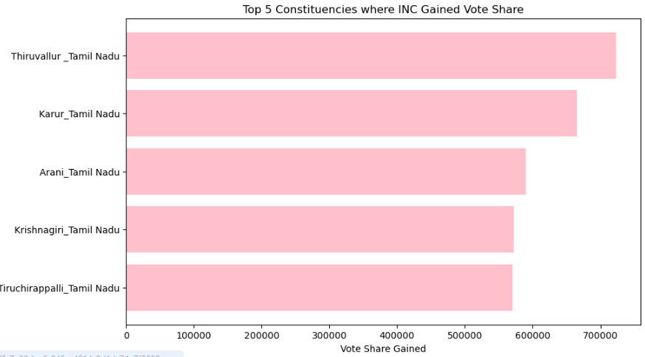

Slide 26
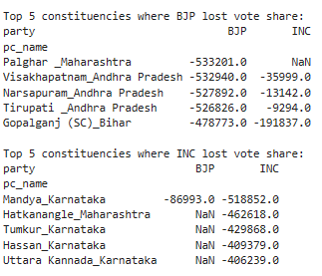
9. Top 5 constituencies for two major national parties where they have lost vote share in 2019 as compared to 2014

Slide 27
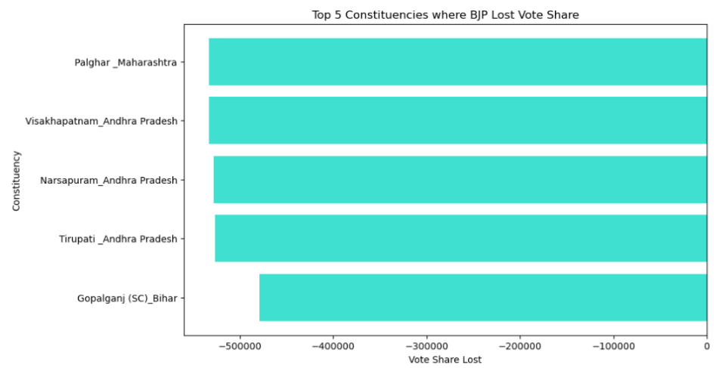

Slide 28
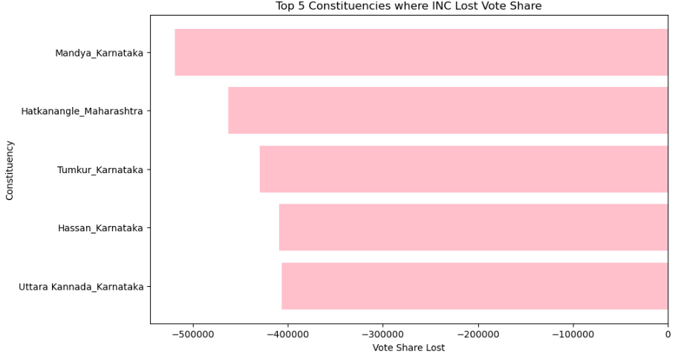

Slide 29
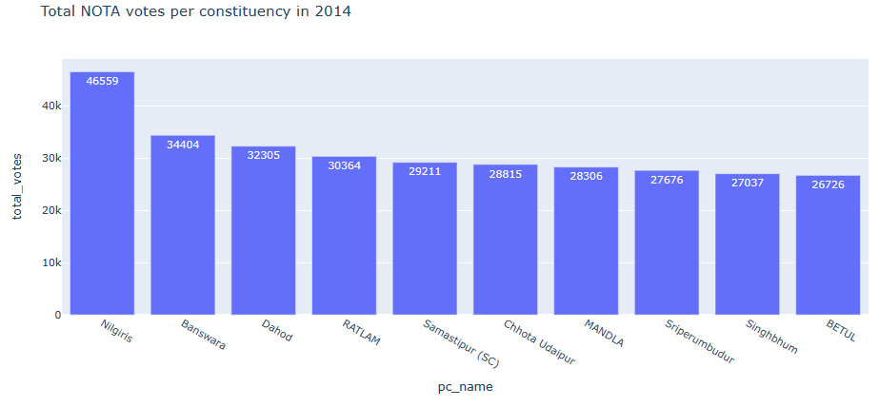
10. Constituency that has voted the most for NOTA?

Slide 30
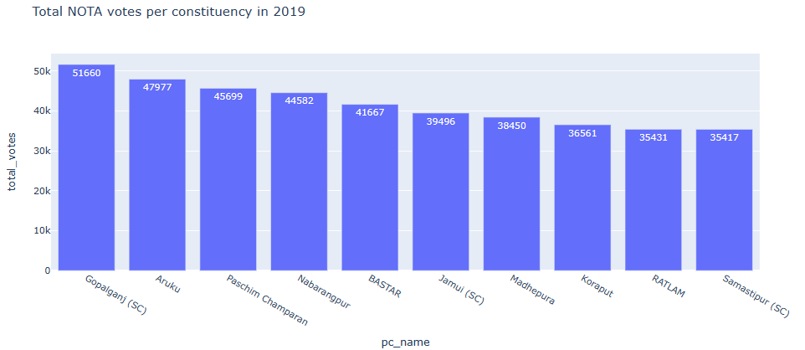

Slide 31
11. Constituencies which elected candidates whose party has less than 10% vote share at state level in 2019
No constituencies elected candidates whose party has less than 10% vote share at state level in 2019

Slide 32
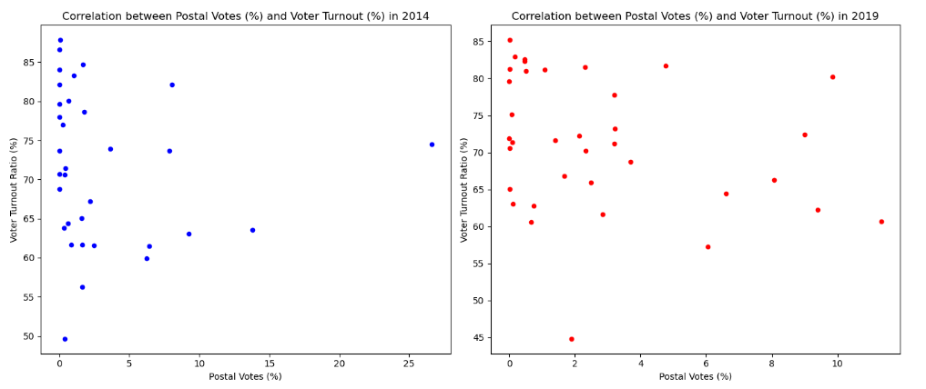
12. Is there a correlation between postal votes % and voter turnout % ?

Slide 33
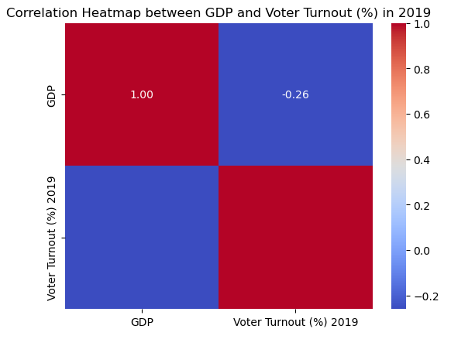
13. Is there a correlation between GDP of a state and voter turnout % ?

Slide 34
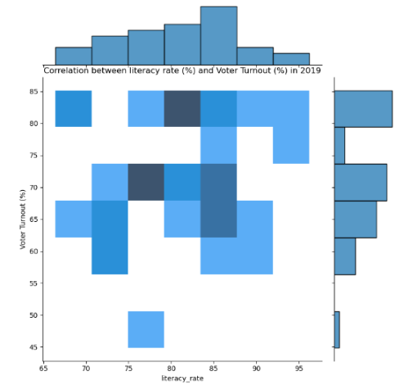
14. Is there a correlation between literacy % of the state and voter turnout % ?

Slide 35
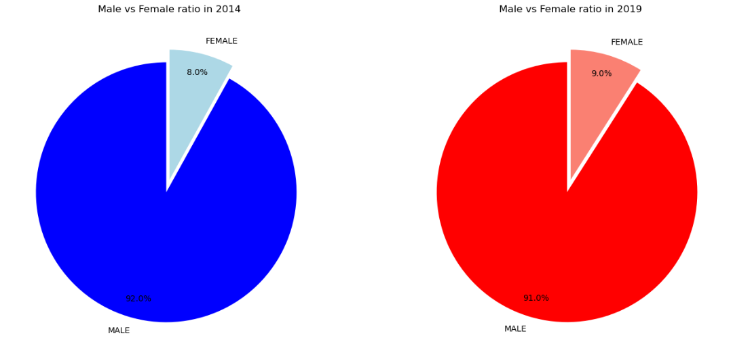
Candidates ratio based on gender in 2014 & 2019

Slide 36
Observations
Highest voter turnout ratio is seen in North eastern states whereas lowest in Jammu & Kashmir.
BJP party has highest percentage of vote share followed by INC.
Highest NOTA votes were polled in tribal areas like Nilgiris, Aruku.
Male candidates are participating more on elections compared to female candidates.

Slide 37

Recommendations
Increase in security, curbing fake news in social media to increase voter turnout ratio in riots prone areas like Jammu & Kashmir.
Voter awareness programmes should be conducted in tribal areas by government using political parties, celebrities, influencers.
Right to reject for NOTA votes.
Home voting for people with disabilities and people above the age of 85 years is a positive move, steps to increase NRI votes should be taken.

Slide 38
Thank You

Slide 39
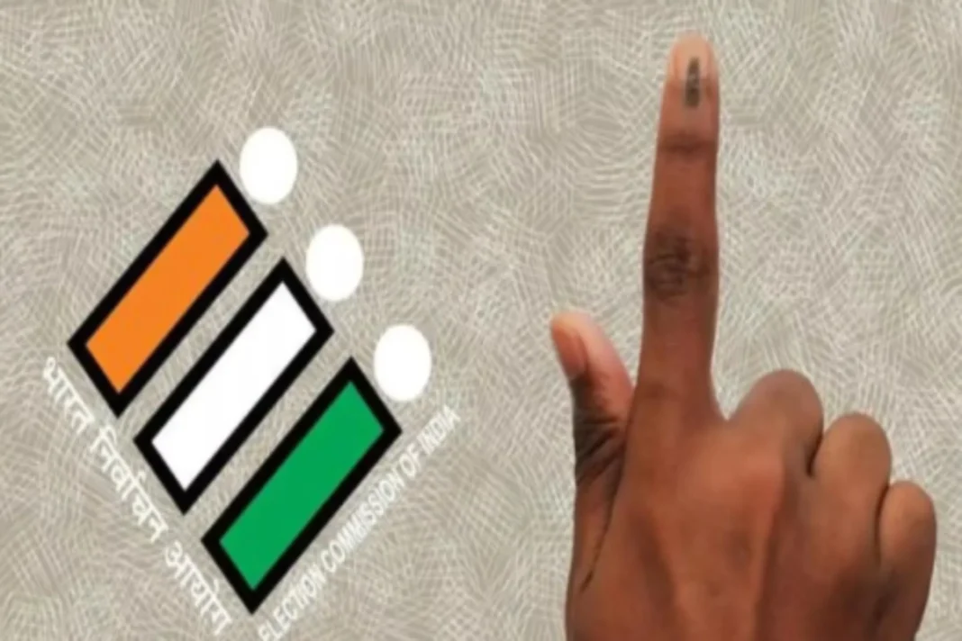
ELECTION
DATA
ANALYSIS

Slide 40
Problem Statement
Tools used & Data overview
Agenda
Analysis & Findings
Observations
Recommendations

Slide 41

Problem Statement
AtliQ Media, a private media company wants to telecast a show on Lok Sabha elections in 2024 in India.
Unlike other channel they do not want to have debate on who is going to win the elections, they rather wanted to present the insights from 2014 and 2019 elections without any bias.
They also want to discuss the less explored themes like voter turnout percentage in India.

Slide 42
Tools used
Data sets used
Programming Language: Python
Libraries: Pandas, Numpy, Matplotlib, Seaborn
IDE: Jupyter Notebook
Constituency wise results 2014 file.
Constituency wise results 2019 file.
State codes file

Slide 43
Data overview

Slide 44
Voter turnout ratio
Postal ballot
NOTA

Slide 45
Analysis & Findings

Slide 46
1. Top 5/bottom 5 constituencies of 2014 and 2019 in terms of voter turnout ratio

Slide 49
2. Top 5/bottom 5 states of 2014 and 2019 in terms of voter turnout ratio

Slide 53
3. Constituencies which elected the same party for two consecutive elections, rank them by % of votes to that winning party in 2019

Slide 55
4. Constituencies which voted for different parties in two elections (list top 10 based on the difference (2019-2014) in voter percentage in two elections)

Slide 57
5. Top 5 candidates based on margin difference with runners in 2014 and 2019

Slide 58
6. % Split of votes of parties between 2014 vs 2019 at national level

Slide 59
7. % Split of votes of parties between 2014 vs 2019 at state level

Slide 61
8. Top 5 constituencies for two major national parties where they have gained vote share in 2019 as compared to 2014

Slide 64
9. Top 5 constituencies for two major national parties where they have lost vote share in 2019 as compared to 2014

Slide 67
10. Constituency that has voted the most for NOTA?

Slide 69
11. Constituencies which elected candidates whose party has less than 10% vote share at state level in 2019
No constituencies elected candidates whose party has less than 10% vote share at state level in 2019

Slide 70
12. Is there a correlation between postal votes % and voter turnout % ?

Slide 71
13. Is there a correlation between GDP of a state and voter turnout % ?

Slide 72
14. Is there a correlation between literacy % of the state and voter turnout % ?

Slide 73
Candidates ratio based on gender in 2014 & 2019

Slide 74
Observations
Highest voter turnout ratio is seen in North eastern states whereas lowest in Jammu & Kashmir.
BJP party has highest percentage of vote share followed by INC.
Highest NOTA votes were polled in tribal areas like Nilgiris, Aruku.
Male candidates are participating more on elections compared to female candidates.

Slide 75
Recommendations
Increase in security, curbing fake news in social media to increase voter turnout ratio in riots prone areas like Jammu & Kashmir.
Voter awareness programmes should be conducted in tribal areas by government using political parties, celebrities, influencers.
Right to reject for NOTA votes.
Home voting for people with disabilities and people above the age of 85 years is a positive move, steps to increase NRI votes should be taken.

Slide 76
Thank You

