Slide 1
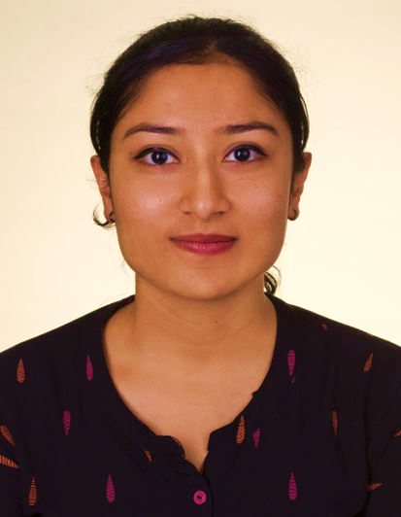

Aishwarya Babu
Ph: 8383948439 | email: aishwaryababu1199@gmail.com | LinkedIn
EXPERIENCE
Training under LTIMindtree (Aug 2025 – Oct 2025)
Mentored by domain experts of EUGL Business unit to work on a structured project as part of LTIMindtree’s academic collaborative initiative
Project: Knowledge Fabric Setup and Automated Incident Handling
Student Intern at Emertxe Information Technology (2022-2024)
Hands-On training program on Embedded Systems
Projects: Image Steganography, Car-BlackBox
TECHNICAL SKILLS
AI/ML: LangChain, LangGraph, RAG Architecture, Prompt Engineering, LLMs, Scikit-learn, DVC, Pandas, NumPy, PyTorch
MLConcepts: Machine & Deep Learning, Natural language processing, Large Language Models, GenAI, AgenticAI
Languages: C/CPP, Java, Python, SQL
Tools & Platforms: Microsoft Azure, PostgreSQL, PowerBI, Angular, streamlit, GIT, DVC
PERSONAL PROJECTS
AI Assistive Tool for Visually Impaired – GenAI & CV-powered Aid: Designed an AI system to assist visually impaired users through scene explanation via image-to-speech using CV and TTS
Career Coach AI – GenAI-powered Career Assistant: Built an NLP-driven assistant using LLMs (OpenAI/Ollama), LangChain and LangGraph to analyze resumes, match jobs and generate personalized interview Q&A
Emotion Detection Pipeline using NLP & ML: Built an end-to-end ML pipeline for emotion classification from social media text using Random Forest
Agentic AI: Personal Assistant : Uses Retrieval-Augmented Generation (RAG), Lang-Graph for workflow management, and ChromaDB as vector storage

