Slide 1
The impacts of teacher working conditions and human capital on student achievement
Delivered by Group 8
19137818: Sahil Deshpande
19084404: Aishwarya Inamdar
19121474: Fasahat Khan

Slide 2
Importance of the Analysis!
ImIm
Context
Problem statement
Poor educational outcomes of students in international examinations like PISA.
Role of teachers in contributing to the quality of the learning process.
Variation in student’s performance based on teacher’s characteristics.
Awareness regarding the adoption of better management and teaching practices.

Slide 3
Methodology
Pre-test among students in the public and private sectors.
Analysis of the pre-test using item response theory (IRT).
The five waves of tests conducted for the shortlisted schools.

Slide 4
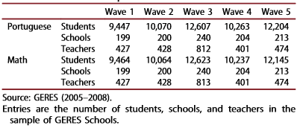
GERES Sample

Slide 5
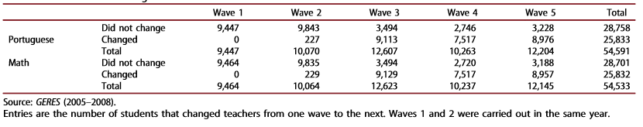
Students who changed teachers

Slide 6
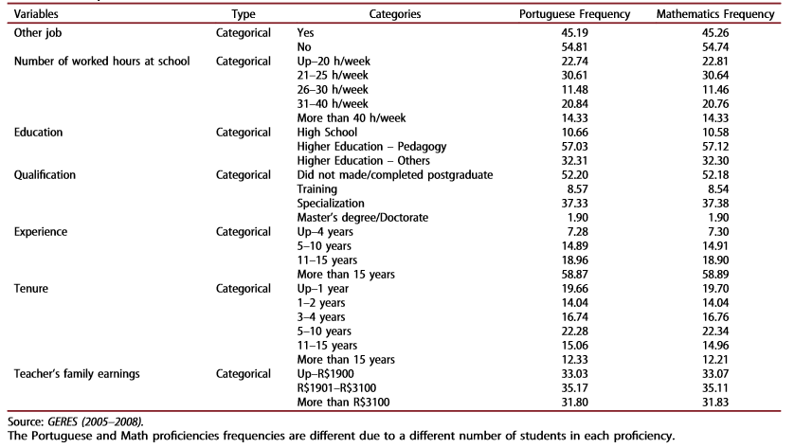
The teacher’s working conditions and characteristics used

Slide 7
Model used for Analysis
Model used is designed by Simon D. Woodcock (2015)
Match & Fixed effect Model

Slide 8
Model used for Analysis
Yijt = x’ijtβ + γi + θj + δij + εijt
Where,
Yijt : Test score
x’ijtβ : Vector of observed control variables + Grade and wave dummies.
γi : Student fixed effect
θj : Teacher fixed effect
δij : Student-Teacher match fixed effect
εijt : Random error

Slide 9
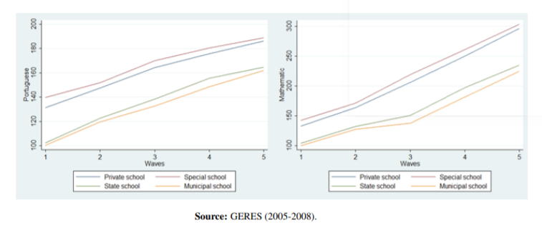
Data & Descriptive Analysis
Evolution of proficiency based on Administrative Network

Slide 10
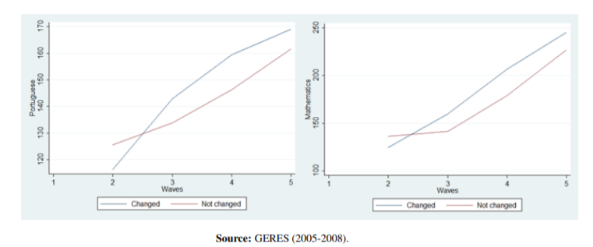
Data & Descriptive Analysis
Evolution of proficiency according to the change of teacher

Slide 11
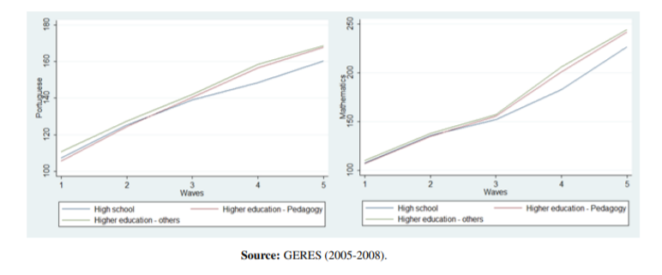
Data & Descriptive Analysis
Evolution of proficiency for teacher education

Slide 12
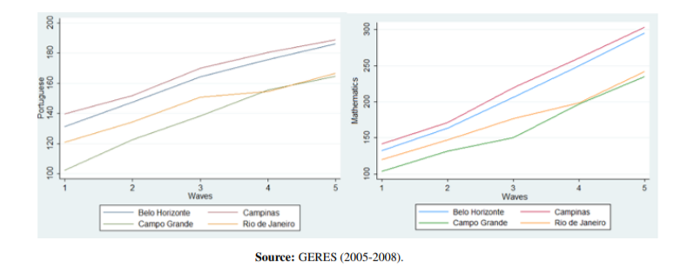
Data & Descriptive Analysis
Evolution of proficiency by city

Slide 13
Result
Estimated regression for each discipline for comparing the result of different models

Slide 14
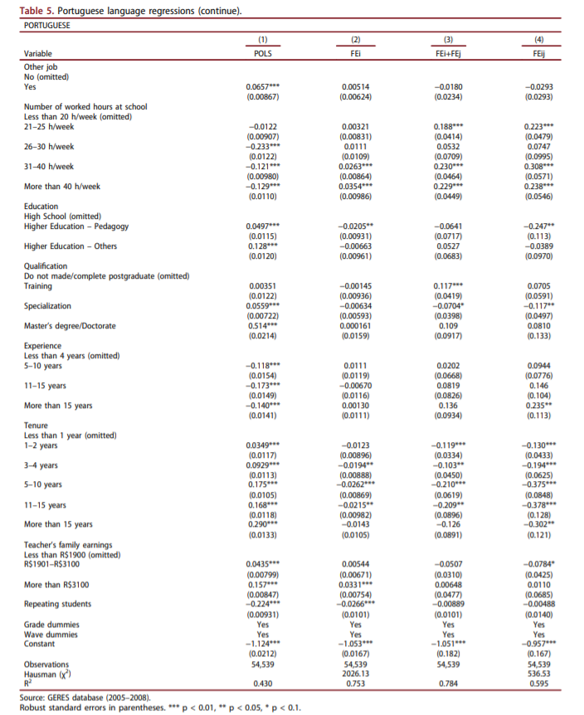

Slide 15
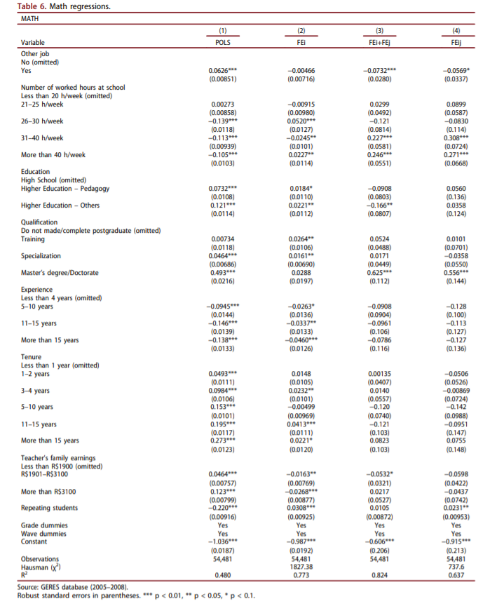

Slide 16
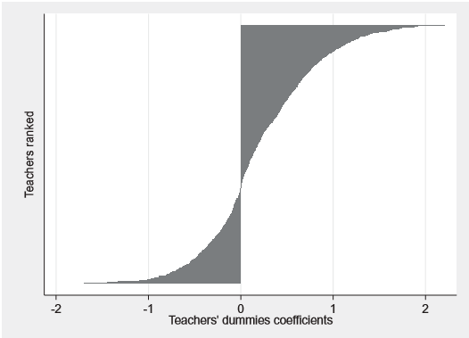
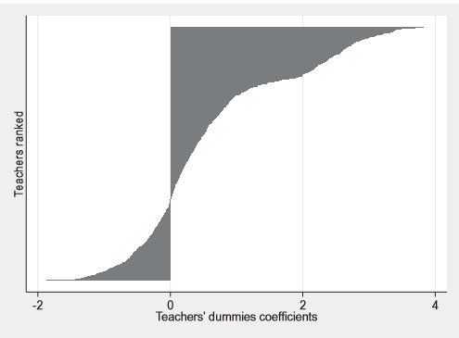
Teacher’s Ranking - Portuguese
Teacher’s Ranking - Mathematics

Slide 17
Teacher | Student
Parameters | Portuguese Test scores | Mathematics Test scores
Teacher working hours | Positive impact | Positive impact
Number of schools taught | Positive impact | More than 1 school negatively impacts
Education | Degree in pedagogy, contributed towards the negative impact | Masters or doctorate degree, contributed towards positive impact
Experience | >15 yrs. = positive impact | No significant impact
Tenure | Tenure at the Same school negative impact | No significant impact

Slide 18
Conclusion
· The results show that teacher working hours positively impact student achievement in both Portuguese and mathematics exams.
· Teachers who teach at more than one school have a negative impact on Mathematics test scores.
· Teachers who hold a degree in pedagogy negatively impact their students’ Portuguese test scores,
· While those who hold a master or doctorate positively impact learning.
· Moreover, teachers with more than 15 years of experience in the profession have a positive effect on Portuguese test scores.
· Contrary, education, experience and tenure did not have a significant impact on Mathematics grades after controlling for all unobserved students, teachers, and the student-teacher match characteristics.
· Change of student from the least skilled to the most skilled teacher improves grade by 5.22 standard deviation in Portuguese and 6.41 standard deviations in Mathematics.

