Slide 1
Core Data Services (CDS)
Joseph Reddy Y
Jan 4 2021

Slide 2
AGENDA
Context
Basics ABAP CDS View
Architecture
Other Features and Advantages
Next steps

Slide 3
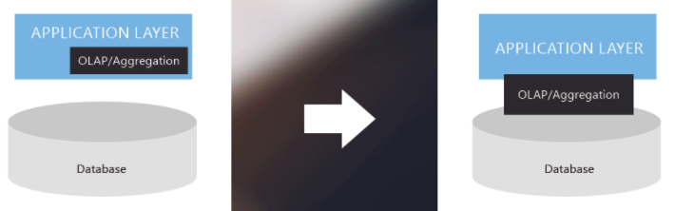
CONTEXT
Scope : Using CDS Views to create BW Data sources in SAP ECC
Purpose: ABAP CDS views are valid in SAP ECC with Oracle DB also. ABAP CDS Views have lot of advantages to create custom data sources. We would like to develop PTS- AP dolphin project custom data sources using this concept.

Slide 4
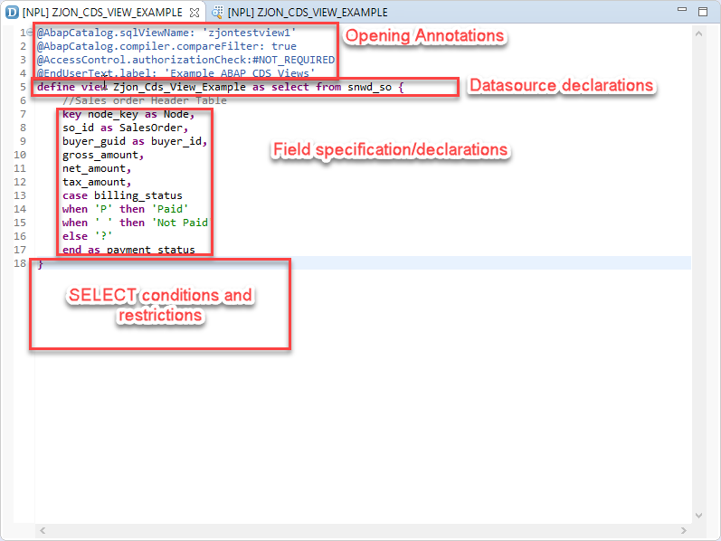
What is CDS?
Core Data Services, or CDS, is a “semantically rich” Data Definition Language (or DDL) created by SAP. It provides an easy to understand and reusable tool that ABAP developers can utilize to execute the “code pushdown” paradigm.
ABAP CDS, made available with SAP Netweaver 7.40 SP5, allows coders to achieve the “code-to-data” programming paradigm using a reusable resource that can be used across different programs and projects.
An ABAP CDS file can ONLY be create within the Eclipse IDE (there is no transaction to do this from SAP GUI). CDS files are written in an augmented form of SQL Script.
SAP ABAP CDS views reside in the application server in the Data Dictionary but process the logic in the database.

Slide 5
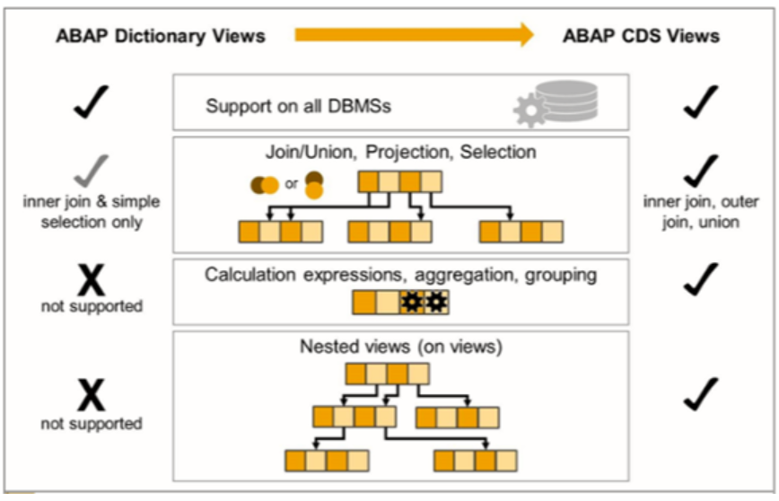
ABAP Dictionary Views vs ABAP CDS Views
ABAP Dictionary Views
Reside in the application server
Have limited basic SQL functions like INNER JOIN or SELECT
ABAP CDS Views
Reside in the application server
Basic SQL functions are INNER JOIN, OUTER JOIN, UNION, or SELECT
Perform calculations, aggregations, grouping, nested views

Slide 6
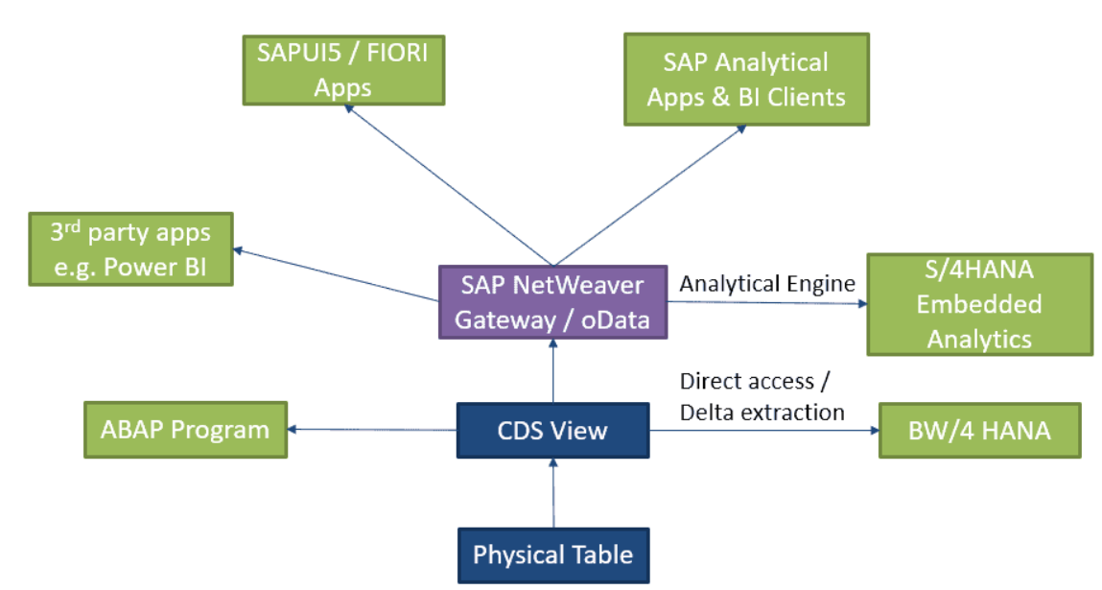
BENEFITS
ABAP CDS Views supports all kinds of joins , set operations, aggregate functions, string, date time functions, currency unit conversion functions. BW Data sources can be built on top of ABAP CDS Views to pull data into BW.
Easy generation of full-fledged OData Services, Can be used in many places.
Easy use of SAP UI5 Smart Controls and Fiori Elements, implicit authorization checks, and
Performance boost, Rich Set of Built-in Functions and Code Pushdown.
Saves the development time, increases productivity.
Upward compatibility to S/4, Ready for future embeded analytics based on CDS Views in S/4 HANA.

Slide 7
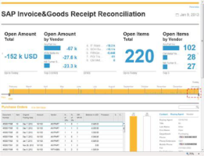
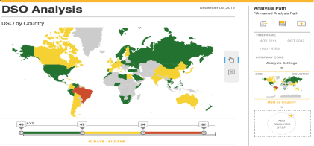
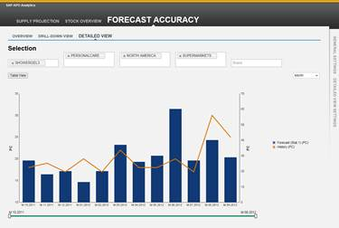
PROJECT ARCHITECTURE
Analytics
Steps:
Develop ABAP CDS Views in ECC.
BW Data sources can be built on top of ABAP CDS Views to pull data into BW.
Consume them in OPEN ODS for real time reporting.
Or Load into ADSO for persistency and consume through composite for reporting.
CDS Views can be developed to Join BW Tables and expose for reporting through Open ODS/Composite.
BW
Composite Provider/OPEN ODS
CDS VIEW
Open ODS/ADSO
Physical Tables
ECC
BW Data source
CDS VIEW
Physical Tables

Slide 8
NEXT STEPS
Check if we have license we can leverage this ABAP CDS Views functionality on Oracle DB.
Give the required Authorization to develop the CDS Views in ECLIPSE.

Slide 9
THE PINK PANTHER™ & © 1964–2018 Metro-Goldwyn-Mayer Studios Inc. All Rights Reserved. © 2018 Owens Corning. All Rights Reserved.

