Slide 1
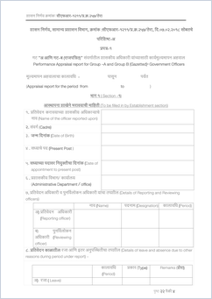
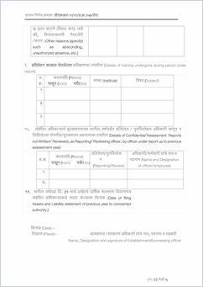
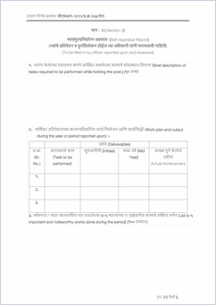
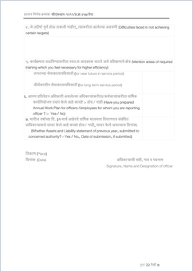
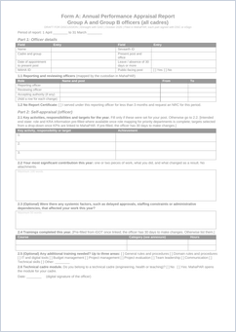
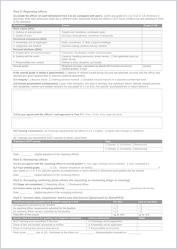
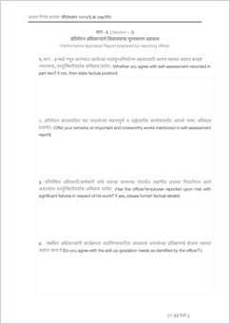
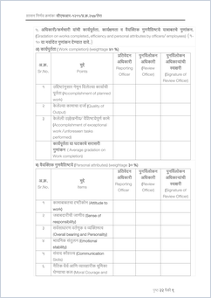
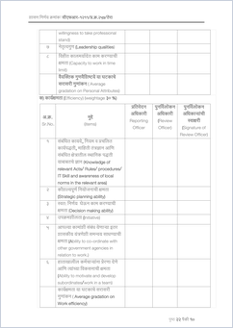
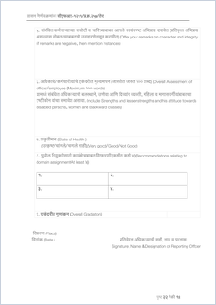
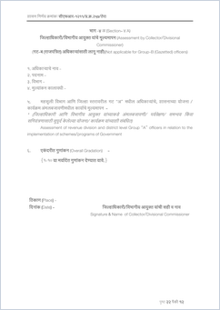
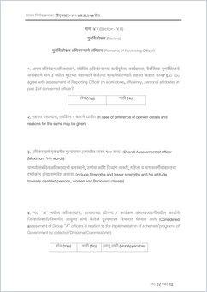
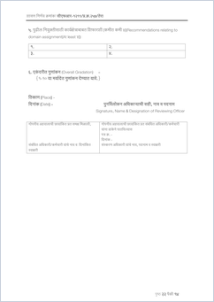
Option 1 · Page silhouettes
Volume, not reading
Every page of the current form against Form A, at the same scale. Deliberately unreadable: the eye reads area, not text.
CURRENT · FORM 1 · 11 PAGES
FORM A · 2 PAGES
What this does well
The scale of the cut is unmistakable in one look, and nothing pretends to be legible. Works for the whole form, for either group.
What it cannot do
It says nothing about what changed inside the form.
Option 1 · best for the whole-form view; pairs with a slide that explains the content
1

Slide 2
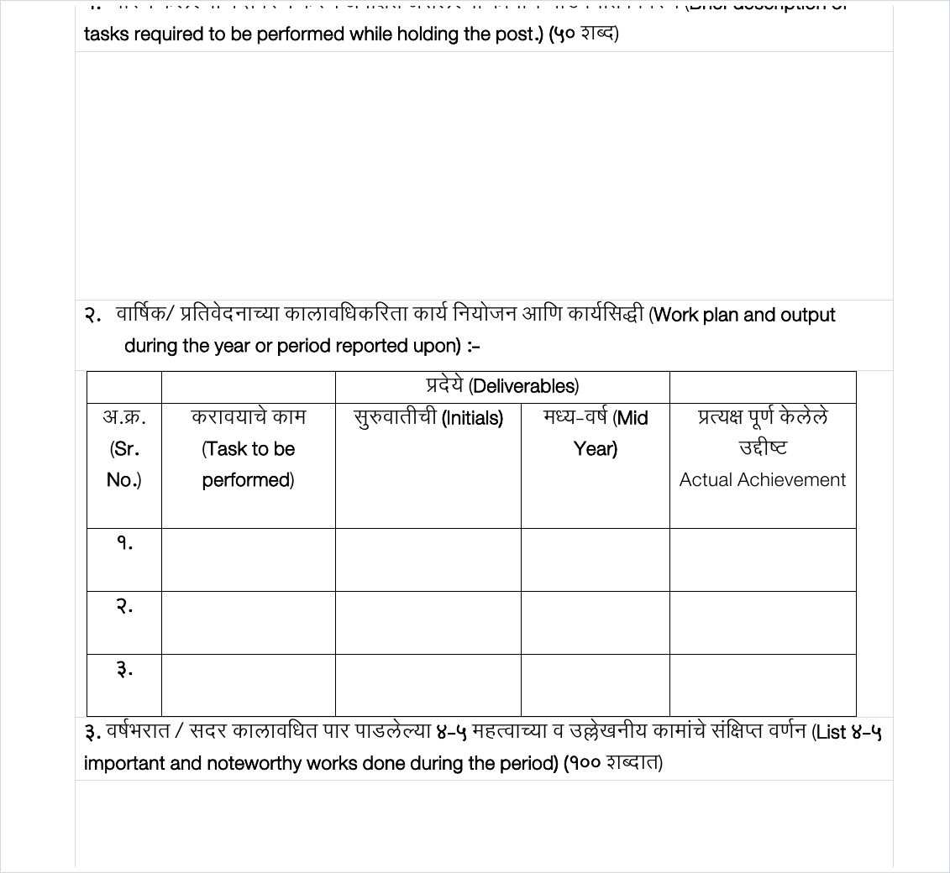
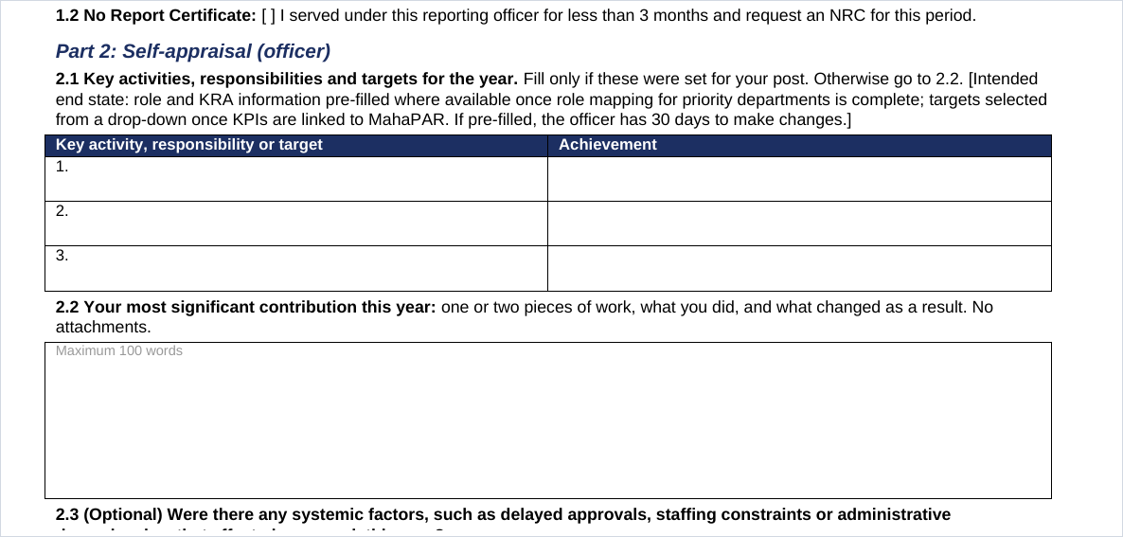
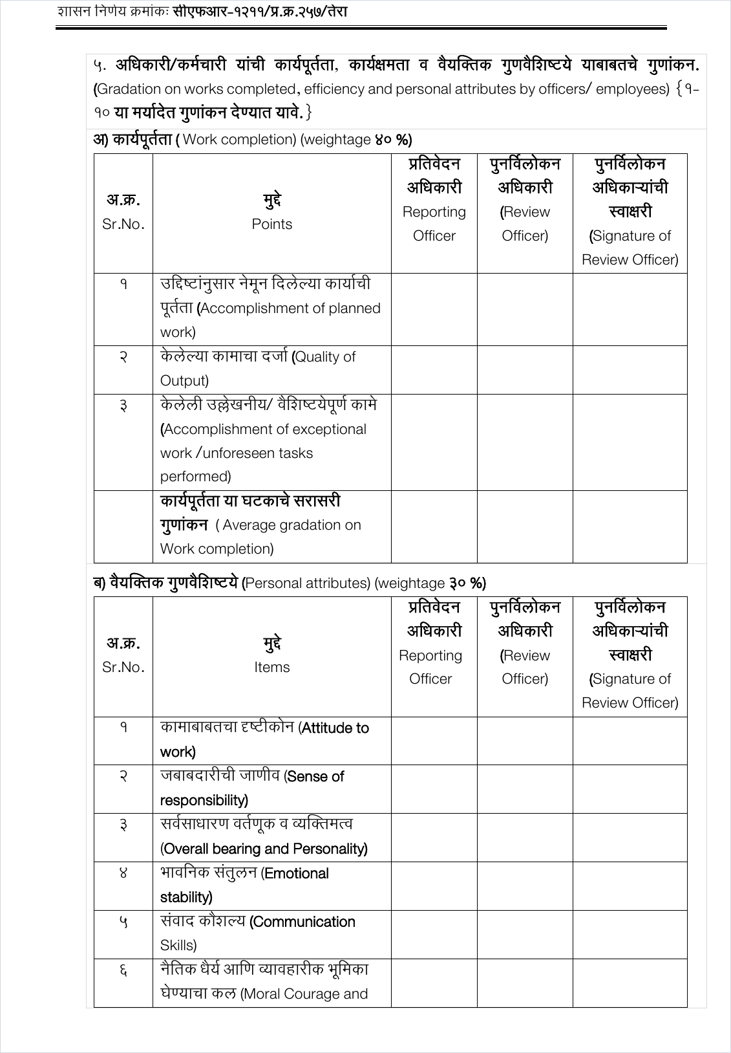
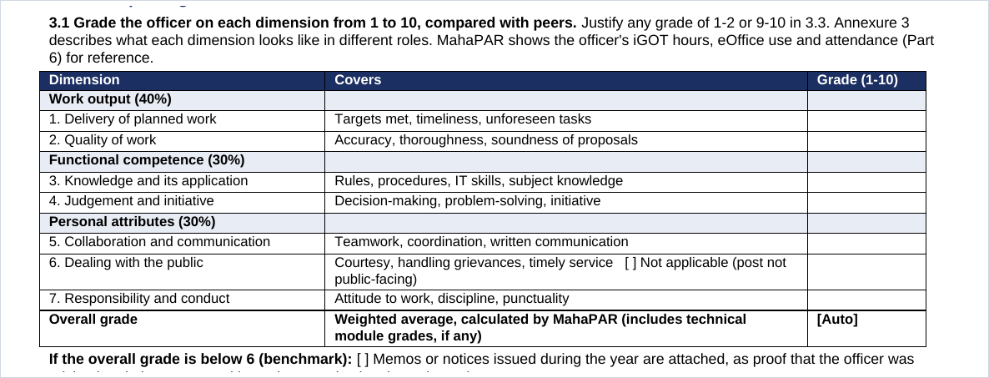
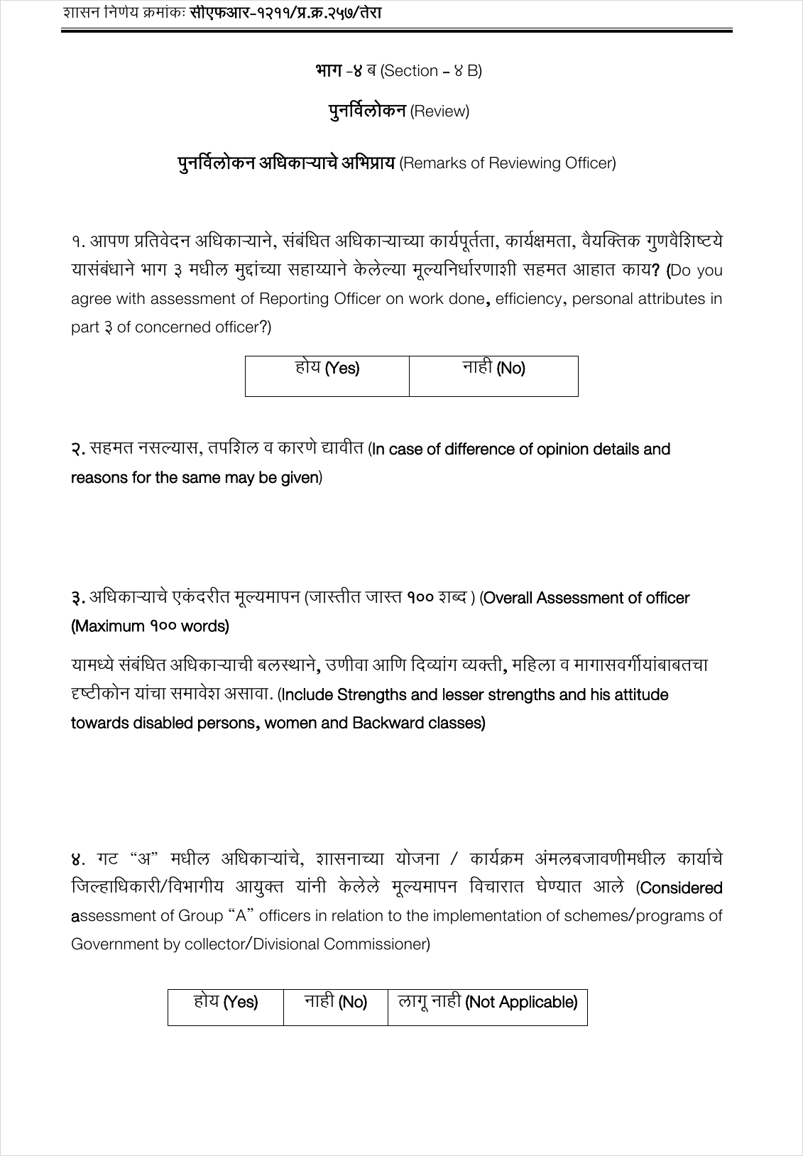
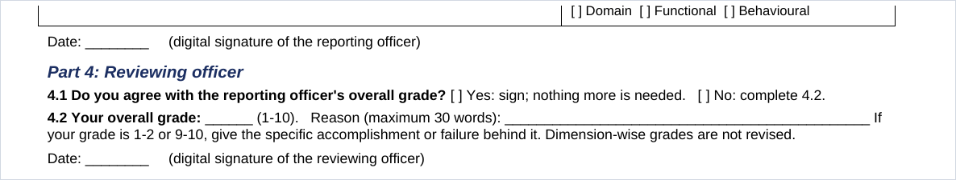
Option 2 · Three stage rows on one slide
Legibility test
Self-appraisal
→
Reporting officer
→
Reviewing officer
→
Option 2 · shows all three stages, but nothing on it can actually be read
2

Slide 3
Option 3 · One stage per slide · Self-appraisal
Whole snapshot, before and after
CURRENT · FORM 1, SECTION 2
FORM A · PART 2
→
What the audience sees
The officer wrote free prose under open headings and repeated details the department already holds. Form A asks for targets against achievement, one significant contribution, and systemic factors — in set fields, with the officer's own details pre-filled.
Option 3 · the only option where the audience can actually read the change · Self-appraisal (1 of 3)
3

Slide 4
Option 3 · One stage per slide · Reporting officer
Whole snapshot, before and after
CURRENT · FORM 1, SECTION 3 · 17 RATED ITEMS
FORM A · PART 3.1 · 7 DIMENSIONS
→
What the audience sees
Three tables of 17 rows, each graded by hand and averaged by hand, become one table of seven dimensions with written descriptors, and MahaPAR calculates the weighted overall grade.
Option 3 · the only option where the audience can actually read the change · Reporting officer (2 of 3)
3

Slide 5
Option 3 · One stage per slide · Reviewing officer
Whole snapshot, before and after
CURRENT · FORM 1, SECTION 4B
FORM A · PART 4
→
What the audience sees
The reviewing officer re-graded every dimension a second time. In Form A they record agreement or disagreement with the reporting officer's overall grade and their own overall grade, with reasons required only where they differ.
Option 3 · the only option where the audience can actually read the change · Reviewing officer (3 of 3)
3

Slide 6
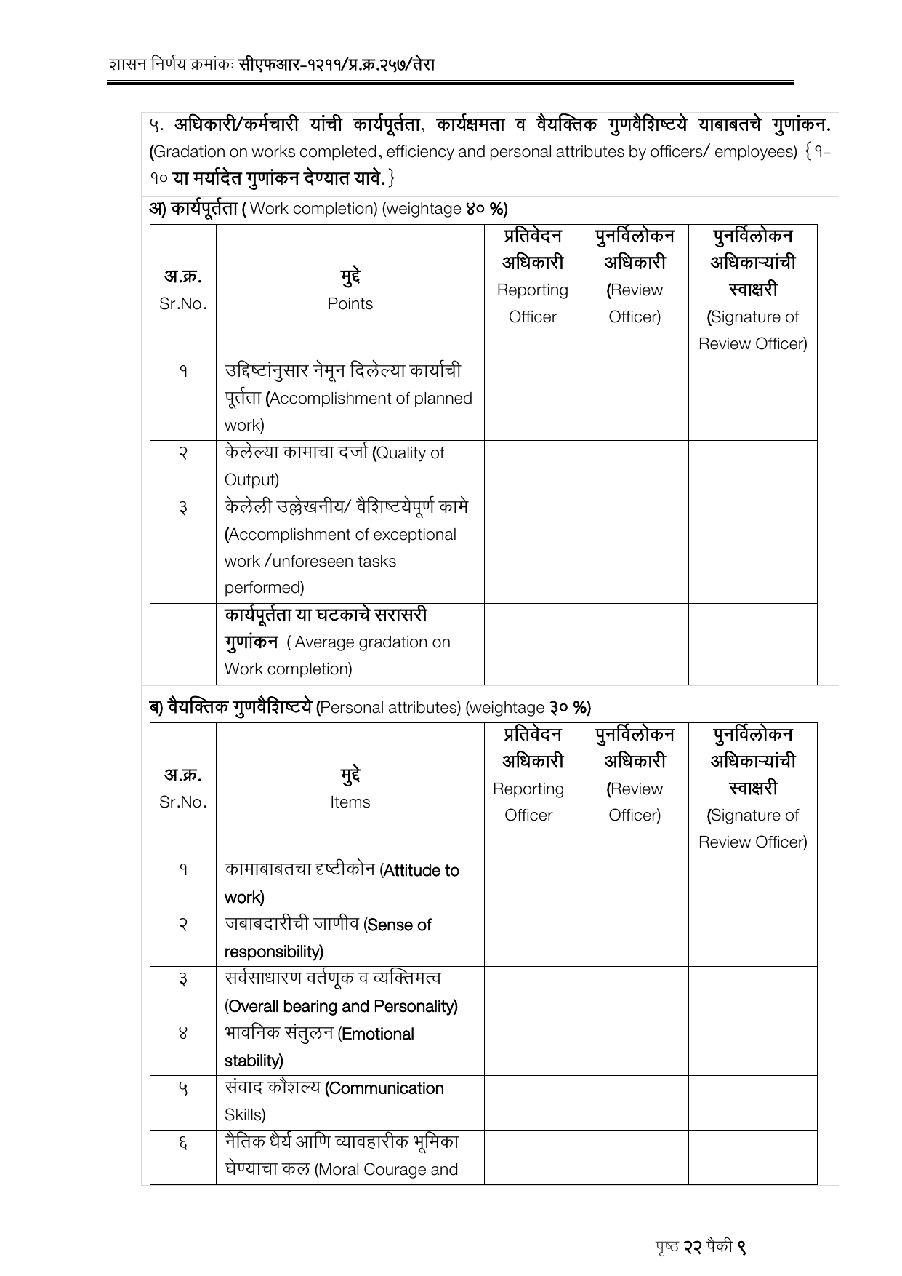
Option 4 · Full page with callout zooms
Context plus detail
Work completion · 3 items, graded and averaged by hand
In Form A this becomes dimensions 1 and 2, and MahaPAR does the arithmetic. Two of the three items collapse into 'delivery of planned work'.
→
Personal attributes · 8 items
Overall bearing, emotional stability, moral courage and leadership are judged separately today. Form A folds them into two dimensions with written descriptors behind each.
→
The catch: the callouts carry the message, not the page. The page behind them is decoration, and a bilingual form needs each callout translated to be useful.
CURRENT · FORM 1, PAGE 6 OF THE FORM
Option 4 · familiar consulting device, but the page itself does no work
4

Slide 7
Option 5 · Structural stack, no screenshot at all
Block height is proportional to real length
CURRENT · FORM 1 · 11 PAGES
FORM A · 2 PAGES
Part 1 · officer details, chain, leave
2 pages
Kept, now pre-filled
Part 1
Part 2
Part 3
Part 4
Part 2 · self-appraisal
2 pages
Cut to about half a page
Part 5
Everything below this line is new ground the old form never covered
Part 6
Part 3 · reporting officer
4 pages
Cut to about one page
Part 4A · Collector / Div. Commissioner
1 page
Removed, subject to GAD
Part 4B · reviewing officer
2 pages
Cut to three lines
Kept · Simplified · Removed · New in Form A Block height is proportional to the real length of each part.
Option 5 · readable, shows volume and shows what happened to each part
5

