Slide 1
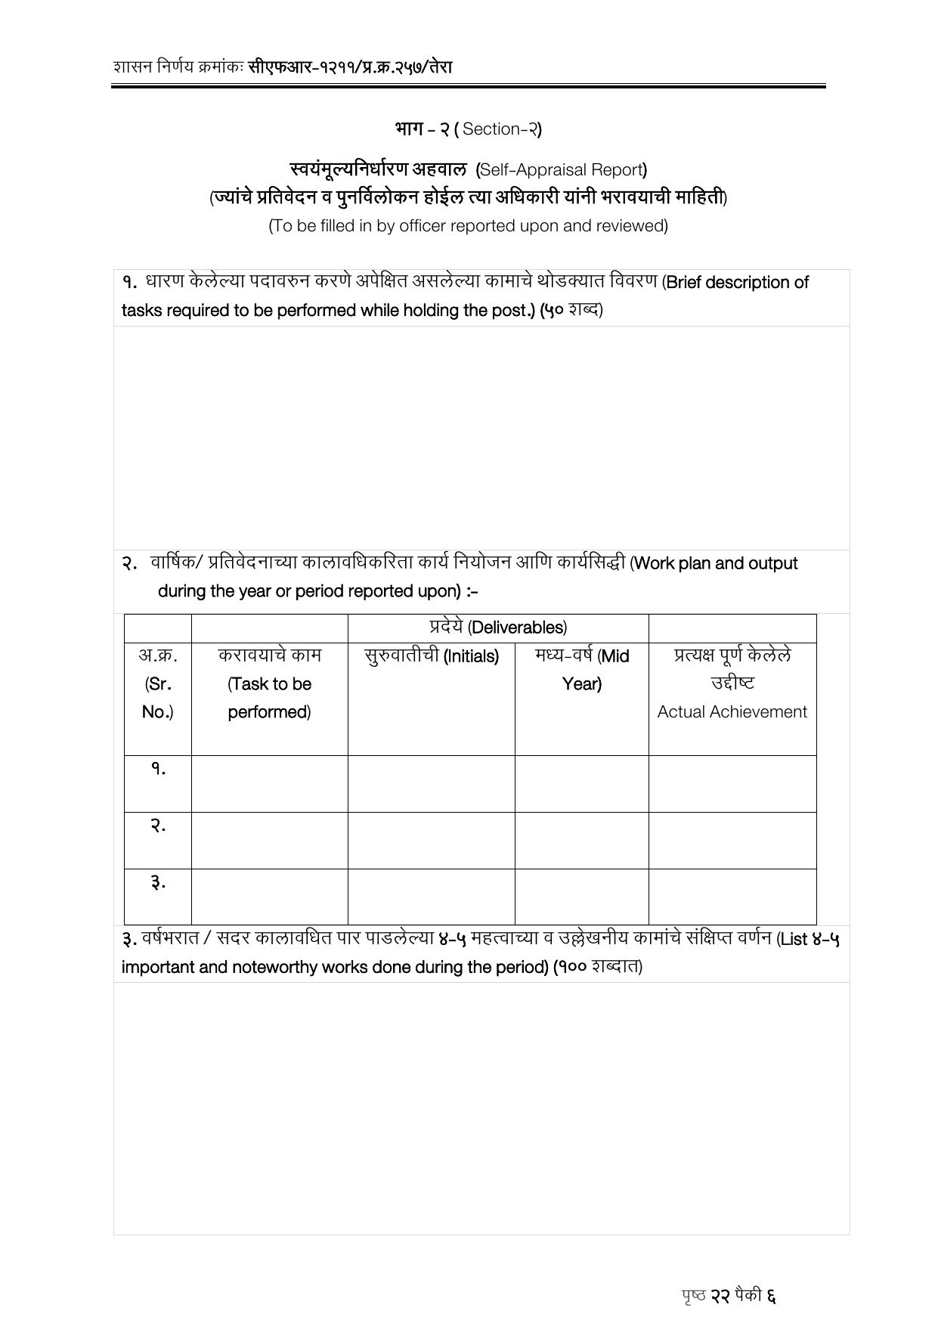
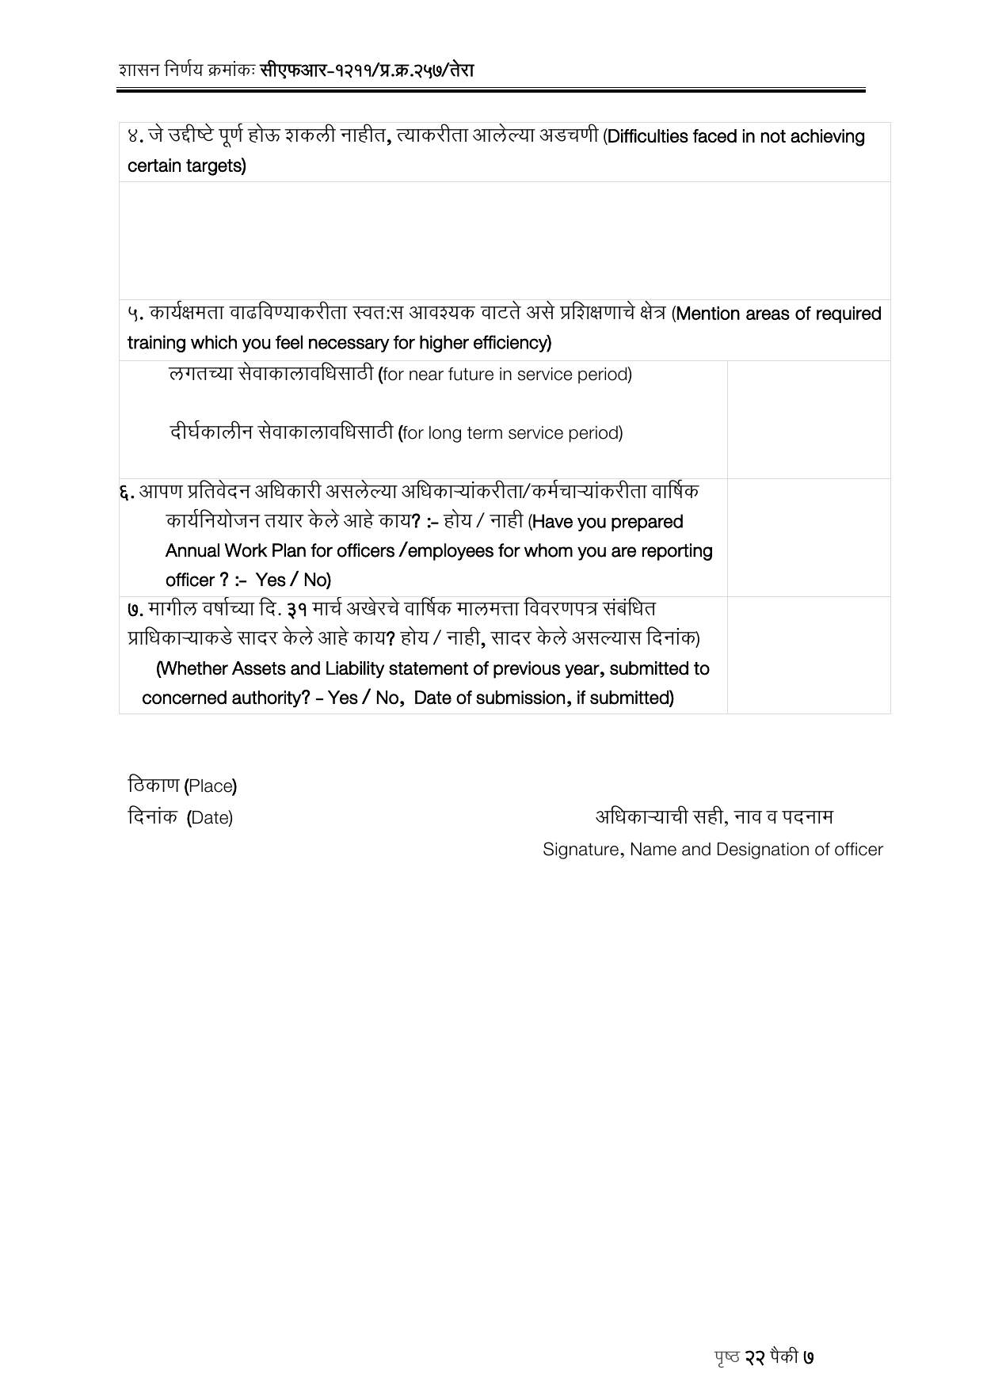
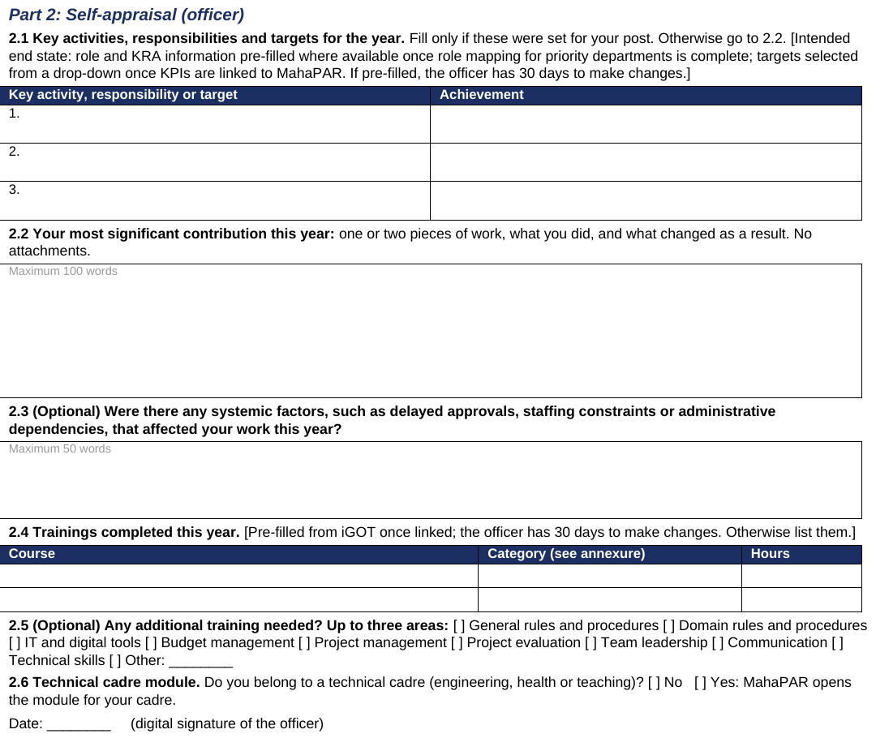
Self-appraisal by the officer
Before and after · the current proforma against Form A draft v5
CURRENT FORM · SECTION 2 · 2 PAGES
FORM A · PART 2 · SELF-APPRAISAL
→
Open prose under free headings becomes key activities against achievement, one significant contribution, and systemic factors.
Current form: Form 1, the Group A / Group B gazetted proforma now in use, shown in Marathi with English in parentheses as it is issued today. · After: Form A draft v5. The draft is written in English; the issued form will be bilingual, Marathi and English, like the present one.

Slide 2
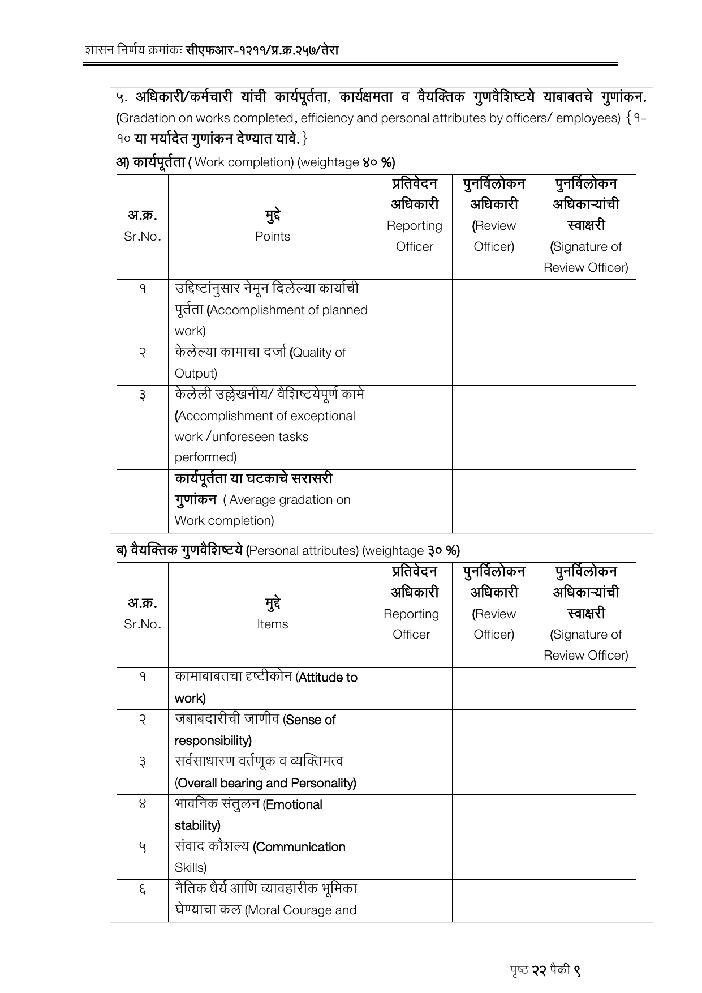
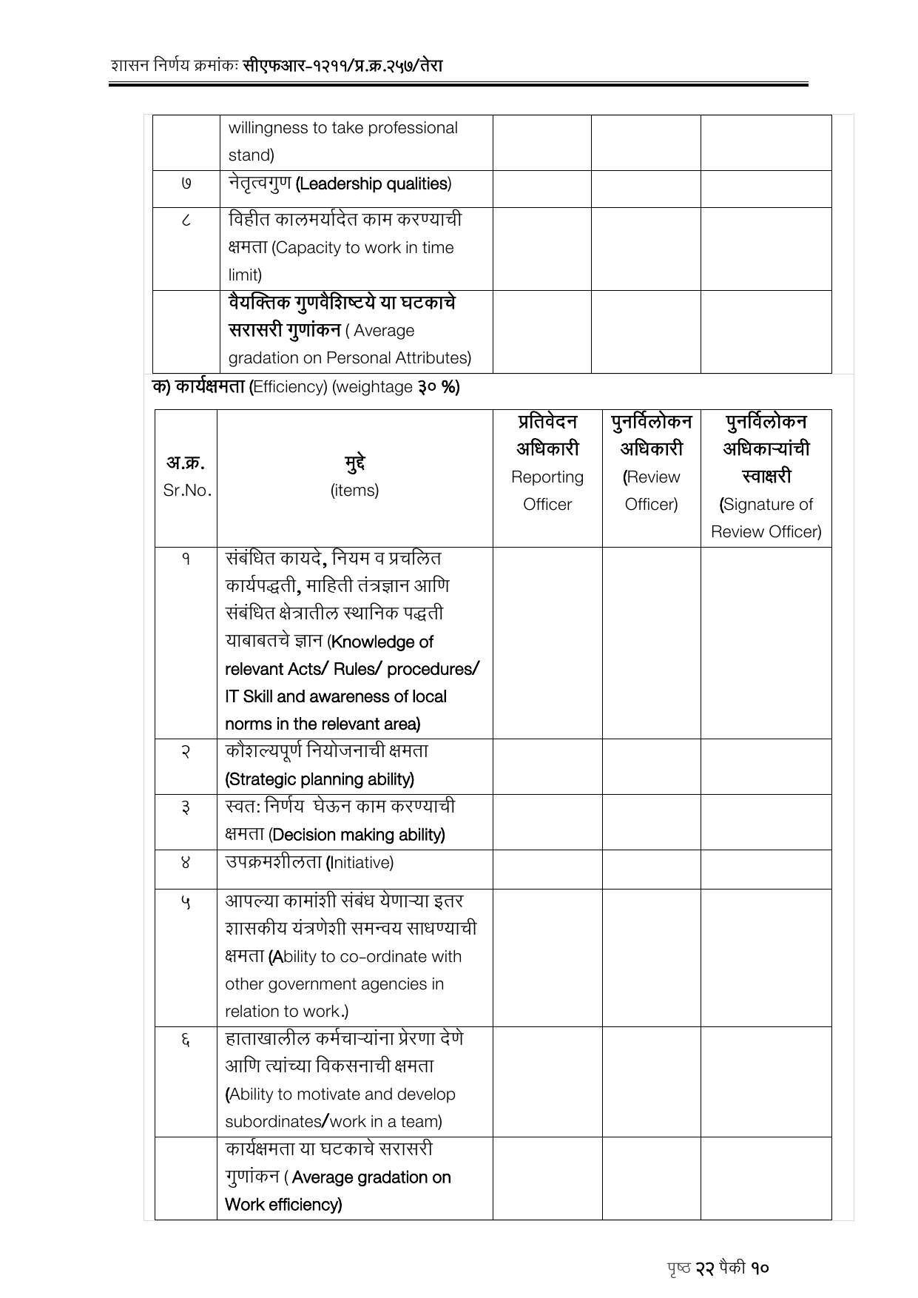
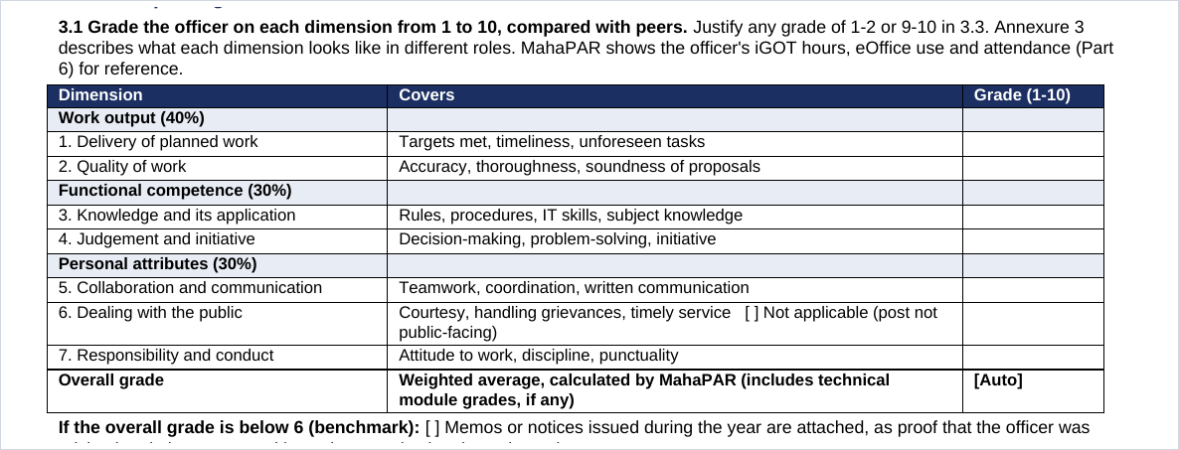
Reporting officer · the graded dimensions
Before and after · the current proforma against Form A draft v5
CURRENT FORM · SECTION 3 · ALL GRADED ITEMS
FORM A · PART 3.1 · 7 DIMENSIONS
→
Three tables of 17 items, each graded and averaged by hand, become one table of seven dimensions, with MahaPAR calculating the weighted overall grade.
Current form: Form 1, the Group A / Group B gazetted proforma now in use, shown in Marathi with English in parentheses as it is issued today. · After: Form A draft v5. The draft is written in English; the issued form will be bilingual, Marathi and English, like the present one.

Slide 3
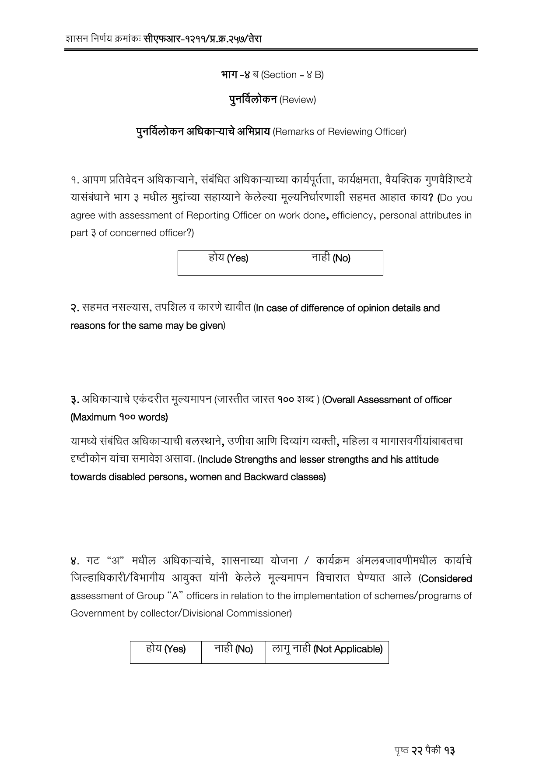
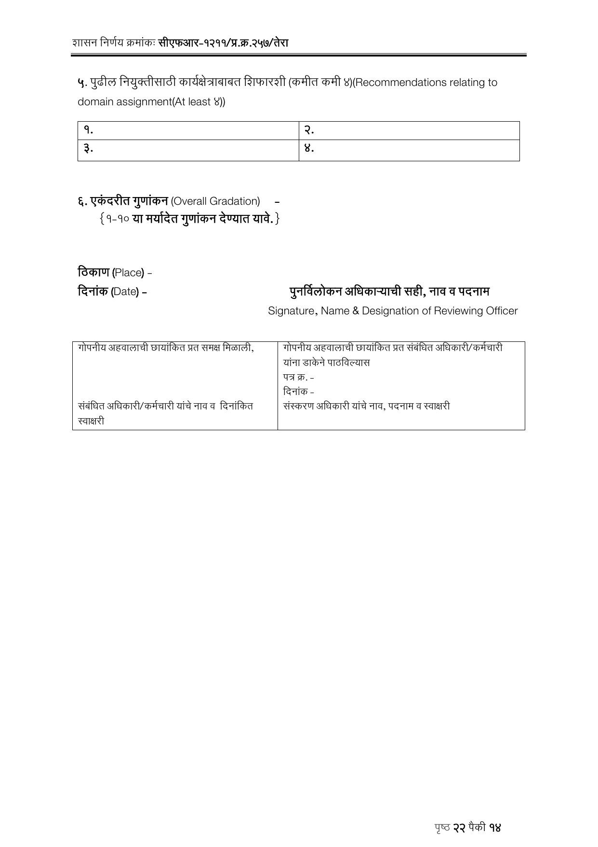
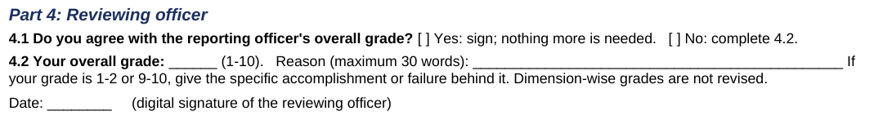
Reviewing officer
Before and after · the current proforma against Form A draft v5
CURRENT FORM · SECTION 4B · 2 PAGES
FORM A · PART 4 · REVIEWING OFFICER
→
Instead of re-grading every dimension, the reviewing officer records agreement or disagreement with the reporting officer's overall grade and gives their own, with reasons required only where they differ.
Current form: Form 1, the Group A / Group B gazetted proforma now in use, shown in Marathi with English in parentheses as it is issued today. · After: Form A draft v5. The draft is written in English; the issued form will be bilingual, Marathi and English, like the present one.

