Slide 1
Analyzing Layoffs in the Top 20 Affected States of the US
GROUP-6
By: Aishwarya Gulab Sheetal Patnaik Lincy Rebello Dhruv Shetty
Pranav

Slide 2
Introduction
Overview: The COVID-19 pandemic has had a significant impact on the US economy, leading to widespread job losses and layoffs across various industries. This analysis focuses on examining the scale and patterns of these layoffs in the top 20 states most affected by the economic downturn.
Objective: The primary goal of this analysis is to provide a comprehensive understanding of the layoff situation in the hardest-hit states, identifying the affected industries,identifying the key drivers to inform policymakers and stakeholders.
Scope: This analysis is aiming in identifying trends of the layoffs over years.

Slide 3
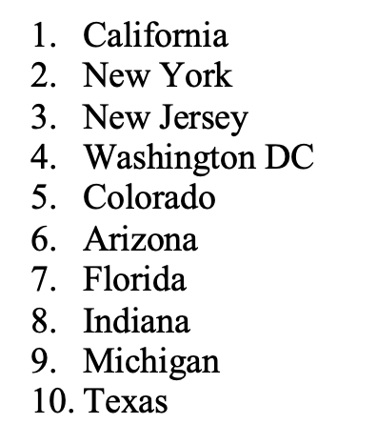
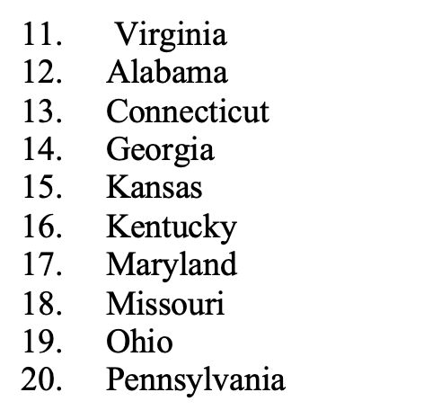
List of the Top 20 affected states

Slide 4
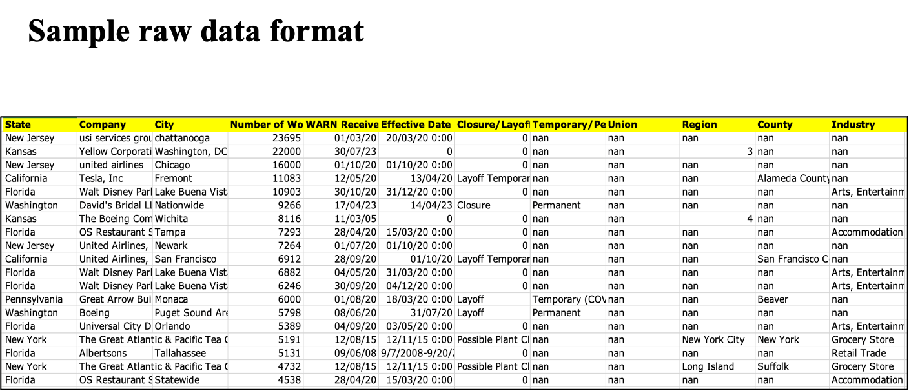

Slide 5
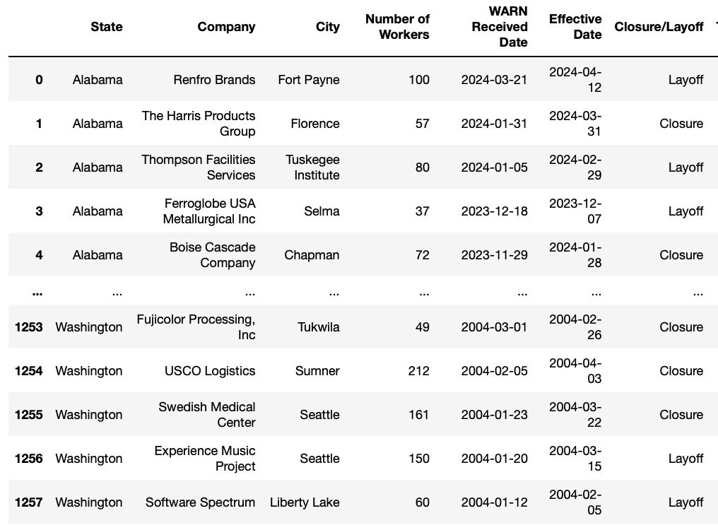
Cleaned Data
Note: We have used python for conducting cleaning and transformation operations.

Slide 6


ETL Process
Snip of pipeline created in Apache NiFi

Slide 7

Usage of Data warehouse
We've created a data warehouse in Snowflake and configured tables within it. So in this, we have loaded the transformed data into this Snowflake database. There is continuous improvement through the usage of this and the performance monitoring and decision making is also enhanced.

Slide 8
Demonstration of our Analysis
We used RDBMS - MYSQL for analyzing the data based on the different states, industries and other dimensions. Few of our findings regarding the analysis that we have done is as follows:
Total number of layoffs across States
Top 20 cities with highest number of layoffs
Trend of Layoffs over years
Number of workers affected by different types of layoffs across states
Top 25 companies with highest number of layoffs

Slide 9
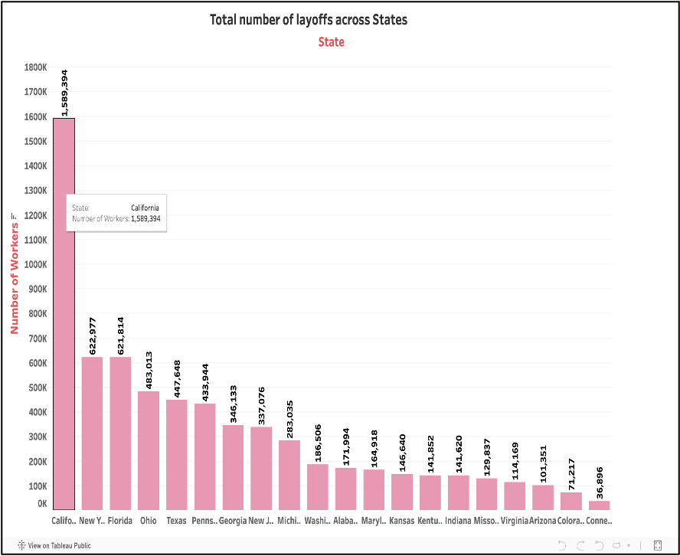
Total number of layoffs across States
● California has the highest total number of workers (around 1.6 million) followed by Texas (around 622,000) and Florida (around 621,000).
●There's a considerable difference in the number of workers across states. While California has the most workers, several states have significantly lower numbers (below 100,000).

Slide 10
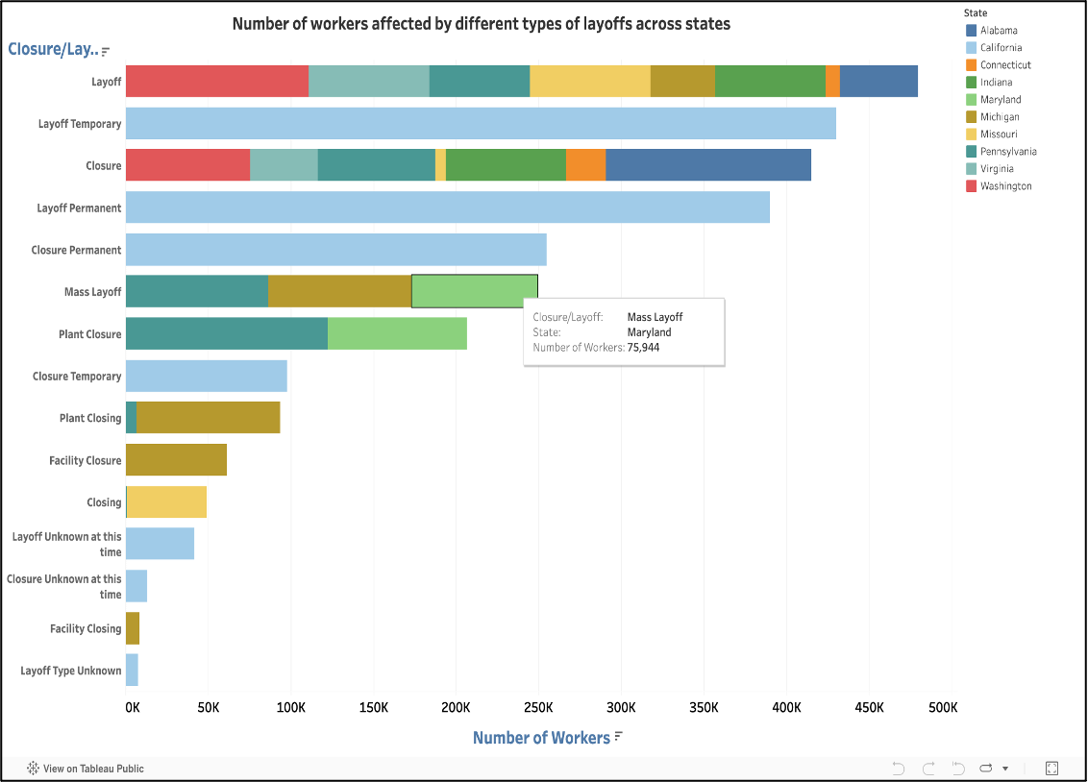
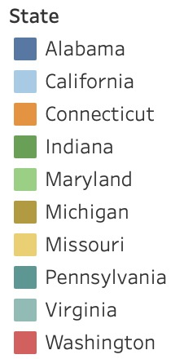
●The graph reveals significant variation in layoff volume across states. Some states, like California, appear to have a higher total number of workers affected by layoffs compared to others.
● By analyzing the distribution of these categories across states, you can identify which types of layoffs are most prevalent in different regions.
Number of workers affected by different types of layoffs across states

Slide 11
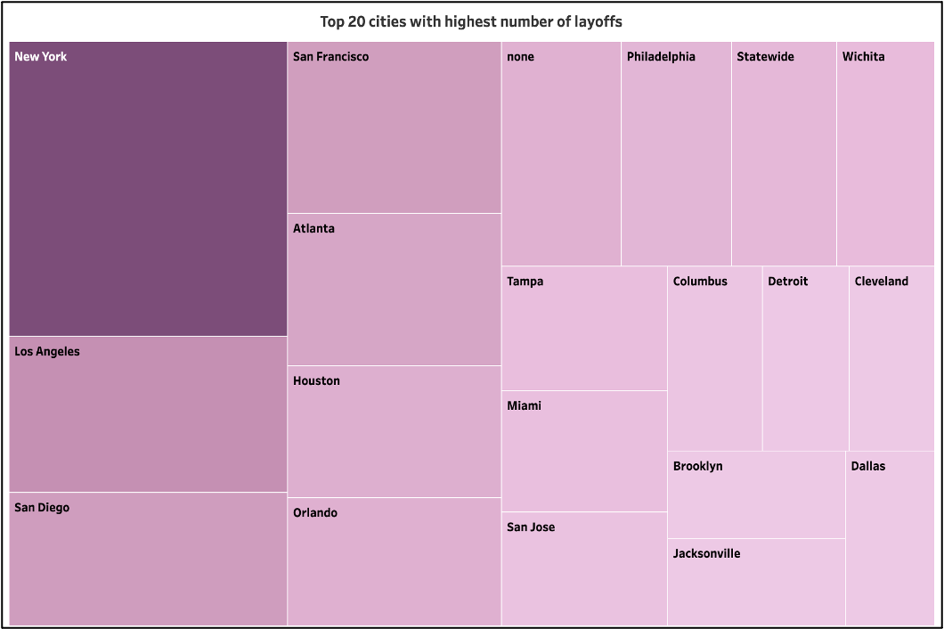
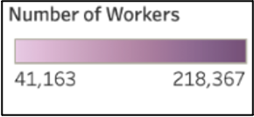
New York has the highest number of workers laid off at 218,367.
Followed by Los Angeles and San Diego
Dallas has the least number of layoffs.
More intense shades of pink correspond to cities with a higher number of layoffs, while lighter shades represent areas with fewer layoffs.
Top 20 cities with highest number of layoffs

Slide 12
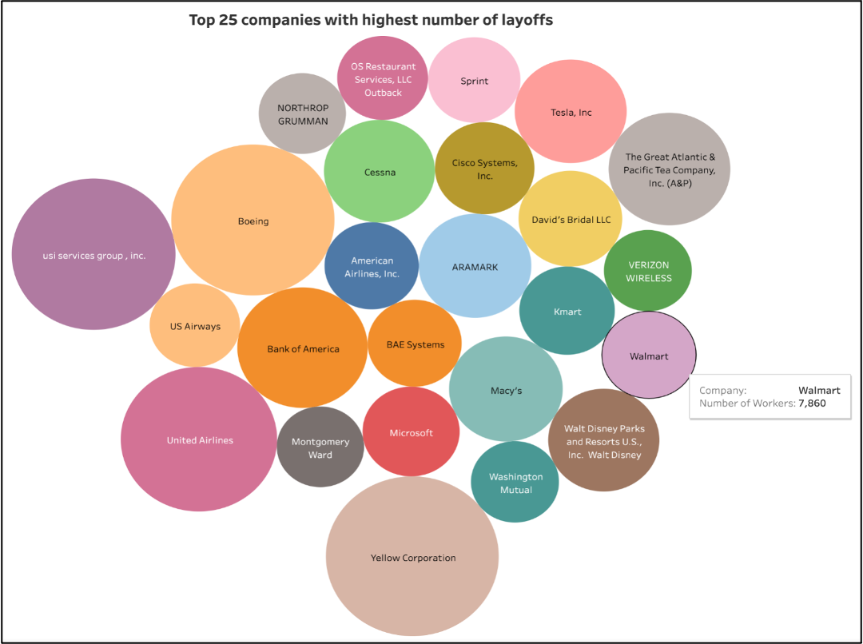
Top 25 companies with highest number of layoffs.
Companies like Yellow Corporation, USI service groups, US Airways, United Airlines, Macy’s, and Bank of America are the top listed companies with highest layoffs.

Slide 13
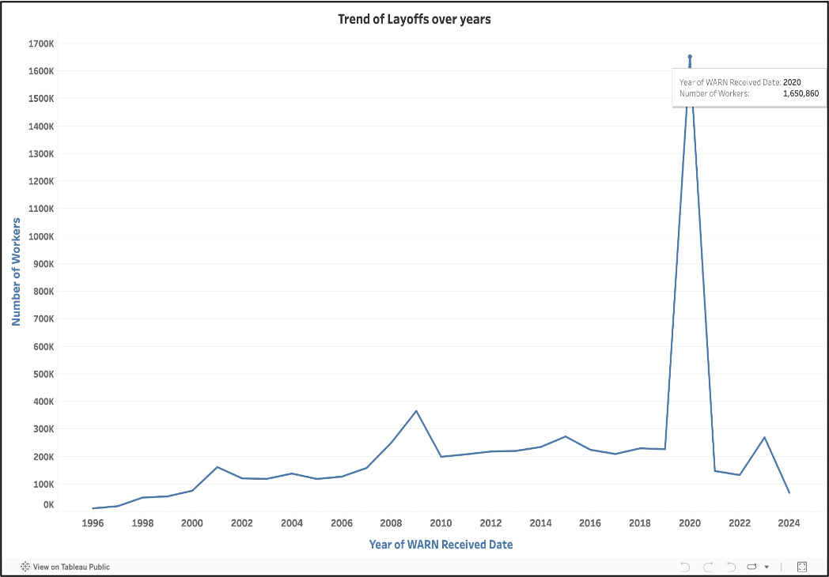
Trend of Layoffs over years
The number of layoffs appears to have fluctuated over the years.
The highest number of layoffs appears to happen between the start of 2020 till the start of 2022, at around 1,650,860 workers due to Covid-19.
There appears to have been a significant increase in layoffs in 2008, which could be due to the Great Recession.
Layoffs appear to have been relatively low in the years between 2014 and 2018.

Slide 14
Key Learnings
City Impact: Certain cities, such as New York, Los Angeles,San Diego experience the highest number of layoffs, indicating potential industry vulnerabilities or economic shifts.
Trend Analysis: The number of layoffs appears to have fluctuated over the years, influenced by Covid-19 and Great Recession.
State-wise Impact: California emerges as particularly affected, with 1,589,394 workers impacted by layoffs, highlighting the need for targeted support and intervention.
Total Layoffs: Overall, the analysis reveals huge number of layoffs across states, cities, companies and years.
Top Companies Affected: Notable companies like Yellow Corporation, USI service groups, US Airways have contributed significantly to the layoffs, necessitating collaboration between government and industry for workforce retention and reemployment initiatives.

Slide 15
Thank You!

