Slide 1
BankPulse
Term deposit propensity on AWS SageMaker
End-to-end MLOps: data lake, training, registry, real-time endpoint, drift monitoring and continuous retraining
Built and run on the AWS Academy Learner Lab
github.com/aishwaryagulhane05/bankpulse-sagemaker-mlops

Slide 2
WHY THIS PROJECT
The problem: most sales calls go nowhere
1 in 9
41,188
+35%
68
calls ends in a term deposit subscription
historical phone contacts, 2008–2010
more subscribers found than the baseline on test
pre-call inputs; call duration excluded (leakage)
Problem
Agents work through call lists in no particular order, so most effort goes on customers who were never going to say yes.
Solution
A classifier scores each customer before the call. Customers above a validated threshold are flagged “call first”; the rest are ranked by score.
Audience | What they get
Campaign managers | Ranked call list, expected subscribers per cut-off
Call-centre agents | Who to call next, highest score first
Data science / MLOps | Training, registry, endpoint, drift, retraining status
Risk and compliance | Model Card, approvals, selection rates by age band
BankPulse · AWS SageMaker MLOps
2 / 10

Slide 3
DATA
Data, contract and features
UCI Bank Marketing
41,188 contacts, 20 inputs, May 2008 – Nov 2010. Positive rate 5.6% train, 10.7% validation, 38.5% test: strong drift over time.
Time-ordered split
Oldest 70% train, next 15% validate, newest 15% test, so no future behaviour leaks into training.
Data contract
Schema, types, allowed values, ranges and 4 cross-column rules checked on every run; the forbidden duration column is dropped.
Versioned feature registry
9 features → 68 inputs. Learned values are fitted on train only and saved in feature_schema.json, so the endpoint encodes exactly like training.
Design decision: economic indicators off
Euribor and employment figures describe the period of the call, not the customer.
With a time-ordered split every later value is outside the training range (PSI 8–17), so trees use them as a clock.
Validation PR-AUC
0.177 with them → 0.229 without
BankPulse · AWS SageMaker MLOps
3 / 10

Slide 4
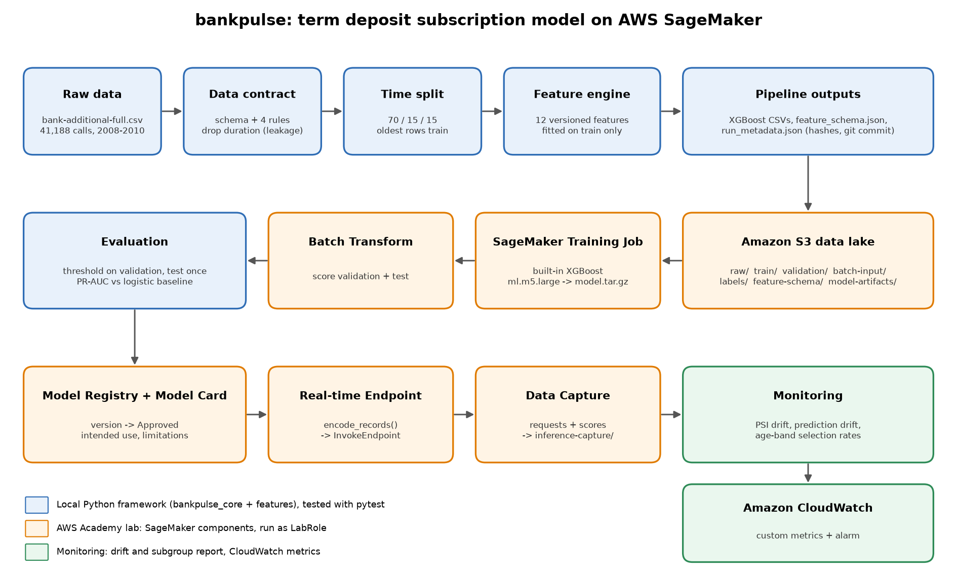
HOW IT FITS TOGETHER
Architecture
Framework (local, tested)
Contract, split, feature registry, lineage
Data lake
Amazon S3 bank-campaign-mlops/
Train and evaluate
XGBoost 1.7-1 Training Job, Batch Transform
Govern and serve
Model Registry, Model Card, endpoint with Data Capture
Monitor and retrain
CloudWatch, EventBridge, SageMaker Pipelines
BankPulse · AWS SageMaker MLOps
4 / 10

Slide 5
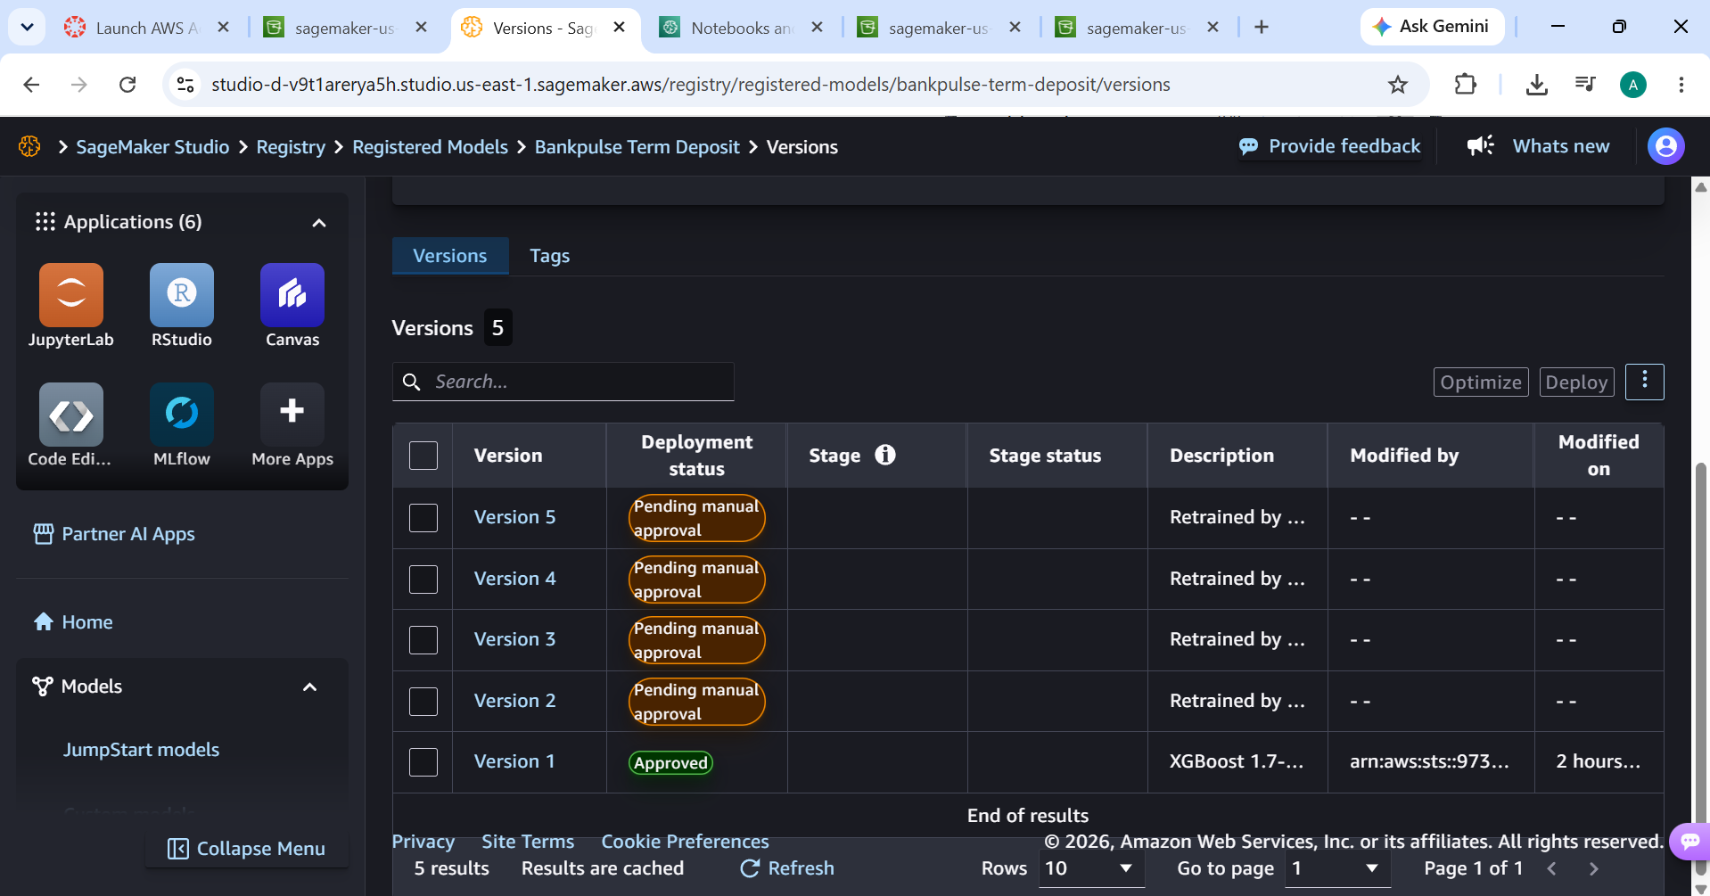
TRAINING
Model development and governance
SageMaker built-in XGBoost
binary:logistic on ml.m5.large, early stopping on validation aucpr.
Tuning on validation only
64-setting grid → max_depth 4, eta 0.05, colsample 0.5, subsample 0.8.
Threshold 0.106
Best F1 on validation, reused unchanged on test.
Approval rule: non-inferiority
Approve if test PR-AUC is within 0.01 of the baseline. Result −0.0039 → approved; the margin and its timing are disclosed.
Model Card
Intended use, Medium risk rating, evaluation results; not for credit or eligibility decisions.
BankPulse · AWS SageMaker MLOps
5 / 10

Slide 6
EVALUATION
Key results: baseline vs SageMaker XGBoost
Metric | Logistic baseline | SageMaker XGBoost
Validation PR-AUC | 0.222 | 0.228
Test PR-AUC | 0.471 | 0.467
Test F1 at validation threshold | 0.306 | 0.369
Test recall | 0.224 | 0.302
Test lift, top 10% | 1.19× | 1.24×
Subscribers found on test | 533 | 718
+35%
subscribers found (718 vs 533)
0.0
max score difference, endpoint vs Batch Transform
Both models use the same 68 inputs. The threshold is chosen on validation and the test split (newest 15%) is evaluated once.
PR-AUC is roughly tied; XGBoost wins clearly at the operating threshold, where the call list is actually cut.
+0.16–0.24
PR-AUC gain from retraining on recent months
BankPulse · AWS SageMaker MLOps
6 / 10

Slide 7
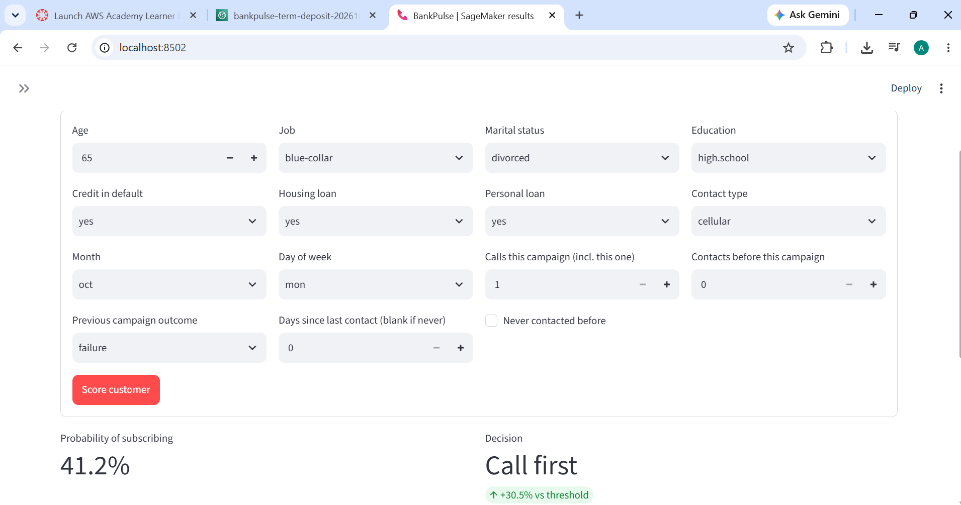
SERVING
Deployment and inference
Real-time endpoint
Approved registry version deployed on ml.m5.large.
Data Capture
100% of requests and responses written to S3 as JSONL for monitoring.
Serving parity
encode_records() uses the saved feature schema; an integration test checks rows are byte-identical to the batch files.
Batch scoring
Batch Transform scores whole validation and test files offline.
Results UI
Streamlit app: live SageMaker status, results, monitoring, and scoring through the endpoint.
BankPulse · AWS SageMaker MLOps
7 / 10

Slide 8
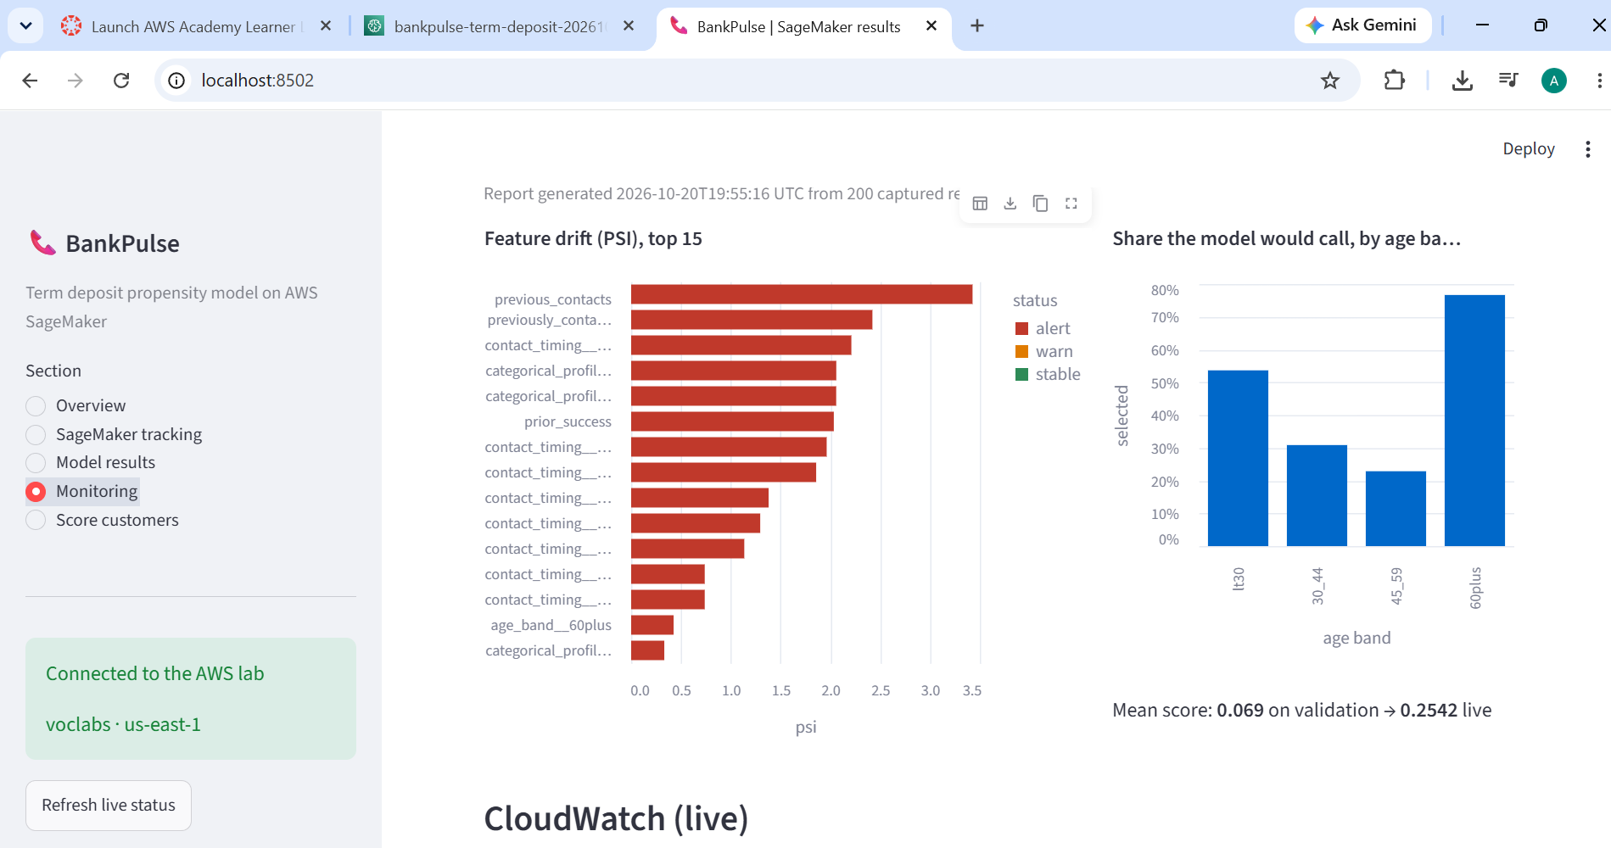
OPERATIONS
Monitoring: drift and fairness
Check | Value | Status
Max feature PSI | 3.43 | Alert: 17 inputs > 0.2
Prediction PSI | 2.95 | Alert: mean 0.07 → 0.25
Age-band selection ratio | 0.30 | Alert: below 0.8
Source
The newest 200 customers captured at the endpoint, compared with the training data.
CloudWatch
Metrics under BankPulse/ModelMonitoring, a feature-drift alarm (PSI > 0.2) and a dashboard.
Managed services
Model Monitor schedules and Clarify were unavailable in the lab, so the project computes the same checks itself.
BankPulse · AWS SageMaker MLOps
8 / 10

Slide 9
RETRAINING
Continuous training on recent data
New month in S3 · schedule · drift alarm
EventBridge
Prepare
Train
Evaluate
challenger vs champion
Register
pending approval
Human approval
blue/green deploy
Trigger | Champion | Challenger | Registered
Month 24 (manual) | 0.588 | 0.751 | version 2
Month 25 (S3 upload) | 0.489 | 0.732 | version 3
capped_campaign v2 | 0.489 | 0.732 | version 4
Month 26 (S3 upload) | 0.474 | 0.660 | version 5 (approved)
Rolling window
Train on the latest 12 months, validate on 2, hold out the newest 2.
Safe ingest
Contract-checked, SHA-256 manifest, duplicates skipped, nothing deleted.
Safe deploy
10% canary for 10 minutes with automatic rollback; the endpoint keeps serving v1 until a deliberate deploy.
Holdout PR-AUC on the newest two months
BankPulse · AWS SageMaker MLOps
9 / 10

Slide 10
WRAP-UP
Limitations, responsible use and next steps
Drift
Test subscription rate (38%) is about 7× training (6%); scores need retraining on recent data.
Modest ranking quality
Test PR-AUC 0.47 against a 0.38 base rate: it prioritises calls, it does not predict outcomes.
Month dominates
The same customer scores 41% in October and 14% in June.
Intended use
Ranking marketing call lists reviewed by staff. Not for credit, lending, pricing or eligibility. Age-band ratio below 0.8 triggers review.
Next steps
• Wire registry approvals to the blue/green deploy (EventBridge → Lambda)
• Validate business rules in the UI scoring form
• Load the deployed version’s feature schema from the endpoint tag
• Re-run monitoring on the new training window after redeploying
Thank you
BankPulse · AWS SageMaker MLOps
10 / 10

