Slide 1
Vrinda Store Data Analysis
Excel Project
By Aishwarya kadam

Slide 2
Objective:
Vrinda store wants to create an annual Sales report for 2022.
So that, store can understand their customers , grow more sales in 2023

Slide 3
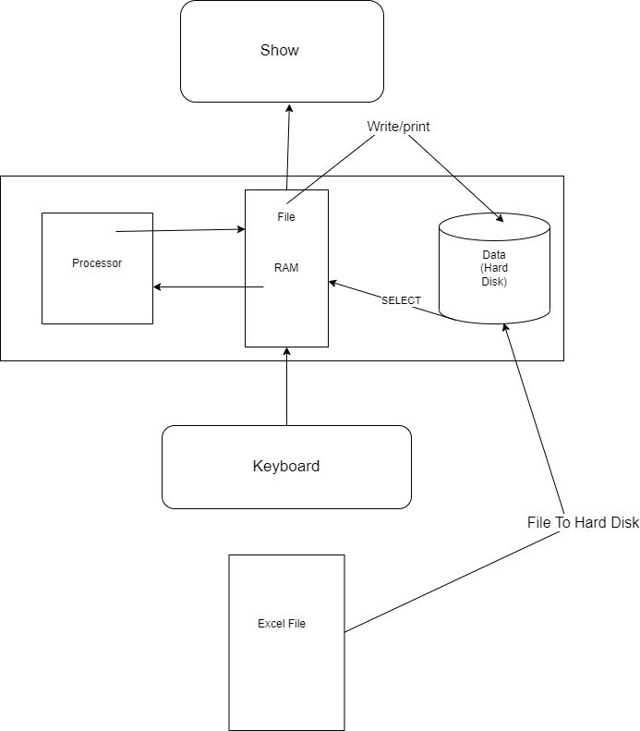

Slide 4
Steps :
Data Cleaning
Data Processing
Data Analysis
Interactive Dashboard
Insights

Slide 5
Data gathering & cleaning :
Imported the CSV file and performed activities like removing duplicates, fixing errors, and transforming the data into an easily analyzed format. The first step in any data analysis project is to clean the data. Because the raw data we receive consists of errors which might affect the insights drawn. Vrinda store data consists of errors in columns like Gender, and Quantity. Some columns' names are duplicates. This data is cleaned thoroughly.
Data Processing :
Then We've created a column called Month from the existing date column, and rename some duplicate column names then we created a column dividing the age data into groups: Senior(>50), Adults (30-501, and Teenagers.

Slide 6
Questions asked :
Compare the sales and orders using a single chart and find the month with the highest sales and orders.
Who purchased more in 2022, men or women?
What are the different order statuses in 2022?
What are the top 5 states that contributed to maximum sales?
Show the relation between Age and gender based on the number of orders?
Which channel is contributing to maximum sales?

Slide 7
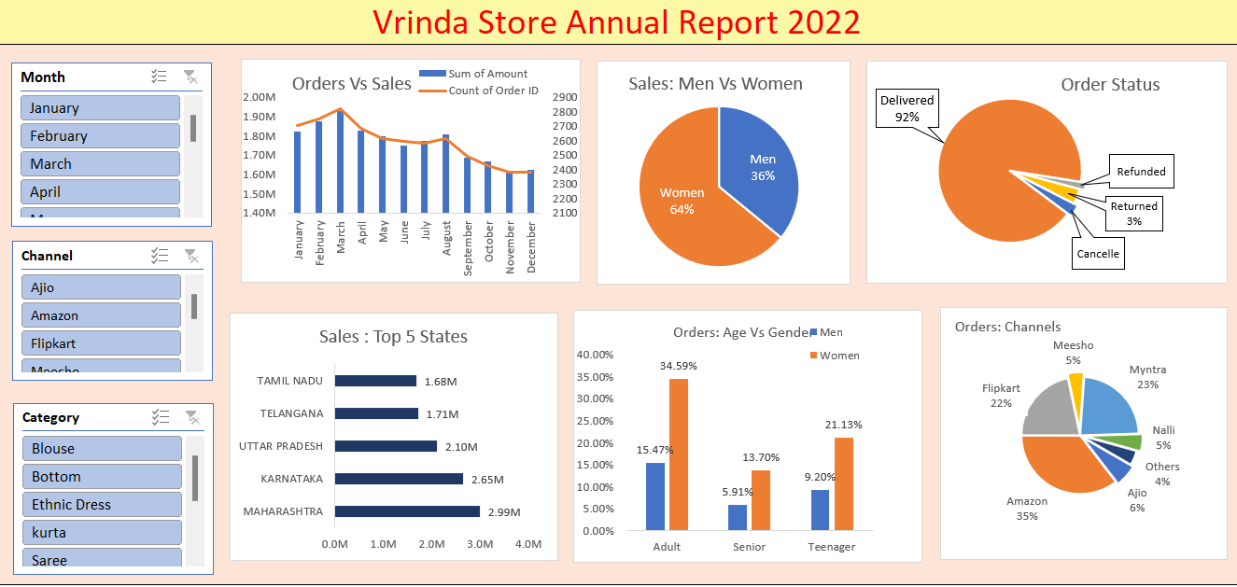

Slide 8
Key insights:
March month recorded the highest sales and orders.
Women purchased more than men (64%)
Maximum order status was seen to be delivered(92%)
Maharashtra, Karnataka, Uttar Pradesh, Telanganaand Tamil Nadu are the top 5 states by highest sales. Women of the Adult age group were the highest to place orders (35%)
Amazon (35%), Myntra (23%) and Flipkart (22%)channels are contributing to maximum sales
Conclusion:
Finally based on the insights, to increase sales in 2023,we can suggest Vrinda store consider the following:
We should target female customers of ages ranging from 30 to 50.
We should produce more products in the categories Sets, Kurtis, and Western dresses as they have the highest sales.
We can target the top states and introduce more products along with discounts, and coupons that are exclusive to this locations .
March has the highest number of sales. So we should release new collection in this month.

Slide 9
THANK YOU
Github link : github.com
YouTube link : https://youtu.be/gTK5rNhWJyA

