Slide 1
Human Resources Data Analytics
Using SQL and PowerBI
By Aishwarya kadam

Slide 2
STEPS :
Import Data
Data Cleaning
Data Processing
Create Dashboard
Basic Information:
The data was in a CSV file
Imported data into MySQL
Used SQL queries to clean and process the data
Used Power BI to create Dashboard

Slide 3
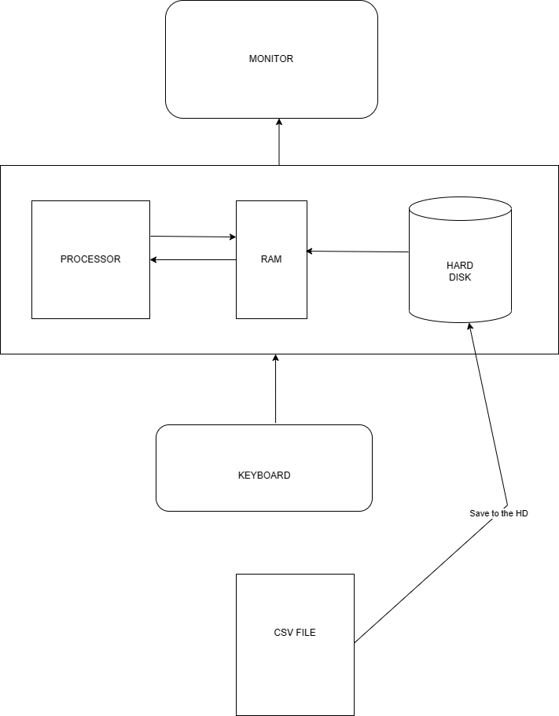

Slide 4
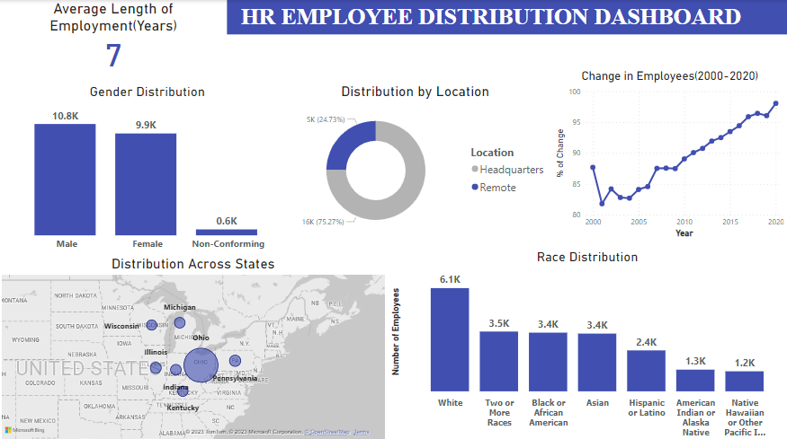

Slide 5
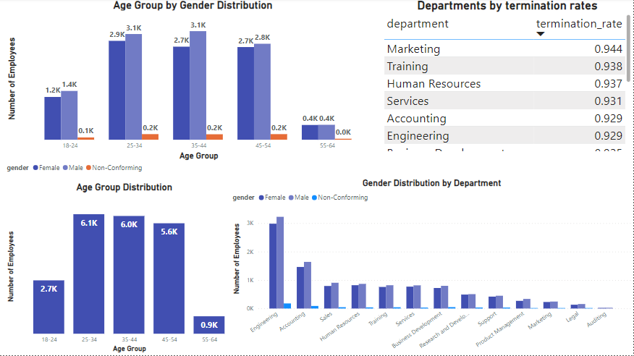

Slide 6
Conclusion :
Target the people in 25-34 age group with engineering background from Ohio for employment

Slide 7
Thank You
YouTube link : https://youtu.be/PzyZI9uLXvY

