Slide 1
NETFLIX Data Analysis Using Tableau
By Aishwarya kadam

Slide 2
Steps:
Import the data from CSV file to Tableau
Dashboard creation

Slide 3
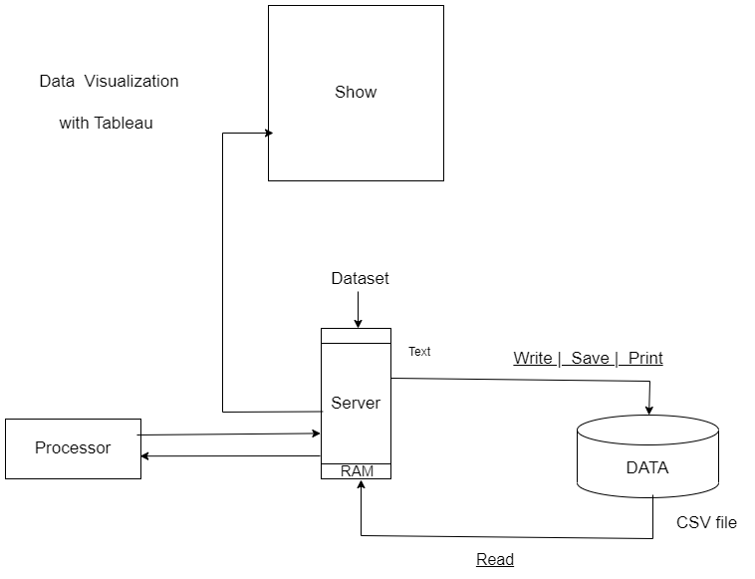

Slide 4
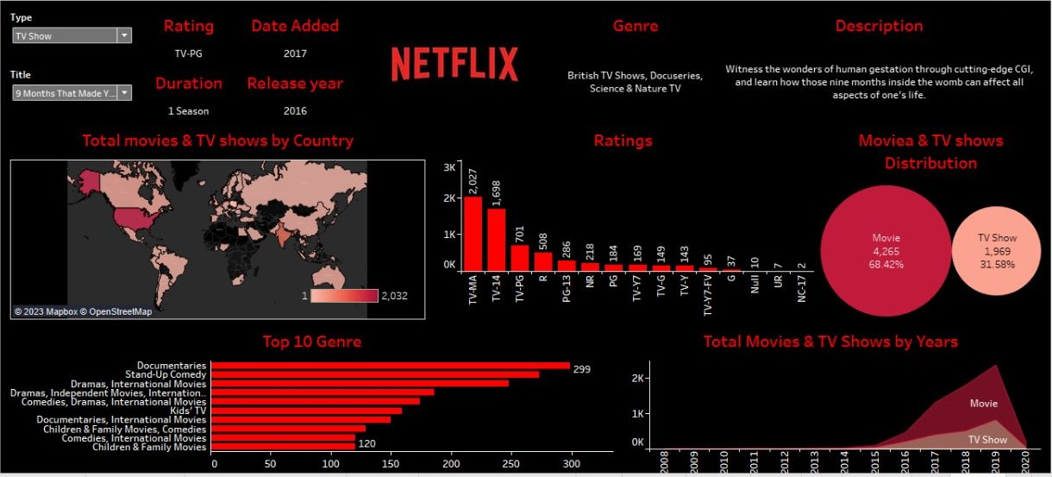

Slide 5
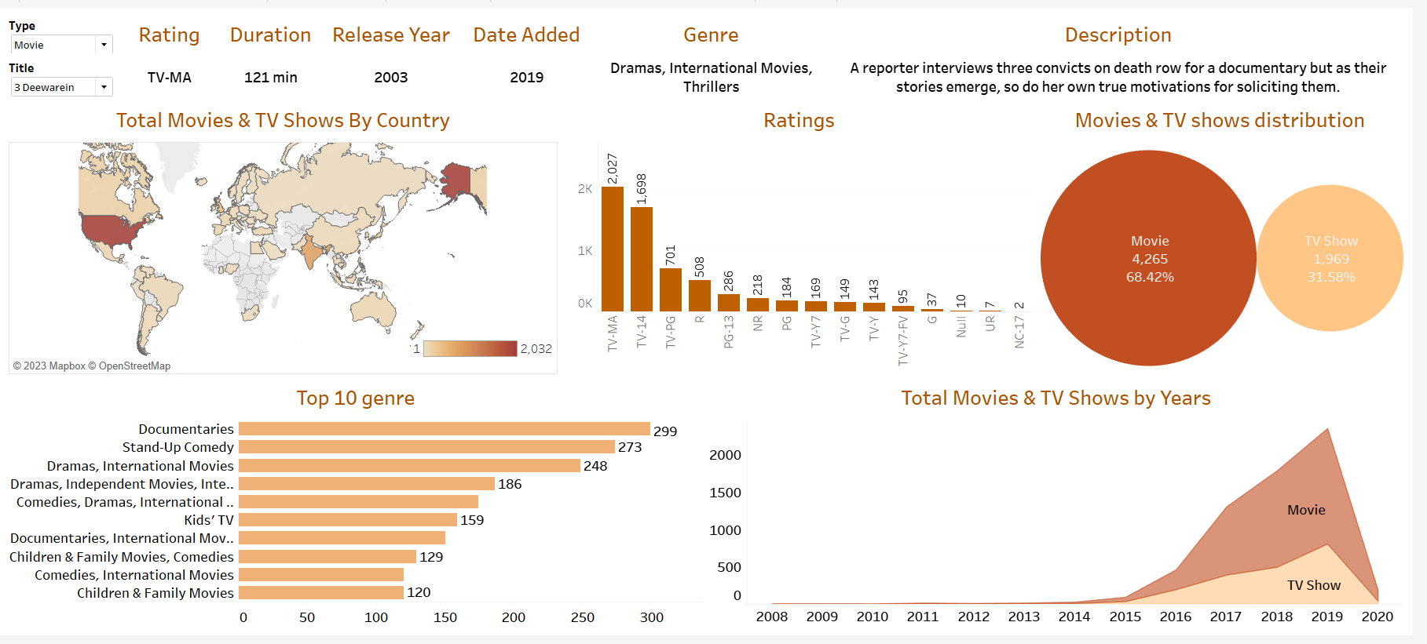

Slide 6
Conclusion:
In past five years of the data movies and TV shows are highly released on Netflix
Most of the Movies and TV shows have been released in US

Slide 7
Thank You
YouTube Link: https://www.youtube.com/watch?v=BTArwS4ljC4

