Slide 1
Road Accident Analysis
Excel Project
By Aishwarya kadam

Slide 2
PROJECT OVERVIEW
The objective of this Excel project is to create a road Accident Dashboard for the years 2021 and 2022,
providing valuable in sight to the clients using a data set of 21 no of fields and 307k+ Records.
The valuable insights include two types of KPIs ( Key Performance Indicator):
Primary KPIs and Secondary KPIs.

Slide 3
Primary KPIs include
Total casualties taken place after the accident
Total casualties & percentage of total with respect to accident severity and maximum casualties by type of vehicle

Slide 4
Secondary KPIs include
Total casualties with respect to vehicle type
Monthly trend showing comparison of casualties for Current Year and Previous Year
Maximum casualties by Road Type
Distribution of total casualties by Road Surface
Relation between casualties by Area/Location & Day/Night

Slide 5
Stakeholders include
Ministry of Transport
Road Transport Department
Police Force
Emergency Service Department
Road Safety Corps
Transport Operators
Traffic Management Agencies
Public
Media

Slide 6
Steps
Requirement Gathering
Data Cleaning
Data Processing
Data Analysis
Data Visualization
Dashboard/Report
Report Insights

Slide 7
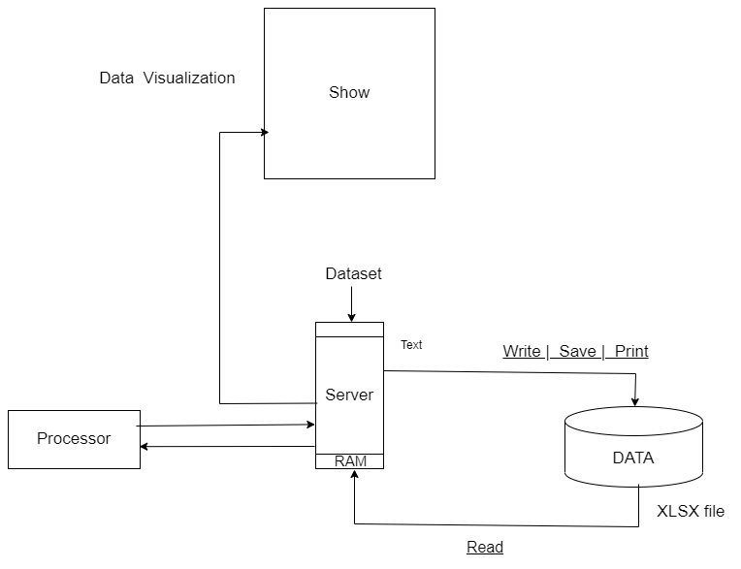

Slide 8
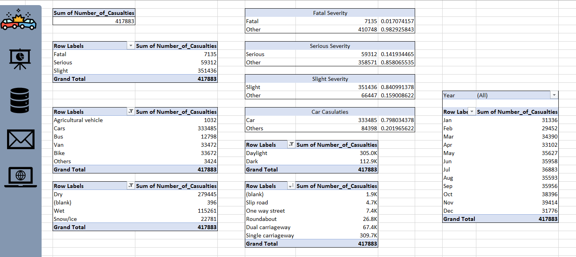
Data Analysis With Pivot Table

Slide 9
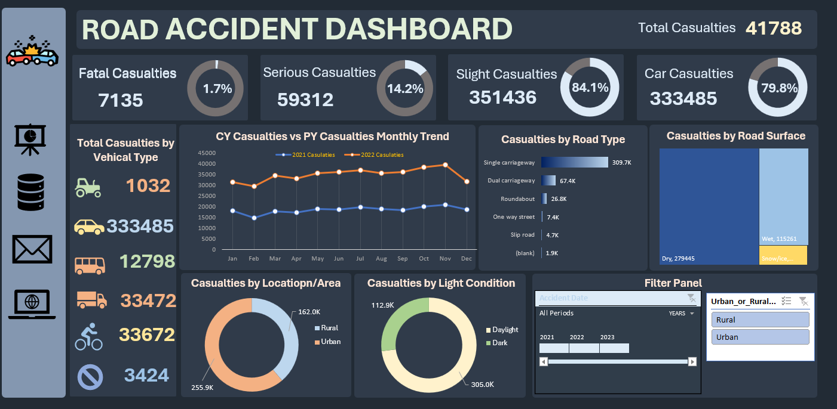
Dashboard

Slide 10
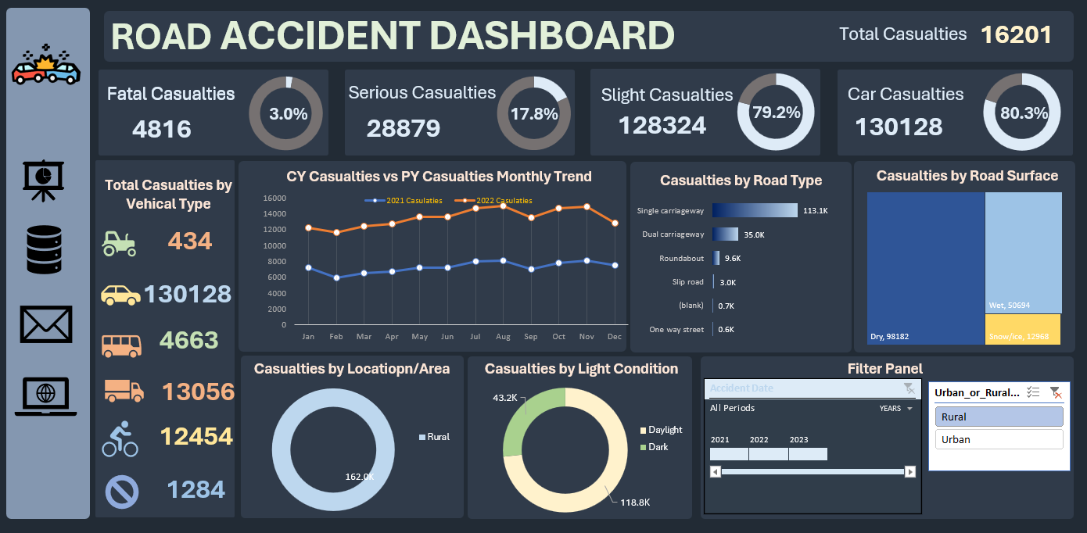
Rural Area wise:

Slide 11
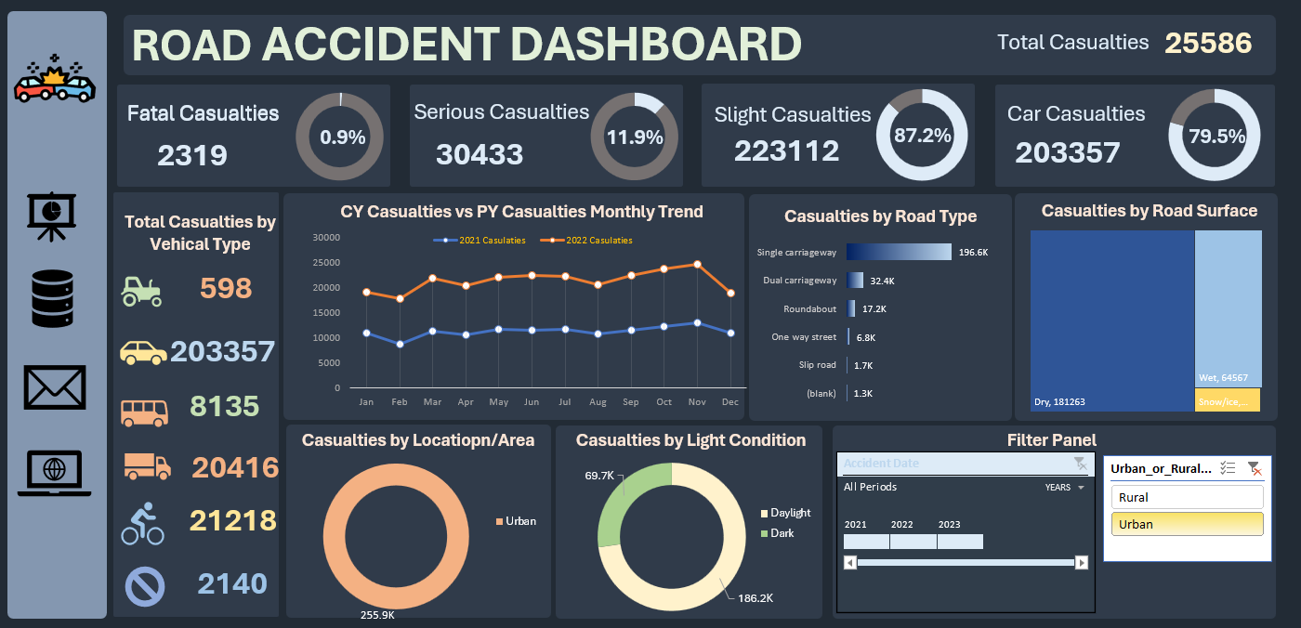
Urban Area Wise:

Slide 12
Conclusions
Most of the casualties are slight casualties.
The majority of casualties by vehicle type are caused by cars.
The month of November has the highest number of casualties.
Casualties are most common on single carriageways and dry surfaces.
Urban areas have the highest number of casualties by location.
The majority of casualties occur during the daytime.

Slide 13
Thank You..!
Reference: https://youtube.com/watch?v=XeWfLNe3moM&feature=share7

