Slide 1
Super Store Sales Dashboard
PowerBI Project
By Aishwarya and Priyanka

Slide 2
Objective
To contribute to success of a business by utilizing data analysis techniques, specifically focusing on Time series analysis, to provide valuable insights.
Accurate sales Forecasting
Complete project on
YouTube: https://youtu.be/fZn83JRt4Nk

Slide 3
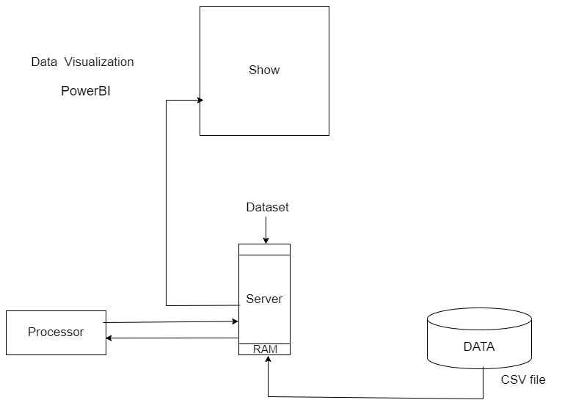
Imported the Data Into PowerBI

Slide 4
Description:
Dashboard creation: Identify the KPIs, design an intuitive and visually appealing dashboard, and have interactive visualization and filtering capability to allow users to explore the data at various levels of granularity.
Data analysis : Provide valuable insights to business entities regarding the effectiveness of their strategies through visualization.
Sales Forecasting : Leverage historic data and apply time series analysis to generate a sales forecast for the next 15 days.
Actionable Insights : The goal is to share valuable insights and actionable information that can drive strategic decisions making and support the super store goals for growth, efficiency, and customer satisfaction.

Slide 5
Useful Insights:
Maximum sales are driven through COD payment mode.
Maximum sales are from the Customer segment (48.09%) and then corporate (32.55%).
Office supplies is the category that has the maximum sales.
Most of the customers preferred standard class ship
Next 15 Days Forecast which is very useful business

Slide 6
Donut Chart: Get a quick overview of the sales and profit distribution by segments, such as customer segments or product sub-categories. Easily compare the contribution of each segment to the overall revenue and profitability.
Column Chart: Discover the sales and profit trends across different product categories or regions using visually appealing and intuitive columns. Identify which categories or regions contribute the most to the overall revenue and profitability
Map: Explore the geographic distribution of sales and profit by visualizing them on a map. Identify regions with high sales or profit concentrations and discover potential opportunities or areas of improvement.
Slicer: Empower yourself with interactivity by using slicers to filter the data based on specific criteria like product categories, regions, or time periods. Explore the impact of different filters on sales and profit metrics dynamically.

Slide 7
Yearly Analysis and Forecast:
One of the highlights of this project is the ability to track sales and profit throughout the year. With intuitive visualizations, you can easily identify seasonal trends, understand the peaks and valleys, and align your strategies accordingly. Plus, I've integrated a robust forecasting model that enables a glimpse into the future by providing a 15-day sales forecast.

Slide 8
The project is based on E-commerce sales insights from Super Store Sales.
Key Skills Learnt:
Incorporated Data Analysis Technique
Map visualization using Power bi
Specializing in time series analysis
Data Cleaning and Wrangling
Chart visualization using Power Bi
Find Business Problems using Power Bi and Sharing Insights
Accurate Sales Forecast using Power Bi

Slide 9
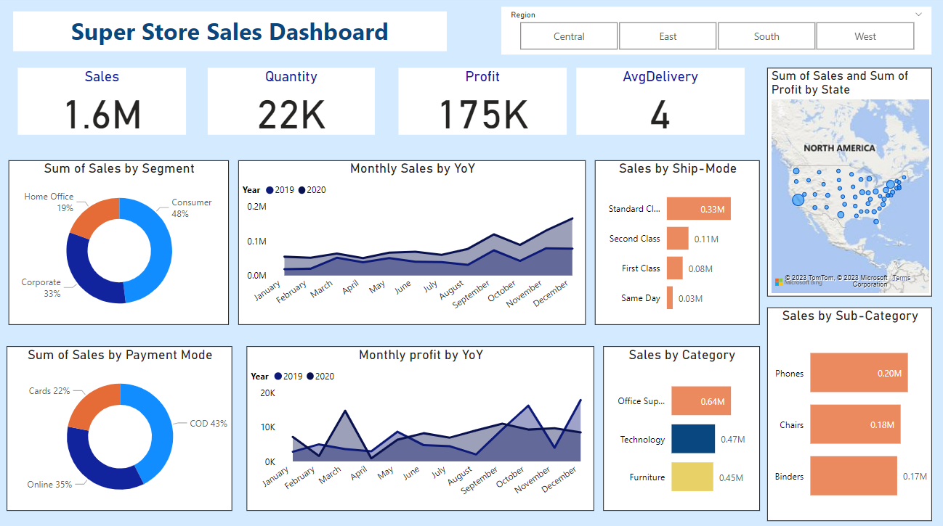
Dashboard

Slide 10
