Slide 1
Presentation
On
Malicious URL Detection
Submitted by:
[Group 4]
Aishwarya Karki (C0903073)
Bikash Thapa Magar (C0907642)
Nirmala Regmi (C0903616)
Samar Fathima (C0908466)
Sijal Shrestha (C0910639)
Sujata Gurung (C0903143)
Submitted to:
Bhavik Ghandi

Slide 2
Preface for Problem Definition:
An estimated 12.8 million websites are infected by Malware.
The average click rate for a phishing campaign is 17.8%. Phishing campaigns that were more targeted and added phone calls had an average click rate of 53.2% – 3 times more effective.
Over 96% of malicious URLs—is with the use of URL link modifiers/shorteners.
Verizon reports that over 70% of all system intrusion breaches involve malware, and 32% of all malware is distributed via the web.

Slide 3
Problem & Target Consumer
Problem:
The project addresses the growing threat of malicious URLs on the internet.
Target Consumer:
Individuals using online platforms for various activities.
Businesses and organizations handling confidential data and customer information.
Why the Target Consumer Should Care:
Phishing attacks result in identity theft, financial losses, and compromise of personal and corporate data.
Consequences include legal liabilities, loss of customer trust, and disruptions to operations.
Implementing an effective phishing detection system is crucial for protecting sensitive information and ensuring overall online security.

Slide 4
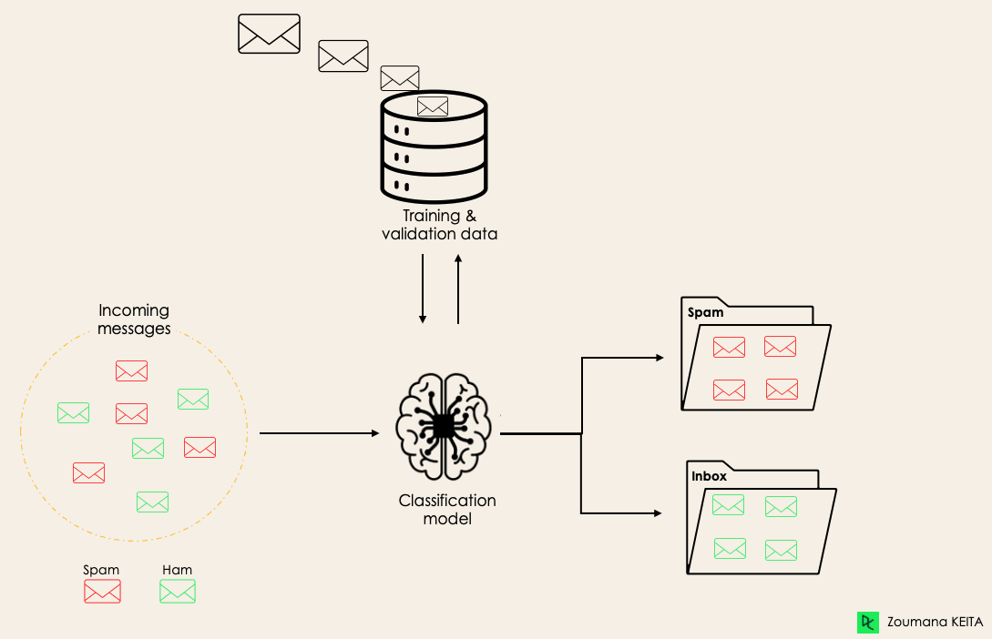
Model Building
Proposed Algorithms to be used:
Logistic Regression
KNN
Decision Tree
Random Forest
Gaussian NB

Slide 5
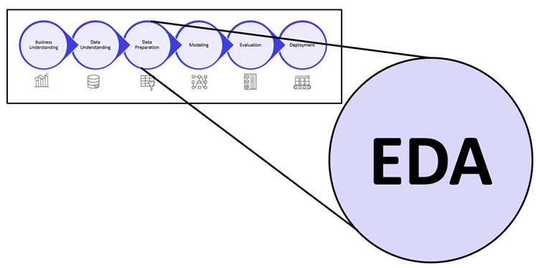
Crucial EDA:
Comparing parameters between different labels:
Considering Correlation between each point of interest
Checking Class Distribution to consider Dataset balancing
Plotting Pairplots for each Point of interest

Slide 6
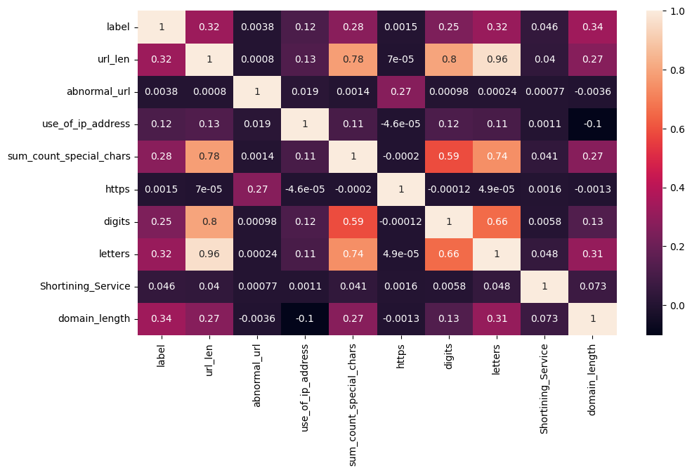
Correlation Matrix

Slide 7
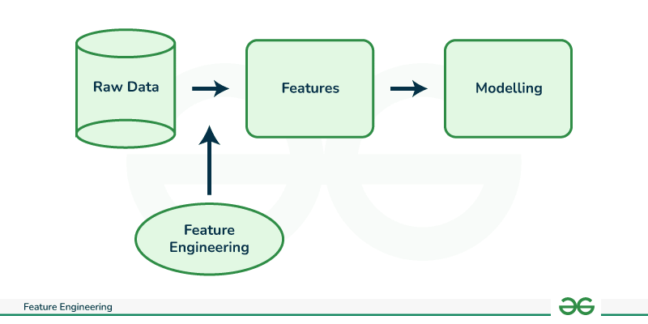
Data Engineering and Fine tuning
Since most of the Features we’ve designated can be pulled directly from the website, we can generate them directly using a set of functions defined for the project.
Then, the rest of Data engineering process involves fitting the features for our classification algorithms, scaling them if necessary and then modifying them as necessary.

Slide 8
Model Deployment:
Deploying the model using dumps generated for each model and then using them to predict user input URLS through Streamlit.
Currently the project is deployed on Local and not on any cloud based solution; Although that solution is being considered for the future.
Learning Curves were plotted to see if the models are fitted well.
Feature importance was checked for the finalized models to check which features were prioritized for model prediction.

Slide 9
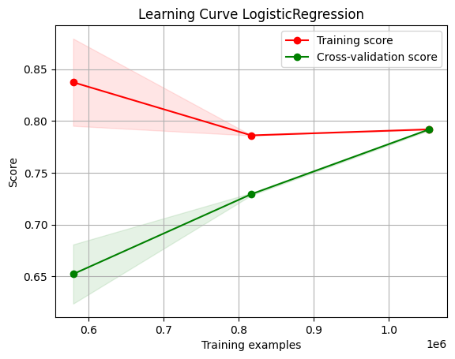
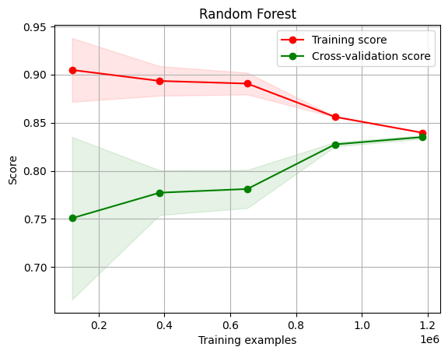
Learning Curves:

Slide 10
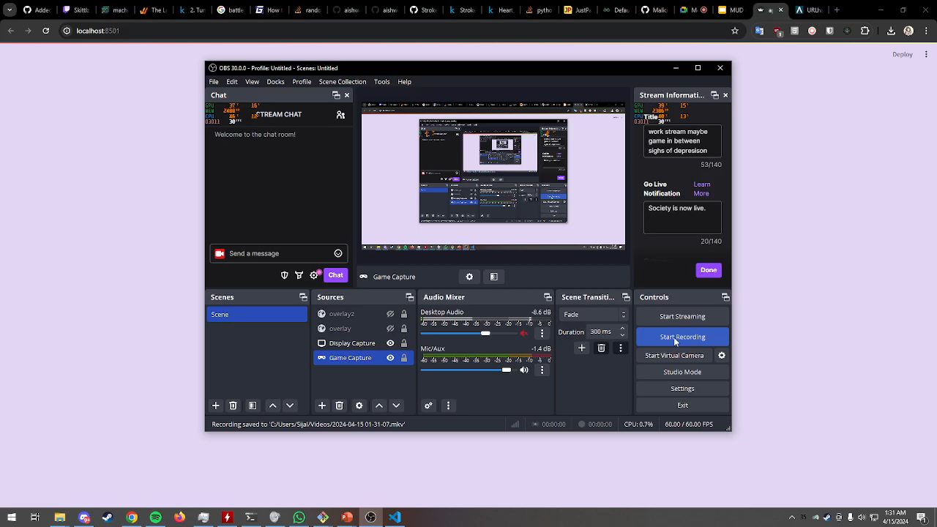
Deployment Video

Slide 11
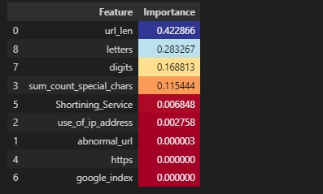
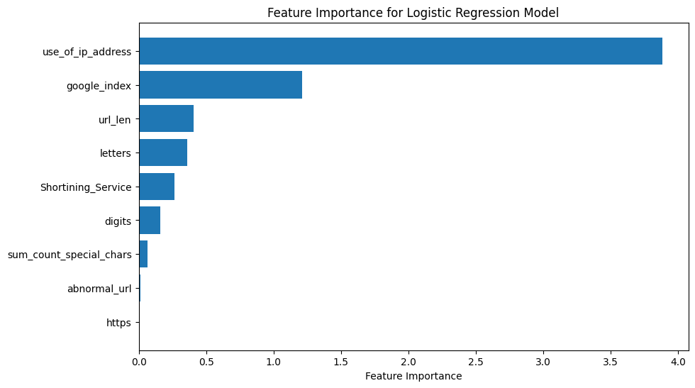
Feature Importance: RF Vs LR

Slide 12
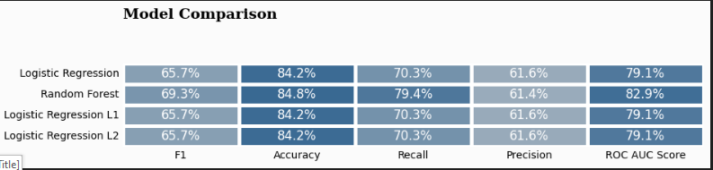
Final results
Using Random Forest we can predict whether the URL is malicious or not with the accuracy of 84.8% and recall of 79.4%.
Alternatively we can use logistic regression with the accuracy of 84.2% and recall of 79.4%.

Slide 13
Questions ??

