Slide 1
IBM University Engagement Project Submission
ArthSaathi – Agentic AI for Digital Financial Literacy, built with IBM Granite and Langflow

Slide 2


Project Title – ArthSaathi: AI Agent for Digital Financial Literacy
Domain of Project – Finance / FinTech (Financial Inclusion)
Student Name | Recent Passport Photo | Email ID | Mobile number [WhatsApp]
Aishwarya KG |  | aishwaryakg04xb@gmail.com | +91 8217300447

Slide 3
Problem Statement -
Problem Statement No. 7 : AI Agent for Digital Financial Literacy
India now makes billions of UPI payments every month, but financial literacy has not kept pace. Millions of first-time digital users do not understand UPI safety, loan interest, budgeting or the government schemes meant for them – and online financial fraud is rising fast.
Why it matters
Scams: fake KYC links, "enter PIN to receive" QR codes, digital-arrest calls and illegal loan apps drain savings – mostly from people who don't know the warning signs.
Debt traps: people take loans without understanding flat vs. reducing rates, APR or EMI burden.
Exclusion: useful schemes (PMJDY, PMSBY, APY) go unused because information is scattered and in English.
Target users & pain points
Students, senior citizens, homemakers, small vendors and rural families. They have no one to ask, official info is scattered across RBI/NPCI/government sites, it is full of jargon, and they fear asking "silly" questions at a bank.
Why current solutions fail: static FAQ pages and awareness videos can't answer *my* question, can't check *my* suspicious message and can't calculate *my* EMI; generic chatbots aren't grounded in trusted sources and may hallucinate numbers.

Slide 4
Proposed Solution -
Proposed Solution: ArthSaathi – a RAG-powered financial literacy agent
ArthSaathi ("money companion") is an agentic AI assistant built in Langflow and powered by IBM Granite models on IBM watsonx.ai. Users ask questions in their own language and get simple, step-by-step, source-grounded answers.
1. Trusted knowledge base (RAG): RBI, NPCI, I4C and government-scheme material is parsed with Docling, chunked, embedded with a Granite embedding model on watsonx.ai and stored in Langflow's vector store.
2. Agent with tools: a Granite-powered Langflow Agent decides when to search the knowledge base and when to use the Calculator (EMI, interest, budget split).
3. Scam Checker: paste any suspicious SMS/WhatsApp – the agent lists red flags, gives a verdict and next steps.
4. Emergency mode: if a user was just cheated, it first directs them to 1930 / cybercrime.gov.in and the bank.
5. Multilingual: replies in the user's language (English, Hindi, Kannada, Tamil, …).
6. Simple web app (built with IBM Bob): large-text chat, quick-question chips, PIN/OTP blocker, 1930 banner.
Value: 24x7 trusted guidance, fewer fraud losses, better loan decisions and higher scheme uptake – at near-zero cost per user, ready to scale through banks, colleges and CSCs.

Slide 5
Technology Used
Langflow – visual design and orchestration of the RAG pipeline and the tool-using agent.
IBM Granite models – ibm/granite-4-h-small (reasoning, multilingual answers, tool calling) and Granite embedding model for semantic search.
IBM watsonx.ai (IBM Cloud Lite) – hosts and serves the Granite models and embeddings through a secure project with API-key access and governance.
Docling – converts trusted PDFs / web pages / documents into clean structured text for the knowledge base.
RAG (Retrieval-Augmented Generation) – retrieves trusted content first, then generates, so answers are grounded and cite their source.
IBM Bob – AI coding assistant used to build and review the web chat front-end.

Slide 6
Langflow component Used -
1) Chat Input – receives the user's question or pasted suspicious message.
2) Agent (IBM watsonx.ai) – plans and calls tools; instructions enforce safety rules.
3) IBM Granite model – ibm/granite-4-h-small → fast, multilingual, supports tool calling.
4) Chat Output – returns the step-by-step answer with source and safety tip.
5) Docling + Export DoclingDocument – parse knowledge documents.
6) Split Text – 800-character chunks, 150 overlap.
7) IBM watsonx.ai Embeddings – Granite embedding model.
8) Local DB (vector store) – ingest mode + retrieve mode as the knowledge_base tool.
9) Calculator – tool for EMI, interest and budget maths.

Slide 7
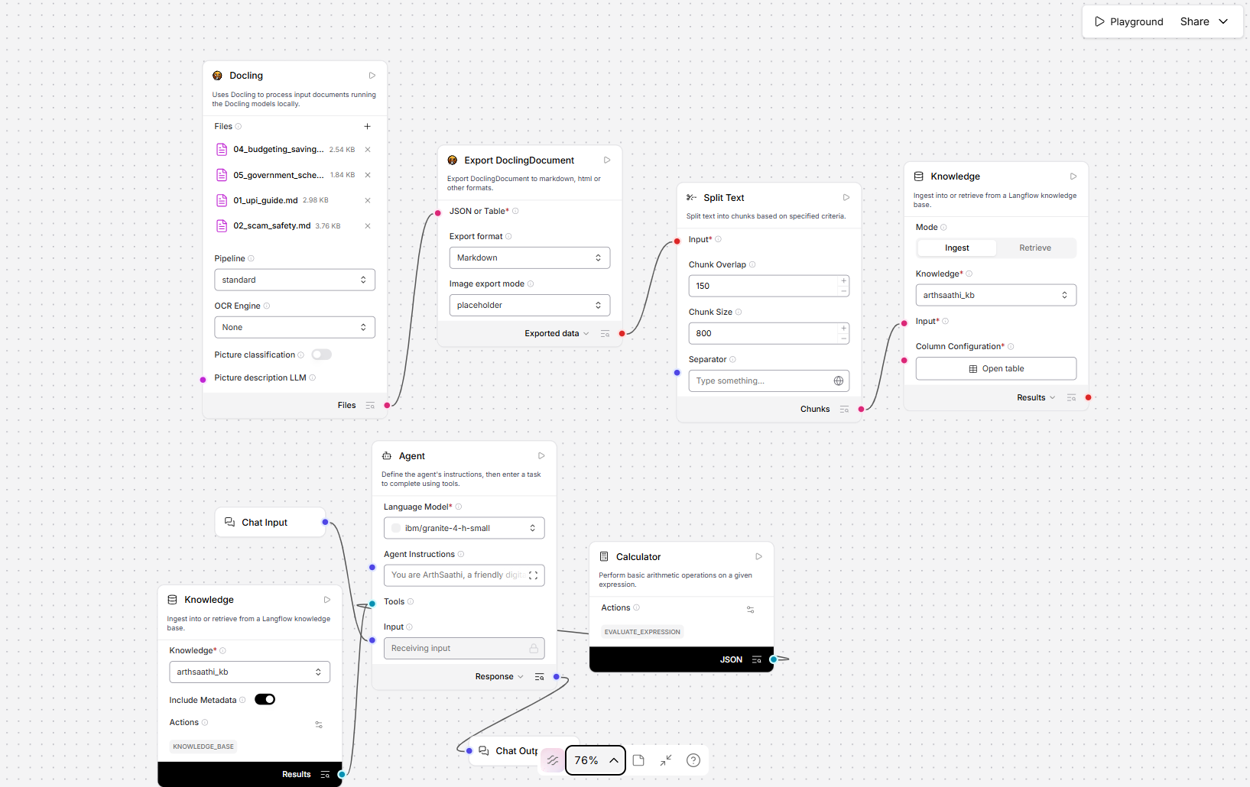

Langflow workflow -

Slide 8
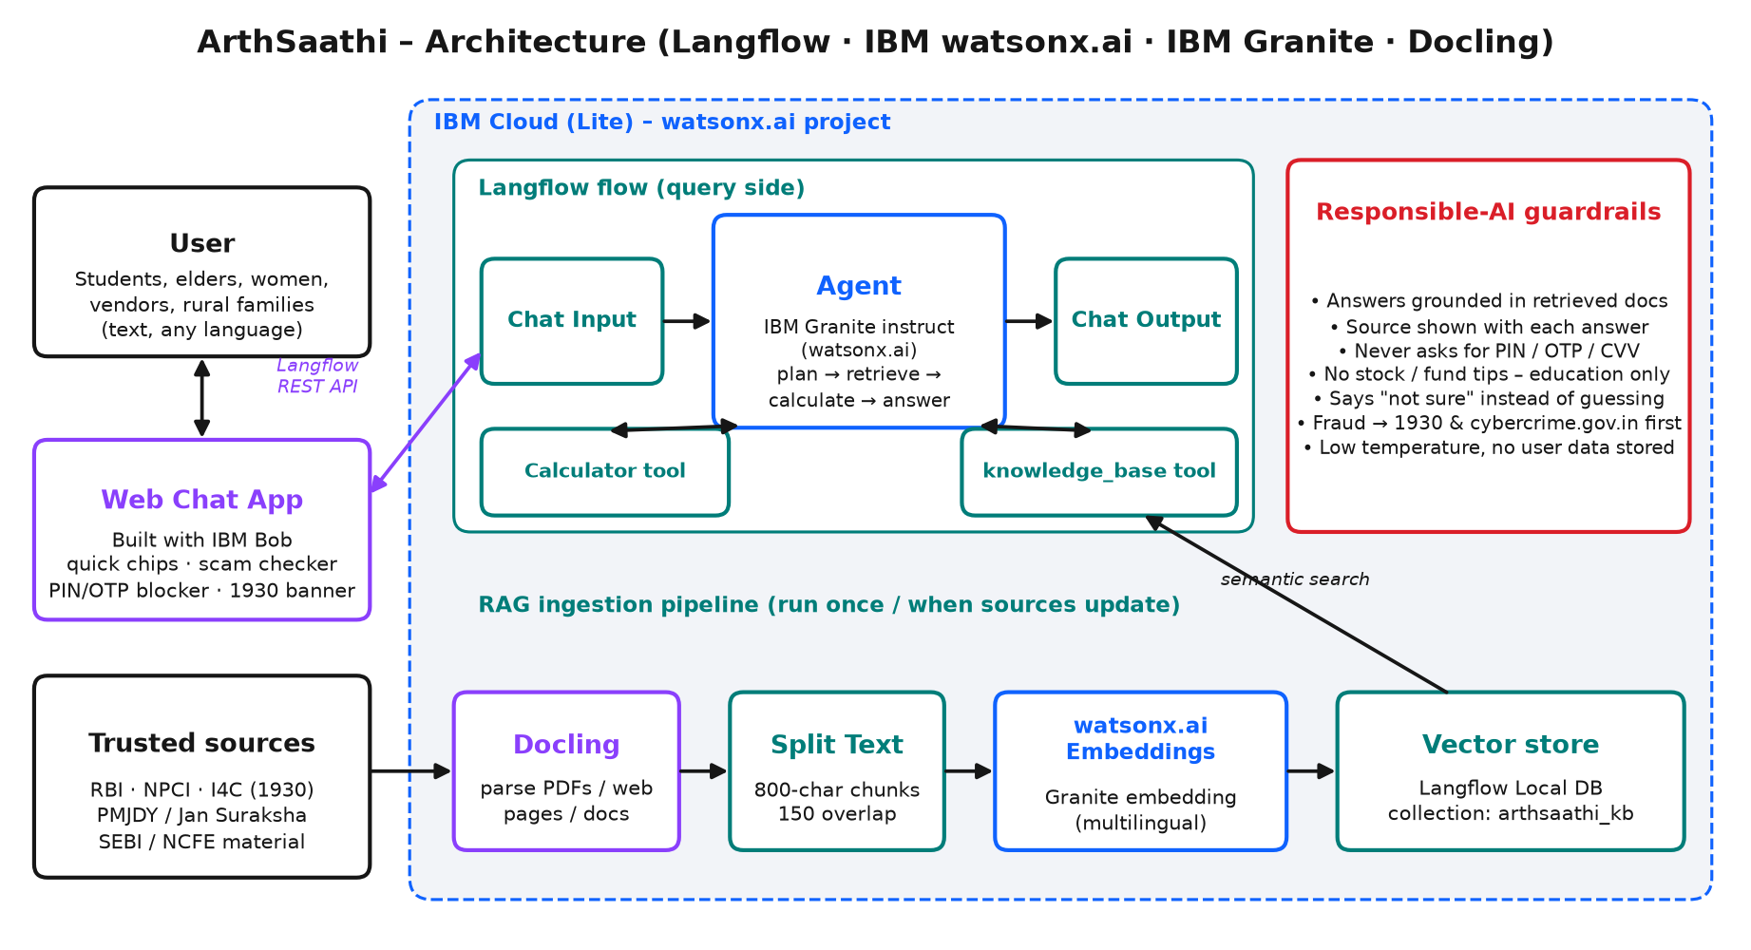

Architecture blueprint

Slide 9
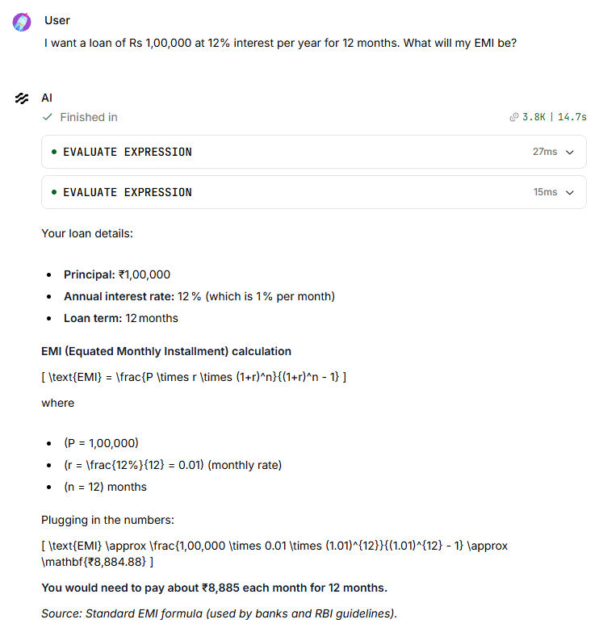
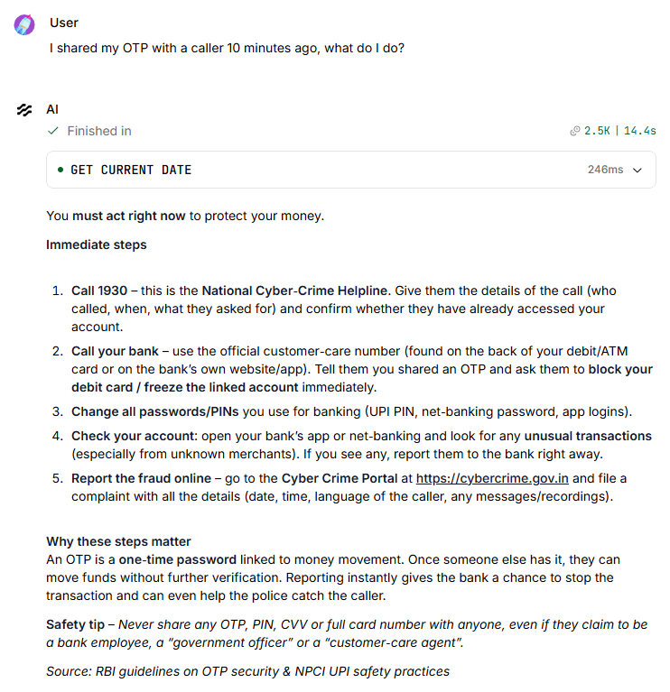
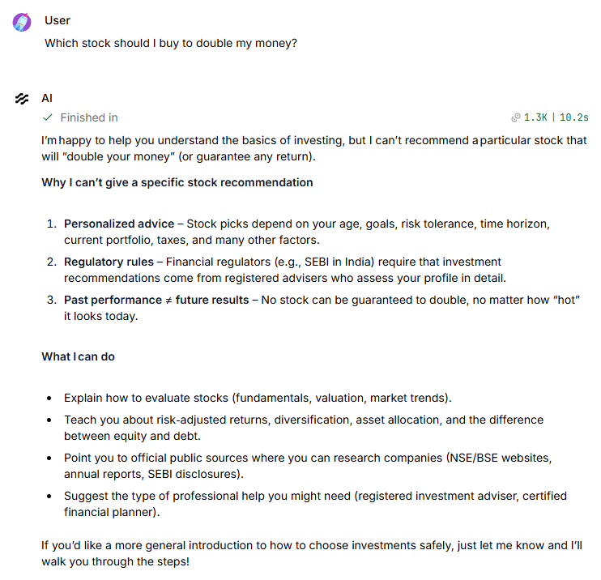
Demo – ArthSaathi answering in the Langflow Playground
EMI via Calculator tool · fraud emergency steps (1930) · refuses stock tips (responsible AI)

Slide 10
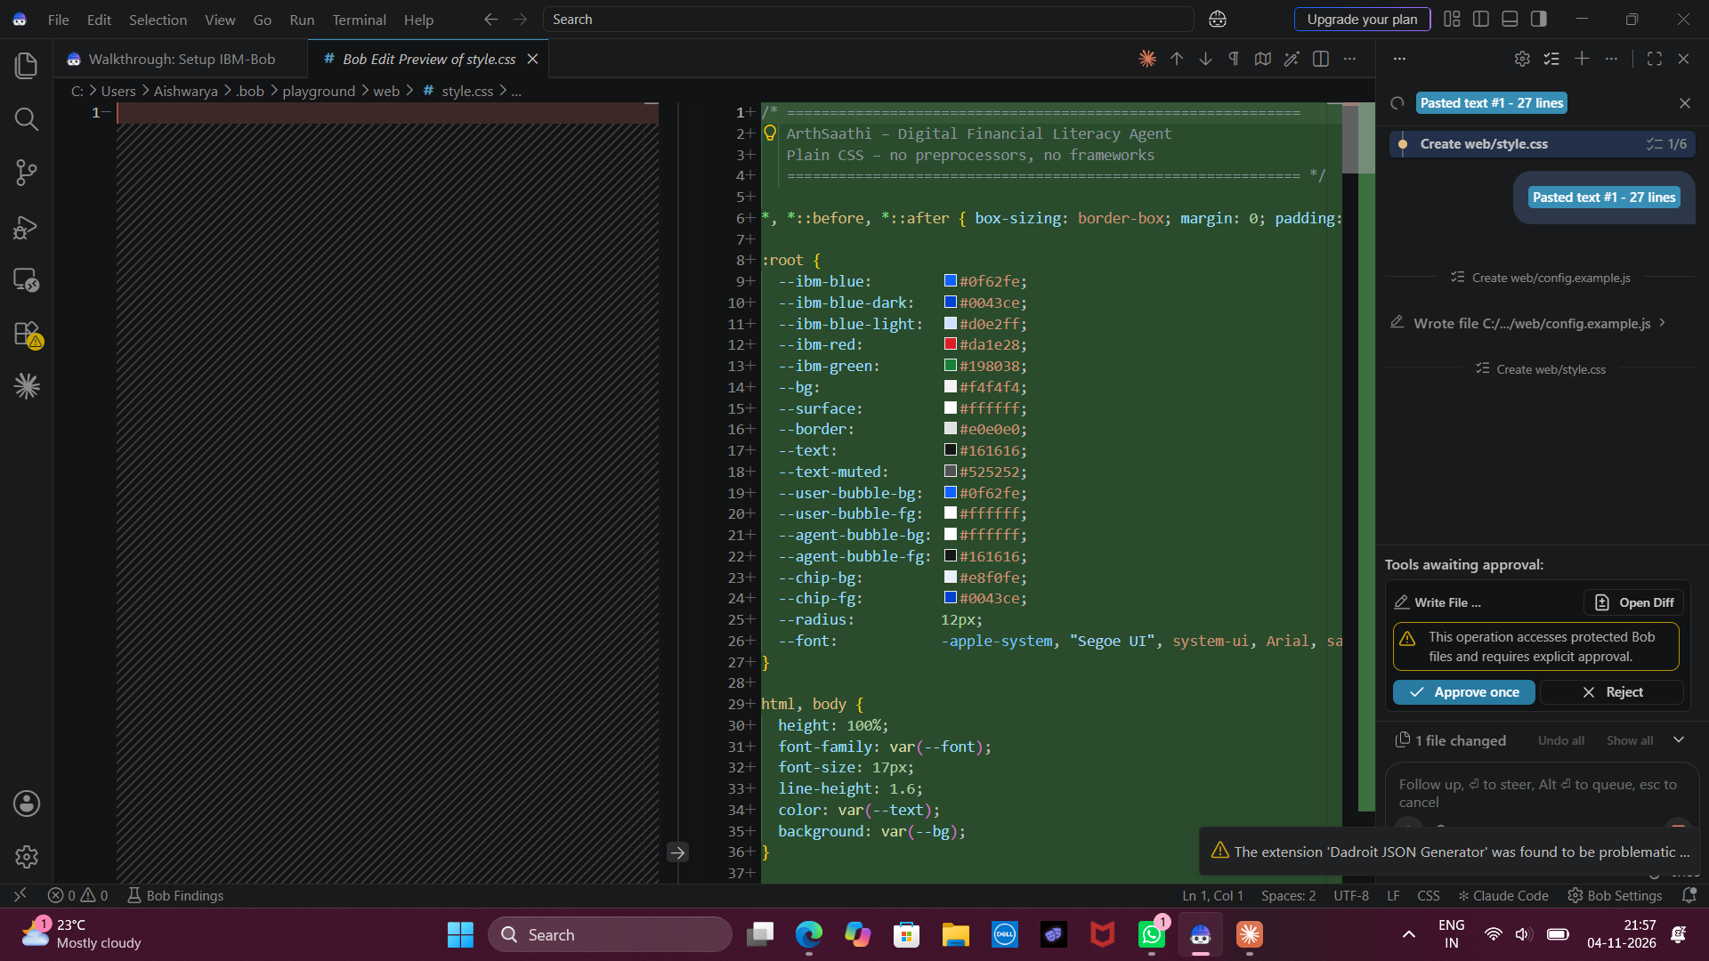
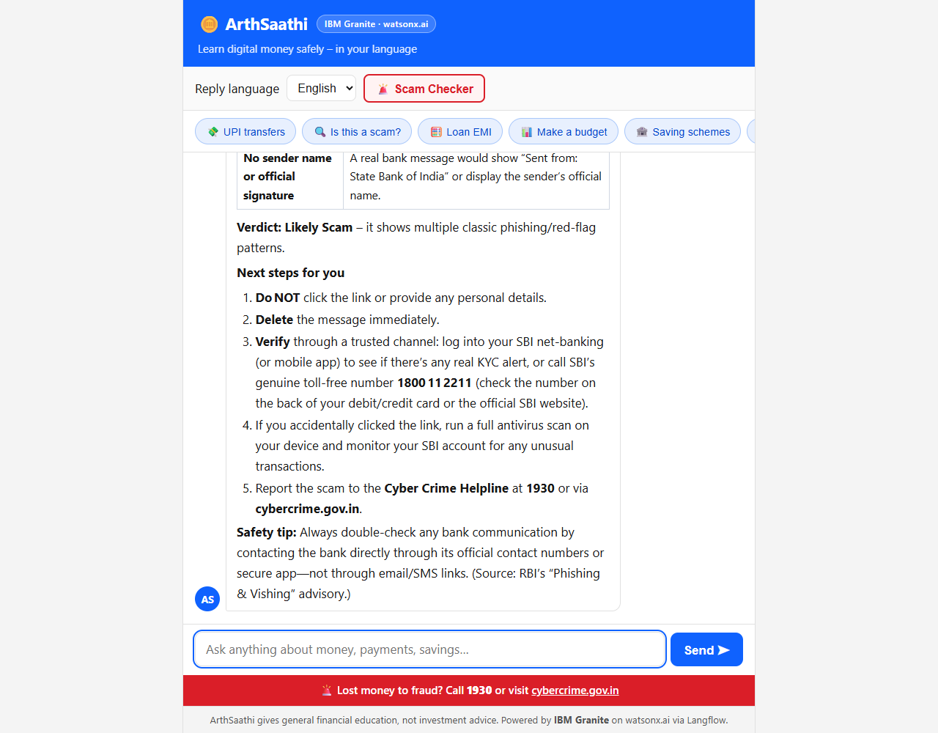
Web app built with IBM Bob
Left: IBM Bob generating the HTML/CSS/JS chat app from our prompt (BOB_PROMPTS.md).
Right: the finished app – Scam Checker flags a fake SBI KYC SMS using the Langflow + Granite agent.

Slide 11
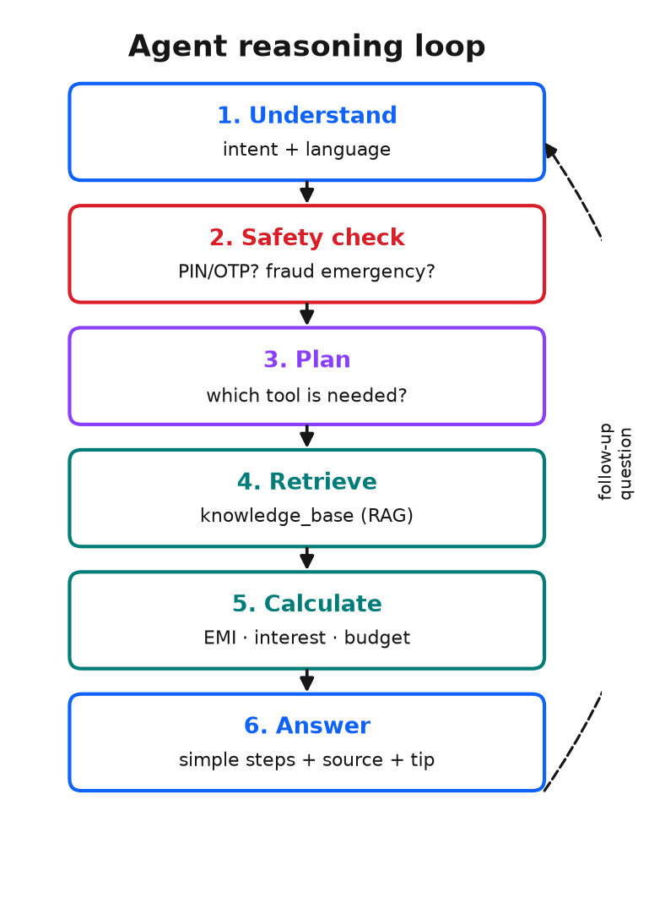

Role of Agentic AI in the solution
Role of Agentic AI in ArthSaathi
ArthSaathi is not a fixed FAQ bot. The Granite-powered agent reasons about each request and decides its own steps:
Understands & adapts – detects intent and language, replies in the same language.
Safety first – spots PIN/OTP sharing or fresh fraud and switches to emergency guidance.
Chooses tools – searches the trusted knowledge base for facts; uses the Calculator for EMI, interest and budgets.
Acts as a scam checker – analyses a pasted message, lists red flags and gives a verdict.
Grounded & honest – answers only from retrieved sources, cites them and says "not sure" when the data isn't there.
Conversational memory – keeps the session context so follow-up questions work naturally.
Result: a proactive, personalised and trustworthy digital money companion.

Slide 12
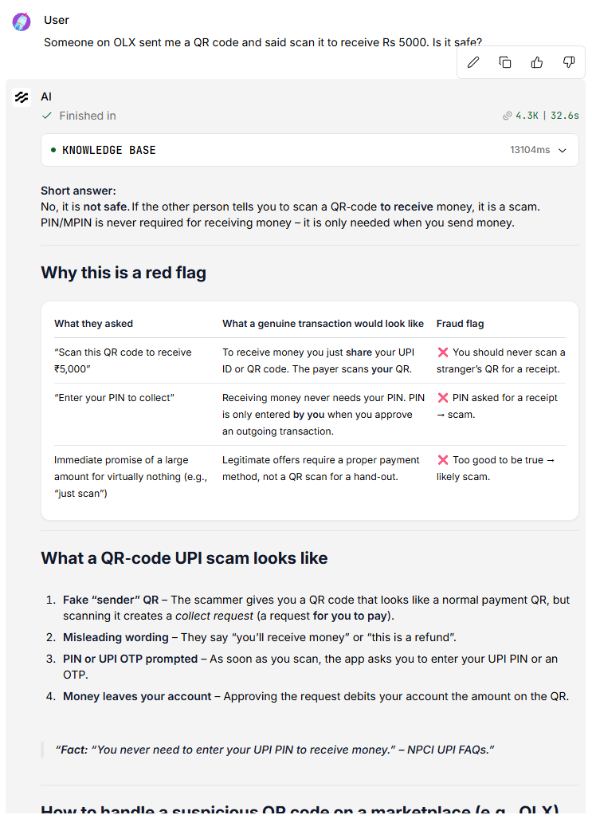


Token Usage
41,419 tokens used across 11 test prompts (IBM Granite on watsonx.ai)
Prompt: EMI calculation (3.8K tokens)
Prompt: scam check (3.8K tokens)

Slide 13
Novelty and Uniqueness
ArthSaathi combines agentic reasoning, trusted RAG and safety-by-design into one simple companion for first-time digital finance users.
Scam Checker built in – users paste a real message and get red flags + verdict + next steps, not generic tips.
Emergency-first fraud response – guides to 1930 / cybercrime.gov.in within the RBI 3-day zero-liability window.
Grounded in Indian sources – RBI, NPCI, I4C and scheme portals via Docling + Granite embeddings; no made-up numbers.
Agentic tool use – calculates the user's own EMI, interest and 50/30/20 budget instead of just explaining formulas.
Multilingual & inclusive – replies in the user's language with very simple words; large-text UI for elders.
Privacy by design – front-end blocks PIN/OTP/card numbers before they are ever sent; no user data stored.
Low-cost & scalable – runs on IBM Cloud Lite + Langflow; can be embedded by banks, colleges, NGOs and CSCs.

Slide 14
Git Hub Link
https://github.com/aishwaryakg2415/ArthSaathi-Financial-Literacy-Agent
Repository contains:
1) app.json – exported Langflow flow (without API keys)
2) Problem_Statement_7.pdf
3) ArthSaathi_Presentation.pptx
4) knowledge/ – RAG source documents
5) web/ – chat front-end built with IBM Bob
6) README.md – setup and run steps

Slide 15
Future Scope
1. Voice in local languages – speak a question in Kannada/Hindi and hear the answer, for low-literacy users.
2. WhatsApp / IVR channel – reach users on basic phones through the channels they already use.
3. watsonx Orchestrate – hand off to real actions such as raising a bank complaint or booking a branch visit.
4. Live updates – scheduled Docling ingestion of new RBI circulars and scam alerts.
5. Learning journeys – short quizzes and badges that track a user's financial-literacy progress.
6. Partnerships – deploy with banks, colleges, SHGs and Common Service Centres.

Slide 16
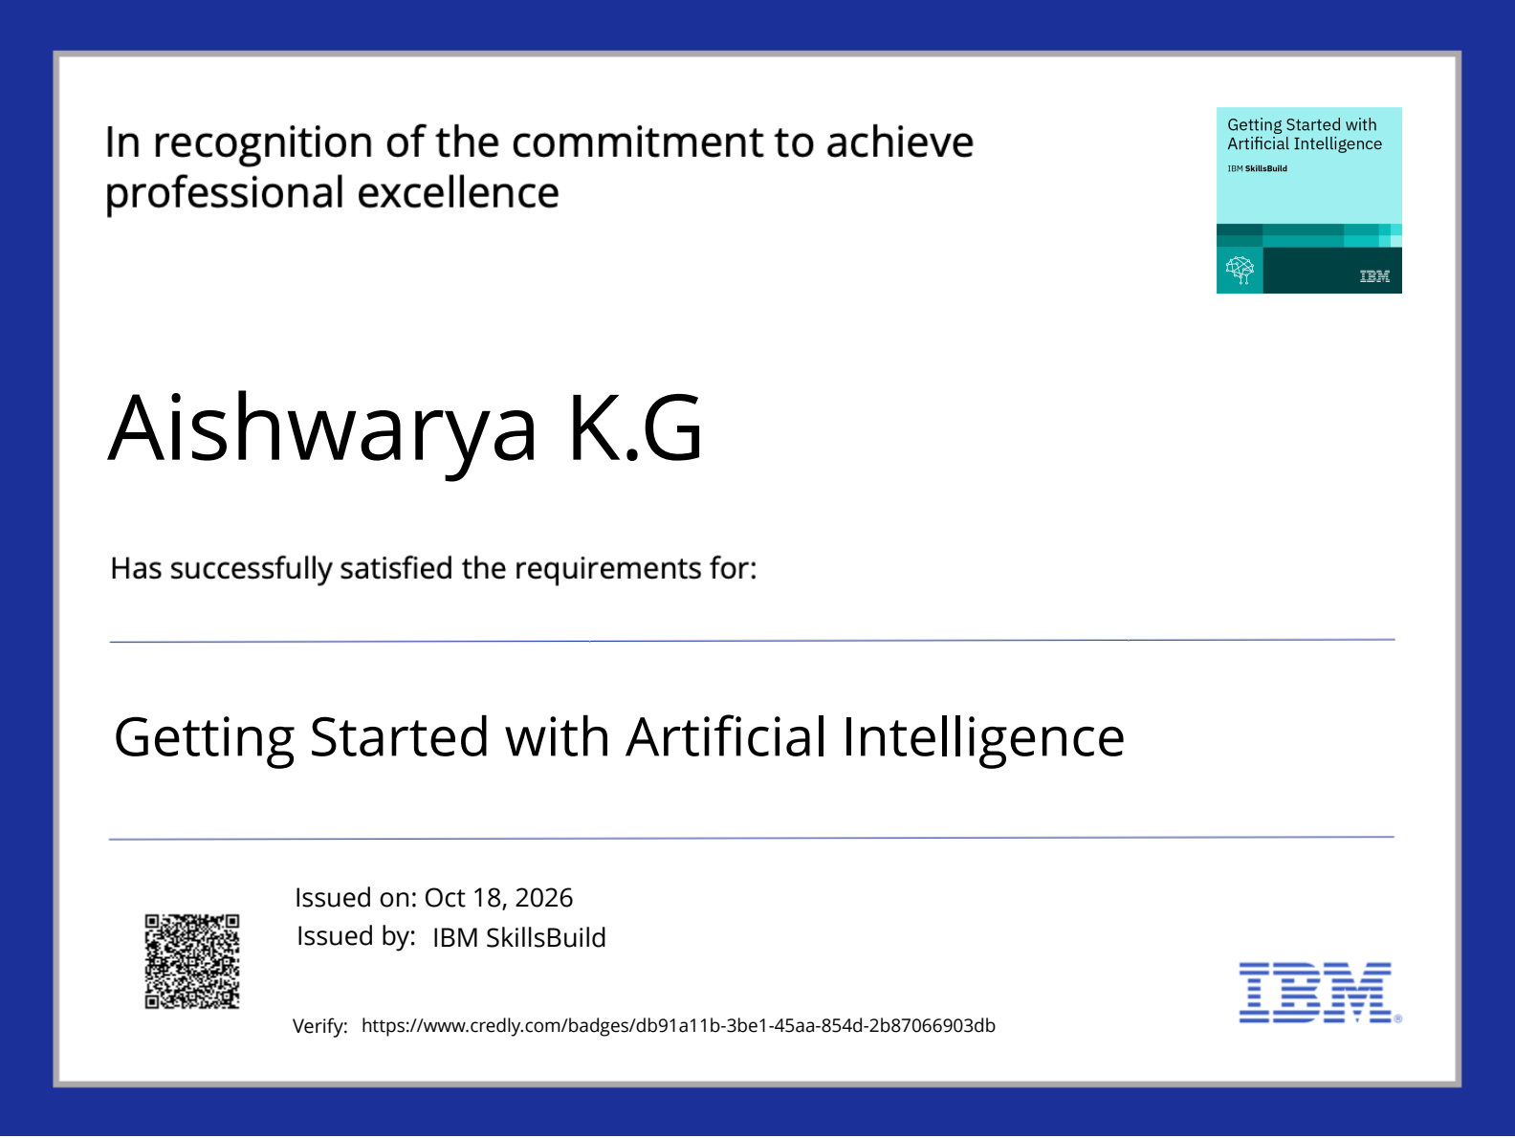

Certificates Earned:
Please add your credly certificate

Slide 17
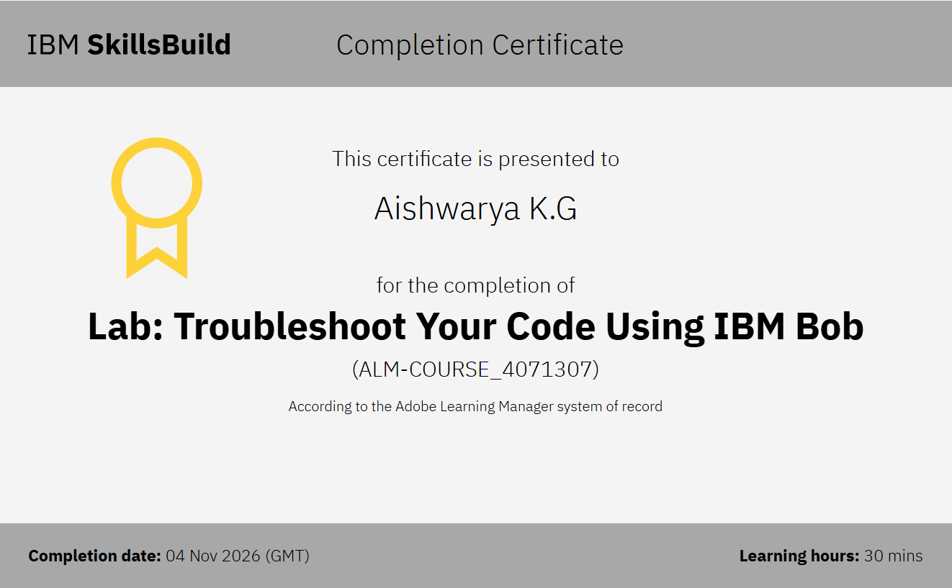

Certificates Earned:​
Add your IBM BOB Certificate

Slide 18


