Slide 1

Basic Details of the Team and Problem Statement
Ministry/Organization Name/Student Innovation:
GOVERNMENT OF GUJARAT
PS Code: 1362
Problem Statement Title:
STUDENT DROPOUT ANALYSIS FOR SCHOOL EDUACTION
Team Name: CODES & BYTES
Team Leader Name: MOKSHITH BALIDI
Institute Code (AISHE):
Institute Name:
CHAITANYA BHARATHI INSTITUTE OF TECHNOLOGY
Theme Name: SMART EDUCATION

Slide 2
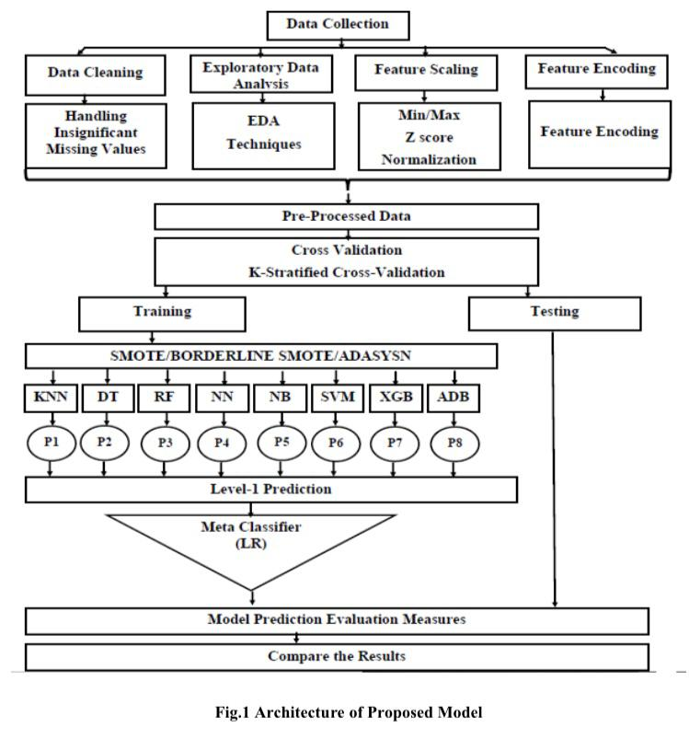

Idea/Approach Details
Project Description Summary:
We're embarking on an exciting project to create a powerful full-stack web application with two primary features:
1.Predictive Insights:
- Users can input student-specific details.
- Our advanced predictive modelling and machine learning techniques will forecast whether a student is likely to graduate successfully or face the risk of dropping out based on historical academic data.
2. Data Analysis at Your Fingertips:
- Users can easily upload comprehensive student datasets.
- The application unlocks the potential for in-depth data analysis, providing precise insights that go beyond traditional methods. You can explore data from various angles, including geographic regions, educational institutions, caste, gender, and states.
SINGLE PAGE APPLICATION (MERN STACK)

Slide 3
Idea/Approach Details
Project Description:
We are embarking on an exciting endeavour to develop a sophisticated full-stack web application with dual capabilities:
1. Predictive Insights:
Empower users to enter student-specific details. Harness the power of advanced predictive modelling and machine learning to forecast whether the individual is likely to graduate successfully or face the challenge of dropout based on historical academic data.
2. Data Analysis at Your Fingertips:
Enable users to effortlessly upload datasets containing comprehensive student information. Unleash the potential of our application to dissect data intricately, delivering precise insights that transcend conventional analysis. Dive into data in the following dimensions:
By Area: Uncover trends and patterns in different geographic regions.
By School: Gain valuable insights tailored to specific educational institutions.
By Caste: Explore the influence of caste on academic outcomes.
By Gender: Investigate gender-based variations in educational achievements.
By State: Access valuable insights and comparisons at the state level.
Describe your Dependencies / Show Stopper here
Dropout analysis, which involves studying and understanding the reasons why students leave or "drop out" of educational programs before completion, is a valuable practice used in various contexts. Here are some key areas where dropout analysis is commonly applied:
1.Education Institutions:
Schools and K-12 Education: Educational institutions use dropout analysis to identify students at risk of leaving school early. This helps them implement intervention strategies to improve student retention rates.
Higher Education: Colleges and universities analyse dropout rates to enhance student success, allocate resources effectively, and develop retention programs.
2.Government and Policy Making:
Education Policy: Governments and policymakers use dropout analysis to shape education policies, allocate funding, and target interventions to reduce dropout rates and improve educational outcomes.
Labor Market Planning: Understanding dropout rates can inform workforce planning and economic development strategies, ensuring an educated and skilled workforce.
.

Slide 4
Team Member Details
Team Leader Name : MOKSHITH BALIDI
Branch : BE Stream : IT Year : II
Team Member 1 Name : Varshith Reddy
Branch : BE Stream : IT Year : II
Team Member 2 Name : Aishwarya Reddy Mamidala
Branch : BE Stream : CSE Year : II
Team Member 3 Name : Vrithika Boggarapu
Branch : BE Stream : IT Year : II
Team Member 4 Name : Kireeti Reddy
Branch : BE Stream : IT Year : II
Team Member 5 Name: Nithin Soma
Branch : BE Stream : IT Year : II
Team Mentor 1 Name: Mr K RAJESH KANNAN, Assistant Professor, Department of IT.
Category : Academic Expertise : Data Science and Programming Paradigms Domain Experience : 5 Years

