Slide 1
TO-DO Android App
- Aishwarya Mallampati

Slide 2
Overview
Features of our TO-DO app
Steps to build the complete app
Step1: Create new Android Studio Project
Step2: Build user interface via layout
Step3: Connect UI elements to logic
Step4: Persistence
Step5: Removing Items
Step6: Editing Items – Edit Activity
MVC Architecture

Slide 3
TO-DO APP FEATURES
DEMO
Display a list with all the to-do items
Add new to-do items to the list
Remove existing to-do items from the list
Modify existing items in the list
The list should be persistent.
Notes:
Lets first understand what all features should be supported by the TO-DO app we are going to build. Explain the features. Lets see how the finished to-do app looks like before we start building it.

Slide 4
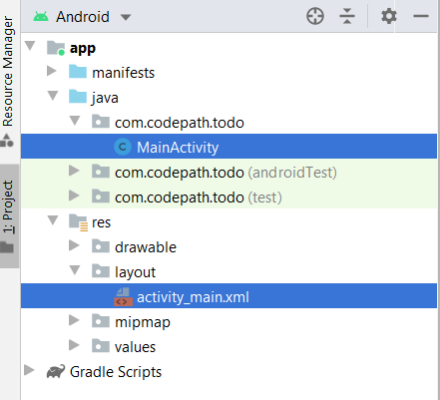
Step1: Create new Android Studio Project
Source code files are placed inside java folder
MainActivity: Place to write functional logic of our project
UI layouts are placed inside res folder
activity_main.xml: Place to design the UI elements of our application
Android Studio Project Structure
Notes:
Lets first understand what all features should be supported by the TO-DO app we are going to build. Explain the features. Lets see how the finished to-do app looks like before we start building it.

Slide 5
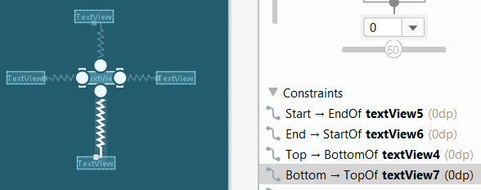
Step2: Build user interface via layout
UI Elements: Buttons, TextView, Image View etc
Layout Types: Linear, Relative, Constraint
We will be using constraint layout to build our UI
Example: TextView with constraints
Notes:
Lets first understand what all features should be supported by the TO-DO app we are going to build. Explain the features. Lets see how the finished to-do app looks like before we start building it.

Slide 6
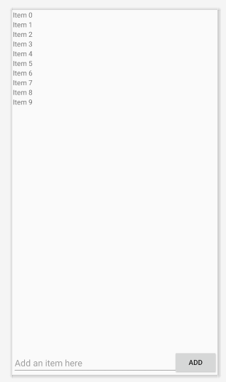
Step2: Build user interface via layout
UI Elements: Buttons, TextView, Image View etc
Layout Types: Linear, Relative, Constraint
We will be using constraint layout throughout this application
We need to add the following things to build our UI:
Place ADD button at the bottom right
Place edit text left to add button at the bottom
Fill the remaining space in the UI with a recycler view placed at the top of edit text
UI Layout
Notes:
Lets first understand what all features should be supported by the TO-DO app we are going to build. Explain the features. Lets see how the finished to-do app looks like before we start building it.

Slide 7

Step3: Connect UI elements to logic
In MainActivity, create variables for each of the UI elements.
Model: Maintain an array list of type string to store all the to-do list items
Notes:
Lets first understand what all features should be supported by the TO-DO app we are going to build. Explain the features. Lets see how the finished to-do app looks like before we start building it.

Slide 8
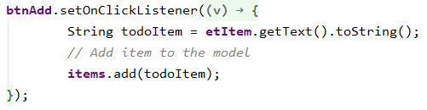
Step3: Connect UI elements to logic
In MainActivity, create variables for each of the UI elements.
Model: Maintain an array list of type string to store all the to-do list items
On clicking add button, add the string in edit text to items
Notes:
Lets first understand what all features should be supported by the TO-DO app we are going to build. Explain the features. Lets see how the finished to-do app looks like before we start building it.

Slide 9
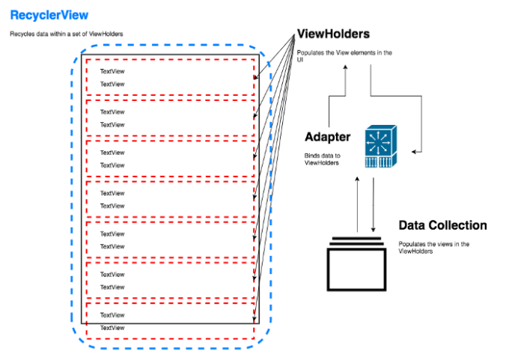

Step3: Connect UI elements to logic
In MainActivity, create variables for each of the UI elements.
Model: Maintain an array list of type string to store all the to-do list items
On clicking add button, add the string in edit text to items
Every RecyclerView requires:
a set of data objects to work with
an adapter to bind that data to the views shown in the ViewHolders
an xml file of the individual view item
a ViewHolder to populate the UI from the xml item file
Notes:
Lets first understand what all features should be supported by the TO-DO app we are going to build. Explain the features. Lets see how the finished to-do app looks like before we start building it.

Slide 10
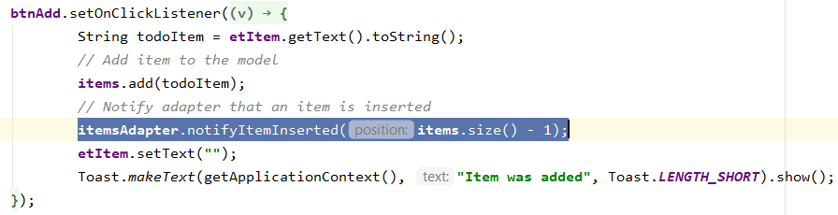
Step3: Connect UI elements to logic
In MainActivity, create variables for each of the UI elements.
Model: Maintain an array list of type string to store all the to-do list items
On clicking add button, add the string in edit text to items
Every RecyclerView requires:
a set of data objects to work with
an adapter to bind that data to the views shown in the ViewHolders
an xml file of the individual view item
a ViewHolder to populate the UI from the xml item file
Notify recycler view adapter that a new to-do item is added to the list
Notes:
Lets first understand what all features should be supported by the TO-DO app we are going to build. Explain the features. Lets see how the finished to-do app looks like before we start building it.

Slide 11
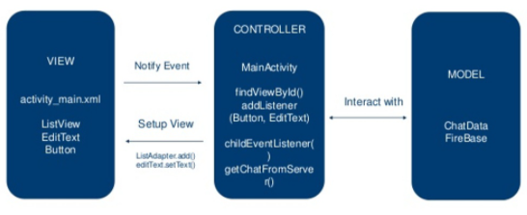
MVC Architecture
Items
Notes:
Lets first understand what all features should be supported by the TO-DO app we are going to build. Explain the features. Lets see how the finished to-do app looks like before we start building it.

Slide 12
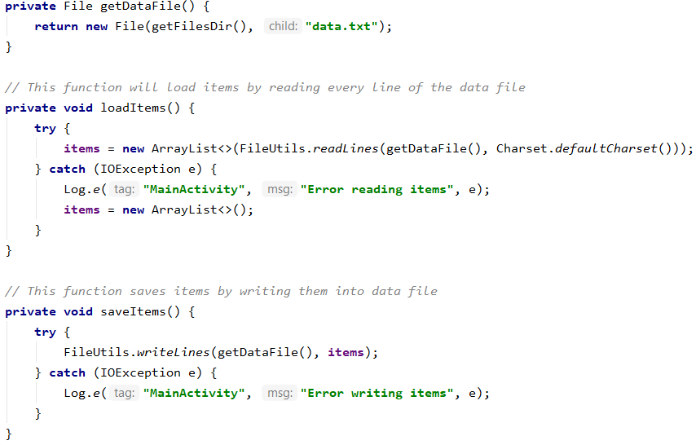
Step4: Persistence
Use Apache Commons IO library to load and store content to files
Create a text file in the app folder
Save to-do list items to the text file whenever user modifies the to-do list(on add, edit, remove)
Load items from text file into the app on startup.
Notes:
Lets first understand what all features should be supported by the TO-DO app we are going to build. Explain the features. Lets see how the finished to-do app looks like before we start building it.

Slide 13
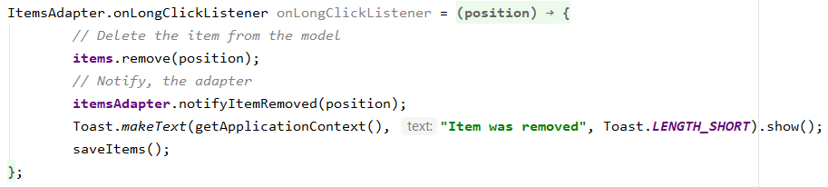
Step5: Removing Items
Remove item from the list on long click.
Notes:
Lets first understand what all features should be supported by the TO-DO app we are going to build. Explain the features. Lets see how the finished to-do app looks like before we start building it.

Slide 14
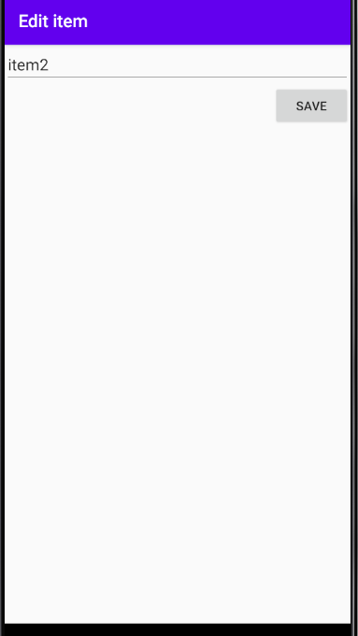
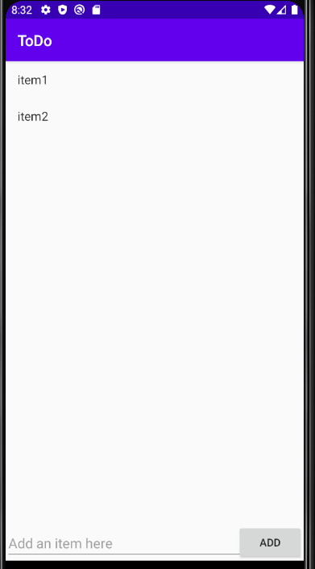
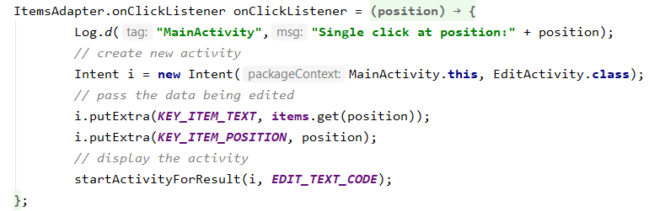
Step6: Editing Items – Edit Activity
Create a new EditActivity to edit items.
MainActivity calls EditActivity when user clicks on an item
Notes:
Lets first understand what all features should be supported by the TO-DO app we are going to build. Explain the features. Lets see how the finished to-do app looks like before we start building it.

Slide 15
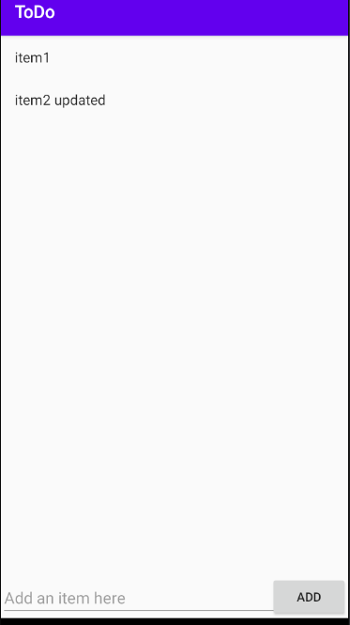
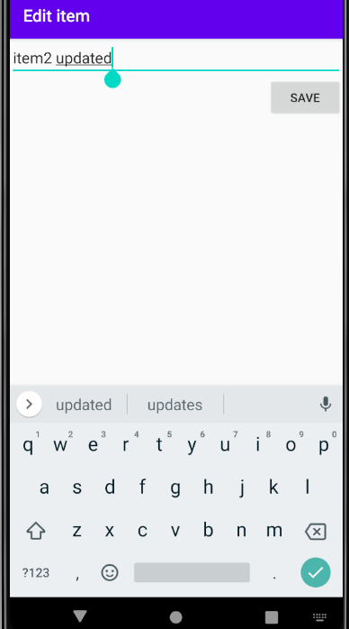
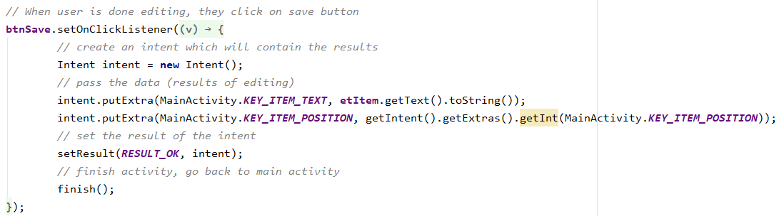
Step6: Editing Items – Edit Activity
Create a new EditActivity to edit items.
MainActivity calls EditActivity when user clicks on an item
EditActivity returns the updated item to MainActivity once user clicks on save button
Notes:
Lets first understand what all features should be supported by the TO-DO app we are going to build. Explain the features. Lets see how the finished to-do app looks like before we start building it.

Slide 16
TO-DO APP
Notes:
Lets first understand what all features should be supported by the TO-DO app we are going to build. Explain the features. Lets see how the finished to-do app looks like before we start building it.

