Slide 1

TradeMaster (Trading App)
Aishwarya Girish Mensinkai
amensink@syr.edu
SUID: 952483319

Slide 2
Introduction
TradeMaster is a versatile and intuitive application designed to support stock trading and cryptocurrencies investment activities.
The platform offers a wide range of tools and features catering to the needs of both individual investors and traders across all experience levels.

Slide 3
Features and Functionality
Real-time Market Data: API list
Advanced Charting Tools: Swift Charts
News and Notifications: News API, Apple push
Security: Firebase
Database: Firebase
Use Face ID to login: Apple
Photo Capture: ImagePicker
Scanning Document: Apple's Vision framework (VNDocumentCameraViewController)
Adding funds to wallet: Apple Pay
Trade Execution: Store in database
Themes: Light/Dark
Portfolio Management

Slide 4
Available API’s
There are many APIs that can be used to get data for free
Coingecko api: https://www.coingecko.com/en/api
Finn hub Stock api: https://finnhub.io/
News api: https://newsapi.org/
Alpha vantage: https://www.alphavantage.co/

Slide 5
Competitive Analysis
Competitors: Robinhood, ETRADE, Fidelity
Differentiation: Advanced charting tools, customizable watchlists, user-friendly interface, Integration of Apple Pay to add funds, Biometric Authentication.

Slide 6
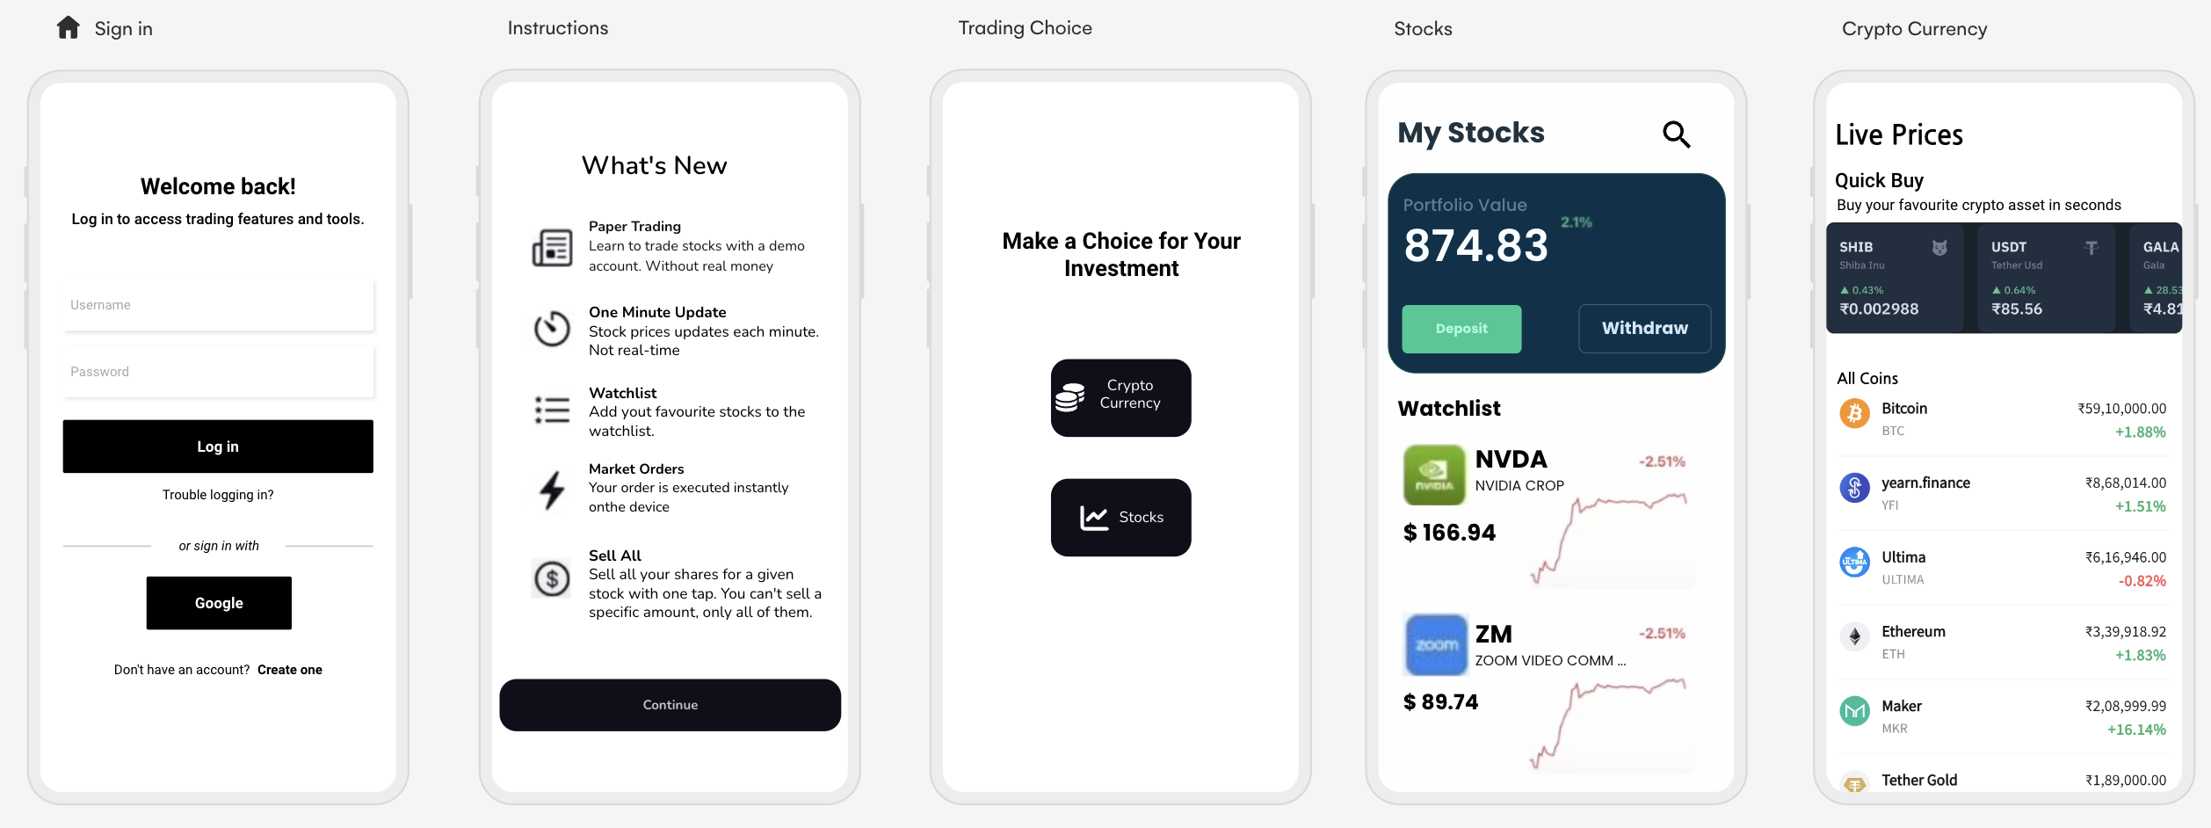
Old Design’s

Slide 7
New Design’s
Figma Design

Slide 8
Conclusion
TradeMaster aims to revolutionize the trading experience by providing a comprehensive platform tailored to the needs of users at all levels of expertise.

