Slide 1

Share riddle for 10 year old
5 Riddles for a 10-Year-Old
What has hands but cannot clap? ⏰
What gets wetter the more it dries? 🧻
The more you take away from me, the bigger I become. What am I? 🕳️
What has many teeth but cannot bite? 🪮
What belongs to you, but other people use it more than you do? 🤔
What gets wetter and wetter the more it dries? Answer: A towel.
I have a face and two hands, but no arms or legs. What am I? Answer: A clock.
What has to be broken before you can use it? Answer: An egg.
The more of this there is, the less you see. What is it? Answer: Darkness.
I’m tall when I’m young, and I’m short when I’m old. What am I? Answer: A candle.

Slide 2
5 Riddles for 10 year old
Chatgpt
Share riddle for 10 year old
5 Riddles for a 10-Year-Old
What has hands but cannot clap? ⏰
What gets wetter the more it dries? 🧻
The more you take away from me, the bigger I become. What am I? 🕳️
What has many teeth but cannot bite? 🪮
What belongs to you, but other people use it more than you do? 🤔
What gets wetter and wetter the more it dries? Answer: A towel.
I have a face and two hands, but no arms or legs. What am I? Answer: A clock.
What has to be broken before you can use it? Answer: An egg.
The more of this there is, the less you see. What is it? Answer: Darkness.
I’m tall when I’m young, and I’m short when I’m old. What am I? Answer: A candle.

Slide 3
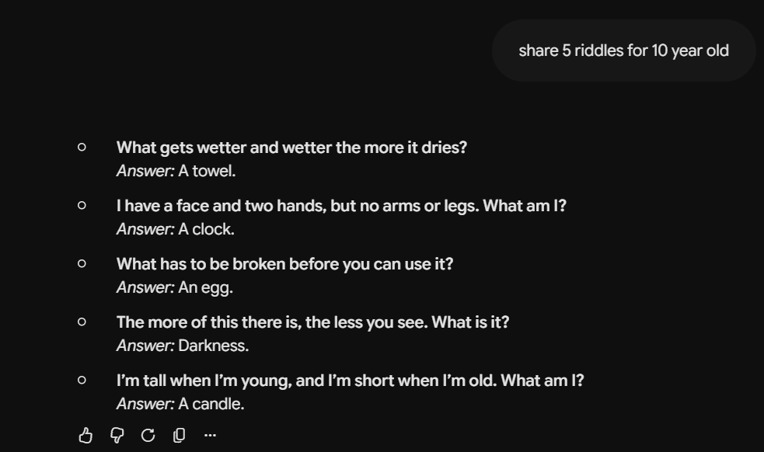
Gemini
Share riddle for 10 year old
What gets wetter and wetter the more it dries? Answer: A towel.
I have a face and two hands, but no arms or legs. What am I? Answer: A clock.
What has to be broken before you can use it? Answer: An egg.
The more of this there is, the less you see. What is it? Answer: Darkness.
I’m tall when I’m young, and I’m short when I’m old. What am I? Answer: A candle.

Slide 4
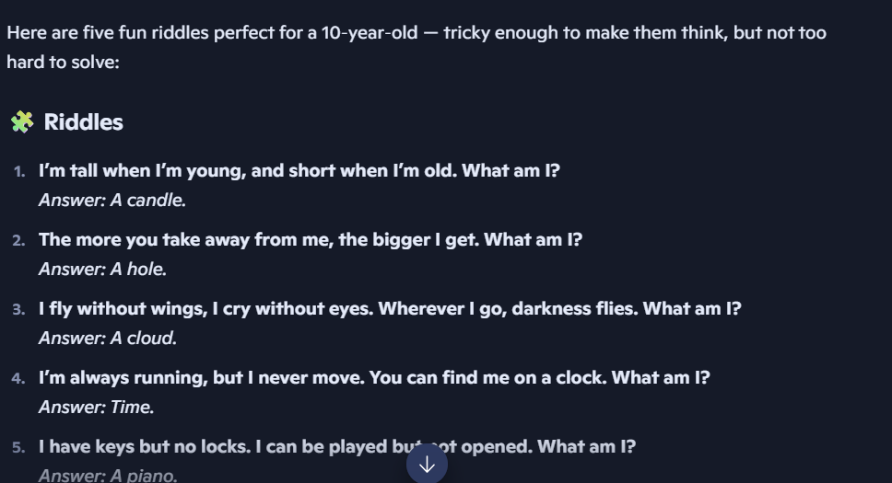
Copilot

Slide 5
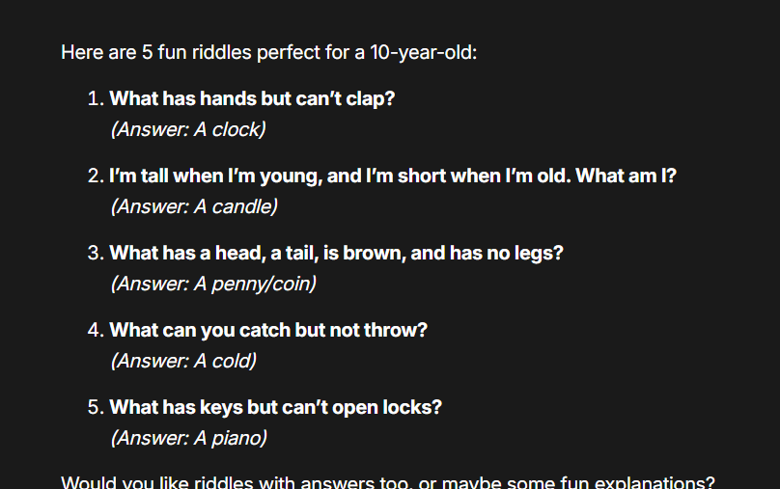
Claude

