Slide 1
DATA MINING
Introductory and Advanced Topics
Part II
Margaret H. Dunham
Department of Computer Science and Engineering
Southern Methodist University
Companion slides for the text by Dr. M.H.Dunham, Data Mining, Introductory and Advanced Topics, Prentice Hall, 2002.

Slide 2
Data Mining Outline
PART I
  Introduction
  Related Concepts
  Data Mining Techniques
PART II
  Classification
  Clustering
  Association Rules
PART III
  Web Mining
  Spatial Mining
  Temporal Mining

Slide 3
Classification Outline
Goal: Provide an overview of the classification problem and introduce some of the basic algorithms
Classification Problem Overview
Classification Techniques
  Regression
  Distance
  Decision Trees
  Rules
  Neural Networks

Slide 4
Classification Problem
Given a database D={t₁,t₂,…,t_{n}} and a set of classes C={C₁,…,C_{m}}, the Classification Problem is to define a mapping f:DC where each t_{i} is assigned to one class.
Actually divides D into equivalence classes.
Prediction is similar, but may be viewed as having infinite number of classes.

Slide 5
Classification Examples
Teachers classify students’ grades as A, B, C, D, or F.
Identify mushrooms as poisonous or edible.
Predict when a river will flood.
Identify individuals with credit risks.
Speech recognition
Pattern recognition

Slide 6
Classification Ex: Grading
x
If x >= 90 then grade =A.
If 80<=x<90 then grade =B.
If 70<=x<80 then grade =C.
If 60<=x<70 then grade =D.
If x<50 then grade =F.
<90
>=90
x
A
<80
>=80
x
B
<70
>=70
x
C
<50
>=60
F
D

Slide 7
Classification Ex: Letter Recognition
View letters as constructed from 5 components:
Letter A
Letter B
Letter C
Letter D
Letter E
Letter F

Slide 8
Classification Techniques
Approach:
  Create specific model by evaluating training data (or using domain experts’ knowledge).
  Apply model developed to new data.
Classes must be predefined
Most common techniques use DTs, NNs, or are based on distances or statistical methods.

Slide 9
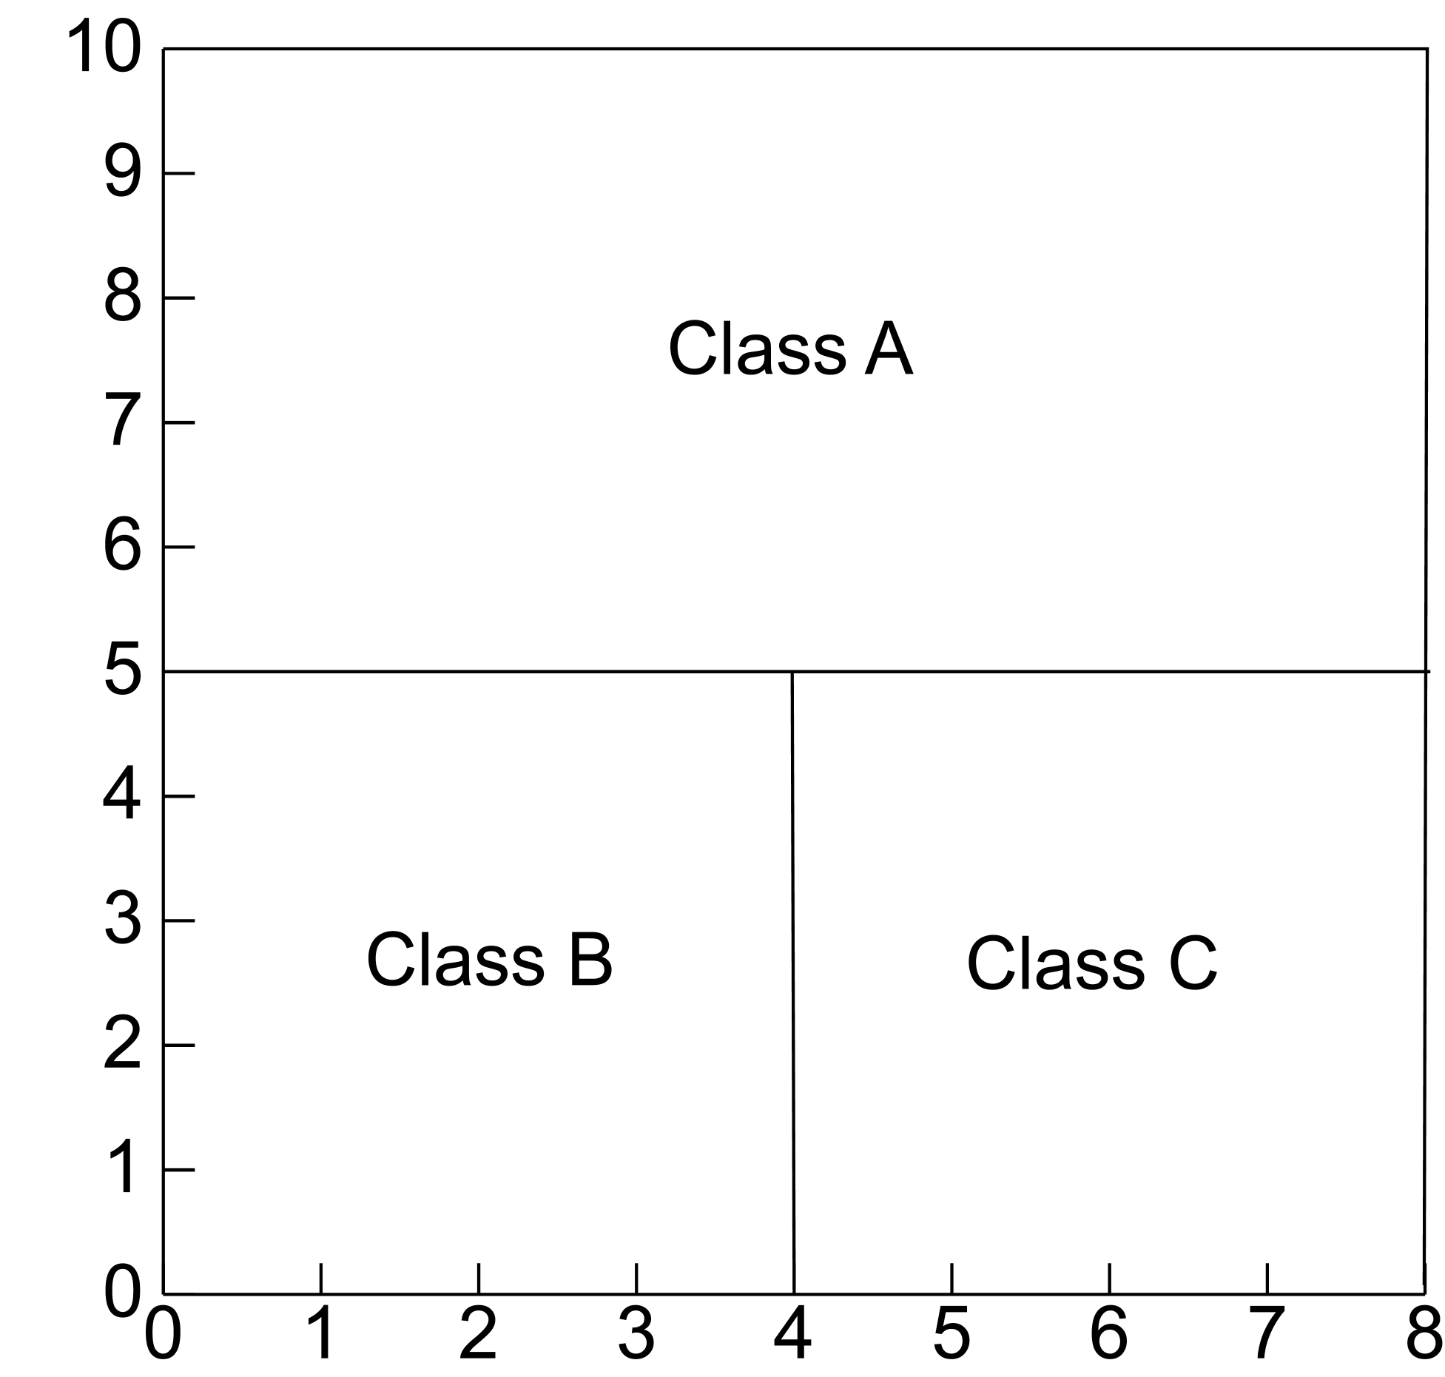
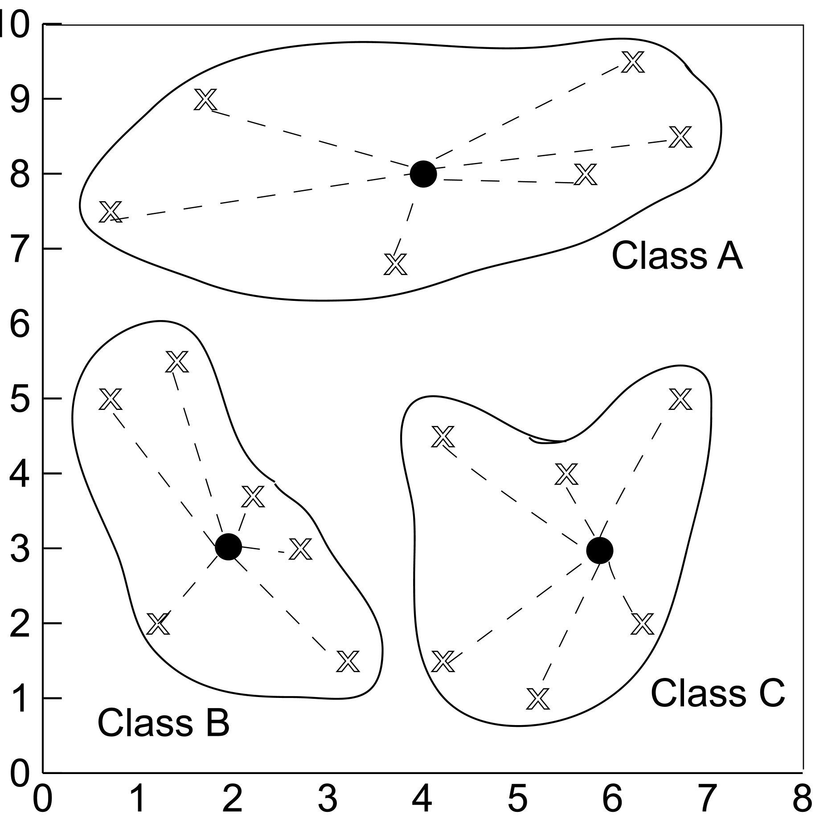
Defining Classes
Distance Based
Partitioning Based

Slide 10
Issues in Classification
Missing Data
  Ignore
  Replace with assumed value
Measuring Performance
  Classification accuracy on test data
  Confusion matrix
  OC Curve

Slide 11
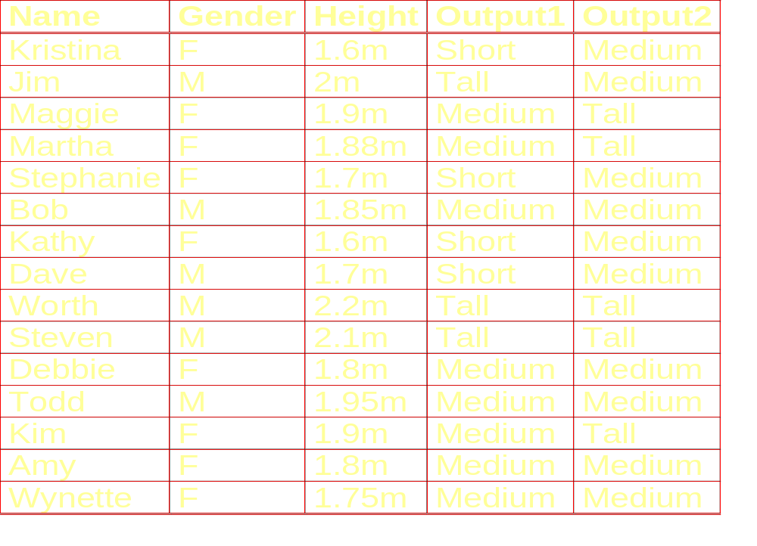
Height Example Data

Slide 12
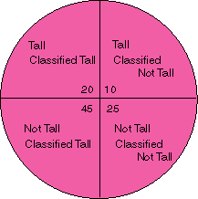
Classification Performance
True Positive
False Negative
False Positive
True Negative

Slide 13
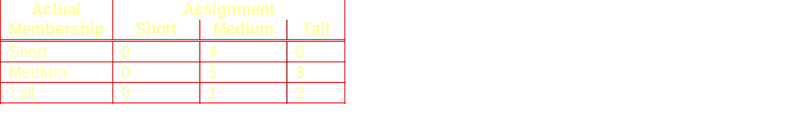
Confusion Matrix Example
Using height data example with Output1 correct and Output2 actual assignment

Slide 14
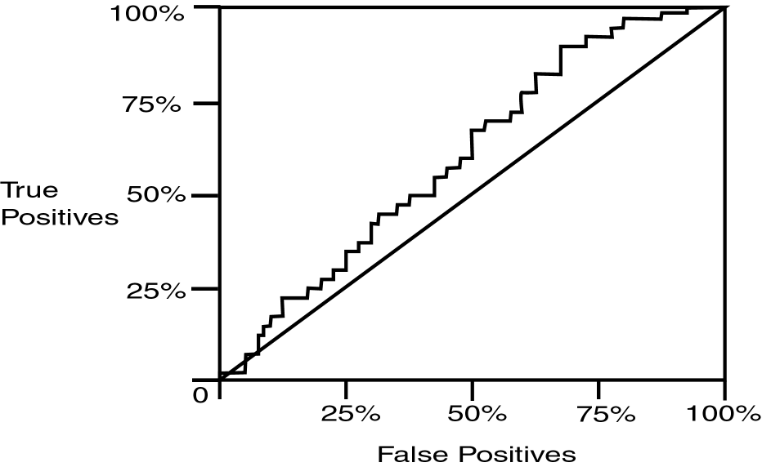
Operating Characteristic Curve

Slide 15
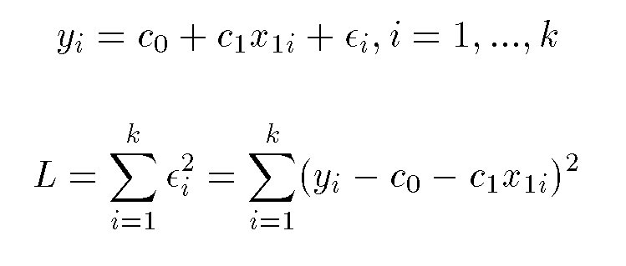
Regression
Assume data fits a predefined function
Determine best values for regression coefficients c₀,c₁,…,c_{n}.
Assume an error: y = c₀+c₁x₁+…+c_{n}x_{n}+ε
Estimate error using mean squared error for training set:

Slide 16
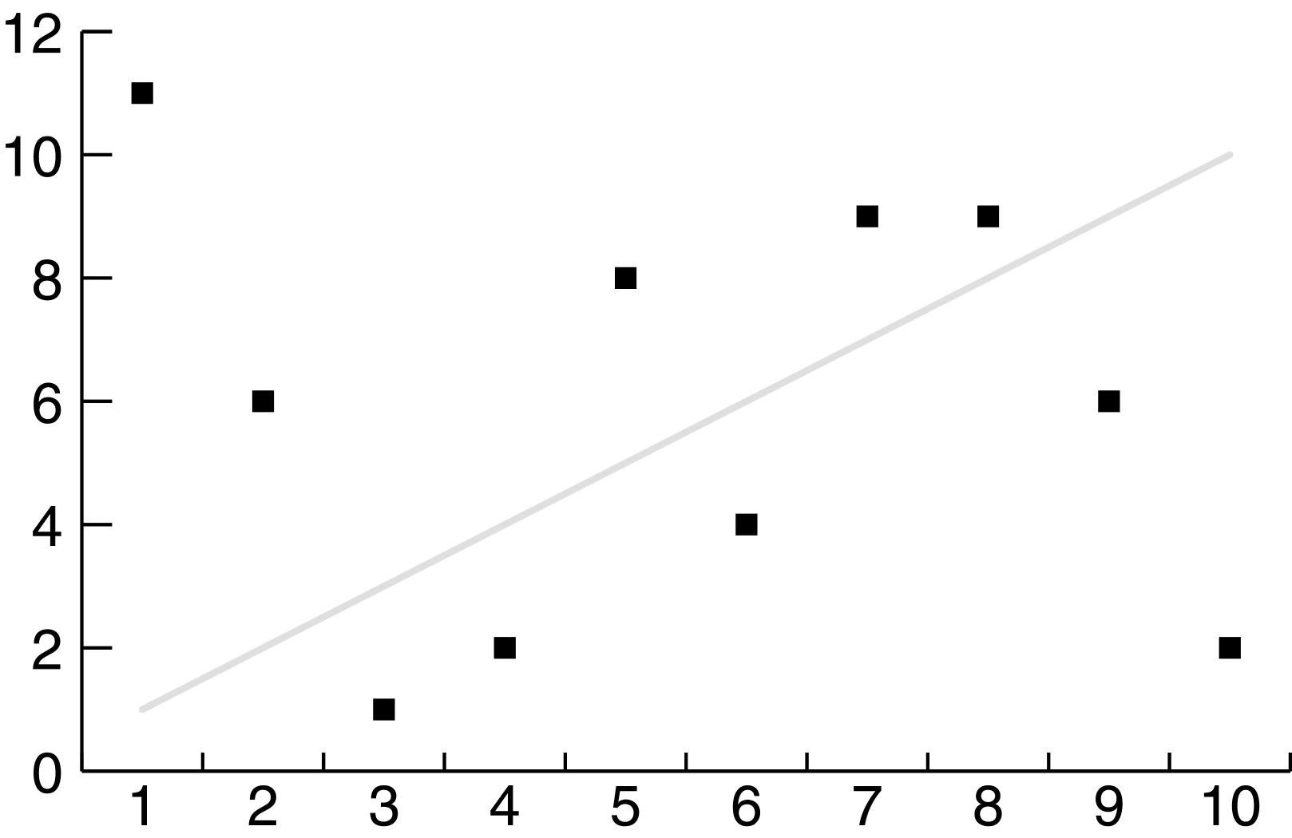
Linear Regression Poor Fit

Slide 17
Classification Using Regression
Division: Use regression function to divide area into regions.
Prediction: Use regression function to predict a class membership function. Input includes desired class.

Slide 18
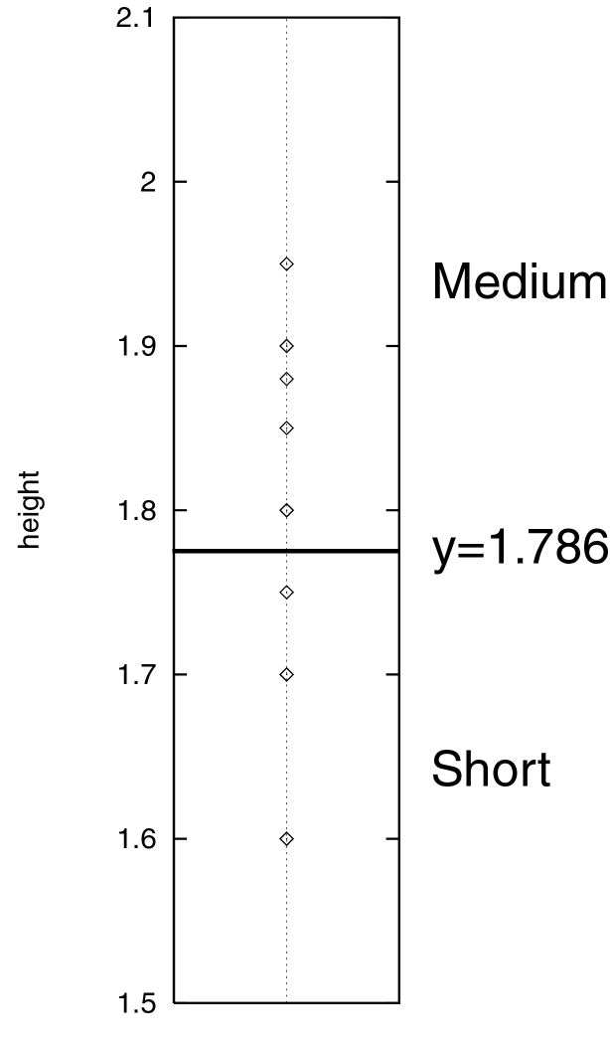
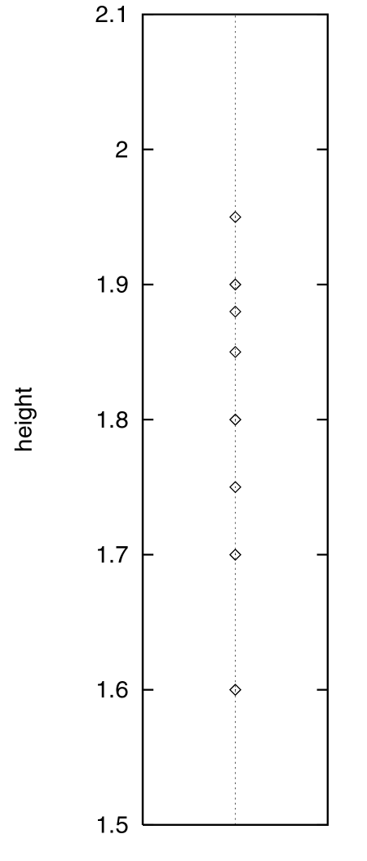
Division

Slide 19
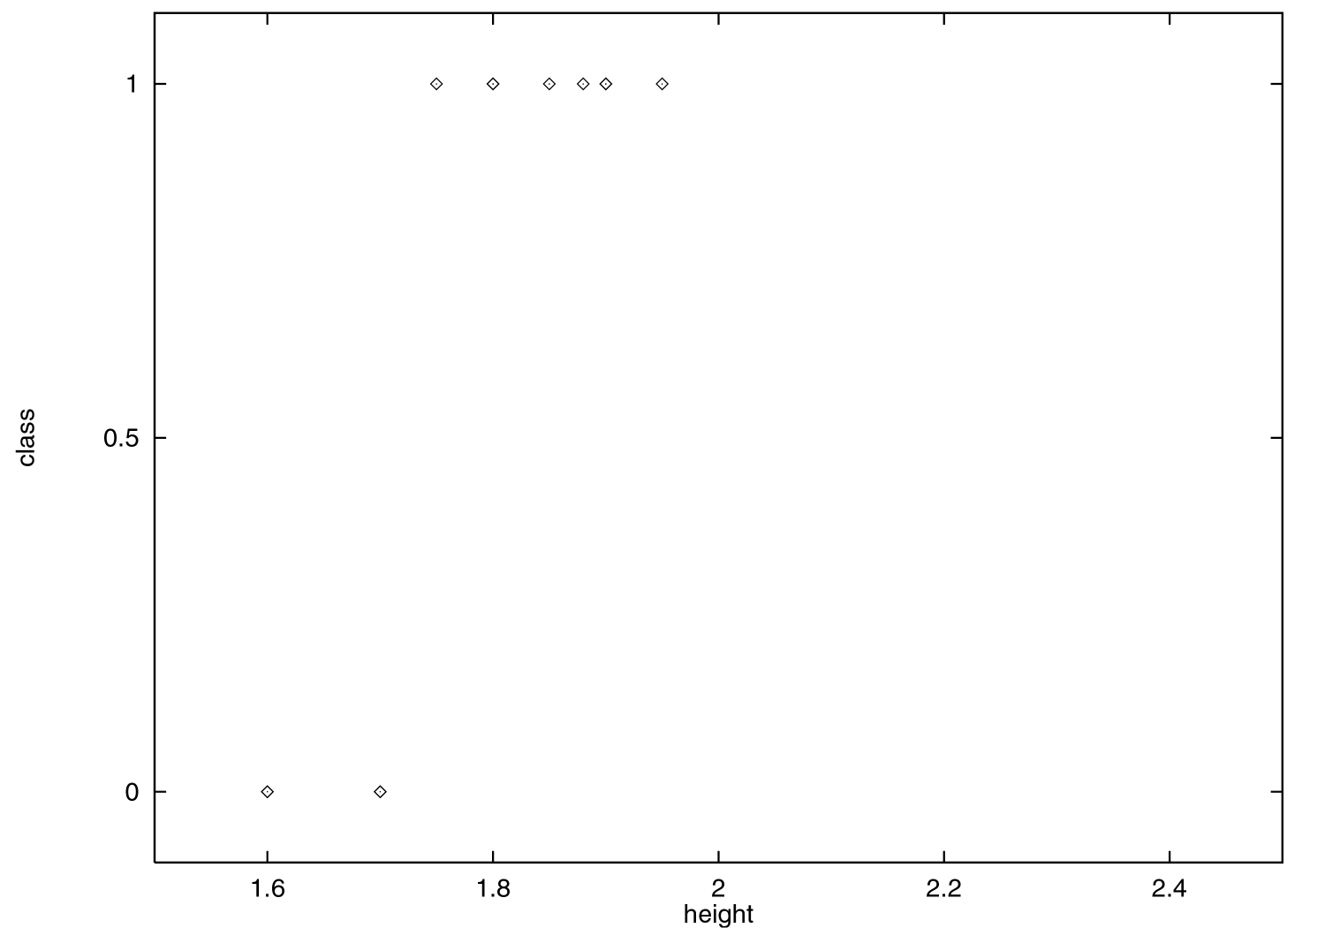
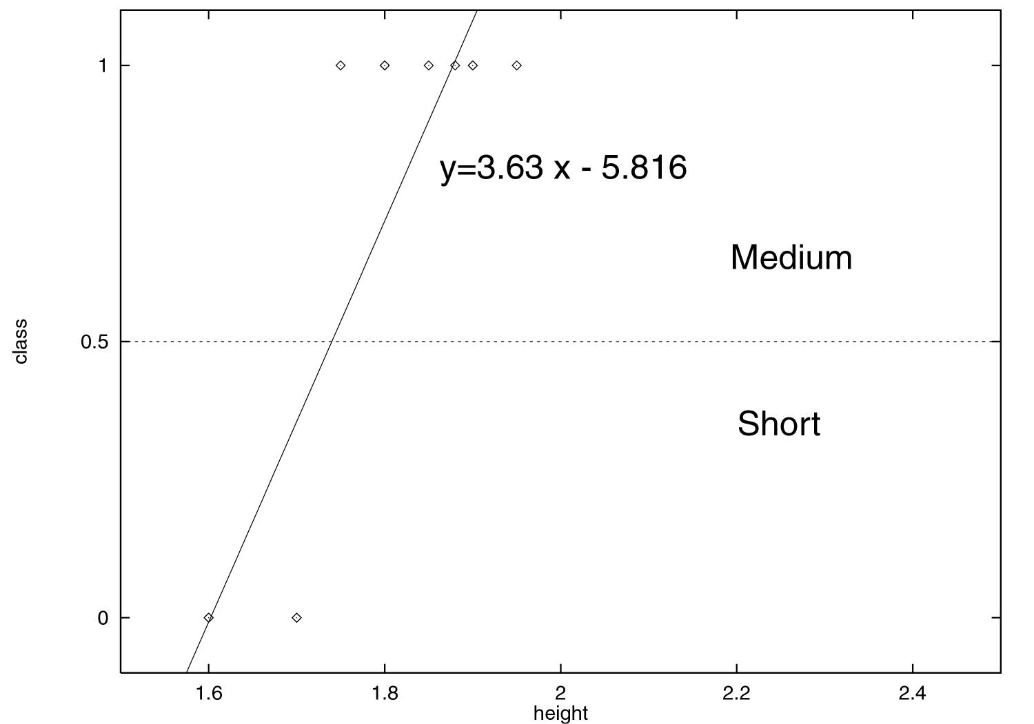
Prediction

Slide 20
Classification Using Distance
Place items in class to which they are “closest”.
Must determine distance between an item and a class.
Classes represented by
  Centroid: Central value.
  Medoid: Representative point.
  Individual points
Algorithm: KNN

Slide 21
K Nearest Neighbor (KNN):
Training set includes classes.
Examine K items near item to be classified.
New item placed in class with the most number of close items.
O(q) for each tuple to be classified. (Here q is the size of the training set.)

Slide 22
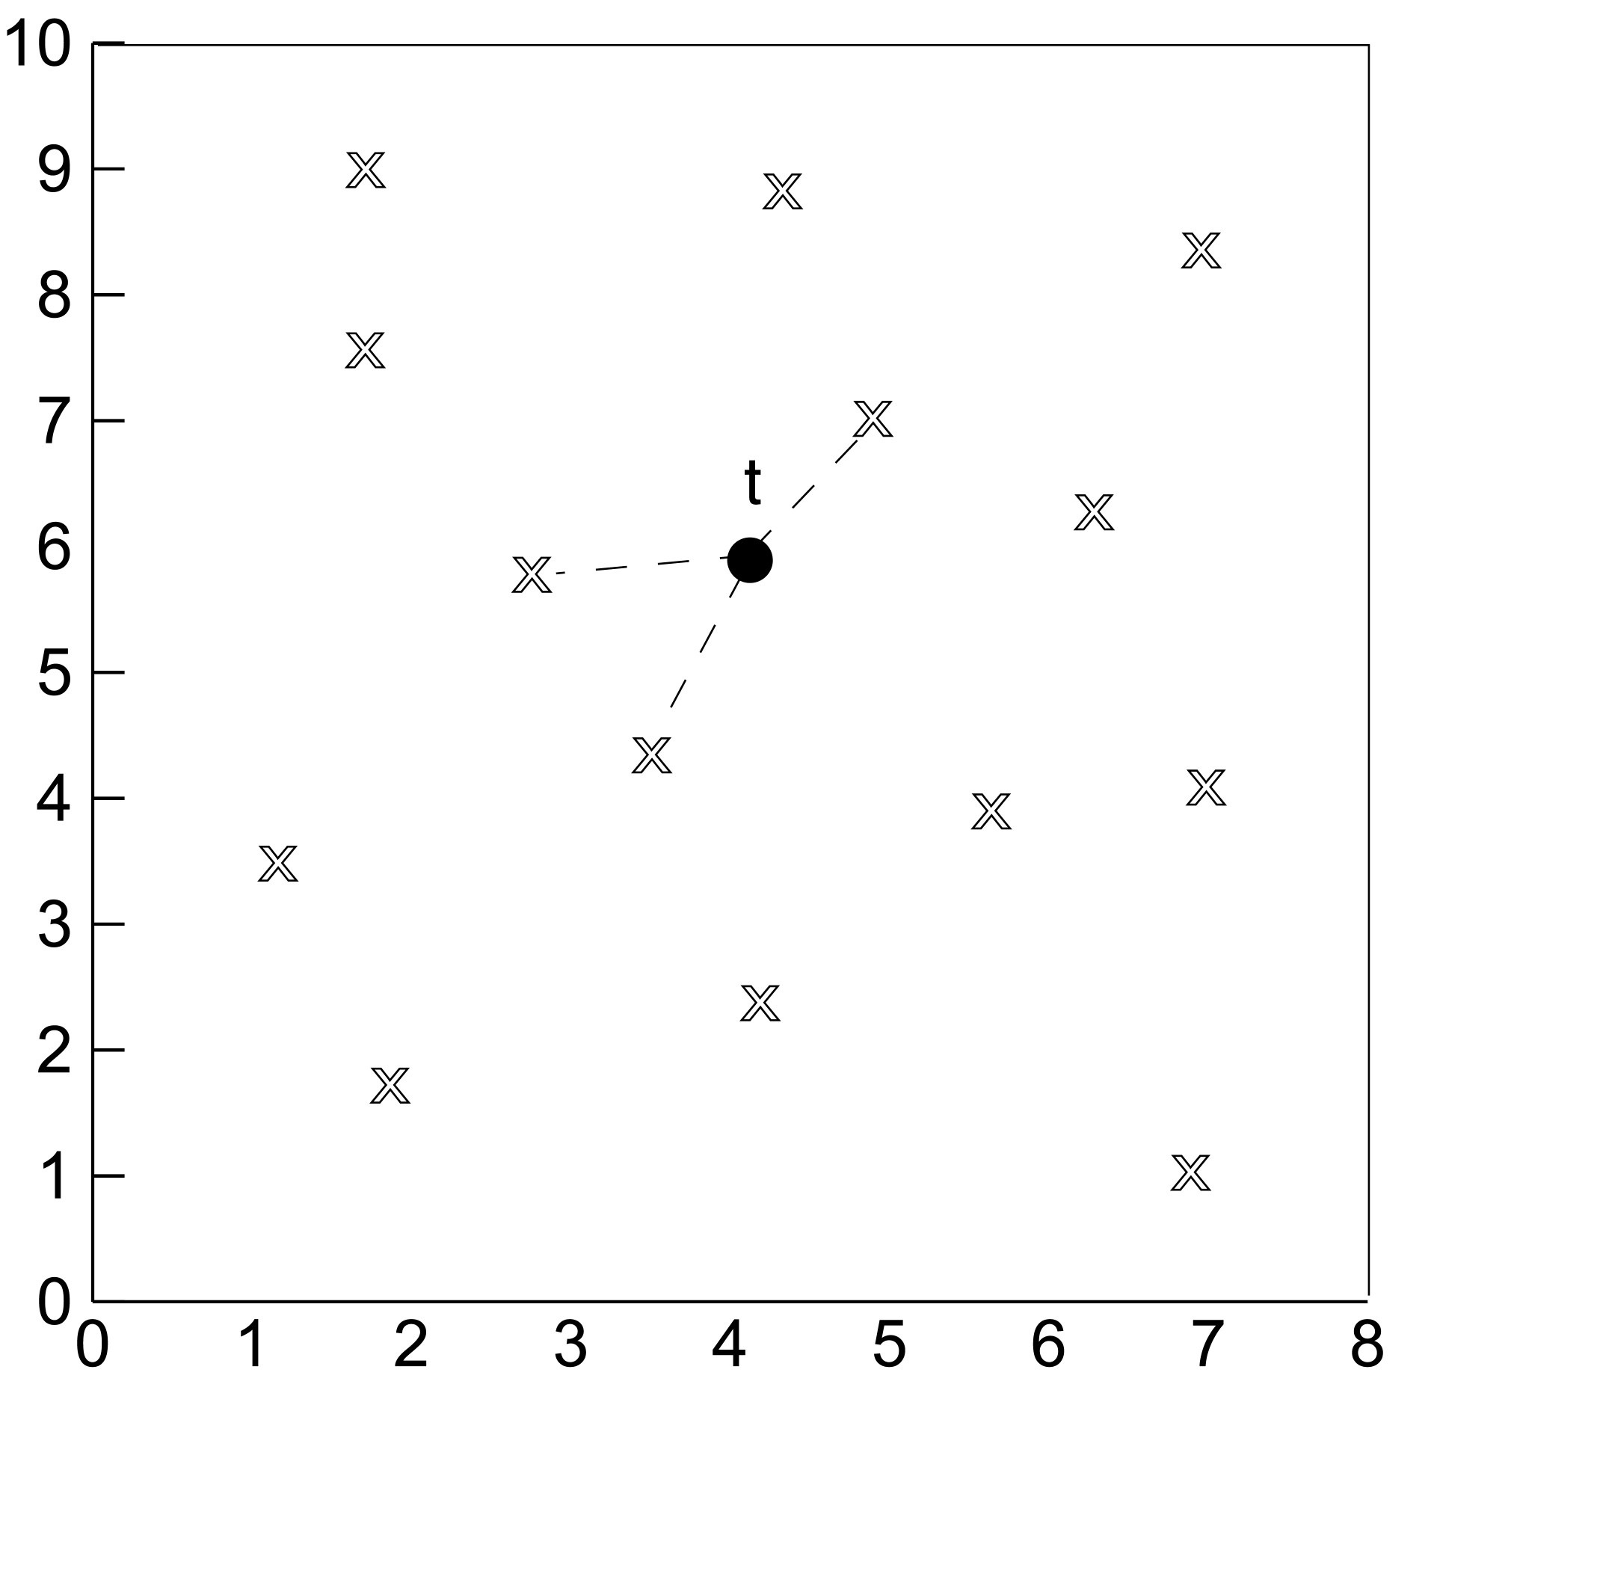
KNN

Slide 23
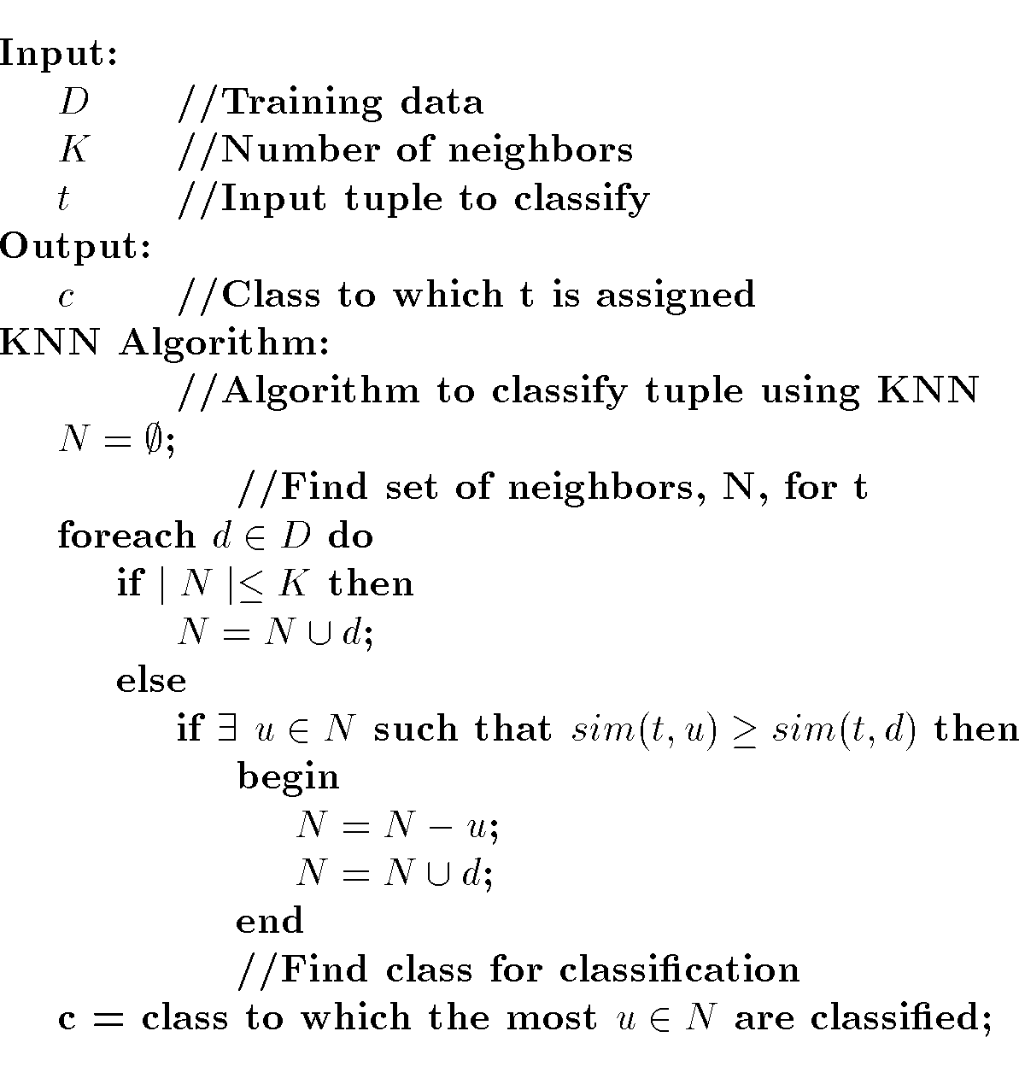
KNN Algorithm

Slide 24
Classification Using Decision Trees
Partitioning based: Divide search space into rectangular regions.
Tuple placed into class based on the region within which it falls.
DT approaches differ in how the tree is built: DT Induction
Internal nodes associated with attribute and arcs with values for that attribute.
Algorithms: ID3, C4.5, CART

Slide 25
Decision Tree
Given:
  D = {t₁, …, t_{n}} where t_{i}=<t_{i1}, …, t_{ih}>
  Database schema contains {A₁, A₂, …, A_{h}}
  Classes C={C₁, …., C_{m}}
Decision or Classification Tree is a tree associated with D such that
  Each internal node is labeled with attribute, A_{i}
  Each arc is labeled with predicate which can be applied to attribute at parent
  Each leaf node is labeled with a class, C_{j}

Slide 26
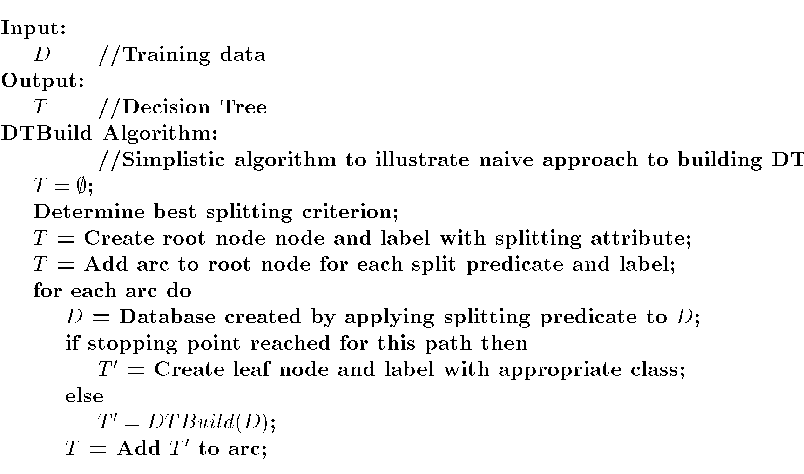
DT Induction

Slide 27
DT Splits Area
M
Gender
F
Height

Slide 28
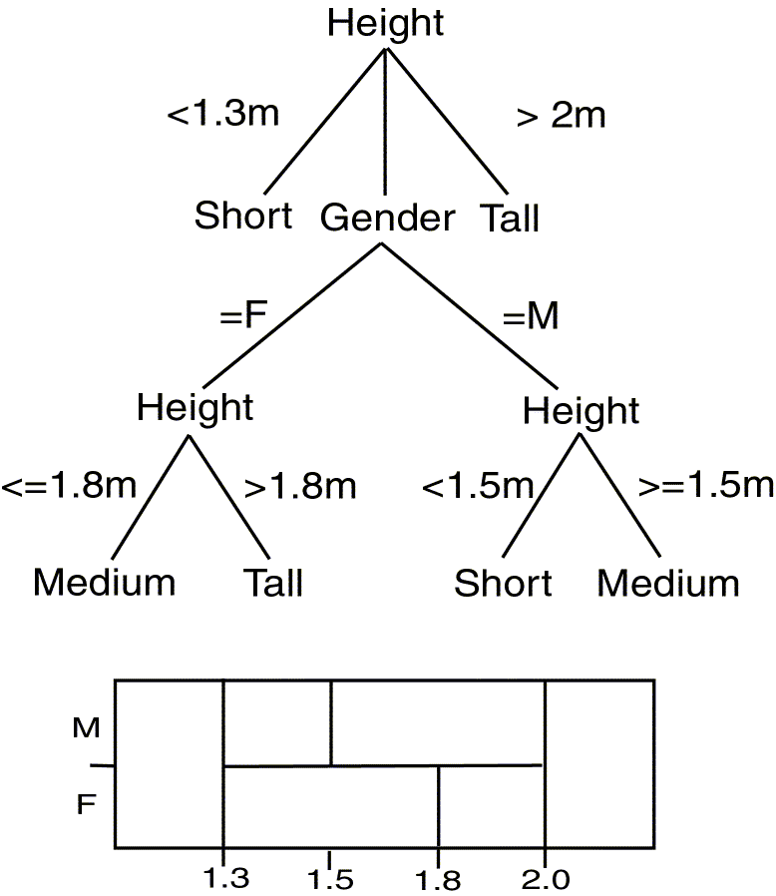
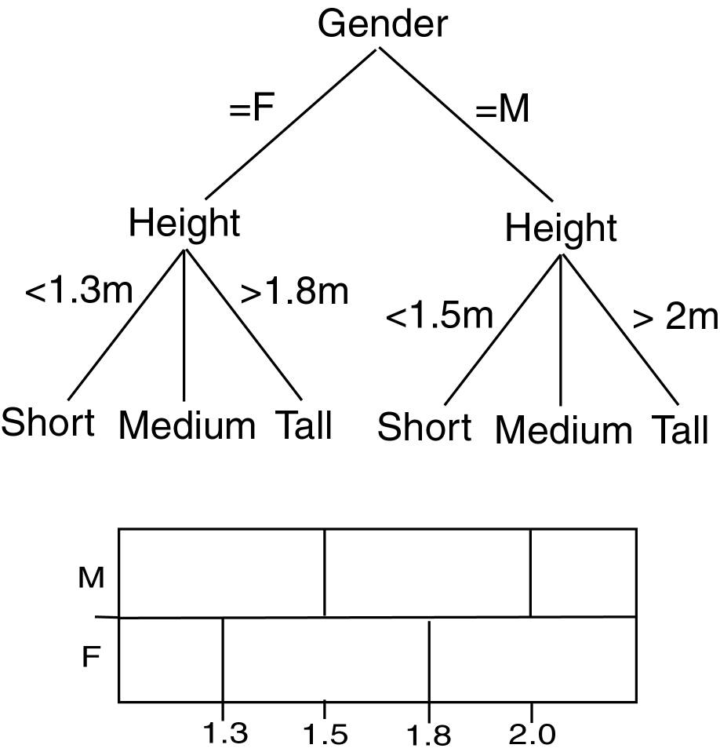
Comparing DTs
Balanced
Deep

Slide 29
DT Issues
Choosing Splitting Attributes
Ordering of Splitting Attributes
Splits
Tree Structure
Stopping Criteria
Training Data
Pruning

Slide 30
Decision Tree Induction is often based on Information Theory
So

Slide 31
Information

Slide 32
DT Induction
When all the marbles in the bowl are mixed up, little information is given.
When the marbles in the bowl are all from one class and those in the other two classes are on either side, more information is given.
Use this approach with DT Induction !

Slide 33
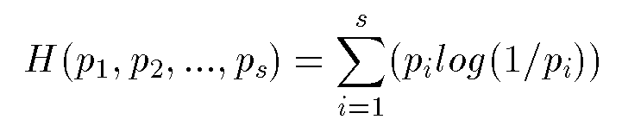
Information/Entropy
Given probabilitites p₁, p₂, .., p_{s} whose sum is 1, Entropy is defined as:
Entropy measures the amount of randomness or surprise or uncertainty.
Goal in classification
  no surprise
  entropy = 0

Slide 34
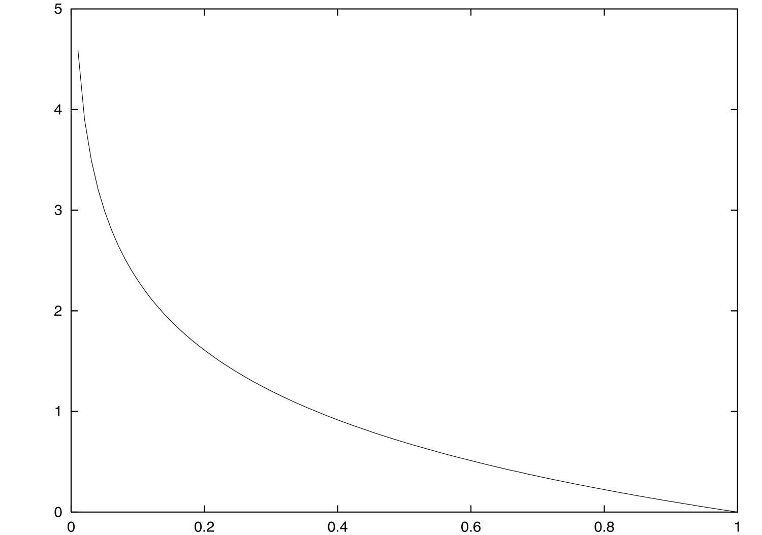
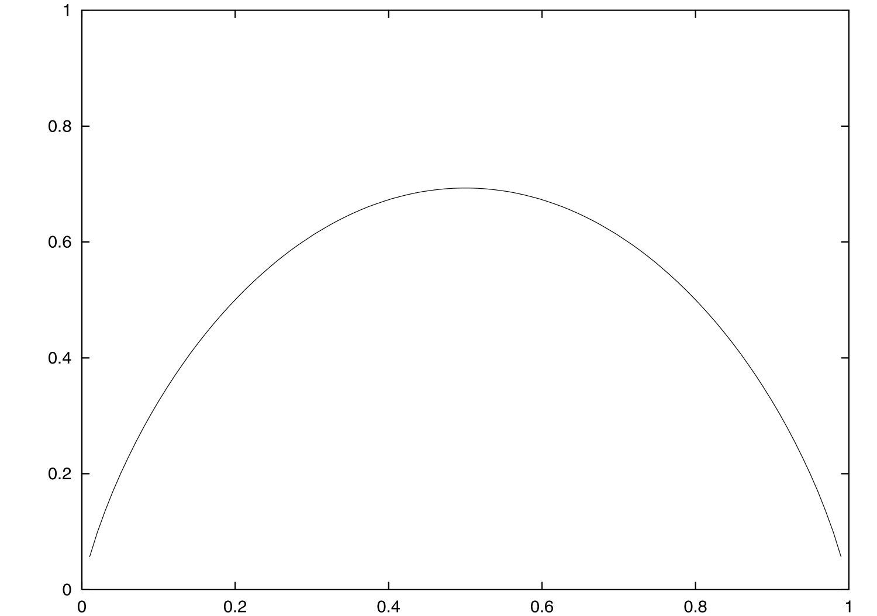
Entropy
log (1/p)
H(p,1-p)

Slide 35
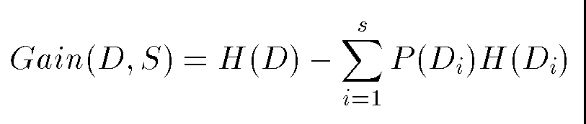
ID3
Creates tree using information theory concepts and tries to reduce expected number of comparison..
ID3 chooses split attribute with the highest information gain:

Slide 36
ID3 Example (Output1)
Starting state entropy:
4/15 log(15/4) + 8/15 log(15/8) + 3/15 log(15/3) = 0.4384
Gain using gender:
  Female: 3/9 log(9/3)+6/9 log(9/6)=0.2764
  Male: 1/6 (log 6/1) + 2/6 log(6/2) + 3/6 log(6/3) = 0.4392
  Weighted sum: (9/15)(0.2764) + (6/15)(0.4392) = 0.34152
  Gain: 0.4384 – 0.34152 = 0.09688
Gain using height:
0.4384 – (2/15)(0.301) = 0.3983
Choose height as first splitting attribute

Slide 37
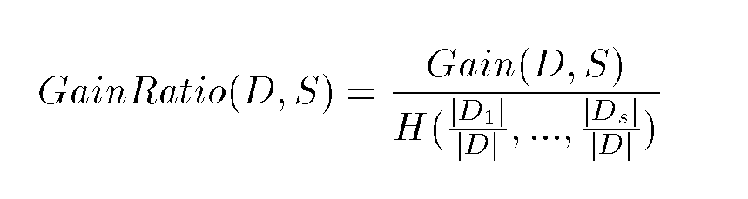
C4.5
ID3 favors attributes with large number of divisions
Improved version of ID3:
  Missing Data
  Continuous Data
  Pruning
  Rules
  GainRatio:

Slide 38
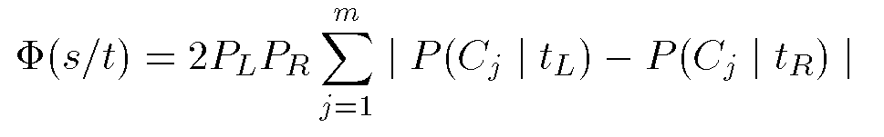
CART
Create Binary Tree
Uses entropy
Formula to choose split point, s, for node t:
P_{L},P_{R} probability that a tuple in the training set will be on the left or right side of the tree.

Slide 39
CART Example
At the start, there are six choices for split point (right branch on equality):
  P(Gender)=2(6/15)(9/15)(2/15 + 4/15 + 3/15)=0.224
  P(1.6) = 0
  P(1.7) = 2(2/15)(13/15)(0 + 8/15 + 3/15) = 0.169
  P(1.8) = 2(5/15)(10/15)(4/15 + 6/15 + 3/15) = 0.385
  P(1.9) = 2(9/15)(6/15)(4/15 + 2/15 + 3/15) = 0.256
  P(2.0) = 2(12/15)(3/15)(4/15 + 8/15 + 3/15) = 0.32
Split at 1.8

Slide 40
Classification Using Neural Networks
Typical NN structure for classification:
  One output node per class
  Output value is class membership function value
Supervised learning
For each tuple in training set, propagate it through NN. Adjust weights on edges to improve future classification.
Algorithms: Propagation, Backpropagation, Gradient Descent

Slide 41
NN Issues
Number of source nodes
Number of hidden layers
Training data
Number of sinks
Interconnections
Weights
Activation Functions
Learning Technique
When to stop learning

Slide 42
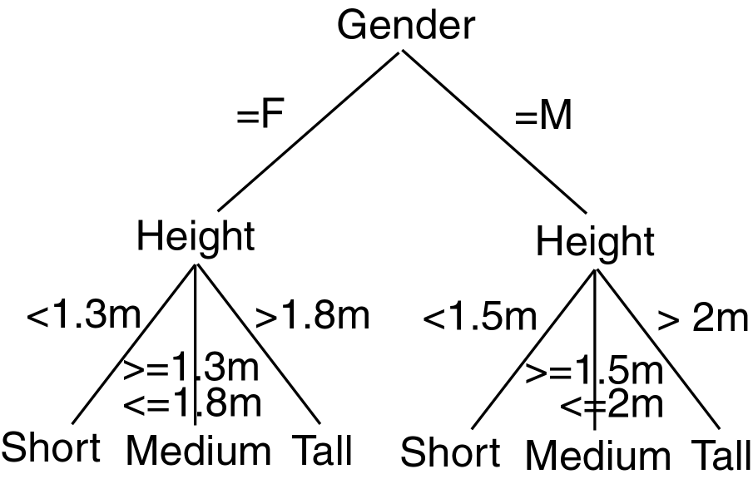
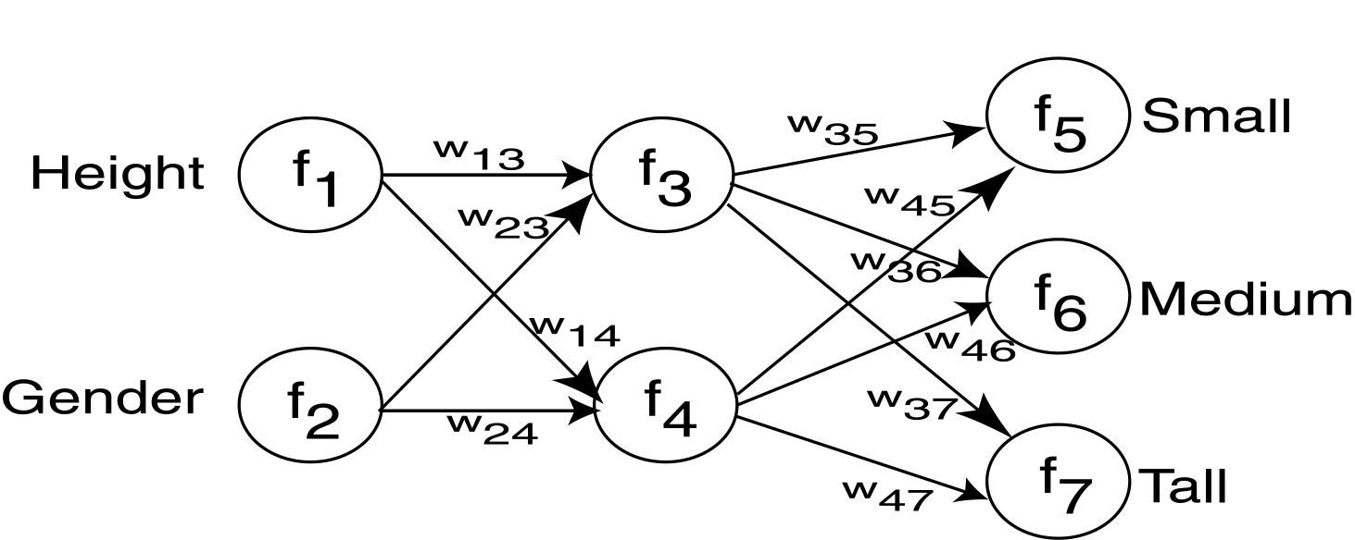
Decision Tree vs. Neural Network

Slide 43
Propagation
Tuple Input
Output

Slide 44
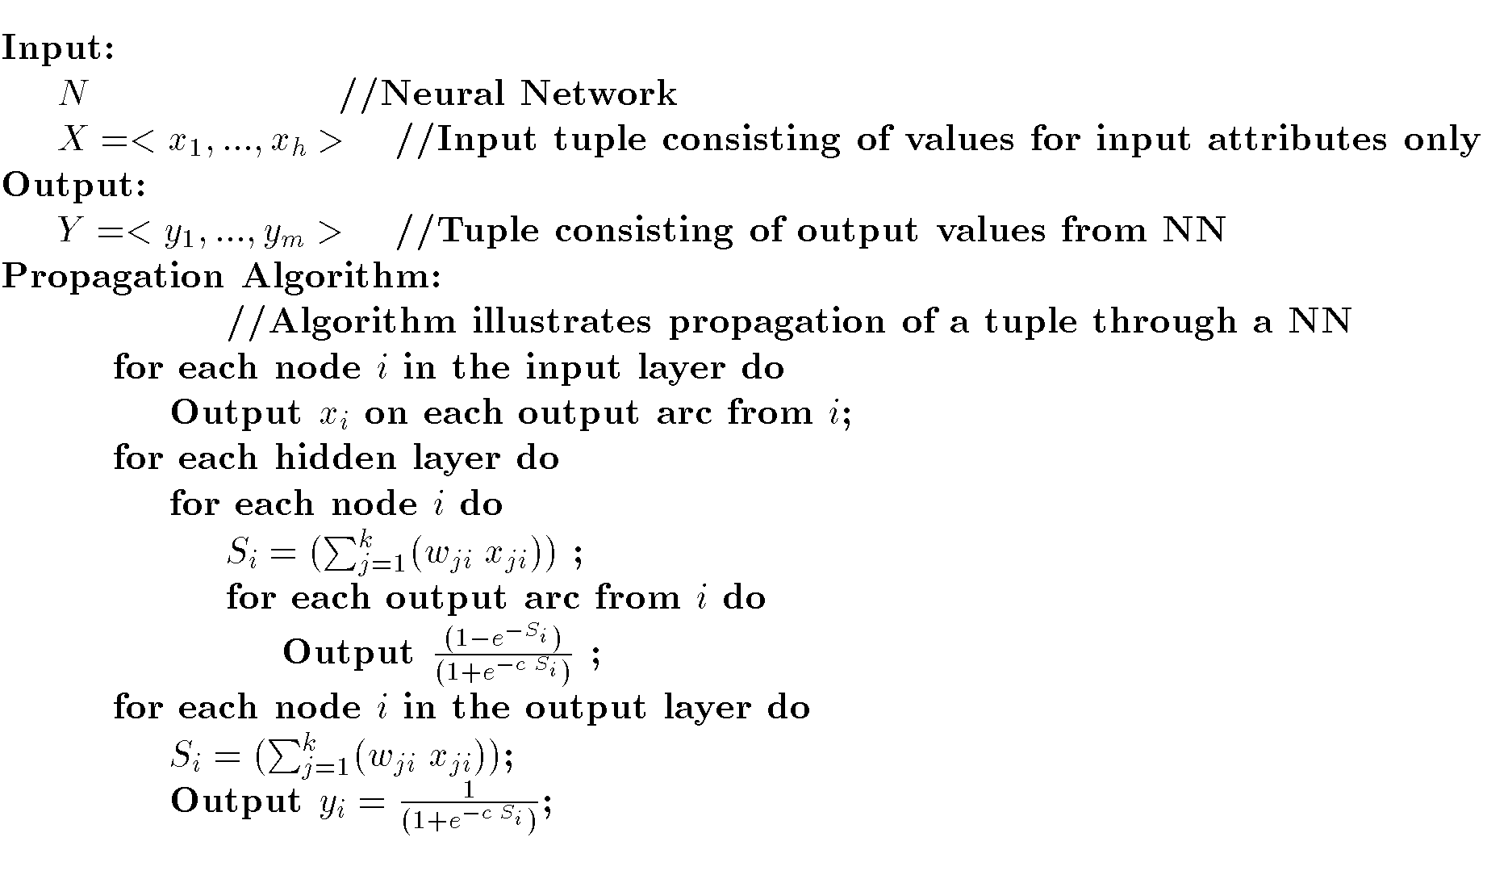
NN Propagation Algorithm

Slide 45
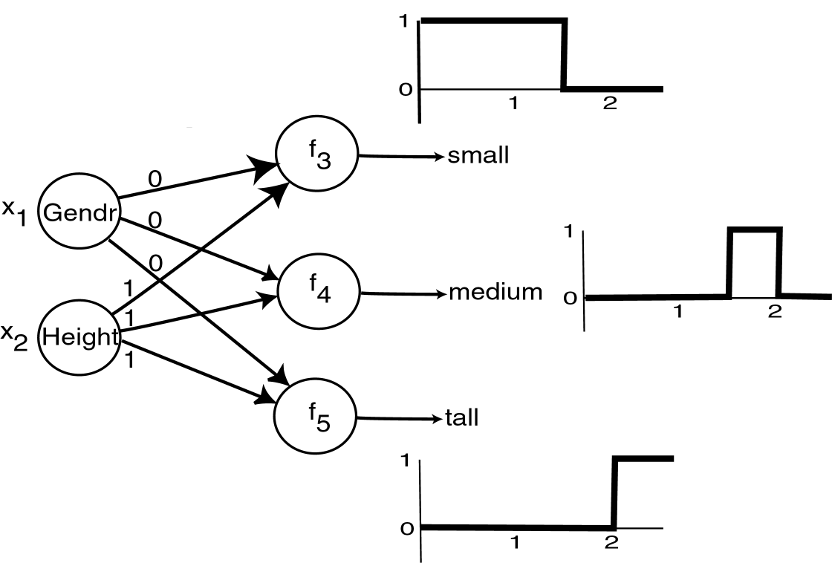
Example Propagation
© Prentie Hall

Slide 46
NN Learning
Adjust weights to perform better with the associated test data.
Supervised: Use feedback from knowledge of correct classification.
Unsupervised: No knowledge of correct classification needed.

Slide 47
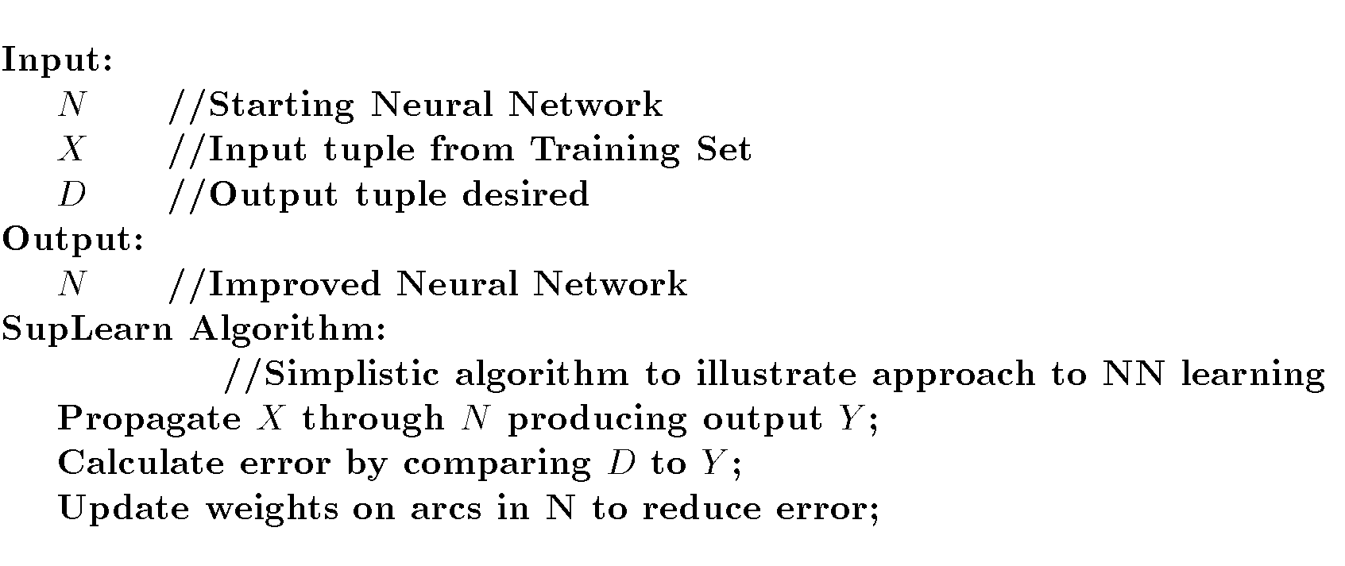
NN Supervised Learning

Slide 48
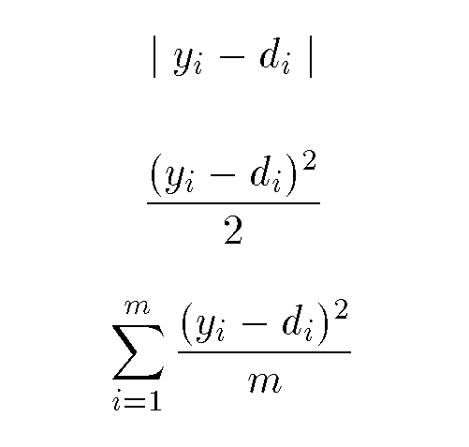
Supervised Learning
Possible error values assuming output from node i is y_{i} but should be d_{i}:
Change weights on arcs based on estimated error

Slide 49
NN Backpropagation
Propagate changes to weights backward from output layer to input layer.
Delta Rule:  w_{ij}= c x_{ij} (d_{j} – y_{j})
Gradient Descent: technique to modify the weights in the graph.

Slide 50
Backpropagation
Error

Slide 51
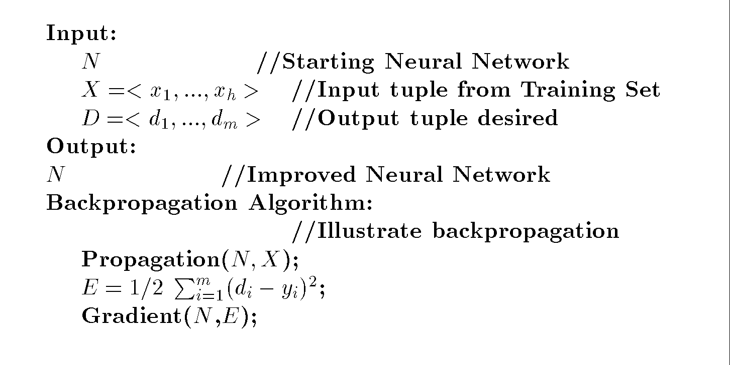
Backpropagation Algorithm

Slide 52
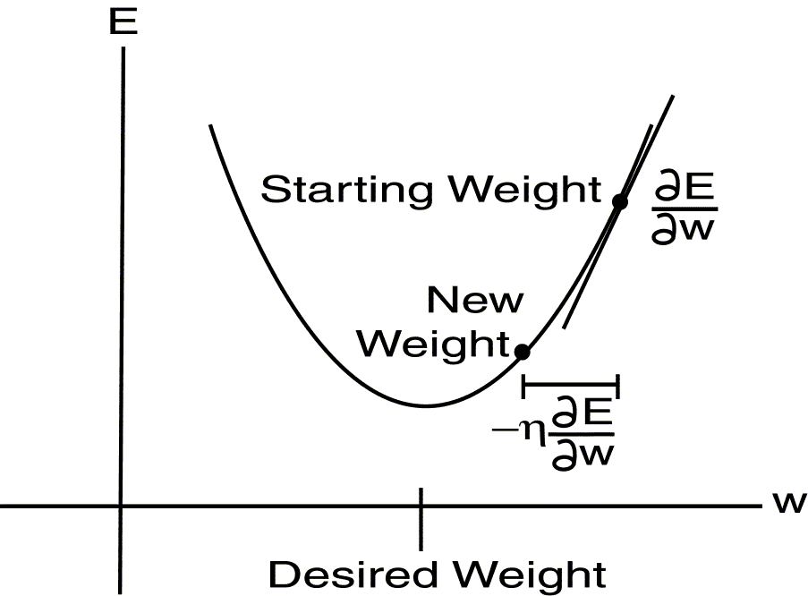
Gradient Descent

Slide 53
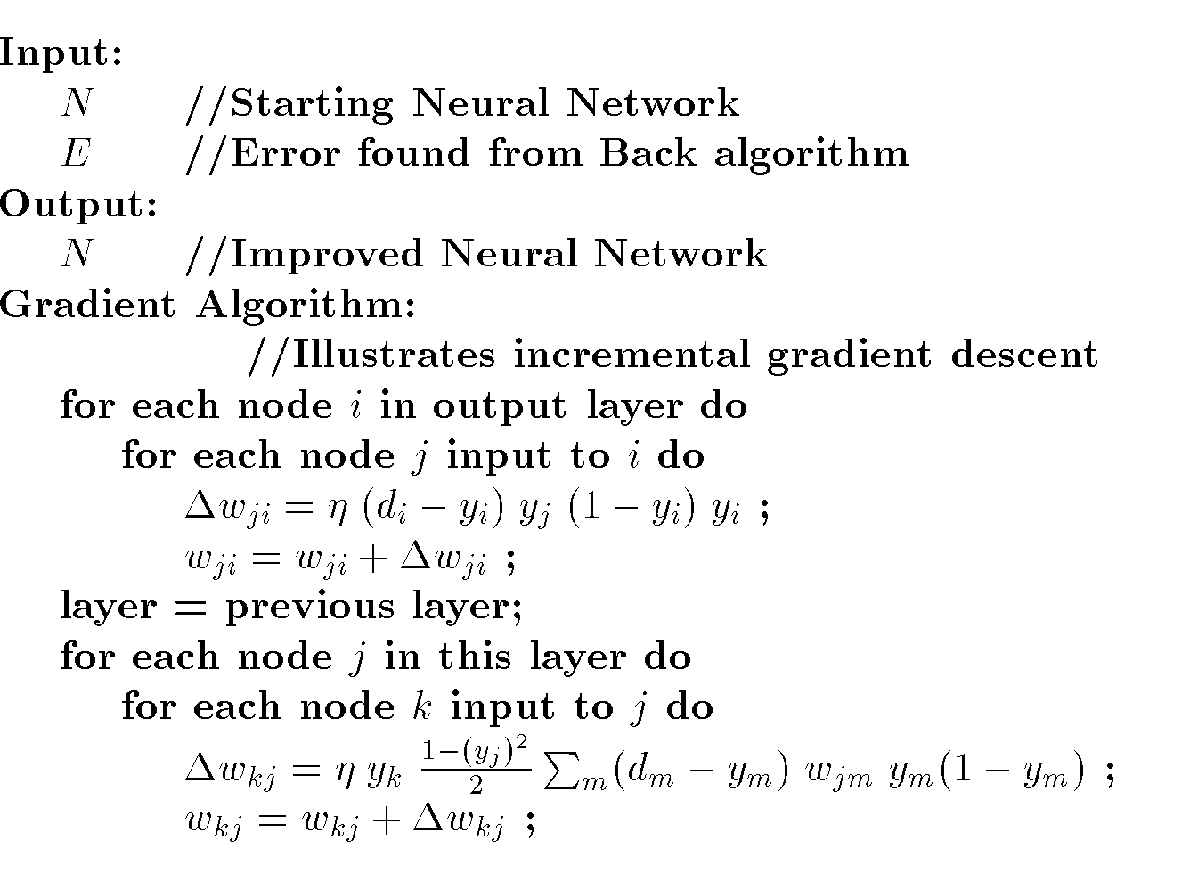
Gradient Descent Algorithm

Slide 54
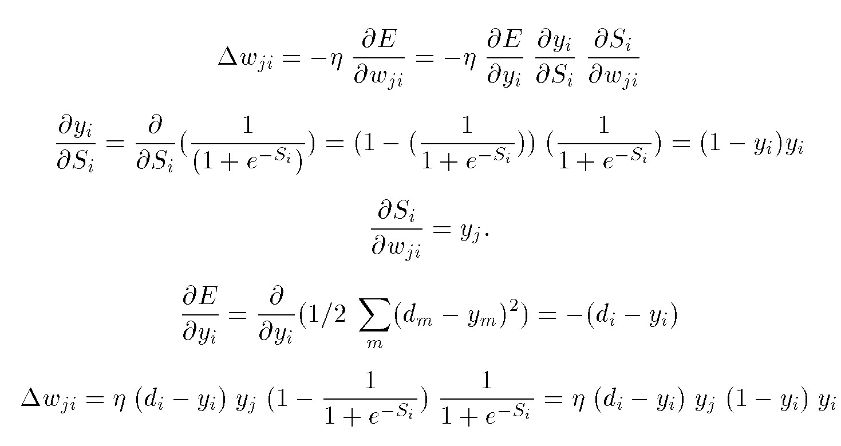
Output Layer Learning

Slide 55
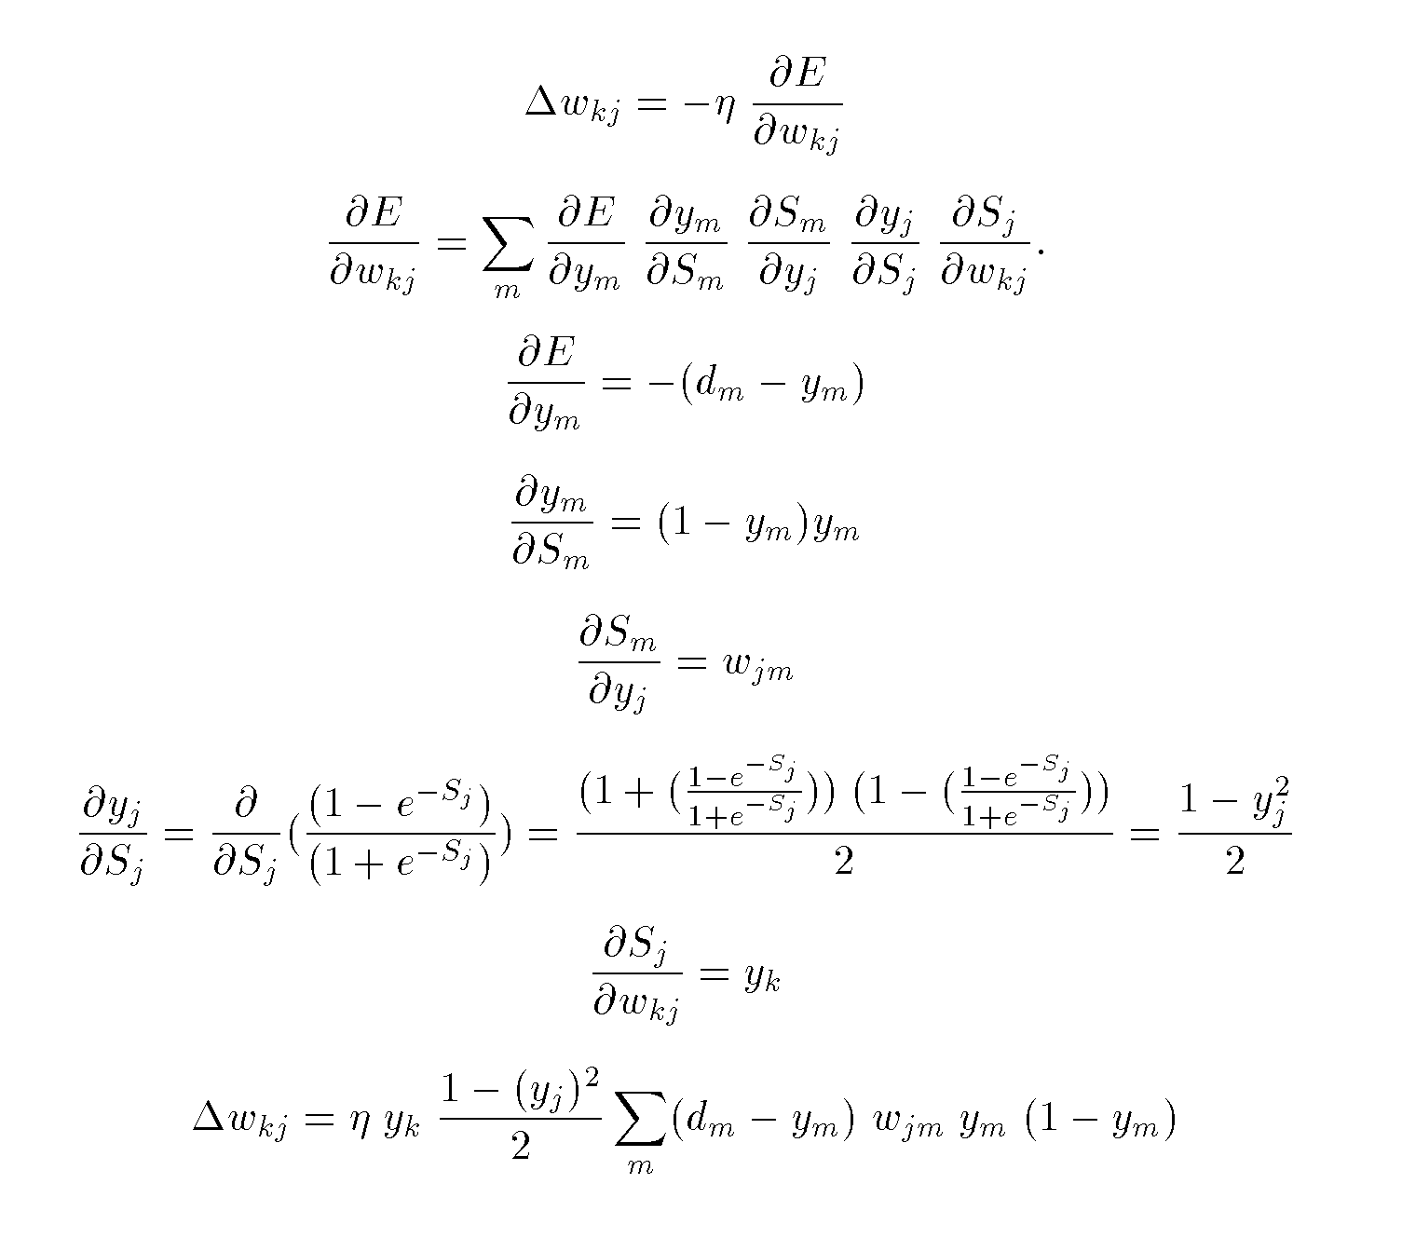
Hidden Layer Learning

Slide 56
Types of NNs
Different NN structures used for different problems.
Perceptron
Self Organizing Feature Map
Radial Basis Function Network

Slide 57
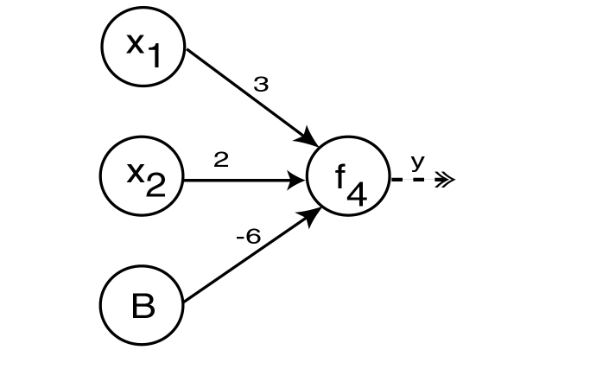
Perceptron
Perceptron is one of the simplest NNs.
No hidden layers.

Slide 58
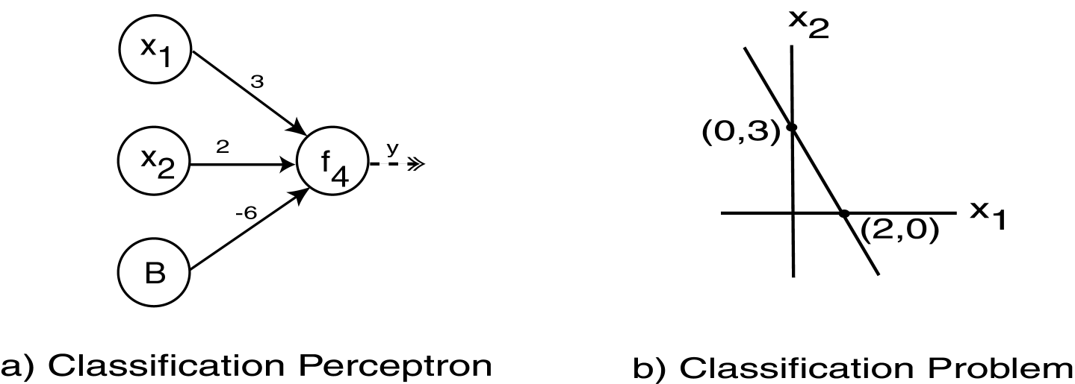
Perceptron Example
Suppose:
  Summation: S=3x₁+2x₂-6
  Activation: if S>0 then 1 else 0

Slide 59
Self Organizing Feature Map (SOFM)
Competitive Unsupervised Learning
Observe how neurons work in brain:
  Firing impacts firing of those near
  Neurons far apart inhibit each other
  Neurons have specific nonoverlapping tasks
Ex: Kohonen Network

Slide 60
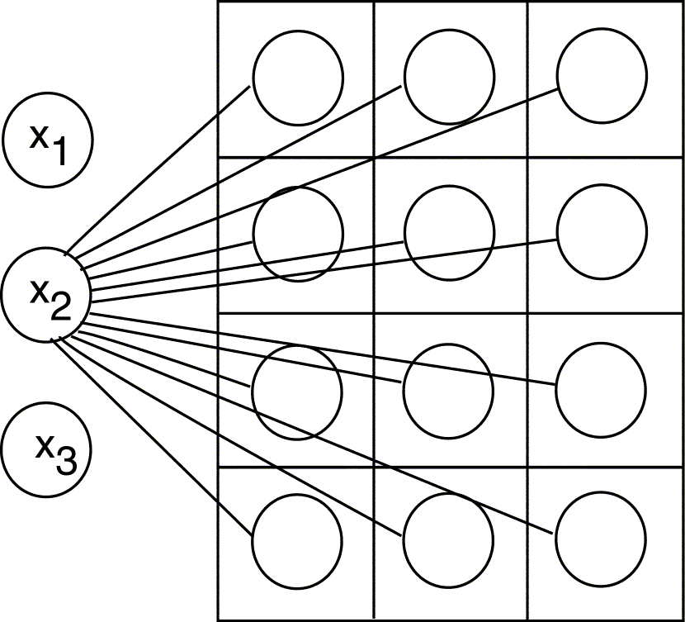
Kohonen Network

Slide 61
Kohonen Network
Competitive Layer – viewed as 2D grid
Similarity between competitive nodes and input nodes:
  Input: X = <x₁, …, x_{h}>
  Weights: <w_{1i}, … , w_{hi}>
  Similarity defined based on dot product
Competitive node most similar to input “wins”
Winning node weights (as well as surrounding node weights) increased.

Slide 62
Radial Basis Function Network
RBF function has Gaussian shape
RBF Networks
  Three Layers
  Hidden layer – Gaussian activation function
  Output layer – Linear activation function

Slide 63
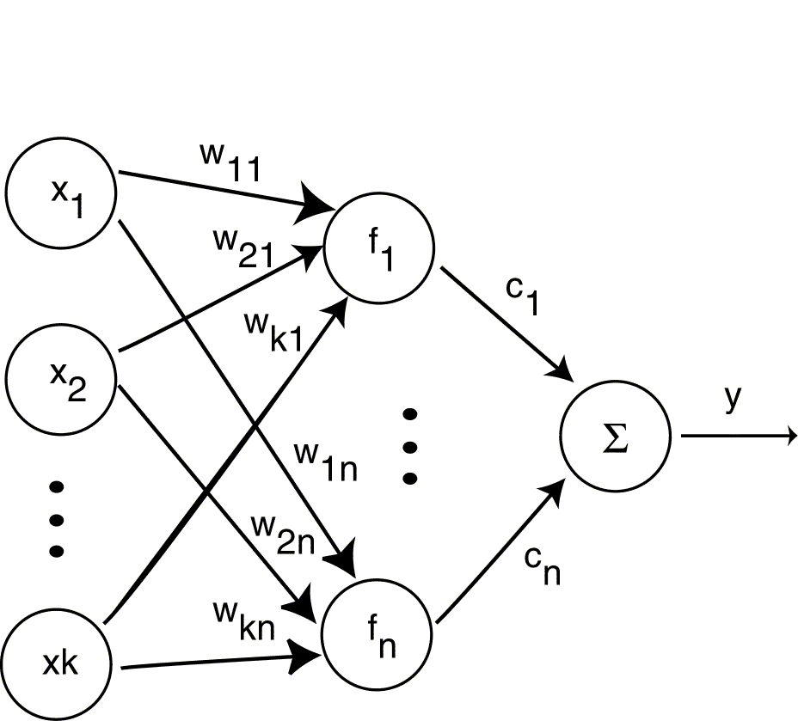
Radial Basis Function Network

Slide 64
Classification Using Rules
Perform classification using If-Then rules
Classification Rule: r = <a,c>
  Antecedent, Consequent
May generate from from other techniques (DT, NN) or generate directly.
Algorithms: Gen, RX, 1R, PRISM

Slide 65
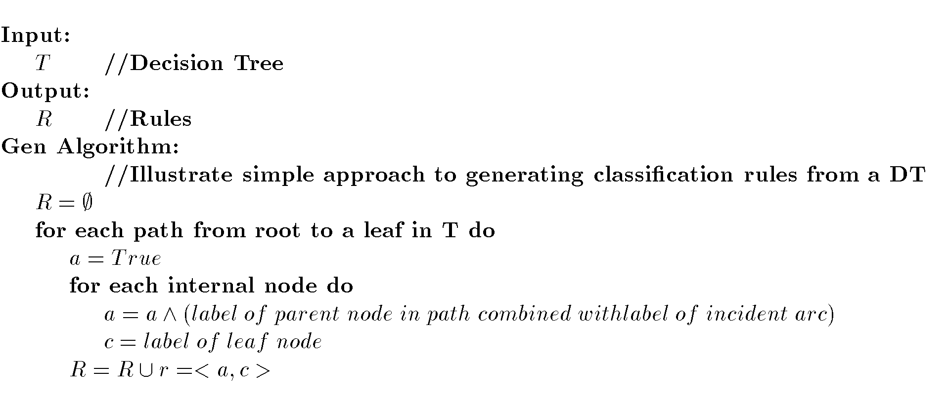
Generating Rules from DTs

Slide 66
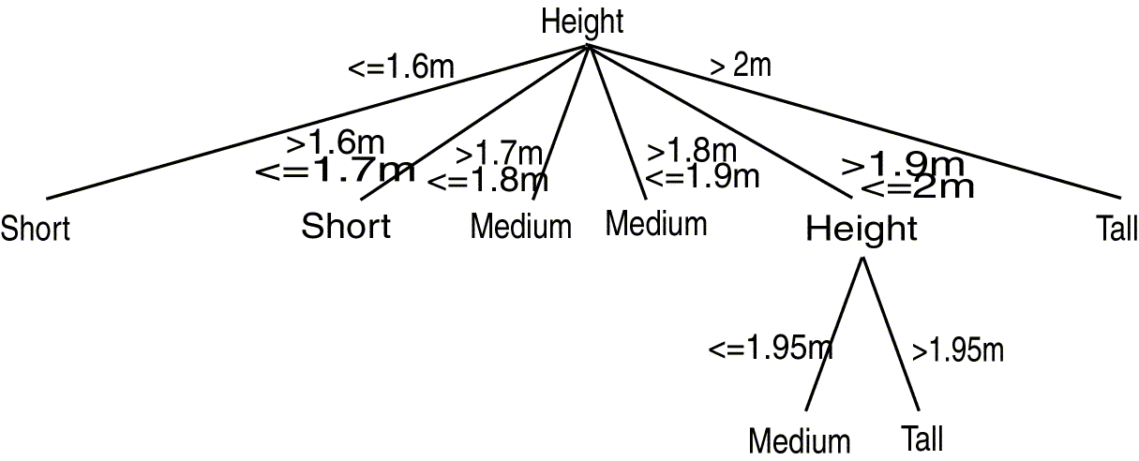
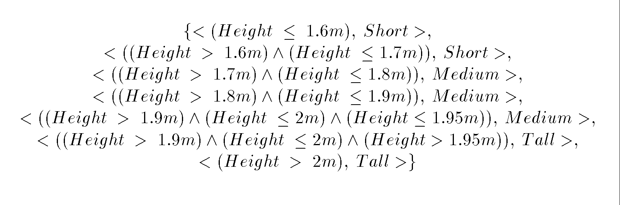
Generating Rules Example

Slide 67
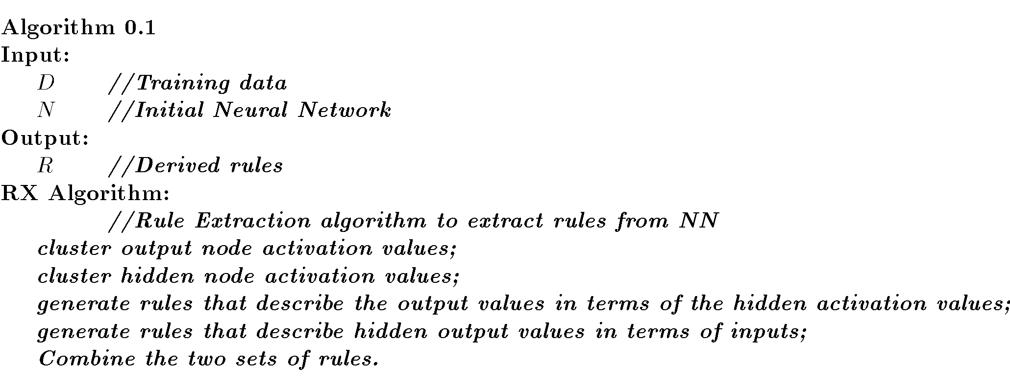
Generating Rules from NNs

Slide 68
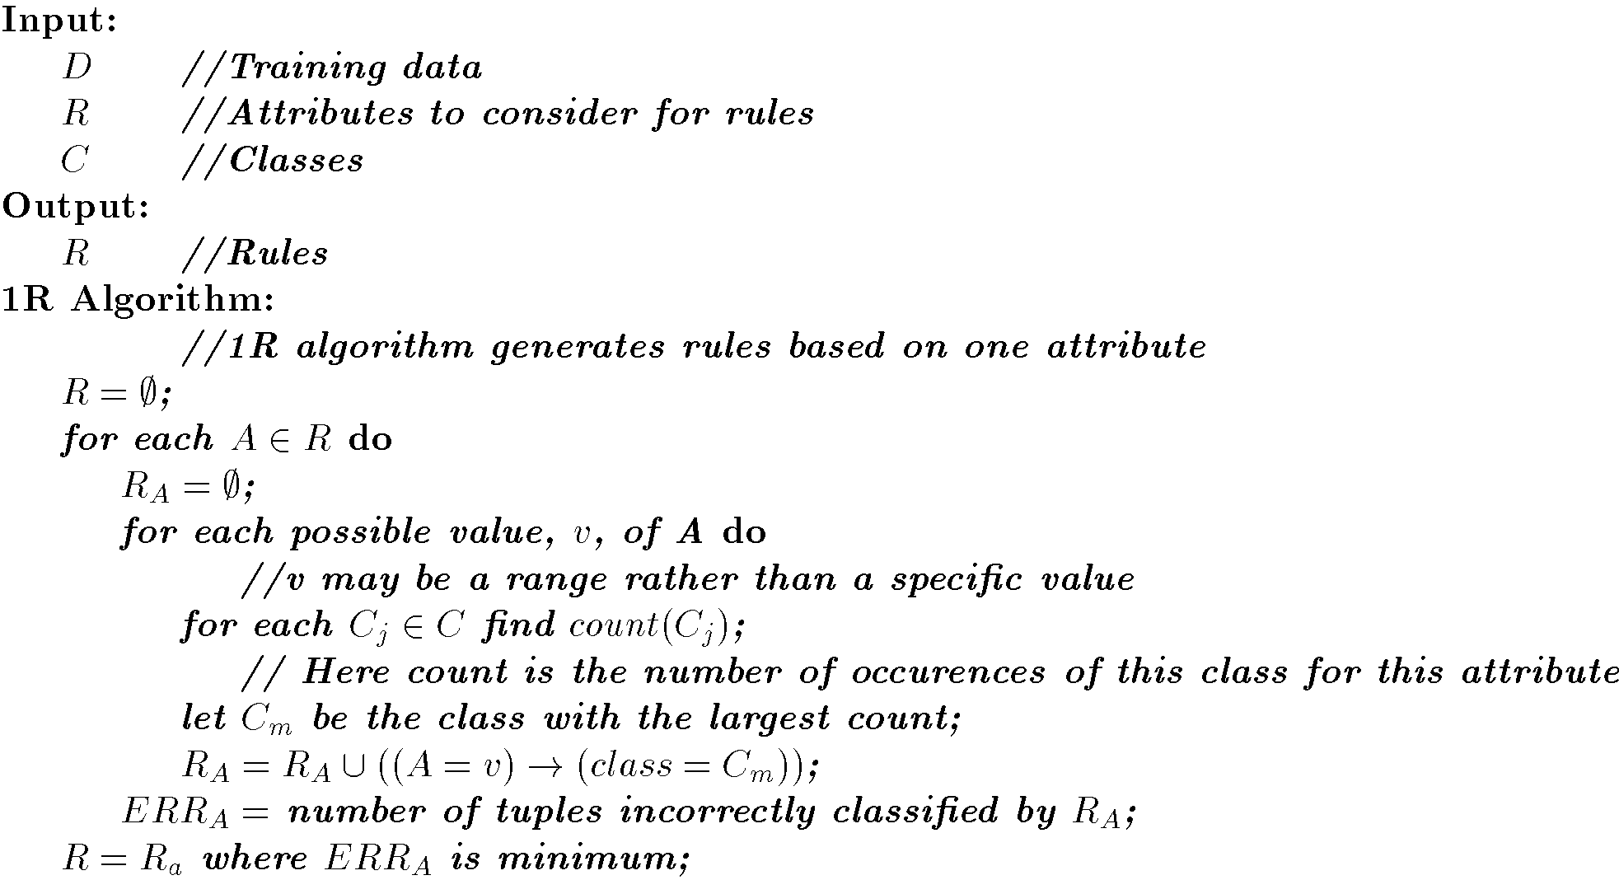
1R Algorithm

Slide 69
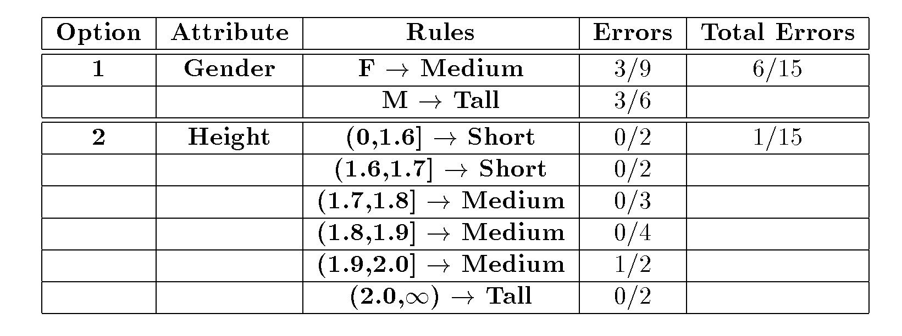
1R Example

Slide 70
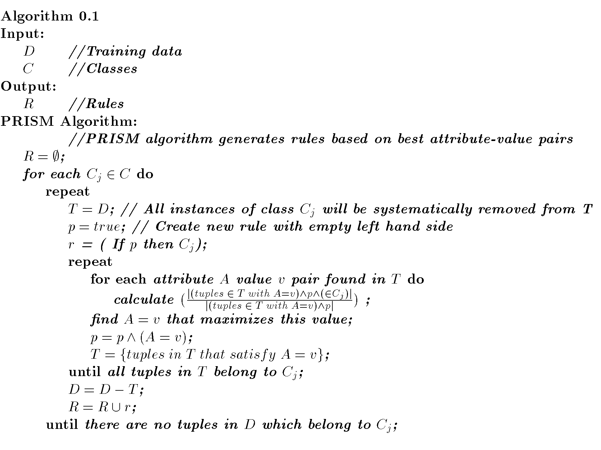
PRISM Algorithm

Slide 71
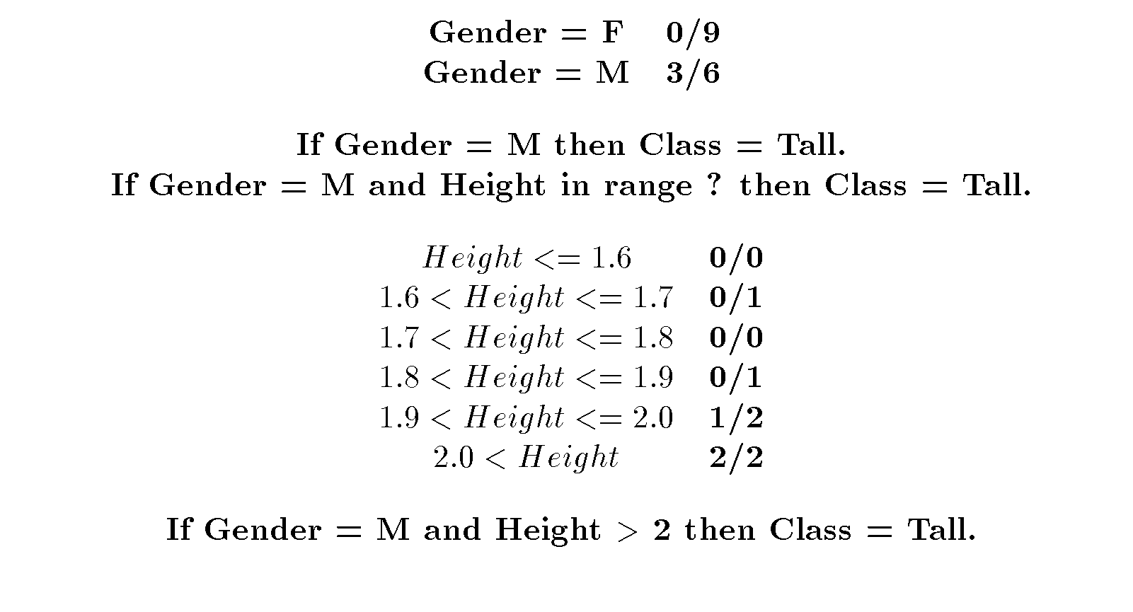
PRISM Example

Slide 72
Decision Tree vs. Rules
Tree has implied order in which splitting is performed.
Tree created based on looking at all classes.
Rules have no ordering of predicates.
Only need to look at one class to generate its rules.

Slide 73
Clustering Outline
Goal: Provide an overview of the clustering problem and introduce some of the basic algorithms
Clustering Problem Overview
Clustering Techniques
  Hierarchical Algorithms
  Partitional Algorithms
  Genetic Algorithm
  Clustering Large Databases

Slide 74
Clustering Examples
Segment customer database based on similar buying patterns.
Group houses in a town into neighborhoods based on similar features.
Identify new plant species
Identify similar Web usage patterns

Slide 75
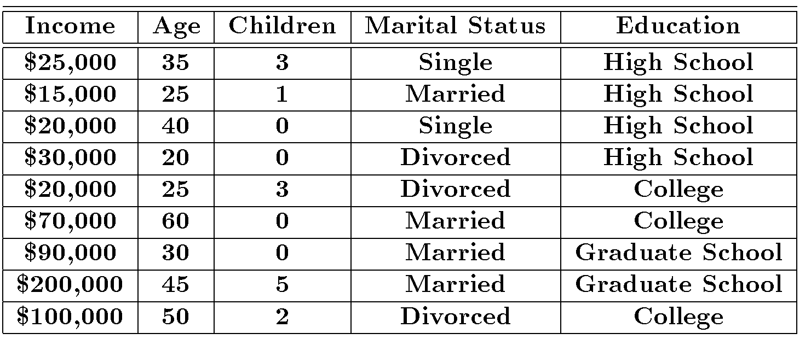
Clustering Example

Slide 76
Clustering Houses
Geographic Distance Based
Size Based

Slide 77
Clustering vs. Classification
No prior knowledge
  Number of clusters
  Meaning of clusters
Unsupervised learning

Slide 78
Clustering Issues
Outlier handling
Dynamic data
Interpreting results
Evaluating results
Number of clusters
Data to be used
Scalability

Slide 79
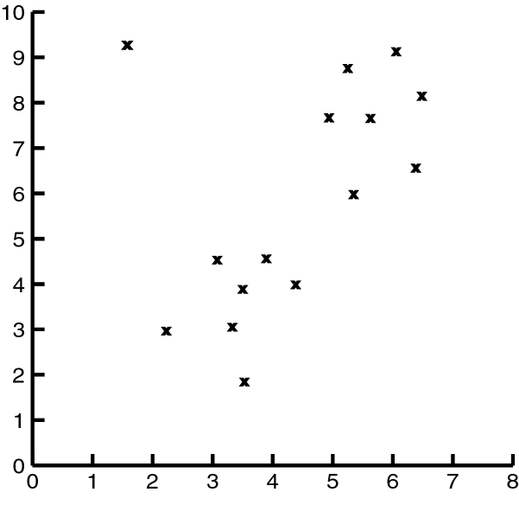
Impact of Outliers on Clustering

Slide 80
Clustering Problem
Given a database D={t₁,t₂,…,t_{n}} of tuples and an integer value k, the Clustering Problem is to define a mapping f:D{1,..,k} where each t_{i} is assigned to one cluster K_{j}, 1<=j<=k.
A Cluster, K_{j}, contains precisely those tuples mapped to it.
Unlike classification problem, clusters are not known a priori.

Slide 81
Types of Clustering
Hierarchical – Nested set of clusters created.
Partitional – One set of clusters created.
Incremental – Each element handled one at a time.
Simultaneous – All elements handled together.
Overlapping/Non-overlapping

Slide 82
Clustering Approaches
Clustering
Hierarchical
Partitional
Categorical
Large DB
Agglomerative
Divisive
Sampling
Compression

Slide 83
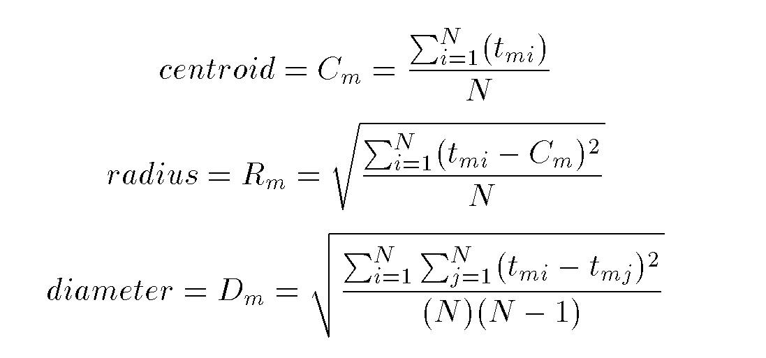
Cluster Parameters

Slide 84
Distance Between Clusters
Single Link: smallest distance between points
Complete Link: largest distance between points
Average Link: average distance between points
Centroid: distance between centroids

Slide 85
Hierarchical Clustering
Clusters are created in levels actually creating sets of clusters at each level.
Agglomerative
  Initially each item in its own cluster
  Iteratively clusters are merged together
  Bottom Up
Divisive
  Initially all items in one cluster
  Large clusters are successively divided
  Top Down

Slide 86
Hierarchical Algorithms
Single Link
MST Single Link
Complete Link
Average Link

Slide 87
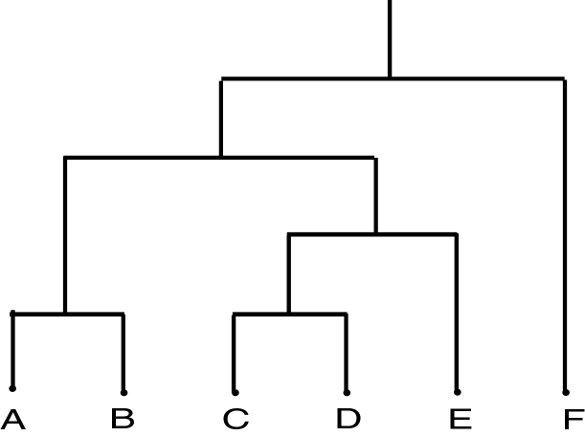
Dendrogram
Dendrogram: a tree data structure which illustrates hierarchical clustering techniques.
Each level shows clusters for that level.
  Leaf – individual clusters
  Root – one cluster
A cluster at level i is the union of its children clusters at level i+1.

Slide 88

Levels of Clustering

Slide 89
Agglomerative Example
 | A | B | C | D | E
A | 0 | 1 | 2 | 2 | 3
B | 1 | 0 | 2 | 4 | 3
C | 2 | 2 | 0 | 1 | 5
D | 2 | 4 | 1 | 0 | 3
E | 3 | 3 | 5 | 3 | 0
A
B
E
C
D
Threshold of
1
2
3
4
5
A
B
C
D
E

Slide 90
MST Example
A
B
 | A | B | C | D | E
A | 0 | 1 | 2 | 2 | 3
B | 1 | 0 | 2 | 4 | 3
C | 2 | 2 | 0 | 1 | 5
D | 2 | 4 | 1 | 0 | 3
E | 3 | 3 | 5 | 3 | 0
E
C
D

Slide 91

Agglomerative Algorithm

Slide 92
Single Link
View all items with links (distances) between them.
Finds maximal connected components in this graph.
Two clusters are merged if there is at least one edge which connects them.
Uses threshold distances at each level.
Could be agglomerative or divisive.

Slide 93

MST Single Link Algorithm

Slide 94

Single Link Clustering

Slide 95
Partitional Clustering
Nonhierarchical
Creates clusters in one step as opposed to several steps.
Since only one set of clusters is output, the user normally has to input the desired number of clusters, k.
Usually deals with static sets.

Slide 96
Partitional Algorithms
MST
Squared Error
K-Means
Nearest Neighbor
PAM
BEA
GA

Slide 97

MST Algorithm

Slide 98

Squared Error
Minimized squared error

Slide 99

Squared Error Algorithm

Slide 100
K-Means
Initial set of clusters randomly chosen.
Iteratively, items are moved among sets of clusters until the desired set is reached.
High degree of similarity among elements in a cluster is obtained.
Given a cluster K_{i}={t_{i1},t_{i2},…,t_{im}}, the cluster mean is m_{i} = (1/m)(t_{i1} + … + t_{im})

Slide 101
K-Means Example
Given: {2,4,10,12,3,20,30,11,25}, k=2
Randomly assign means: m₁=3,m₂=4
K₁={2,3}, K₂={4,10,12,20,30,11,25}, m₁=2.5,m₂=16
K₁={2,3,4},K₂={10,12,20,30,11,25}, m₁=3,m₂=18
K₁={2,3,4,10},K₂={12,20,30,11,25}, m₁=4.75,m₂=19.6
K₁={2,3,4,10,11,12},K₂={20,30,25}, m₁=7,m₂=25
Stop as the clusters with these means are the same.

Slide 102

K-Means Algorithm

Slide 103
Nearest Neighbor
Items are iteratively merged into the existing clusters that are closest.
Incremental
Threshold, t, used to determine if items are added to existing clusters or a new cluster is created.

Slide 104

Nearest Neighbor Algorithm

Slide 105
PAM
Partitioning Around Medoids (PAM) (K-Medoids)
Handles outliers well.
Ordering of input does not impact results.
Does not scale well.
Each cluster represented by one item, called the medoid.
Initial set of k medoids randomly chosen.

Slide 106

PAM

Slide 107

PAM Cost Calculation
At each step in algorithm, medoids are changed if the overall cost is improved.
C_{jih} – cost change for an item t_{j} associated with swapping medoid t_{i} with non-medoid t_{h}.

Slide 108

PAM Algorithm

Slide 109
BEA
Bond Energy Algorithm
Database design (physical and logical)
Vertical fragmentation
Determine affinity (bond) between attributes based on common usage.
Algorithm outline:
  Create affinity matrix
  Convert to BOND matrix
  Create regions of close bonding

Slide 110

BEA
Modified from [OV99]

Slide 111
Genetic Algorithm Example
{A,B,C,D,E,F,G,H}
Randomly choose initial solution:
{A,C,E} {B,F} {D,G,H} or
10101000, 01000100, 00010011
Suppose crossover at point four and choose 1st and 3rd individuals:
  10100011, 01000100, 00011000
What should termination criteria be?

Slide 112

GA Algorithm

Slide 113
Clustering Large Databases
Most clustering algorithms assume a large data structure which is memory resident.
Clustering may be performed first on a sample of the database then applied to the entire database.
Algorithms
  BIRCH
  DBSCAN
  CURE

Slide 114
Desired Features for Large Databases
One scan (or less) of DB
Online
Suspendable, stoppable, resumable
Incremental
Work with limited main memory
Different techniques to scan (e.g. sampling)
Process each tuple once

Slide 115
BIRCH
Balanced Iterative Reducing and Clustering using Hierarchies
Incremental, hierarchical, one scan
Save clustering information in a tree
Each entry in the tree contains information about one cluster
New nodes inserted in closest entry in tree

Slide 116
Clustering Feature
CT Triple: (N,LS,SS)
  N: Number of points in cluster
  LS: Sum of points in the cluster
  SS: Sum of squares of points in the cluster
CF Tree
  Balanced search tree
  Node has CF triple for each child
  Leaf node represents cluster and has CF value for each subcluster in it.
  Subcluster has maximum diameter

Slide 117

BIRCH Algorithm

Slide 118

Improve Clusters

Slide 119
DBSCAN
Density Based Spatial Clustering of Applications with Noise
Outliers will not effect creation of cluster.
Input
  MinPts – minimum number of points in cluster
  Eps – for each point in cluster there must be another point in it less than this distance away.

Slide 120
DBSCAN Density Concepts
Eps-neighborhood: Points within Eps distance of a point.
Core point: Eps-neighborhood dense enough (MinPts)
Directly density-reachable: A point p is directly density-reachable from a point q if the distance is small (Eps) and q is a core point.
Density-reachable: A point si density-reachable form another point if there is a path from one to the other consisting of only core points.

Slide 121

Density Concepts

Slide 122

DBSCAN Algorithm

Slide 123
CURE
Clustering Using Representatives
Use many points to represent a cluster instead of only one
Points will be well scattered

Slide 124

CURE Approach

Slide 125

CURE Algorithm

Slide 126

CURE for Large Databases

Slide 127

Comparison of Clustering Techniques

Slide 128
Association Rules Outline
Goal: Provide an overview of basic Association Rule mining techniques
Association Rules Problem Overview
  Large itemsets
Association Rules Algorithms
  Apriori
  Sampling
  Partitioning
  Parallel Algorithms
Comparing Techniques
Incremental Algorithms
Advanced AR Techniques

Slide 129
Example: Market Basket Data
Items frequently purchased together:
  Bread ⇒PeanutButter
Uses:
  Placement
  Advertising
  Sales
  Coupons
Objective: increase sales and reduce costs

Slide 130
Association Rule Definitions
Set of items: I={I₁,I₂,…,I_{m}}
Transactions: D={t₁,t₂, …, t_{n}}, t_{j}⊆ I
Itemset: {I_{i1},I_{i2}, …, I_{ik}} ⊆ I
Support of an itemset: Percentage of transactions which contain that itemset.
Large (Frequent) itemset: Itemset whose number of occurrences is above a threshold.

Slide 131

Association Rules Example
I = { Beer, Bread, Jelly, Milk, PeanutButter}
Support of {Bread,PeanutButter} is 60%

Slide 132
Association Rule Definitions
Association Rule (AR): implication X ⇒ Y where X,Y ⊆ I and X ∩ Y = ;
Support of AR (s) X ⇒ Y: Percentage of transactions that contain X ∪Y
Confidence of AR (α) X ⇒ Y: Ratio of number of transactions that contain X ∪ Y to the number that contain X

Slide 133

Association Rules Ex (cont’d)

Slide 134
Association Rule Problem
Given a set of items I={I₁,I₂,…,I_{m}} and a database of transactions D={t₁,t₂, …, t_{n}} where t_{i}={I_{i1},I_{i2}, …, I_{ik}} and I_{ij} ∈ I, the Association Rule Problem is to identify all association rules X ⇒ Y with a minimum support and confidence.
Link Analysis
NOTE: Support of X ⇒ Y is same as support of X ∪ Y.

Slide 135
Association Rule Techniques
Find Large Itemsets.
Generate rules from frequent itemsets.

Slide 136

Algorithm to Generate ARs

Slide 137
Apriori
Large Itemset Property:
Any subset of a large itemset is large.
Contrapositive:
If an itemset is not large,
none of its supersets are large.

Slide 138

Large Itemset Property

Slide 139

Apriori Ex (cont’d)
s=30% α = 50%

Slide 140
Apriori Algorithm
C₁ = Itemsets of size one in I;
Determine all large itemsets of size 1, L_{1;}
i = 1;
Repeat
i = i + 1;
C_{i} = Apriori-Gen(L_{i-1});
Count C_{i} to determine L_{i;}
until no more large itemsets found;

Slide 141
Apriori-Gen
Generate candidates of size i+1 from large itemsets of size i.
Approach used: join large itemsets of size i if they agree on i-1
May also prune candidates who have subsets that are not large.

Slide 142

Apriori-Gen Example

Slide 143

Apriori-Gen Example (cont’d)

Slide 144
Apriori Adv/Disadv
Advantages:
  Uses large itemset property.
  Easily parallelized
  Easy to implement.
Disadvantages:
  Assumes transaction database is memory resident.
  Requires up to m database scans.

Slide 145
Sampling
Large databases
Sample the database and apply Apriori to the sample.
Potentially Large Itemsets (PL): Large itemsets from sample
Negative Border (BD ⁻ ):
  Generalization of Apriori-Gen applied to itemsets of varying sizes.
  Minimal set of itemsets which are not in PL, but whose subsets are all in PL.

Slide 146

Negative Border Example
PL
PL ∪BD⁻(PL)

Slide 147
Sampling Algorithm
D_{s} = sample of Database D;
PL = Large itemsets in D_{s} using smalls;
C = PL ∪ BD⁻(PL);
Count C in Database using s;
ML = large itemsets in BD⁻(PL);
If ML = ∅ then done
else C = repeated application of BD^{-;}
Count C in Database;

Slide 148
Sampling Example
Find AR assuming s = 20%
D_{s} = { t₁,t₂}
Smalls = 10%
PL = {{Bread}, {Jelly}, {PeanutButter}, {Bread,Jelly}, {Bread,PeanutButter}, {Jelly, PeanutButter}, {Bread,Jelly,PeanutButter}}
BD⁻(PL)={{Beer},{Milk}}
ML = {{Beer}, {Milk}}
Repeated application of BD⁻ generates all remaining itemsets

Slide 149
Sampling Adv/Disadv
Advantages:
  Reduces number of database scans to one in the best case and two in worst.
  Scales better.
Disadvantages:
  Potentially large number of candidates in second pass

Slide 150
Partitioning
Divide database into partitions D¹,D²,…,D^{p}
Apply Apriori to each partition
Any large itemset must be large in at least one partition.

Slide 151
Partitioning Algorithm
Divide D into partitions D¹,D²,…,D^{p;}
For I = 1 to p do
L^{i} = Apriori(D^{i});
C = L¹ ∪ … ∪ L^{p};
Count C on D to generate L;

Slide 152
Partitioning Example
L¹ ={{Bread}, {Jelly}, {PeanutButter}, {Bread,Jelly}, {Bread,PeanutButter}, {Jelly, PeanutButter}, {Bread,Jelly,PeanutButter}}
D¹
L² ={{Bread}, {Milk}, {PeanutButter}, {Bread,Milk}, {Bread,PeanutButter}, {Milk, PeanutButter}, {Bread,Milk,PeanutButter}, {Beer}, {Beer,Bread}, {Beer,Milk}}
D²
S=10%

Slide 153
Partitioning Adv/Disadv
Advantages:
  Adapts to available main memory
  Easily parallelized
  Maximum number of database scans is two.
Disadvantages:
  May have many candidates during second scan.

Slide 154
Parallelizing AR Algorithms
Based on Apriori
Techniques differ:
  What is counted at each site
  How data (transactions) are distributed
Data Parallelism
  Data partitioned
  Count Distribution Algorithm
Task Parallelism
  Data and candidates partitioned
  Data Distribution Algorithm

Slide 155
Count Distribution Algorithm(CDA)
Place data partition at each site.
In Parallel at each site do
C₁ = Itemsets of size one in I;
Count C_{1;}
Broadcast counts to all sites;
Determine global large itemsets of size 1, L₁;
i = 1;
Repeat
i = i + 1;
C_{i} = Apriori-Gen(L_{i-1});
Count C_{i;}
Broadcast counts to all sites;
Determine global large itemsets of size i, L_{i};
until no more large itemsets found;

Slide 156

CDA Example

Slide 157
Data Distribution Algorithm(DDA)
Place data partition at each site.
In Parallel at each site do
Determine local candidates of size 1 to count;
Broadcast local transactions to other sites;
Count local candidates of size 1 on all data;
Determine large itemsets of size 1 for local candidates;
Broadcast large itemsets to all sites;
Determine L₁;
i = 1;
Repeat
i = i + 1;
C_{i} = Apriori-Gen(L_{i-1});
Determine local candidates of size i to count;
Count, broadcast, and find L_{i};
until no more large itemsets found;

Slide 158

DDA Example

Slide 159
Comparing AR Techniques
Target
Type
Data Type
Data Source
Technique
Itemset Strategy and Data Structure
Transaction Strategy and Data Structure
Optimization
Architecture
Parallelism Strategy

Slide 160

Comparison of AR Techniques

Slide 161

Hash Tree

Slide 162
Incremental Association Rules
Generate ARs in a dynamic database.
Problem: algorithms assume static database
Objective:
  Know large itemsets for D
  Find large itemsets for D ∪ {Δ D}
Must be large in either D or Δ D
Save L_{i} and counts

Slide 163
Note on ARs
Many applications outside market basket data analysis
  Prediction (telecom switch failure)
  Web usage mining
Many different types of association rules
  Temporal
  Spatial
  Causal

Slide 164
Advanced AR Techniques
Generalized Association Rules
Multiple-Level Association Rules
Quantitative Association Rules
Using multiple minimum supports
Correlation Rules

Slide 165
Measuring Quality of Rules
Support
Confidence
Interest
Conviction
Chi Squared Test

