Slide 1
DISCOVER DAG DEPENDENCIES - TEAM 12

Slide 2
OUR APPROACH
1.DELETE UNWANTED COLUMNS
2.TAKE SAMPLE FROM DATA
4.RUN APRIORI ALGORITH TO FIND ASSOCIATION RULES
3.USE START TIMESTAMP AND END TIMESTAMP TO FIND DEPENDENCIES
5.PLOT THE GRAPH BASED ON THE ASSOCIATION RULES OBTAINED FROM THE APRIORI ALGORITHM

Slide 3
1. DELETE UNWANTED COLUMNS
Columns Like count, order id, duration etc., were not required for finding dependencies
Only required columns were kept for further processing

Slide 4
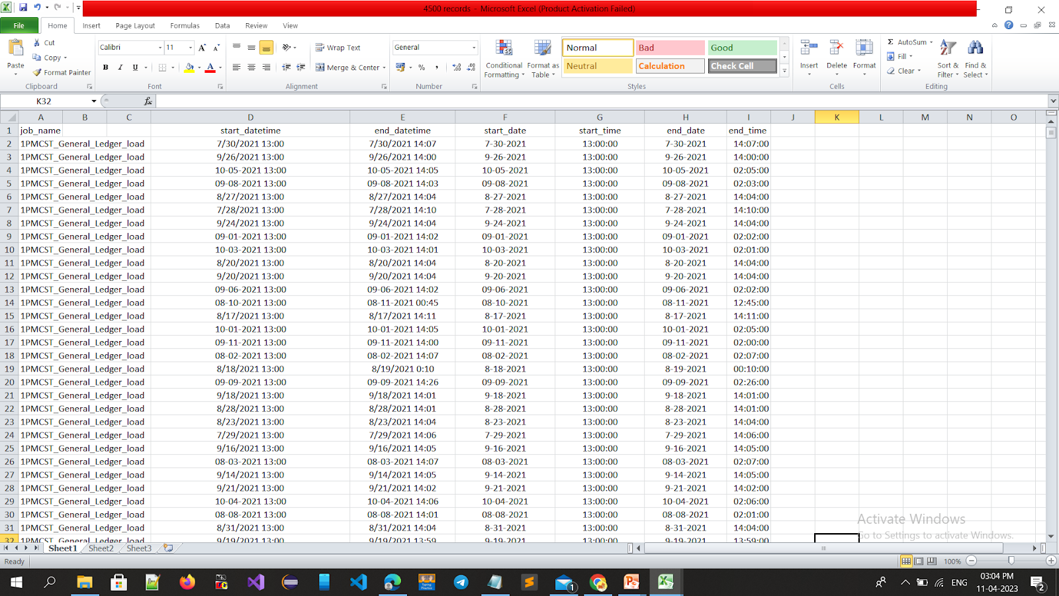

Slide 5
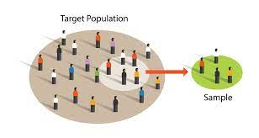
2.TAKE SAMPLE FROM DATA
Since entire dataset cannot be processed at a time, we have taken samples for processing
Sample of 4500 rows was taken

Slide 6
3.USE START TIMESTAMP AND END TIMESTAMP TO FIND DEPENDENCIES
Analyse the difference of the start and end times of the jobs to find their sequence
The pairs where end time one job is less than that the start of the other job, are taken

Slide 7
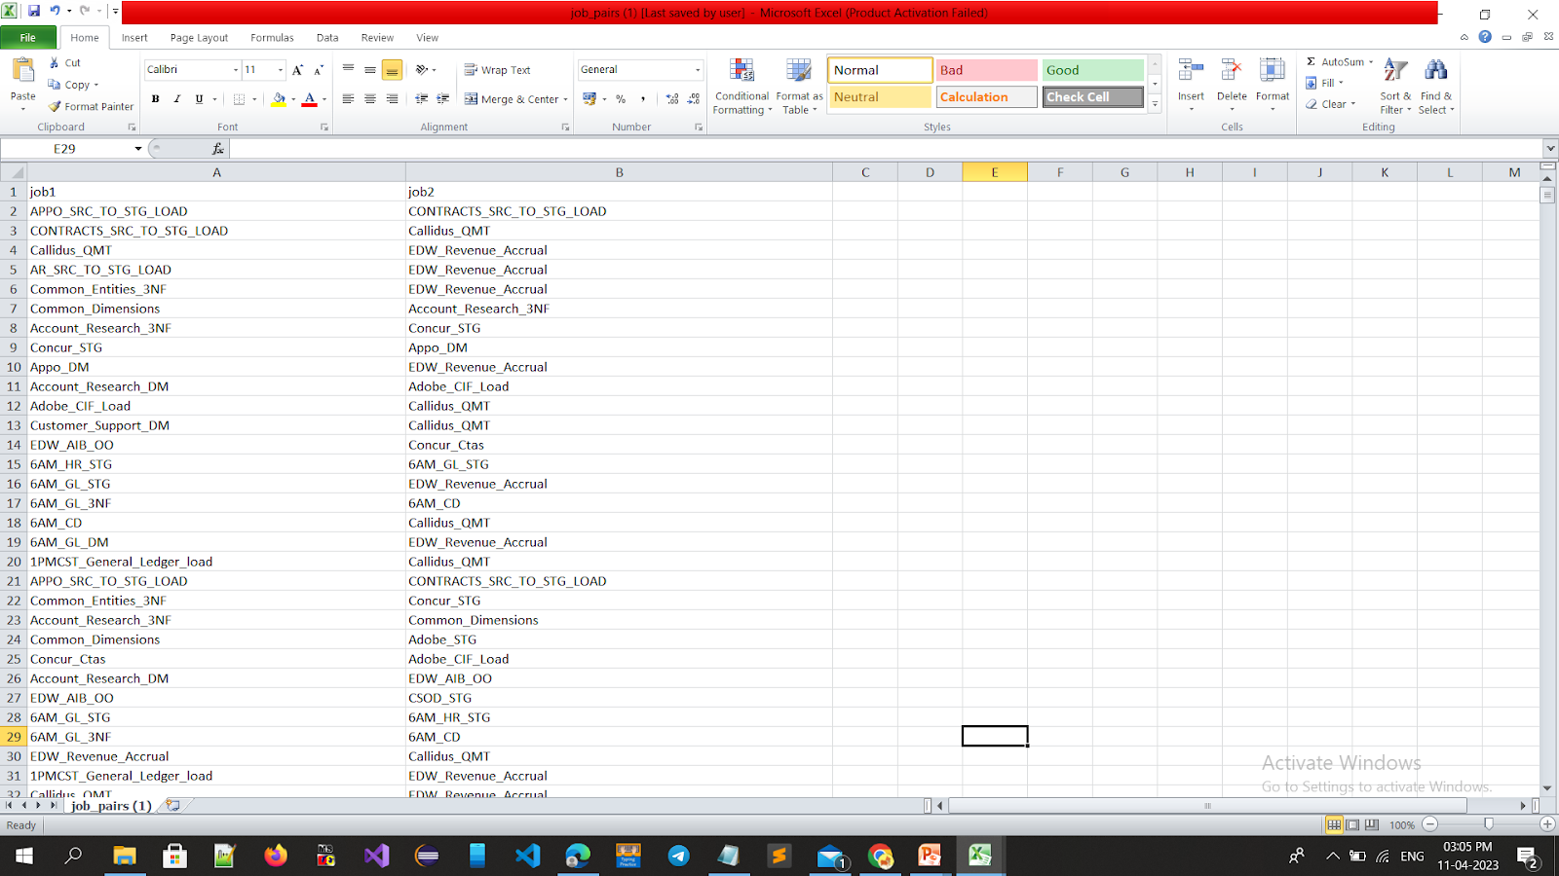

Slide 8
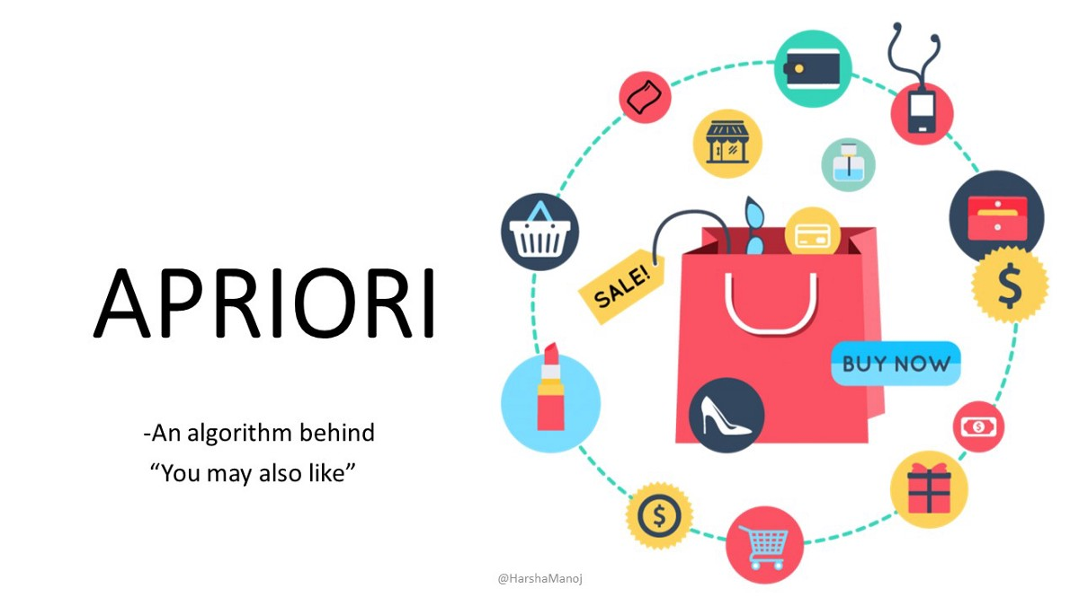
4.RUN APRIORI ALGORITHM TO FIND ASSOCIATION RULES
This algorithm helps to find parameters like confidence, lift and support
These parameters help to identify how strong
the dependency is

Slide 9
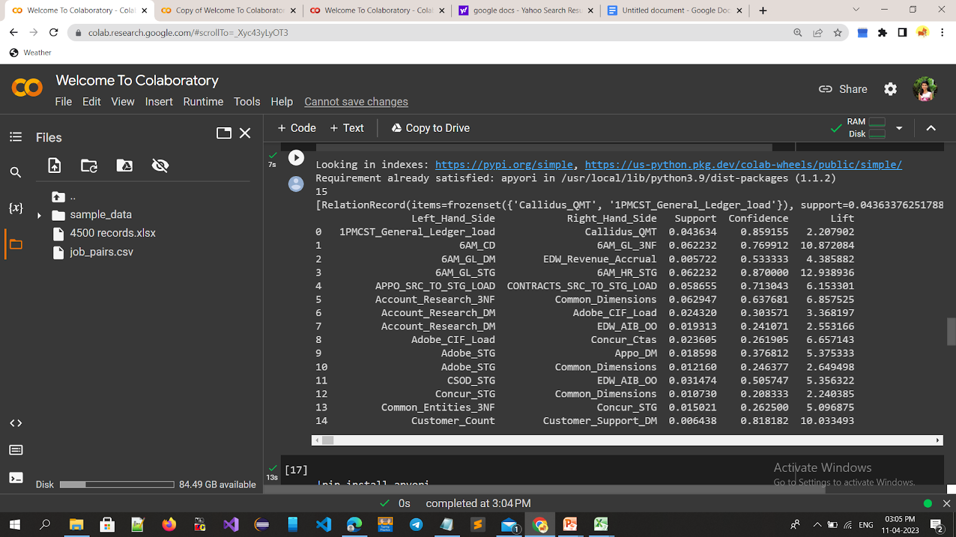

Slide 10
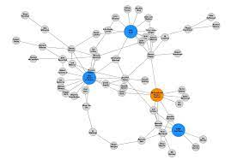
5.PLOT THE GRAPH BASED ON THE ASSOCIATION RULES OBTAINED FROM THE APRIORI ALGORITHM
Graph has been made using NetworkX and Matplotlib libraries

Slide 11
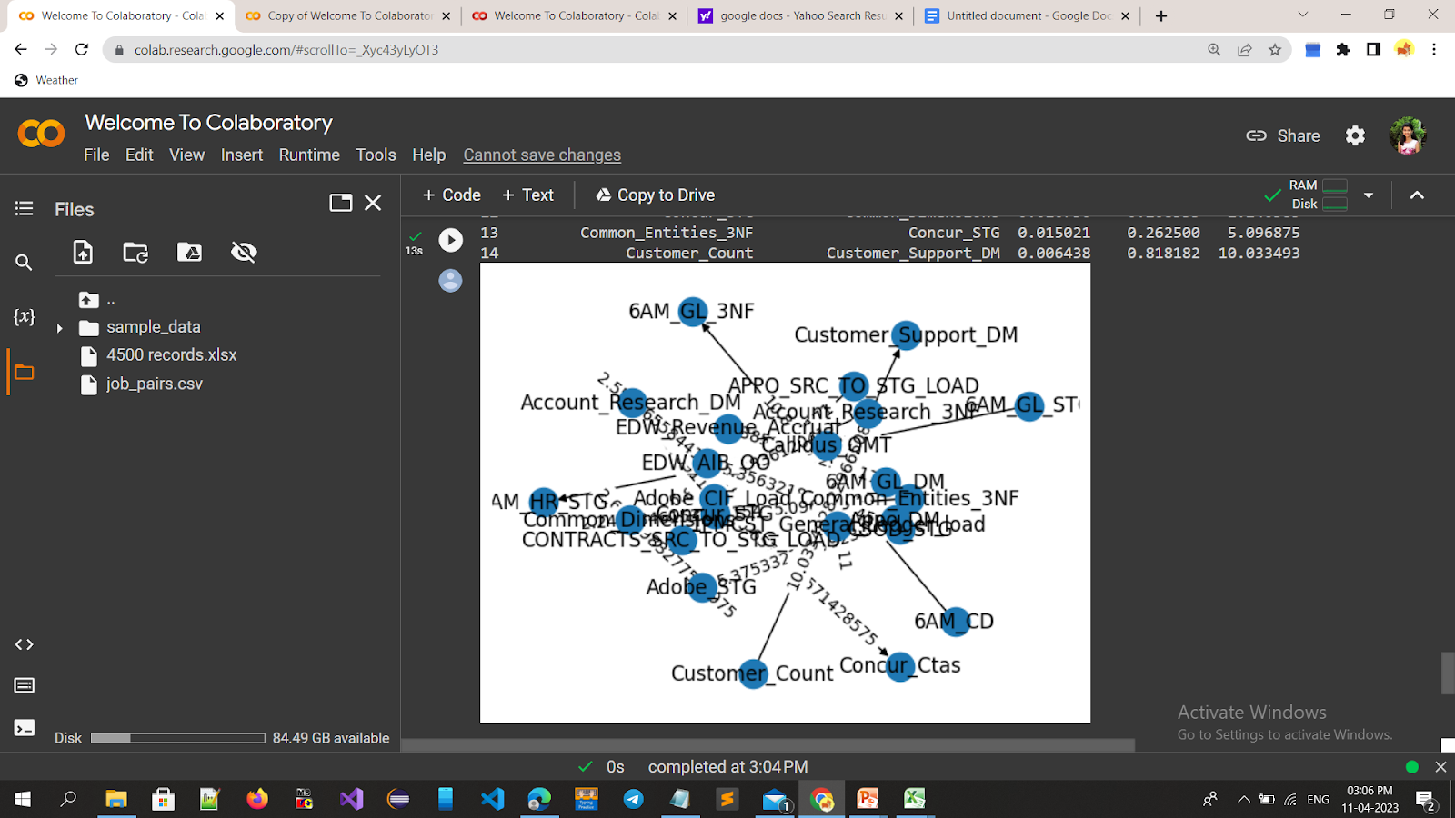

Slide 12
Thank you!
Isha Anil Suryawanshi
Aishwarya Patankar
Yashashri Sonawane

