Slide 1
Room Booking Application
Presented By:
Aishwarya Patil

Slide 2
Problem Statement
This application will help to book rooms and select rooms of interest. Customer can search rooms by type.

Slide 3
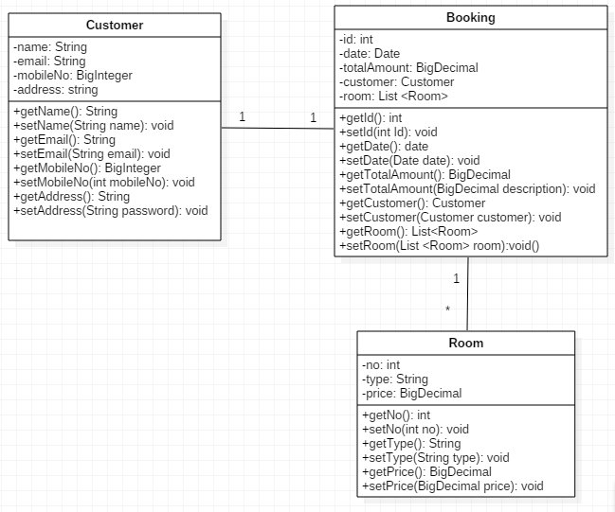
POJO Class

Slide 4
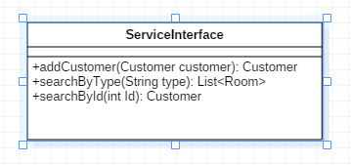
Service Interface

Slide 5
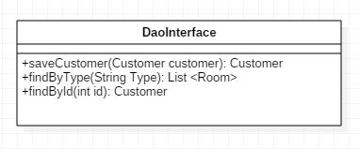
Repository Interface

Slide 6
Thank you

