Slide 1
Seoul Bike Rental Analysis
Impact of Weather on Bike Usage

Slide 2
Introduction
Seoul's bike rental system helps commuters and tourists.
Objective: Understand demand patterns and weather impact.
Dataset: Seoul Bike Sharing data.

Slide 3
Key Insights
Bike rentals peak in Spring & Autumn.
Cold winters reduce bike usage significantly.
Optimal temperature for bike rentals: 15-25°C.
Rain and snow negatively affect rentals.

Slide 4
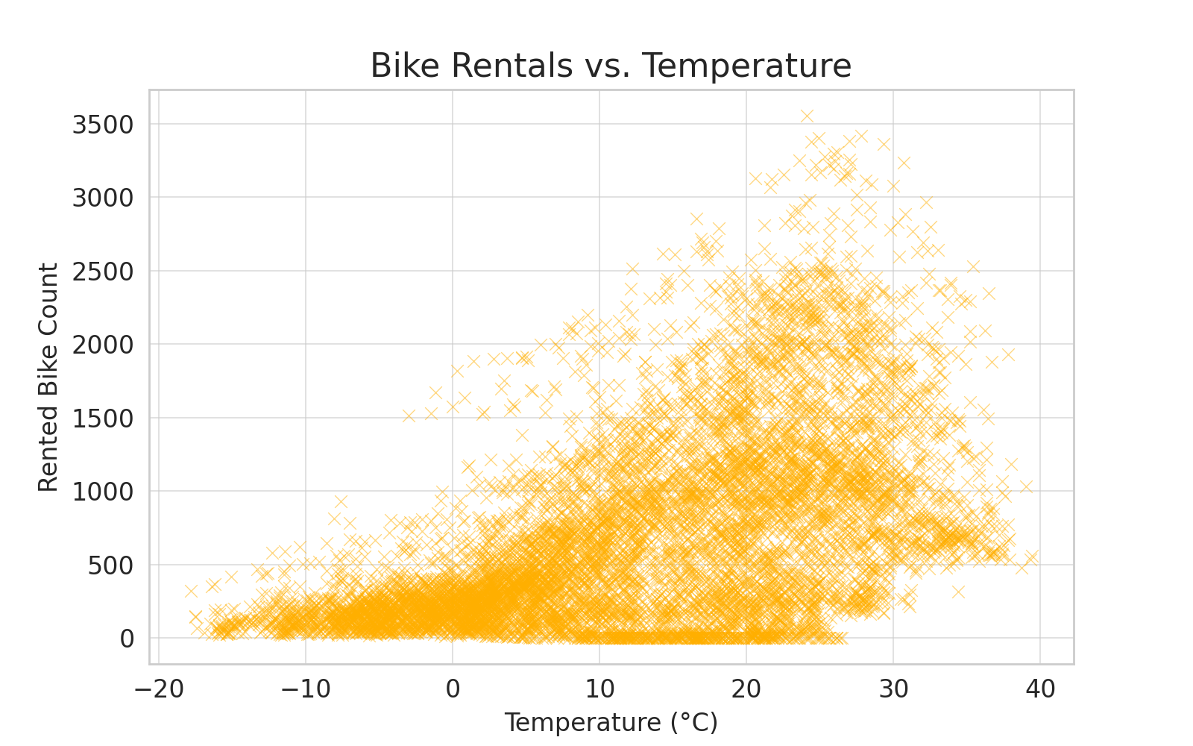
Bike Rentals vs. Temperature

Slide 5
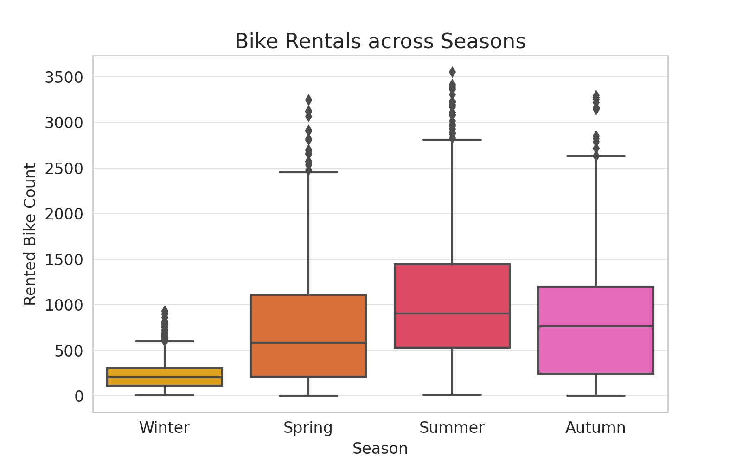
Bike Rentals across Seasons

Slide 6
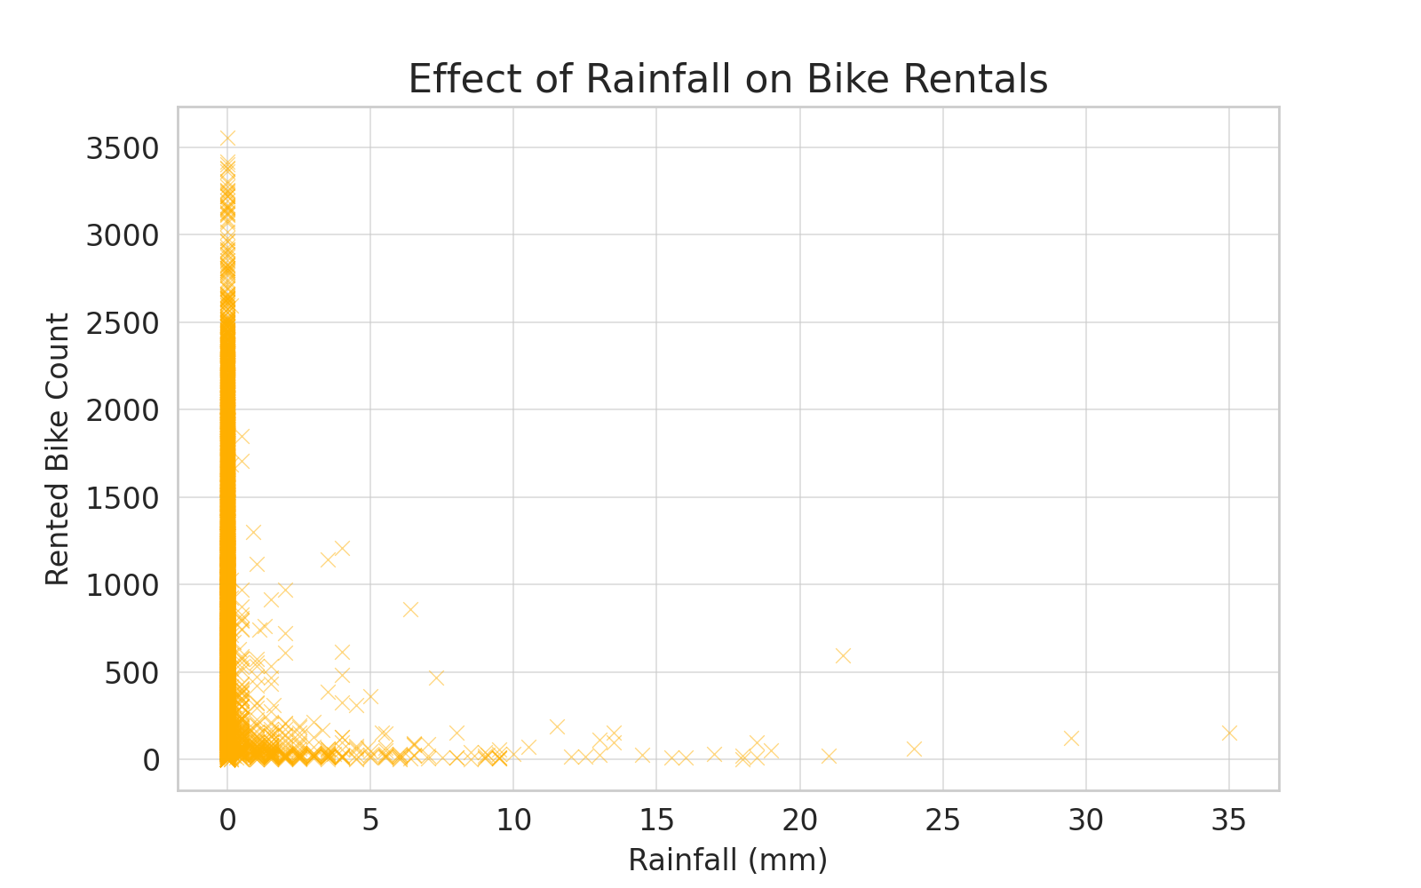
Effect of Rainfall on Bike Rentals

Slide 7
Conclusion & Recommendations
Encourage winter biking through incentives.
Improve bike infrastructure for rainy days.
Consider dynamic pricing based on weather conditions.

