Slide 1
Crafting Compelling Web Presences

Slide 2
WIPRO
It is a global company delivering innovation-led strategy, technology, and business consulting services. We are focusing on these 3 services of the company. 1. Cybersecurity 2. Wipro’s Digital Operations and Platforms 3. Artificial Intelligence

Slide 3
CYBERSECURITY
Cybersecurity encompasses a wide range of practices and technologies aimed at protecting computer systems, networks, applications, and sensitive data from malicious attacks
Company provides with expertise and experience cybersecurists. it provides the design and implementation of security without interruption
Wipro’s recent acquisitions of leading strategy consulting firms Edgile, Ampion and Capco enabled us to accelerate the development of Wipro cybertransform to meet this demand
They are involved in the Face down treats, Building data and stored in cloud and also in X-ray vision

Slide 4
Artificial Intelligence
Wipro ai360 is a platform designed to help enterprises harness the full potential of ai technology. By integrating ai across various aspects of the business ecosystem, Wipro ai360 acts as a facilitator, enabling companies to embrace the future with confidence.
The combination of human expertise and ai capabilities allows for accelerated decision-making, Data-driven insights, and the realization of ambitious goals.
The team at wipro ai360 comprises a diverse group of professionals, including Data scientists, architects, Domain specialists, technologists, and Engineers, all working together to deliver innovative solutions to clients.

Slide 5
Data Analytics
Data serves as the cornerstone of business operations, providing valuable information, insights, and opportunities for growth.
Wipro recognizes the significance of data in driving business success and leverages technology and ai to enhance its capabilities.
By combining the art and science of data analysis, intelligence, and creativity, Wipro bridges the gap between data and people, unlocking the potential that data offers.
With a wealth of experience in harnessing the power of data, Wipro helps organizations turn their ambitions into tangible outcomes, enabling them to realize their full potential.

Slide 6
Determine the platform on which the website is developed (Use online tools to identify)
The online tool used to identify the platform on the website is used is wapplyzer
Analytics_wappalyzer_wipro.csv

Slide 7
Mobile Responsiveness and Mobile Optimization
We can use many online tools to check the responsiveness of the website like Google chrome inspector, Responsinator, Browser stack etc
Click on f12 key where the inspector section pops up and then click on the Toggle device elimination icon by opening this icon we get the results as below slides
We get many options in this like devices, dimensions so as per requirements we can alter all the options

Slide 8
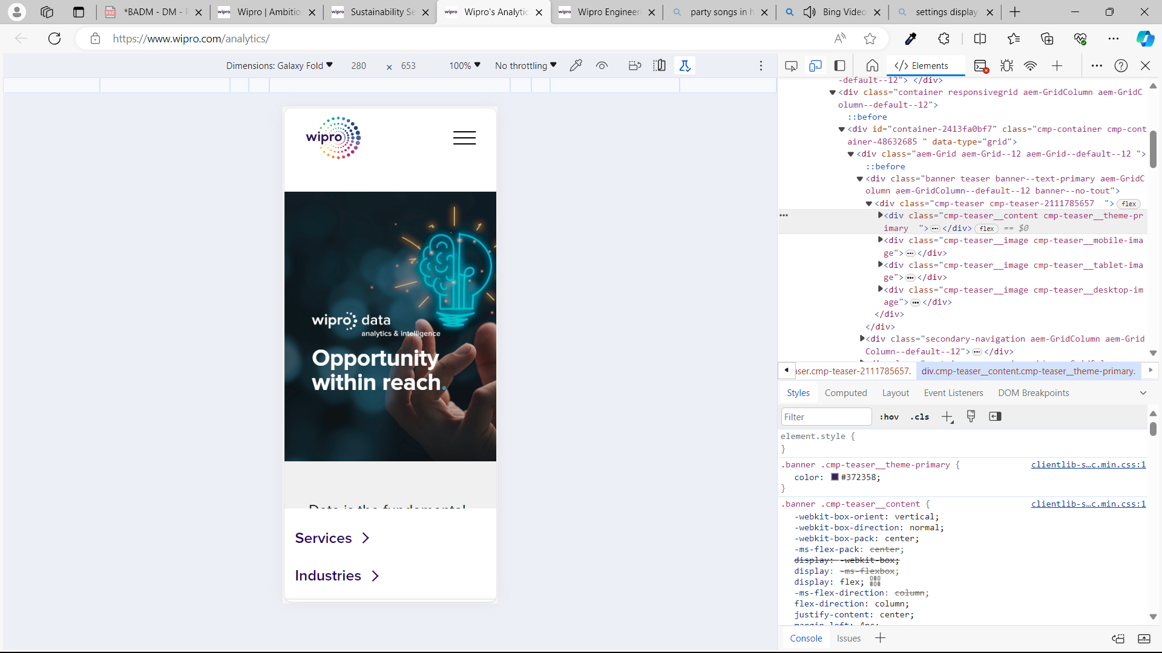
This is result of Data Analytics page for Galaxy fold

Slide 9
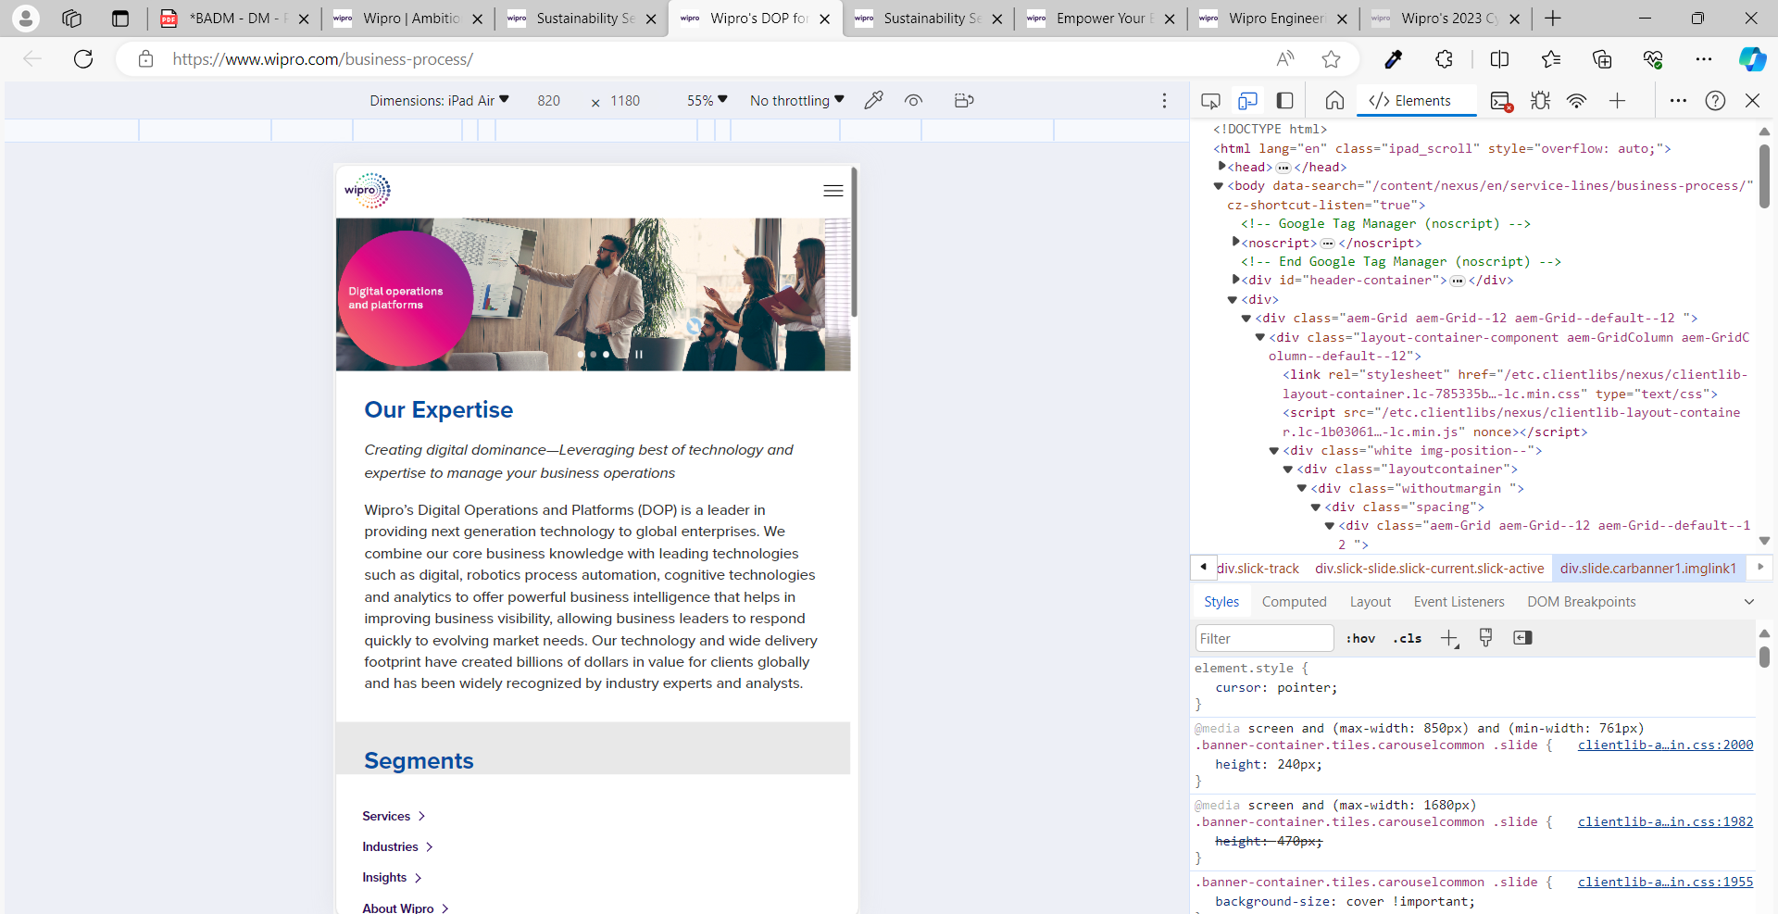
This is the result of Bussiness process services page for ipad air

Slide 10
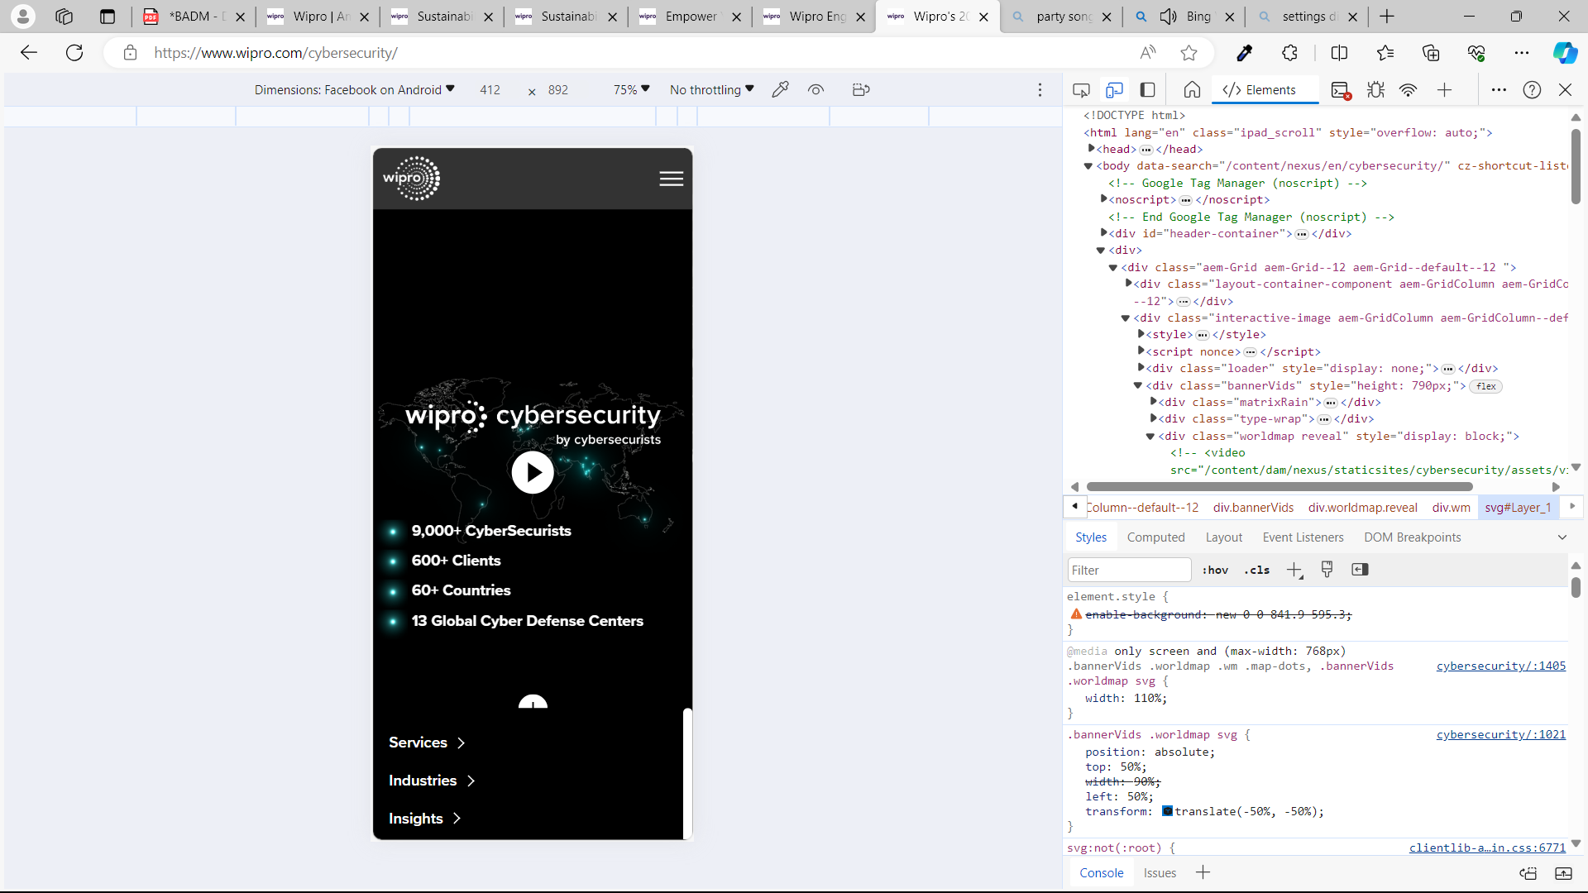
This is the result of Cybersecurity services page for Facebook on Android

Slide 11
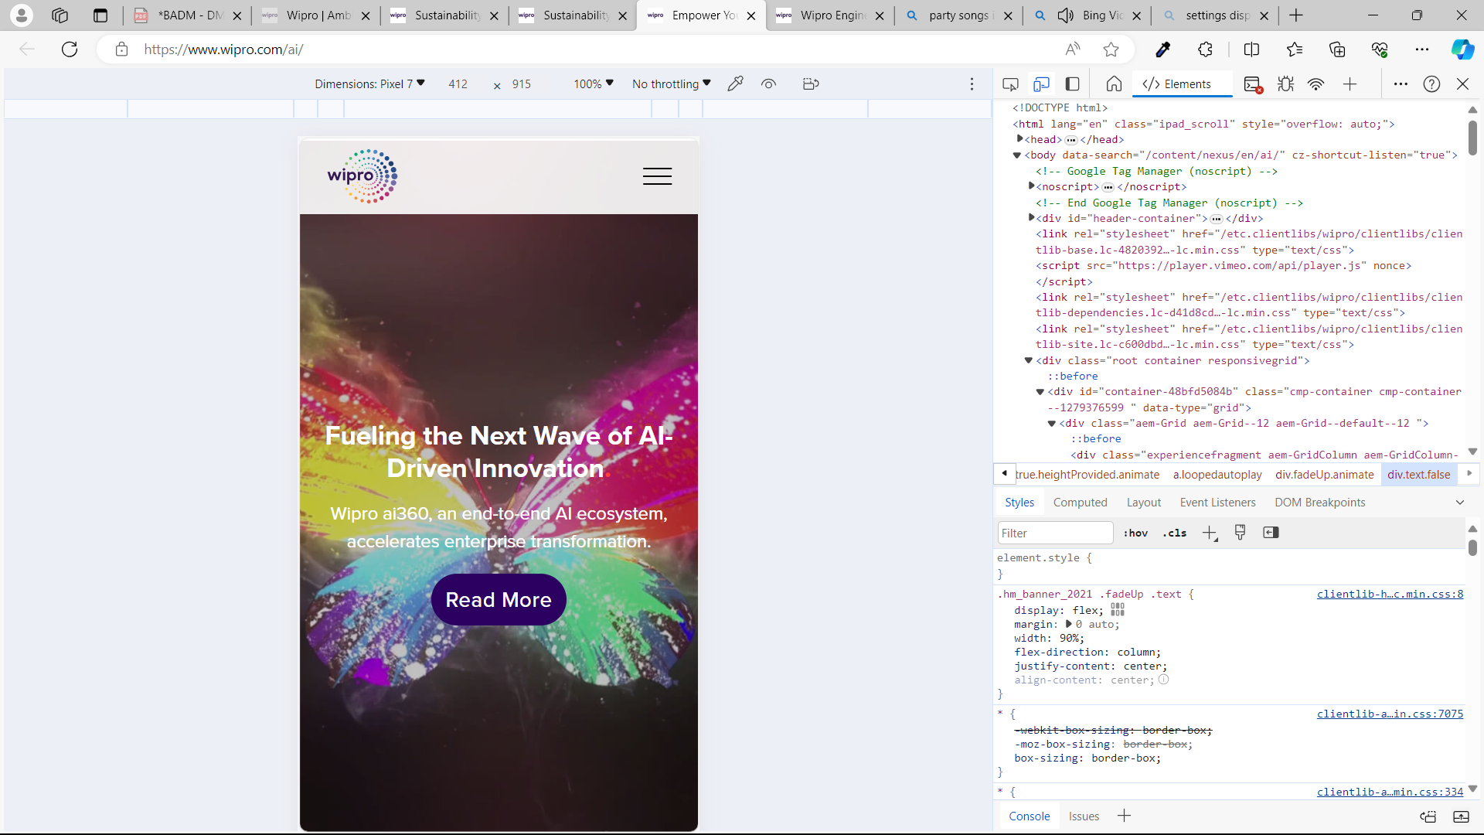
This is the result of Artificial intelligence services page for Pixel 7

Slide 12
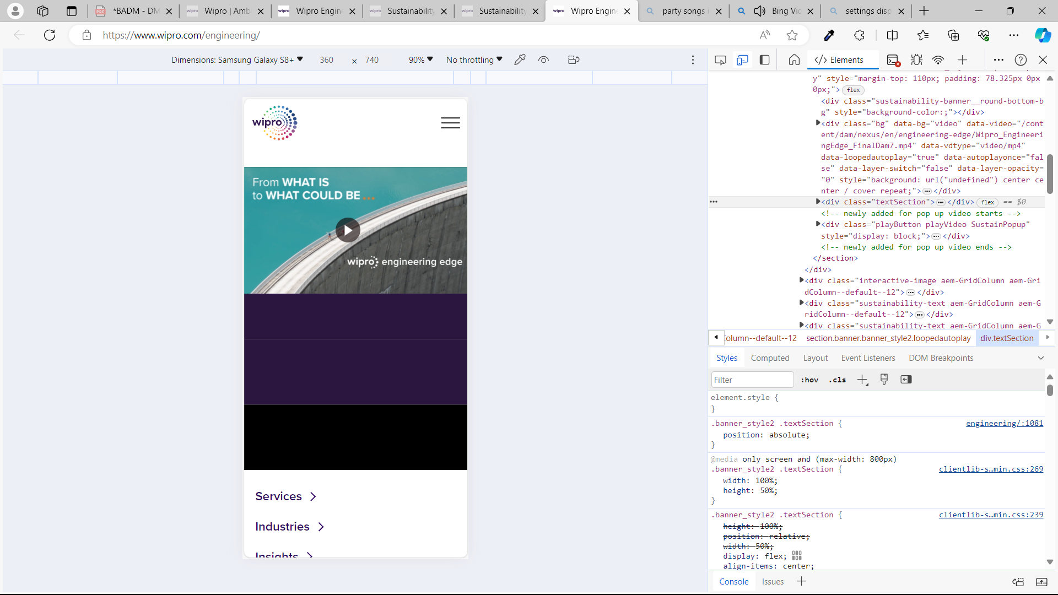
This is the result of Engineering services page for Sumsang 8+

Slide 13
Some of the Suggestions to avoid during Website Design
Main navigation menu has poor organization
Font and the picture collision
Stuffing to many information in one page which makes the user perplexity
Having a lack of hierarchy
Too many links

Slide 14
list of best practices for creating visually appealing and user-friendly website designs
Keep the design clean and uncluttered: avoid overcrowding the website with too many elements. use white space effectively to create a visually pleasing layout.
Make your website a breeze to navigate :Ease of navigation is a fundamental aspect of User-centric web design. A confusing navigation structure can lead to frustration and prompt users to leave your site.
Use a consistent color scheme: Choose a color palette that complements your brand and use it consistently throughout the website for a cohesive look

Slide 15
list of best practices for creating visually appealing and user-friendly website designs
Prioritize readability: use legible fonts, appropriate font sizes, and sufficient contrast between text and background colors to ensure easy readability.
Emphasise visual hierarchy : effective visual hierarchy enhances the usability and accessibility of your site and helps guide visitors to take the actions you want them to take.
Optimize for mobile responsiveness: design your website to be mobile-friendly, ensuring that it looks and functions well on various devices and screen sizes.
Include intuitive navigation: make it easy for users to find their way around the website by using clear navigation menus and logical page structures.

Slide 16
Design a landing page for their product or service to generate leads for Figma
Link of the website created on Figma
https://www.figma.com/file/rAaqbdd3tRoxKpT5O0m8oe/Untitled?type=design&node-id=0%3A1&mode=design&t=cwjaFQIhaRSDIJ2Z-1

Slide 17


