Slide 1
Payless Car Rentals
Aishwarya Ram Solaisamy Ramachandran
Team ID: 15
Folder: b-f19-15
“E-business” class, Prof. Hanh Pham, Fall 2019

Slide 2
Outline
Business Model
1.1 Business Context and Goals
1.2 Technical Requirements & Technologies
Architecture
Protocols
Database (with data examples)
Schedule

Slide 3
Business Model: B2C
Business Context and Goals:
Payless Website has:
Huge Varieties of Vehicles to Rent
Many Customers compare prices before final booking, this website tracks customer logins.
To increase sales, Email Marketing Automation Program is employed.
24 * 7 Customer Support
Manage Inventory Count
Supports both Cash and Card Payment

Slide 4
Business Model
Our Customers:
Payless Car Rental primarily serves E-City customers who
1. require a temporary vehicle for example, those who do not own car,
2. travelers who are out of town, or
3. owners of damaged or destroyed vehicles who are awaiting repair or insurance compensation.

Slide 5
Business Model
Vehicles we Rent- Our Products:
CARS
Standard Car
Full Size Car
SUVs
Compact SUV
Full Size SUV
Vans
Mini Van

Slide 6
Business Model
1.2 Technical Technologies & Requirements
PLATFORM:
PAYLESS Rentals supports the following
Operating System:
1. iOS
2. Windows
3. Linux
Browsers:
1. Google Chrome
2. Mozilla Firefox
3. Safari
4. Internet Explorer
Users
Users
1.Registered
Customers
2. Admin
3. Guests

Slide 7
Business Model
1.2 Technical Requirements & Technologies
Programming Languages Used:
a) Client Side Programming Language
1. HTML 5
2. CSS3 Bootstrap (for styling)
3. Javascript
b) Server Side Programming Language(Middleware/Framework)
1. PHP
c) Back end Programming
1. SQL Queries in phpMyAdmin
Web Server Used: CS Web Space
SQL Server:
Database Name: b_f19_15_db
Socket Connection:
Java

Slide 8
ARCHITECTURE
Front Page
<index.php>
Header Page
<header.php>
Footer Page
<footer.php>
Body Page
<index.php>
Menu
<header.php>
Navigation Bar
<header.php>
Registration
<customer_register.php>
Home Page
<index.php>
My Account
<my_account.php>
Shop
<shop.php>
Shopping Cart
<cart.php>
Contact Us
<contact.php>
customer_orders
Vehicle Categories
<sidebar.php>
CheckOut
<checkout.php>
products
Product Details
<details.php>
Order Placed
<payment_options.php>
product_categories
LogOut
<logout.php>
EditAccount
<edit_account.php>
ChangePassword
<change_pass.php>
MyOrders
<my_orders.php>
customers
customers
customers_orders

Slide 9
Socket Connection with the Bank Server
Port #
Flag file
f-As.dat
Payment
Data File
Ac.dat
response
Bank
Socket
Server
Rental
Server
request Payment
Flag File
F-Qc.dat
Payment Data file As.dat
Port #
Payment
Data File
Qc.dat
Payment Datafile Qs.dat

Slide 10
Socket Connection with the Mayor TaxServer
Port #
Flag file
f-As.dat
TaxPayment
Data File
Ac.dat
response
Mayor
Server
Socket
Rental
Server
request IT payment
Flag File
F-Qc.dat
TaxPayment Data file As.dat
Port #
TaxPayment
Data File
Qc.dat
TaxPayment Datafile Qs.dat

Slide 11
Socket Connection with the Shipment Server
Port #
Flag file
f-As.dat
Shipment
Data File
Ac.dat
response
Shipment
Server
Socket
Rental
Server
request Shipment
Flag File
F-Qc.dat
Shipment Data file As.dat
Port #
Shipment
Data File
Qc.dat
Shipment Datafile Qs.dat

Slide 12
Socket Connection with the IT Services
Port #
Flag file
f-As.dat
Transaction
Data File
Ac.dat
response
IT Service
Server
Socket
Rental
Server
request Transaction
Flag File
F-Qc.dat
Transaction Data file As.dat
Port #
Transaction
Data File
Qc.dat
Transaction Datafile Qs.dat

Slide 13
PROTOCOLS
3.1 TRANSACTIONS
T1: REGISTRATION - Enables a new customer to register his information
T2: LOGIN - Enables an existing customer to login
T3: SHOP PAGE - Displays all the vehicle information to the Guest, Customers and Admin
T4: DETAILS PAGE - Displays every details about the vehicle.
T5: PAYMENT OPTIONS PAGE - Gets the Shipping and Payment information from the User and stores the order information in the customer_orders table.
T6: MY ACCOUNT - MY ORDERS - Displays the order information of a registered customer
T7: MY ACCOUNT - EDIT ACCOUNT - Enables the customers to edit their account information
T8: MY ACCOUNT - CHANGE PASSWORD - Enables the customers to change their passwords

Slide 14
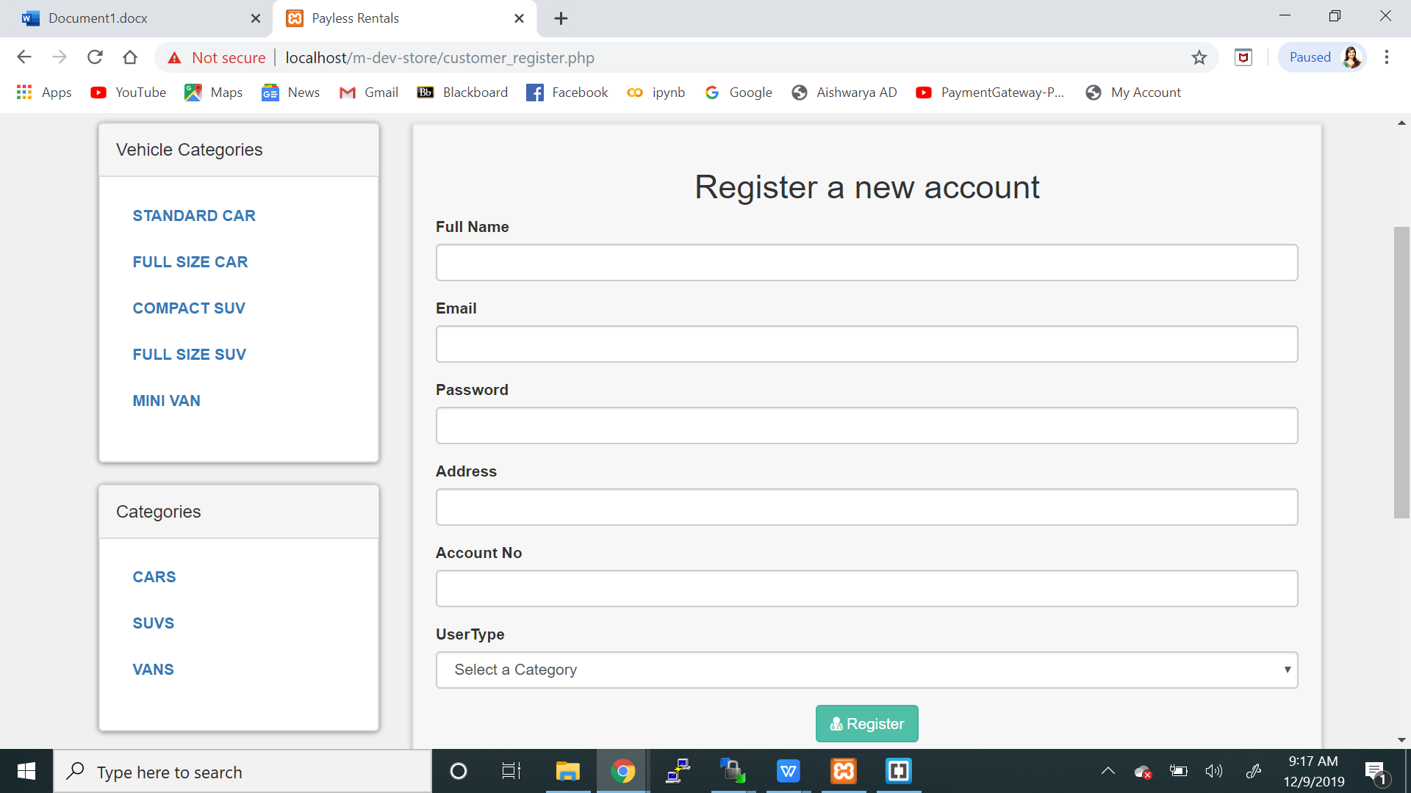
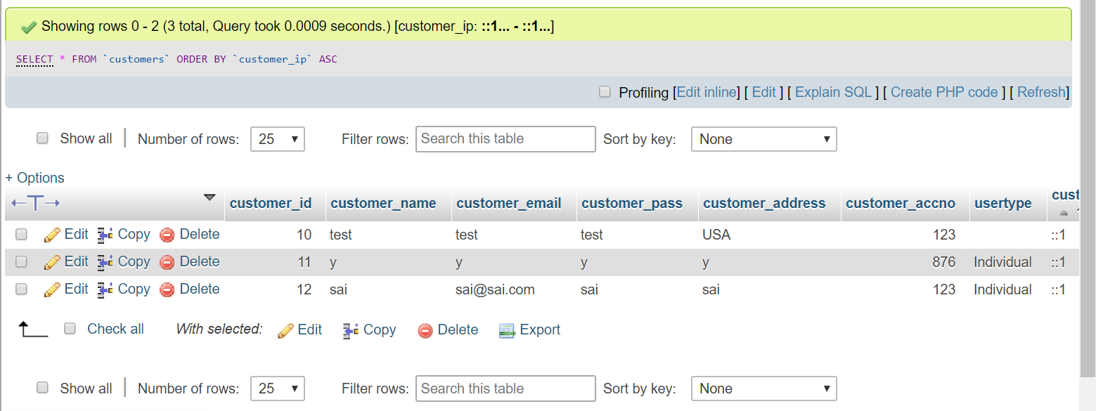
3.2 PROTOCOLS
ClientServer:
Chrome
Web Server:
CS Server
Database Server:phpMyAdmin
DBname:b_f19_15_db
requests
inserts into customer
table
customer_register.php
User
response
records inserted
“You have been registered
successfully”
Registration Page

Slide 15
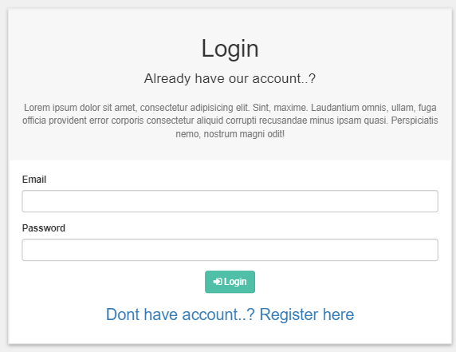
3.2 PROTOCOLS
ClientServer:
Chrome
Web Server:
CS Server
Database Server:phpMyAdmin
DBname:b_f19_15_db
requests
checks customer login
customer_login.php
Table:
customers
User
returns login response
returns login response
“Your email or password
is incorrect”
Login Page
“Your are now
logged in”

Slide 16
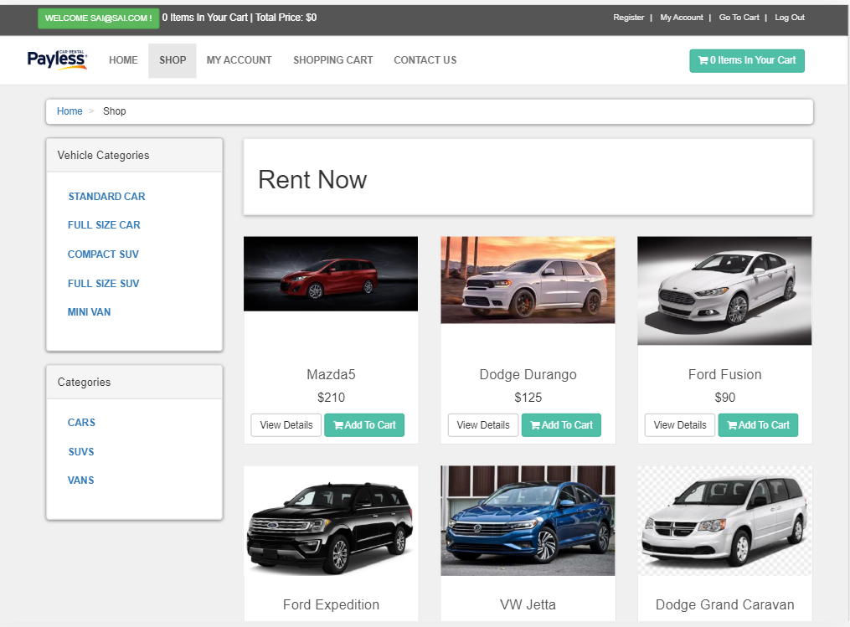
3.2 PROTOCOLS
ClientServer:
Chrome
Web Server:
CS Server
Database Server:phpMyAdmin
DBname:b_f19_15_db
selects vehicle info
requests vehicle info
shop.php
Table:
products
User
displays vehicle info to the user
responds vehicle info
to the web server
Shop Page

Slide 17
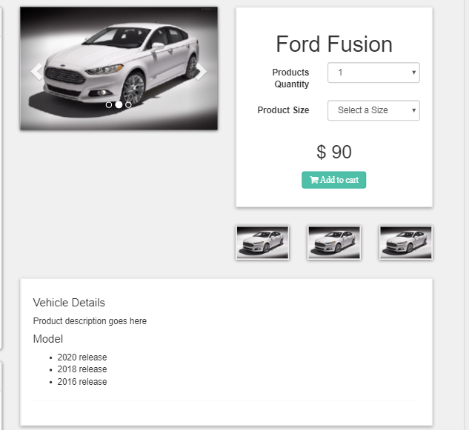
3.2 PROTOCOLS
ClientServer:
Chrome
Web Server:
CS Server
Database Server:phpMyAdmin
DBname:b_f19_15_db
selects vehicle info
requests vehicle info
details.php & functions.php
Table:
products
User
responds vehicle info to the user
returns vehicle info
to the web server
Item Description Page

Slide 18
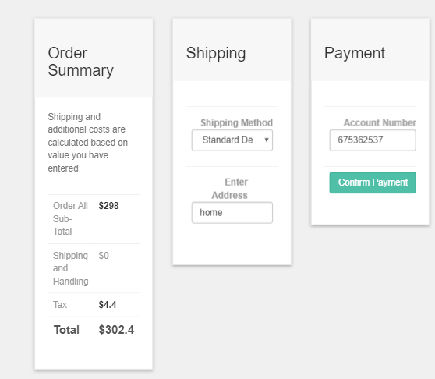
3.2 PROTOCOLS
ClientServer:
Chrome
Web Server:
CS Server
Database Server:phpMyAdmin
DBname:b_f19_15_db
executes the insert query
to the customer_orders
table
requests to store the shipping
& payment details
payment_options.php
Table:
customer_
orders
User
responds to the web browser
with the order confirmation number
returns confirmation no. to
the webserver
payment_options Page

Slide 19
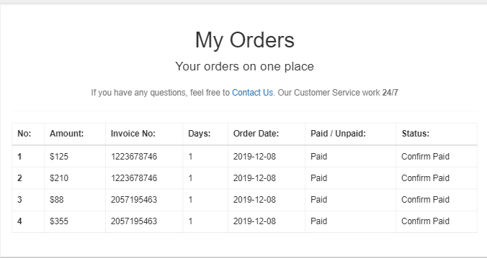
3.2 PROTOCOLS
ClientServer:
Chrome
Web Server:
CS Server
Database Server:phpMyAdmin
DBname:b_f19_15_db
selects order info from
the table customer_orders
requests order info
of the customer
my_orders.php
Table:
customer_
orders
User
responds to the web browser
with the order info of the customer
returns order info
to the webserver
MyAccount: my_orders Page

Slide 20
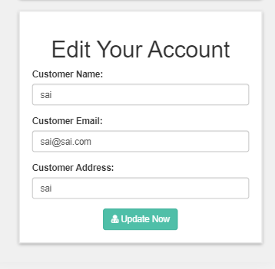
3.2 PROTOCOLS
ClientServer:
Chrome
Database Server:phpMyAdmin
DBname:b_f19_15_db
Web Server:
CS Server
updates the customer
table with the info
requests for account edit to
the web server
edit_account.php
Table:
customers
User
responds to the web browser
with updated message.
returns updated info
to the web server
“Your account has been edited,
to complete the process,
Please Relogin”
MyAccount: edit_account Page

Slide 21
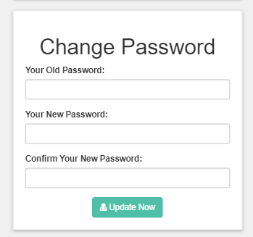
3.2 PROTOCOLS
ClientServer:
Chrome
Web Server:
CS Server
Database Server:phpMyAdmin
DBname:b_f19_15_db
updates the password
in the table customers
requests to update the
password to the web server
change_pass.php
Table:
customers
User
responds to the web browser
with updated message.
returns updated info
to the web server
“Sorry your new password
did not match”
“Your password has been updated”
MyAccount: Change Password Page

Slide 22
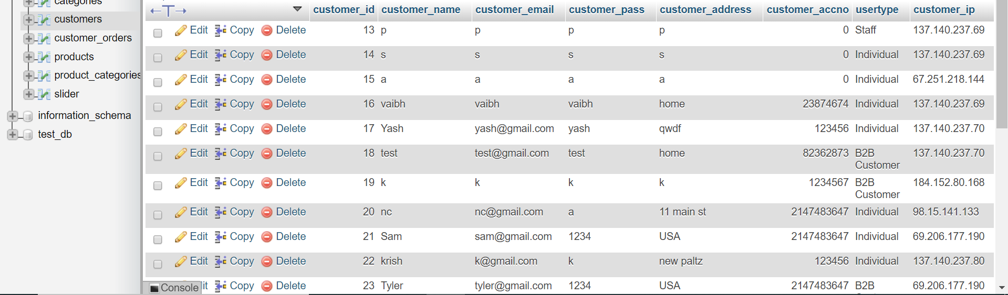
Table: Customers

Slide 23
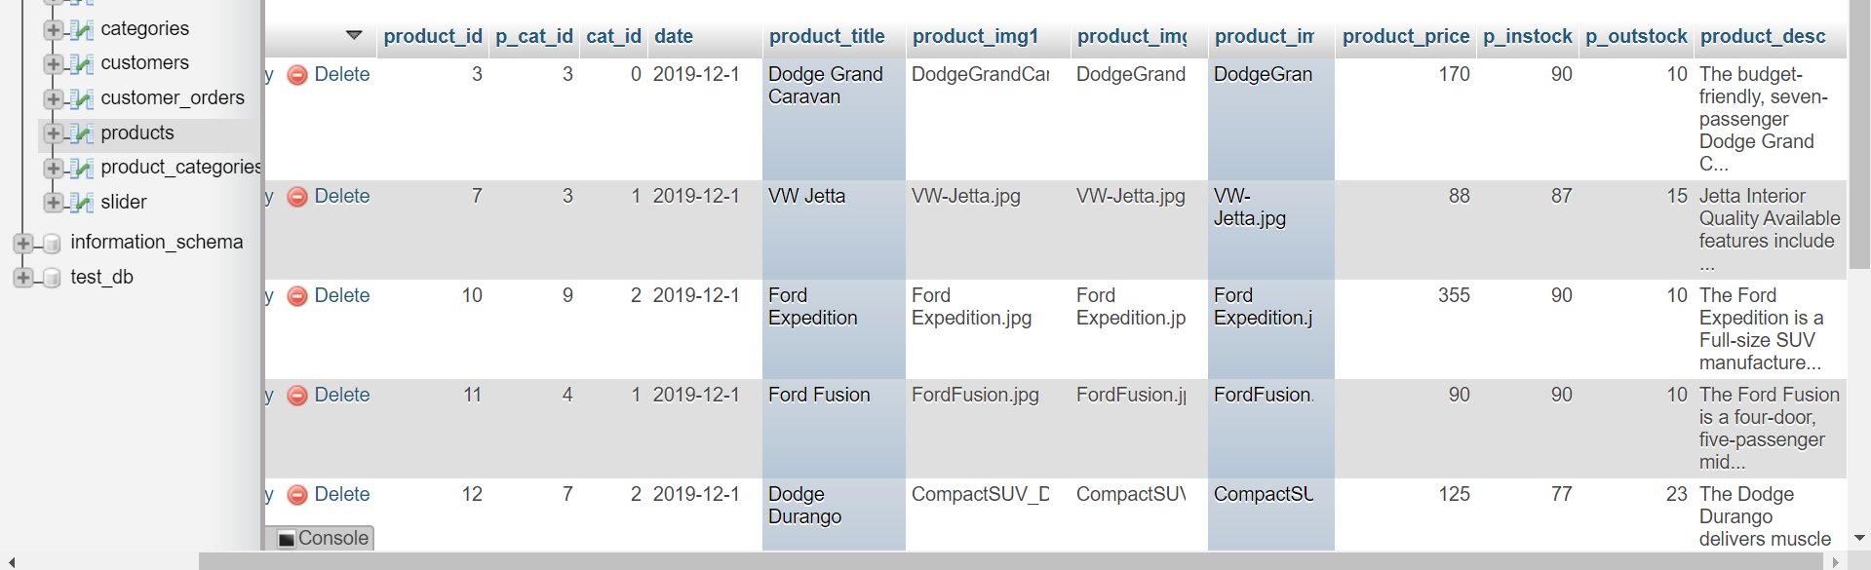
Table: Products

Slide 24
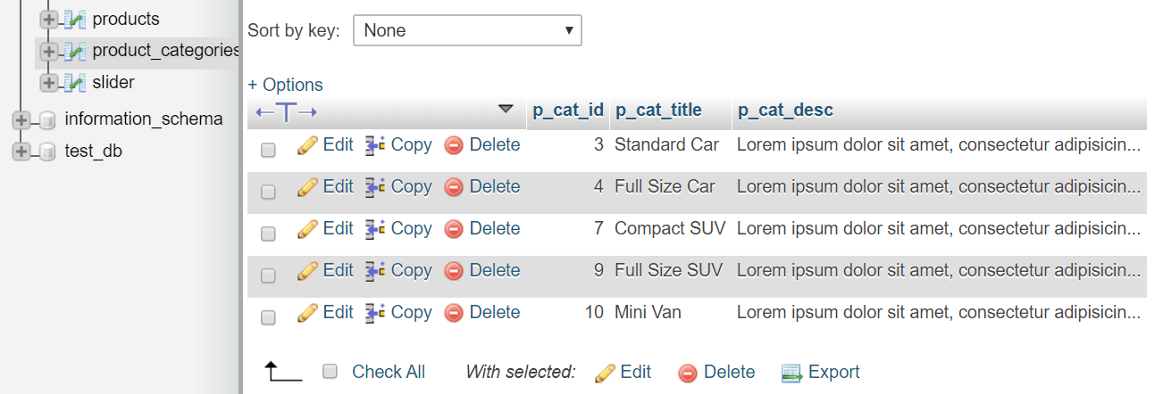
Table: Product Categories

Slide 25
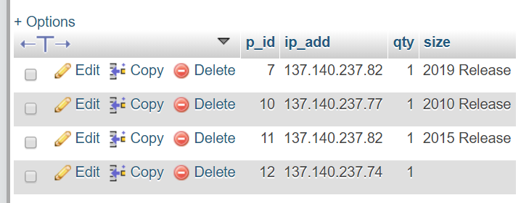
Table: Cart

Slide 26
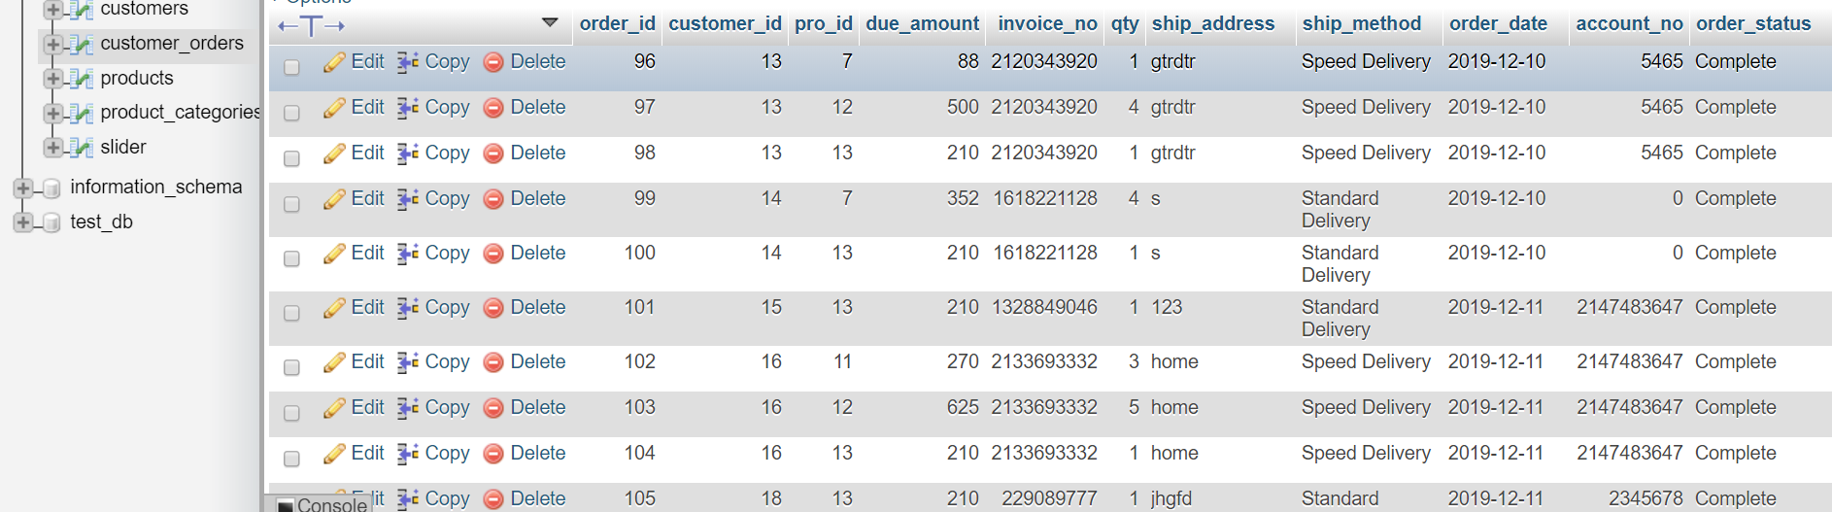
Table: Customer_Orders

Slide 27
SCHEDULE
Date | What to be done | By whom
Oct 29 | Design Presentation | Aishwarya
Nov 19 | Software Demo (15’) | Aishwarya
Dec 10 | Running Company Web Site | Aishwarya
December 11 & 12 | Make purchases (shopping period) | Aishwarya
December 13 | Submit Shopping Record, Report, Software Files | Aishwarya

