Slide 1

Actuate Erd Pro
Building a Report from Scratch

Slide 2
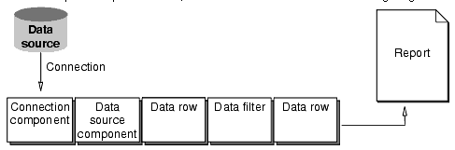
How reports get data

Slide 3
How reports get data
Database Source : Stores the data.
Connection: Communication link to the database.
Connection Component : Stores information about the connectivity properties for the report.
DataSource Component: Using connection components, it selects the data and stores it in datarow.
DataRow: Set of variables containing the data for the report.
Data Filters: Additional Filters the data (if required) as per the report requirement.
Report: Receives the data and displays it.

Slide 4
Checklist for creating a Report
Should have at least one report section.
a Valid Connection component.
A Datastream and a datarow.
Placing the components at right slot.
A Pagelist, page and a flow.

