Slide 1
EECS E6690 Presentation
HCV Disease Prediction
Group Members
Takumi Hayushi (th3000)
Aishwarya Patange (aap2239)
Aishwarya Sen (as6718)
Manasi Khandekar (mk4679)

Slide 2

Problem Statement and Introduction
Hepatitis C is a liver disease caused by the Hepatitis C Virus (HCV). Its ailment duration varies from short-term to chronic infection for different people. Hepatitis C can develop into serious, life threatening diseases like cirrhosis and fibrosis. Thus, its timely diagnosis and treatment is of utmost importance.
Hence, an efficient and accurate predictive model for the detection and classification of various liver diseases caused by HCV is essential and would enable the infected to avail timely treatment.
Fig.1. HC Virus

Slide 3
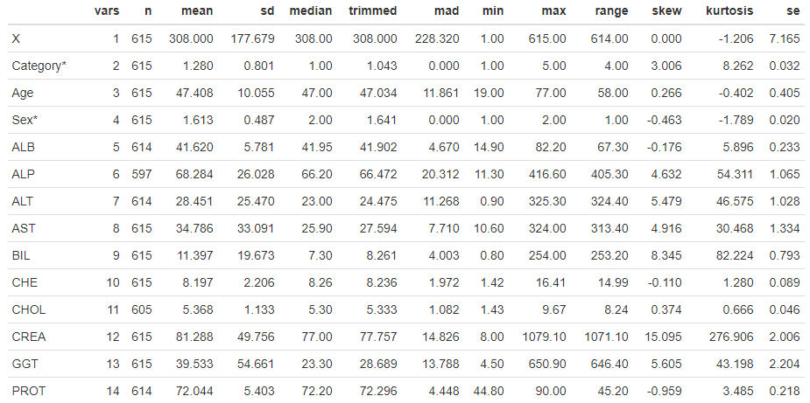
Dataset Description
The dataset has 615 rows of patient data with 14 attributes
All attributes except Sex and Category are numeric.
Category is the target attribute with classes as Blood donors vs. Hepatitis C (including its progress ('just' Hepatitis C, Fibrosis, Cirrhosis)
The predictive attributes are :
X (patient ID), Age (in years), Sex (f,m), ALB, ALP, ALT, AST, BIL, CHE, CHOL, CREA, GGT, PROT (Liver function test results)
Fig.2. Statistical Summary of Dataset

Slide 4
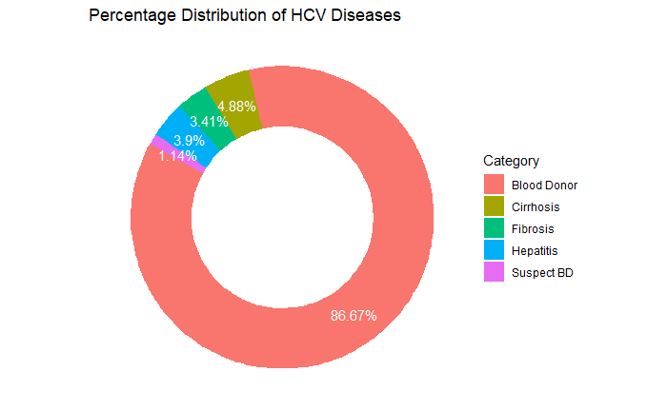
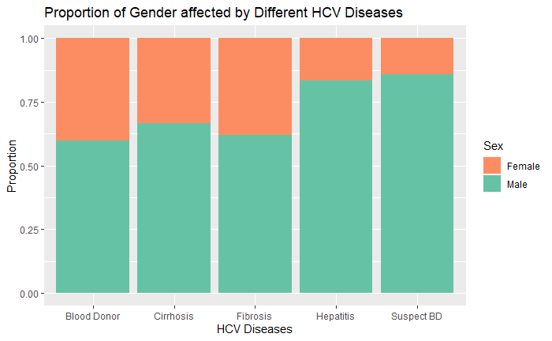
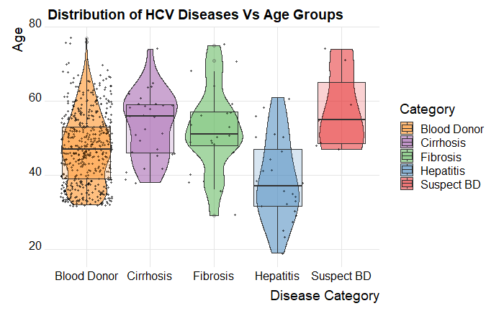
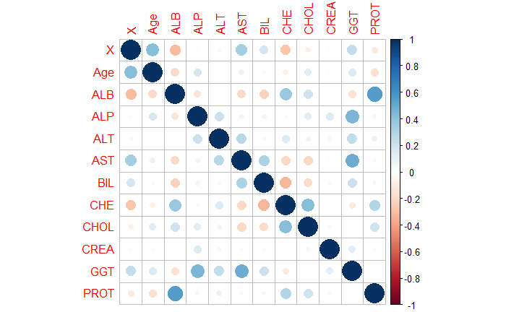
Exploratory Data Analysis
Fig. 3. Percentage Distribution of HCV Diseases
Fig. 4. Proportion of Gender affected by Different HCV Diseases
Fig. 5. Distribution of HCV Diseases Vs Age Groups
Fig. 6. Correlation Plot

Slide 5
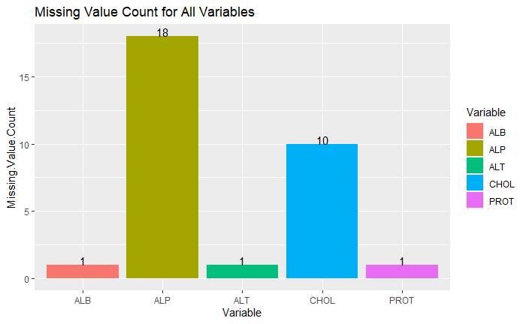
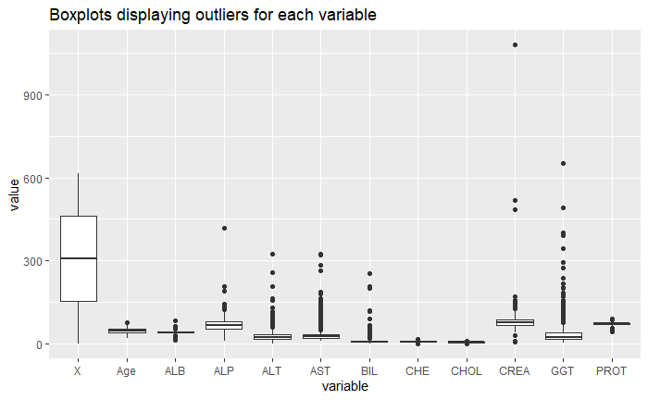
Data Preprocessing
Encode character columns as numeric
Impute NA values using median
Removal of outliers
Remove insignificant columns like patient ID
Fig. 7. Missing Value Count for all Variables
Fig. 8. Outlier Analysis using Boxplots

Slide 6
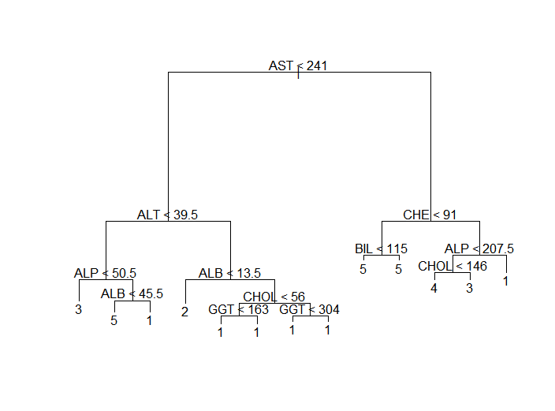
Decision Tree Model
Variables actually used :
"AST" "ALT" "ALP" "ALB" "CHOL" "GGT" "CHE" "BIL"
Number of terminal nodes: 13
Pruned the tree, found tree with size 5 to be the optimal one, with least cross validation error.
Due to pruning, overfitting was decreased but classification error rate increased, because of removal of certain nodes.
 | Unpruned Tree | Pruned Tree
Misclassification Error Rate | 0.04989 | 0.07592
Fig. 11. Decision Tree Model
Table 1. Comparison of Error Rate for Unpruned Vs Pruned Trees

Slide 7
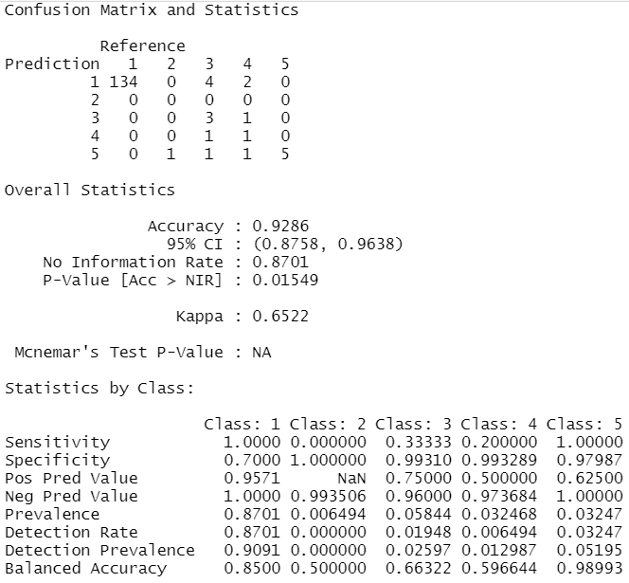
XGBoost Model
Used mlogloss as metric to evaluate training
Of Multiclass softmax objective function.
Max depth of 10, gamma = 3 lowered chances
of overfitting
Gbtree was used as booster, to reduce
Misclassification rate in subsequent iteration
Fig. 15. Statistics for XGBoost Model

Slide 8
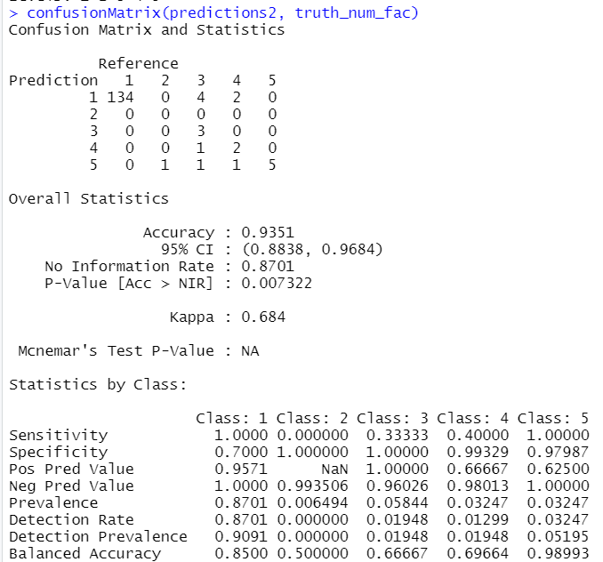
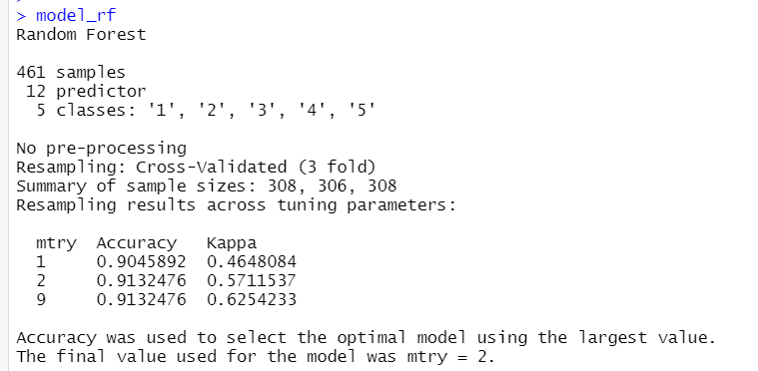
Random Forest Model
2 variables were randomly sampled as candidates at each split.
50 trees were used
Fig. 12. Statistics for Random Forest Model
Fig. 13. Random Forest Model Summary

Slide 9
Comparison of the 3 models
Table 2. Comparison of results for different models
Model | Accuracy
Decision Trees | 71.74
Random Forest | 93.51
XGBoost | 92.86

Slide 10
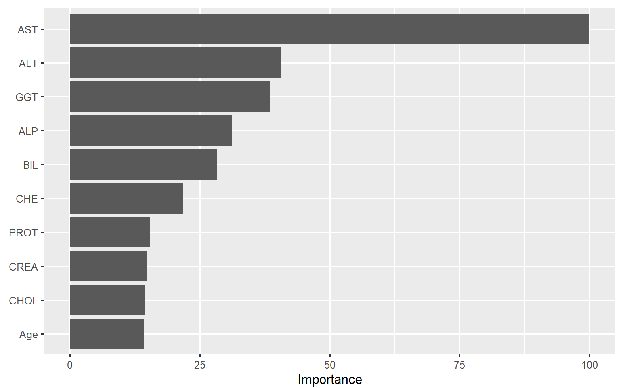
Variable Importance
Fig. 14. Variable Importance Plot from Random Forest Model

Slide 11
Results and Conclusions
We have successfully analyzed and processed the data, and used three types of models in the process.
The Random Forest model was the most accurate as compared to the other two.
As part of our update on our report, we will be using local interpretable model-agnostic explanations (LIME) to explain the prediction models.

Slide 12
References
UCI Machine Learning Repository: HCV data data set. (n.d.). Retrieved December 13, 2022, from https://archive.ics.uci.edu/ml/datasets/HCV%20data
The Elements of Statistical Learning: Data Mining, Inference and Prediction, 2nd Edition. Springer, 2009. https://hastie.su.domains/Papers/ESLII.pdf.
An Introduction to Statistical Learning, Springer, 2014. from ttps://www.statlearning.com.
Chawla, N. V., et al. “SMOTE: Synthetic Minority Over-Sampling Technique.” Journal of Artificial Intelligence Research, vol. 16, June 2002, pp. 321–57. Crossref, https://doi.org/10.1613/jair.953.
Butt, M. B., Alfayad, M., Saqib, S., Khan, M. A., Ahmad, M., Khan, M. A., &amp; Elmitwally, N. S. (2021, December 10). Diagnosing the stage of hepatitis C using machine learning. Journal of Healthcare Engineering. Retrieved December 13, 2022, from https://www.hindawi.com/journals/jhe/2021/8062410/

