Slide 1
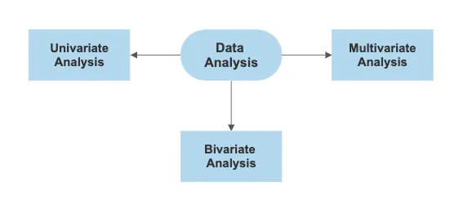

Slide 2
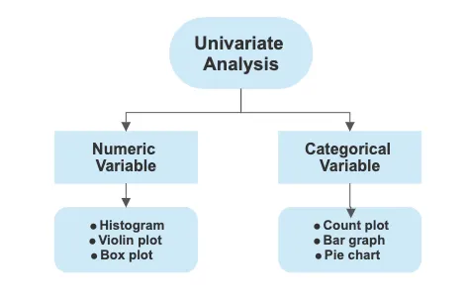

Slide 3
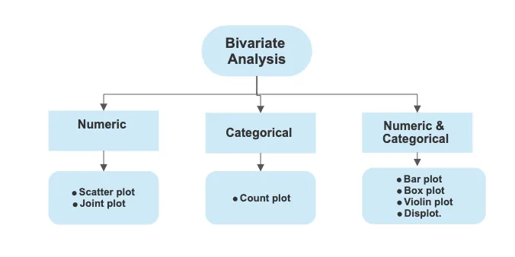

Slide 4
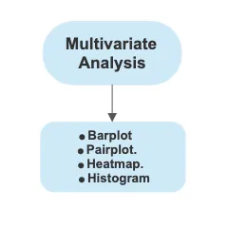

Slide 5
Seaborn
Seaborn is a library mostly used for statistical plotting in Python.
It is built on top of Matplotlib and provides beautiful default styles and color palettes to make statistical plots more attractive.

Slide 6
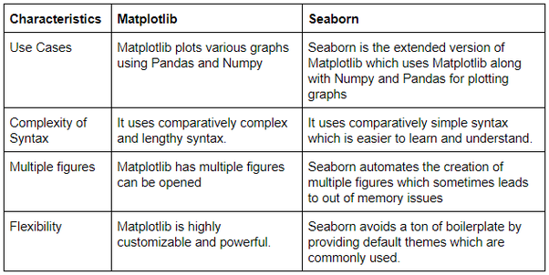

Slide 7
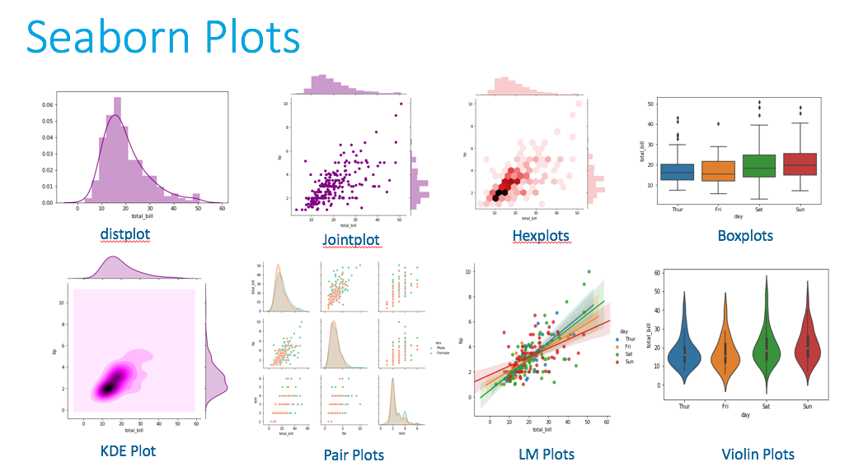

Slide 8
Heatmap

Slide 9
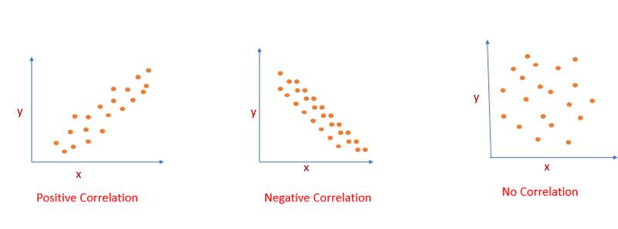

Slide 10
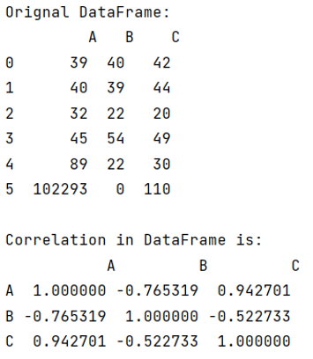
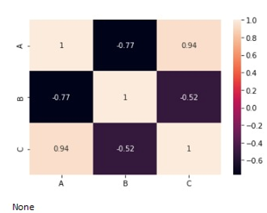
df.corr()
sns.heatmap(result, annot=True)

Slide 11
Violin Plots

Slide 12
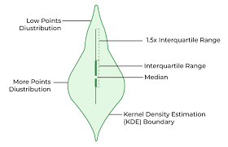

Slide 13
Joint Plot

Slide 14
JointPlot()
A Jointplot showcases the relationship between two variables, combining scatter plots, hexbin plots, regression plots, or 2D kernel density plots with histograms, KDE (Kernel Density Estimate) plots, or other representations of the univariate distribution of each variable on the margins.
This multifaceted approach highlights the correlation or potential relationship between the two variables and provides insights into their distributions.

Slide 15
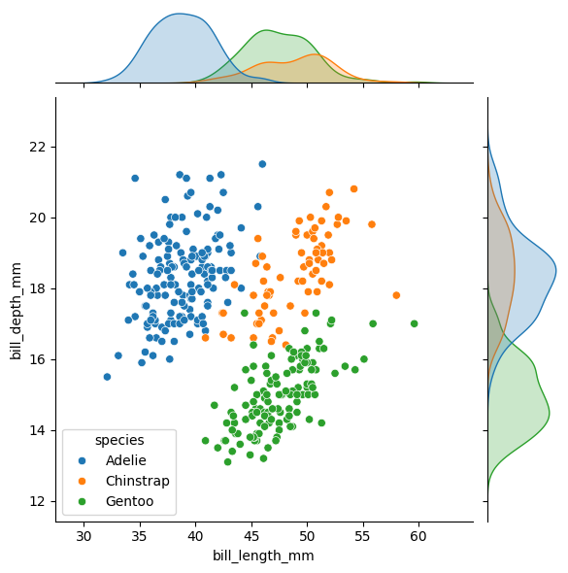

Slide 16
Identifying Relationships: They help in discovering the nature of the relationship between two variables, be it linear, non-linear, or if any clusters form.
Spotting Outliers: By visualizing the data points directly, outliers that do not fit into the general pattern can be easily spotted.
Understanding Distribution: The marginal plots provide a clear view of each variable’s distribution, offering insights into skewness, kurtosis, and other distributional properties.

Slide 17

Plotly Python library is an interactive open-source library.

