Slide 1
Data Distribution
“Probability Distribution”

Slide 2
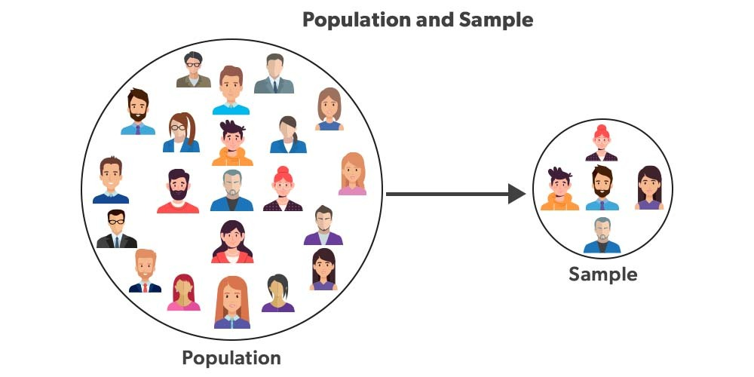

Slide 3
Statistical data distributions describe how data points are spread out across different values in a dataset.
Understanding these distributions helps in
analyzing and interpreting data
revealing patterns
trends
underlying structures.

Slide 4
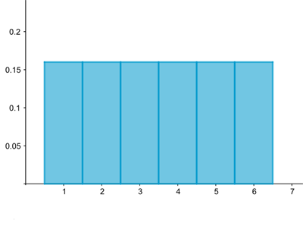
A histogram visualizing the distribution associated to rolling a die. The probability of rolling each of the six possible numbers is 1/6=0.166.

Slide 5
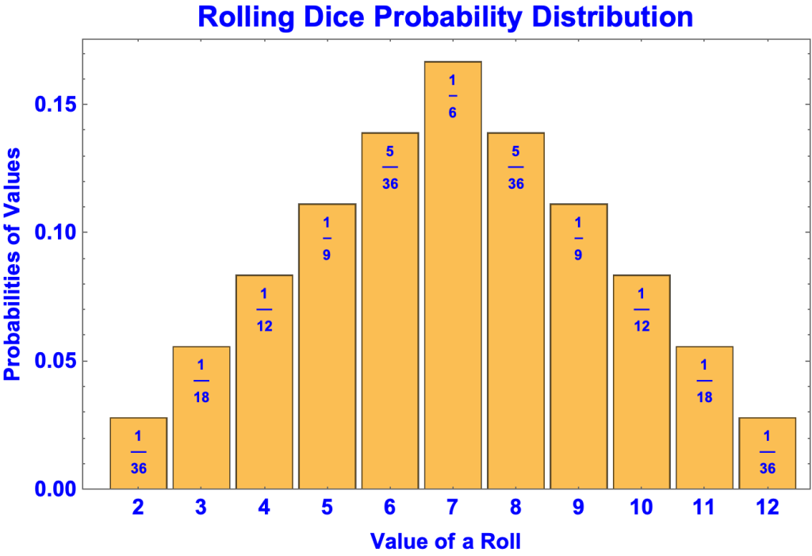

Slide 6
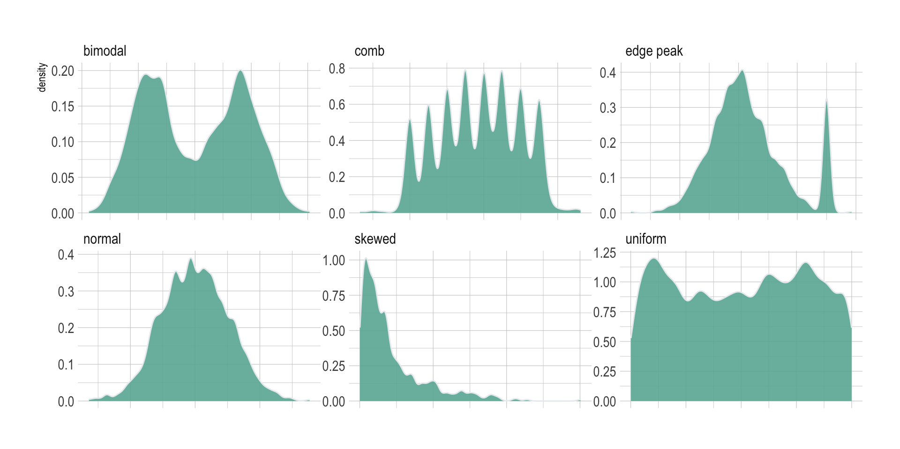

Slide 7
Data Visualizations
“Visualizing the distribution of our variables is an important step in exploring and analyzing data”

Slide 8
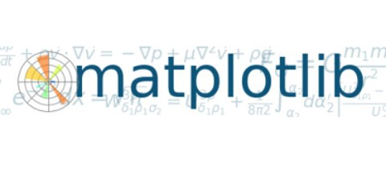

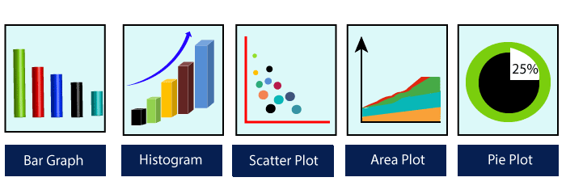
https://matplotlib.org/
John D. Hunter – Developed in 2003
(1968-2012)

Slide 9
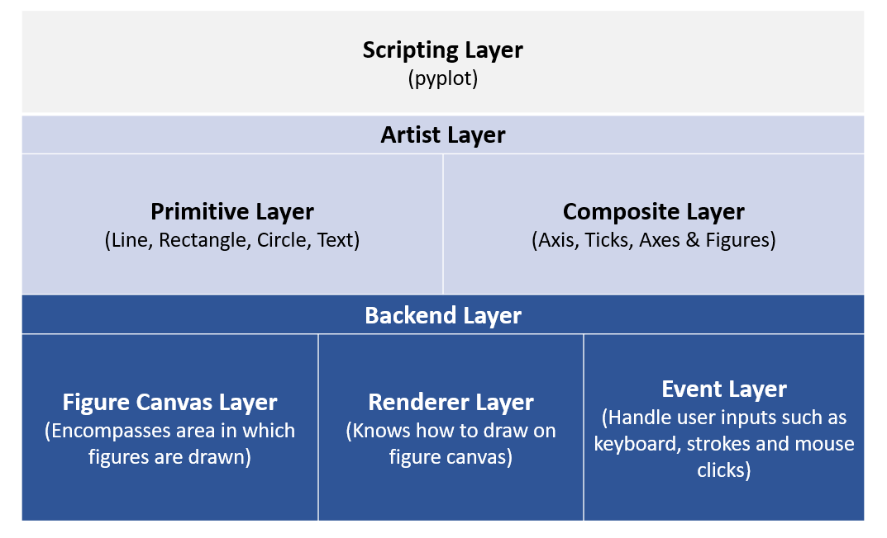

Slide 10
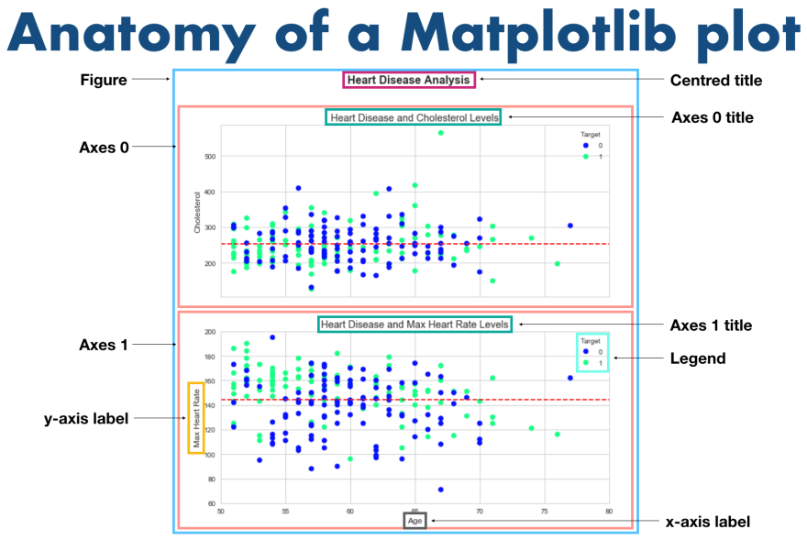

Slide 11
What is subplot()
The Matplotlib subplot() function is defined as to plot two or more plots in one figure. We can use this method to separate two graphs which plotted in the same axis Matplotlib supports all kinds of subplots, including 2x1 vertical, 2x1 horizontal, or a 2x2 grid.
It accepts the three arguments: they are nrows, ncols, and index. It denote the number of rows, number of columns and the index.

Slide 12
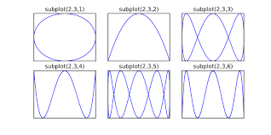

Slide 13
Boxplot

Slide 14
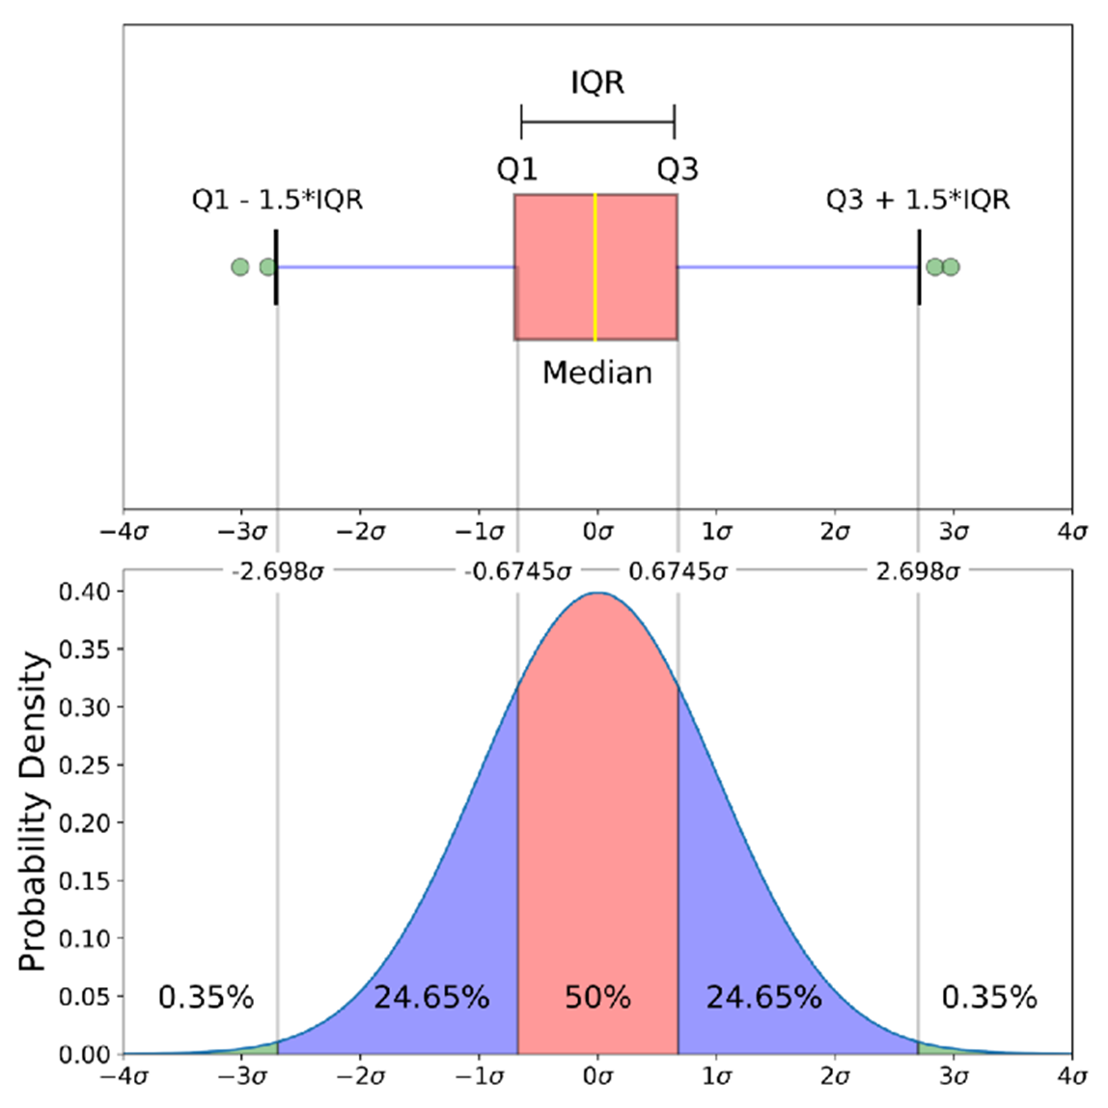

Slide 15
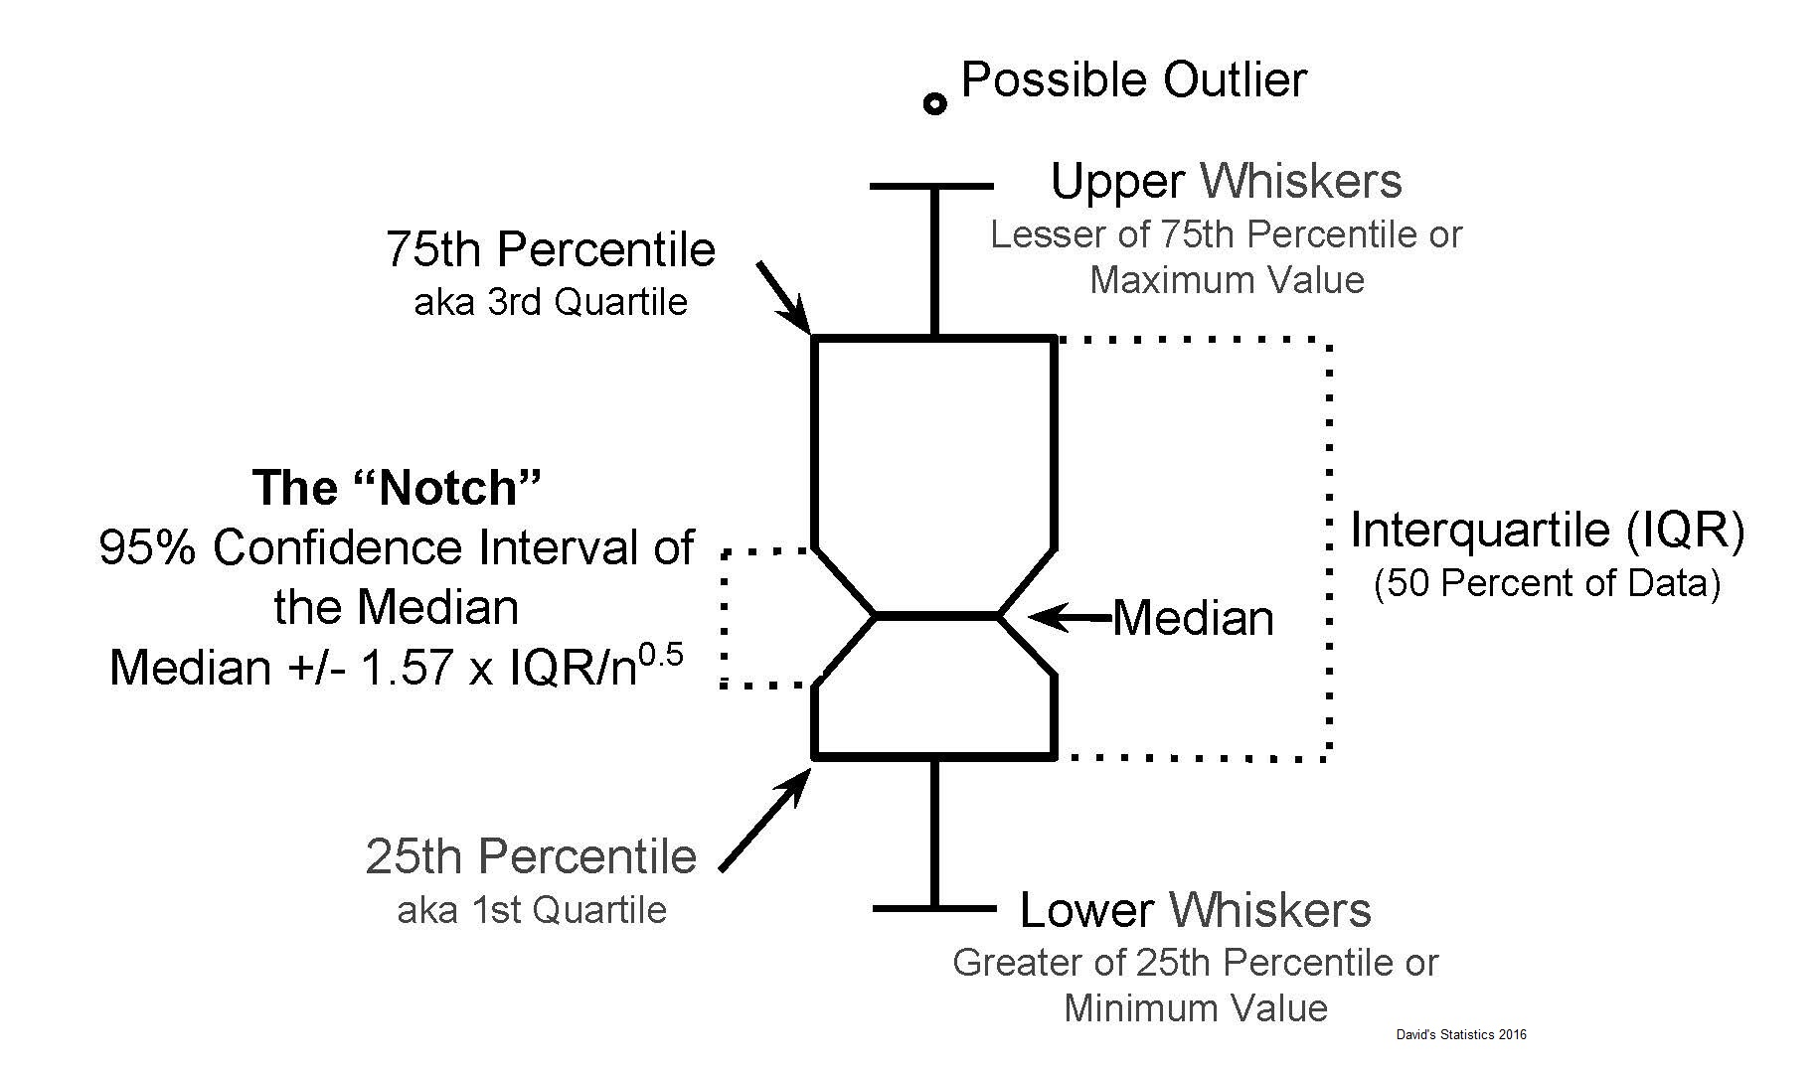

Slide 16
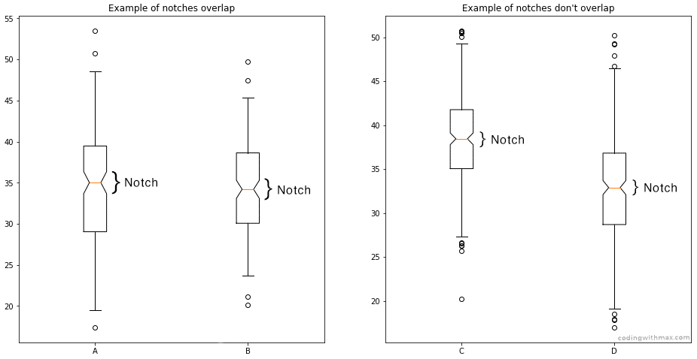

Slide 17
Radar Vs Polar Chart

Slide 18
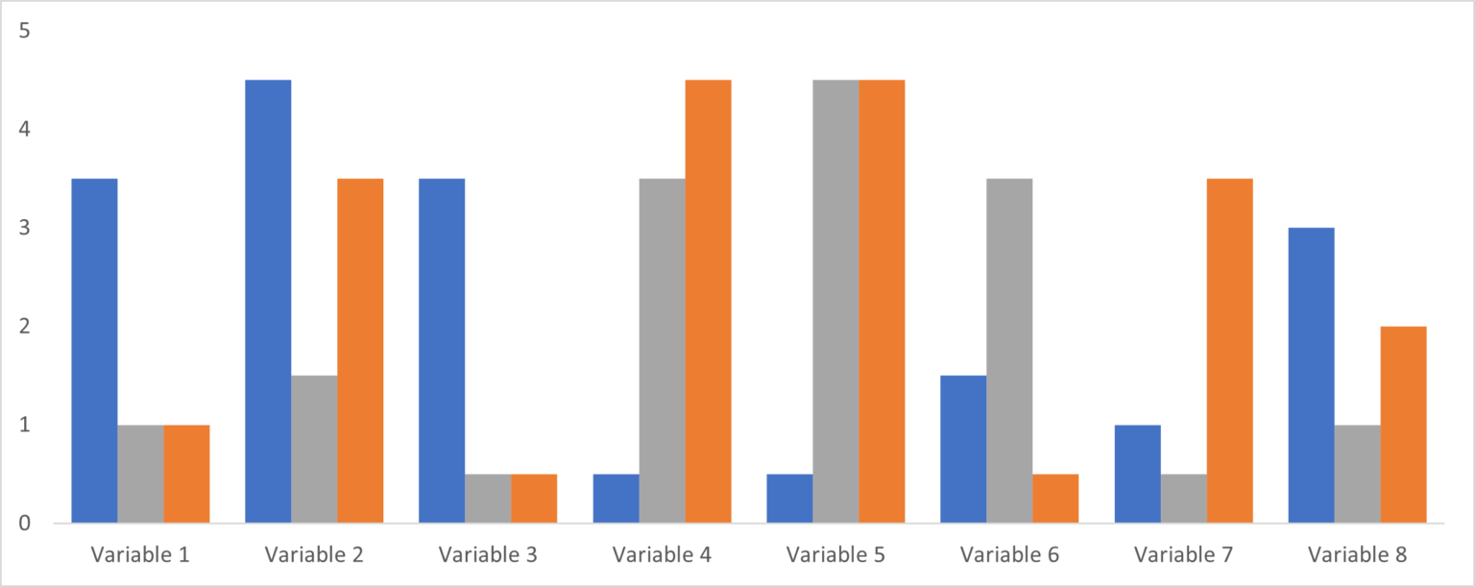
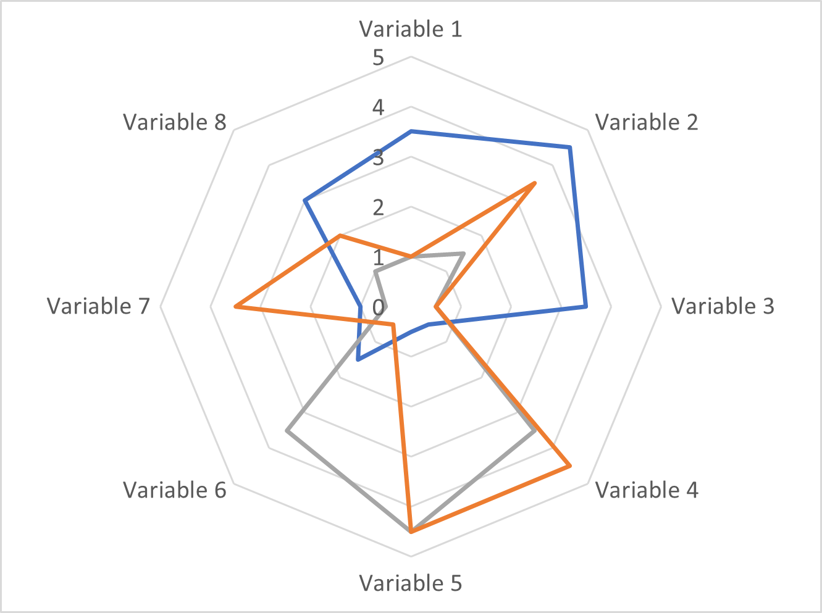

Slide 19
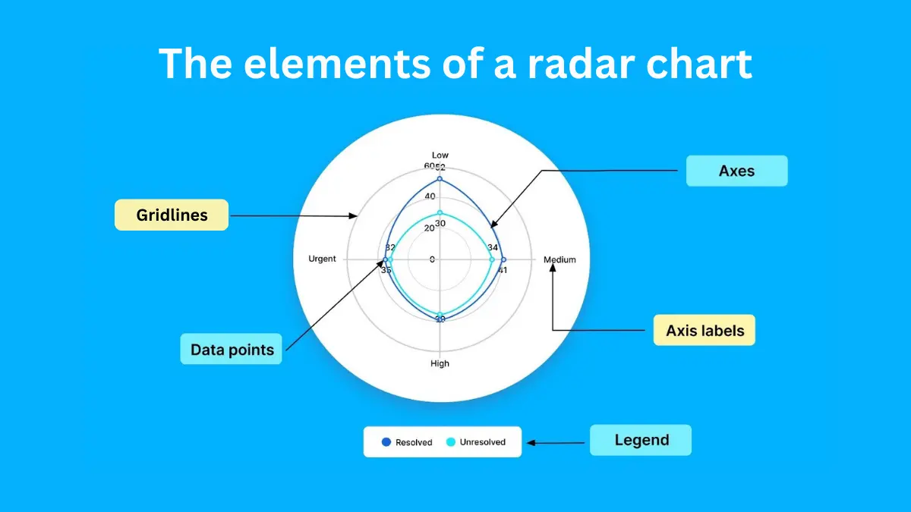

Slide 20
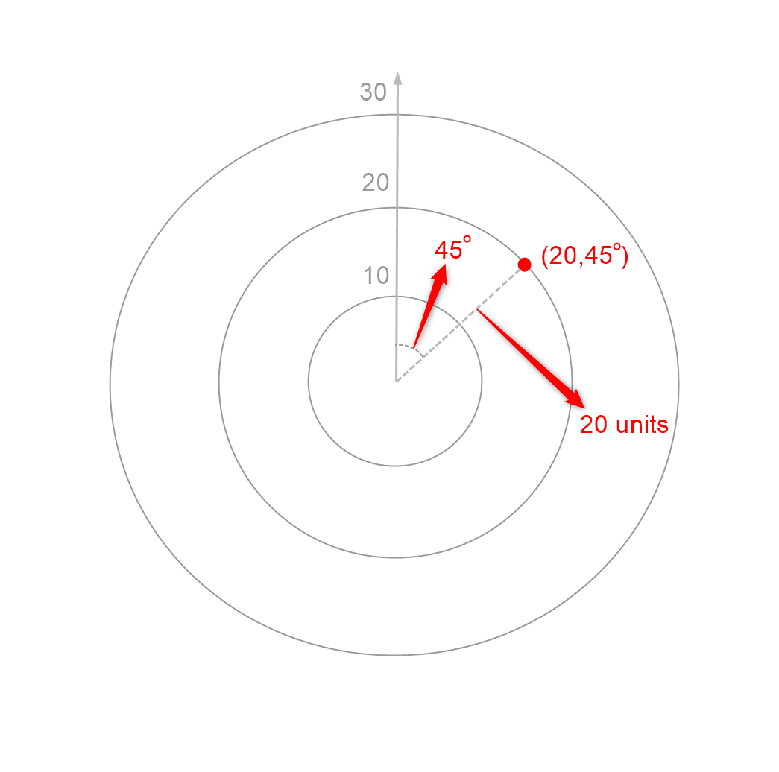

Slide 21
Radar Chart
Polar Chart
Also known as Spider Chart or a Star Chart.
Helps in analysis of multivariate data
With a radar chart, however, each radial axis acts as a dimension, allowing us to plot multivariate data.
a radar chart uses one continuous axis and one categorical or discrete axis.
A polar chart typically plots two dimensions – one using the radial distance and one using the angle.
Polar charts are used in scientific and mathematical contexts to represent specialized datasets.
Polar charts are especially suited to cyclical datasets, like in the chart below where a fictional biologist tracks tree leaf volume in tropical and temperate forests.

Slide 22
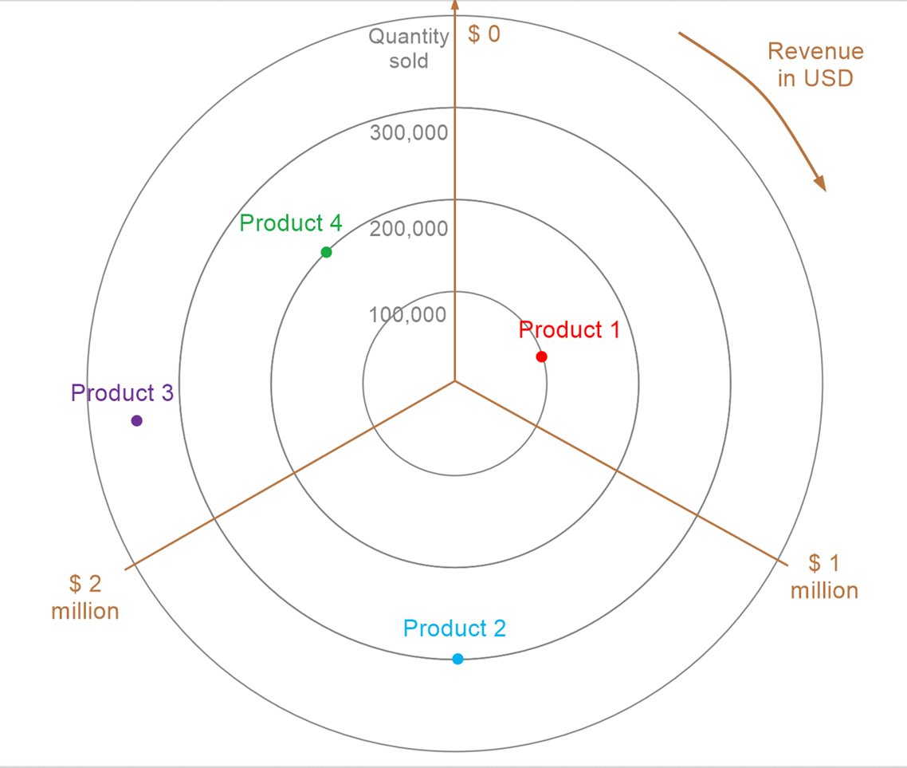
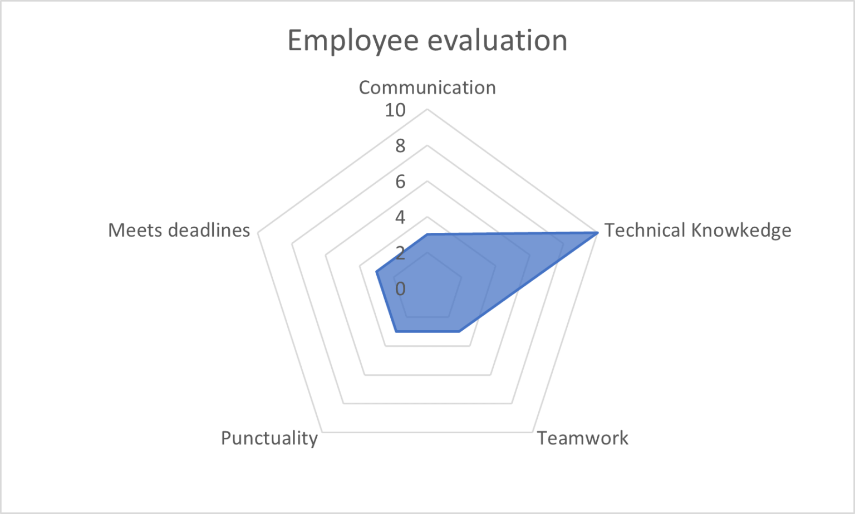

Slide 23
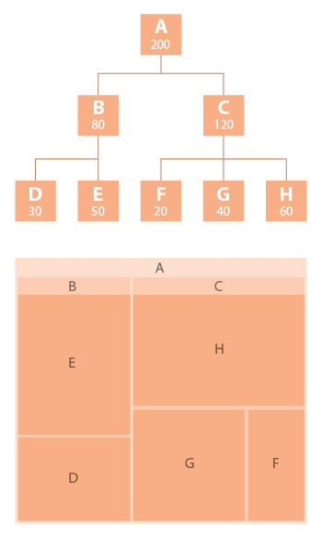
Tree Chart
A tree map represents hierarchal data .
The shapes are used to show a size relative to its area.
Tree maps are able to show how categories are divided based on each level of the hierarchy.

Slide 24
Tree Map
Tree maps display hierarchical (tree-structured) data as a set of nested rectangles.
Each branch of the tree is given a rectangle, which is then tiled with smaller rectangles representing sub-branches.
A leaf node’s rectangle has an area proportional to a specified dimension on the data.
Often the leaf nodes are colored to show a separate dimension of the data.

Slide 26
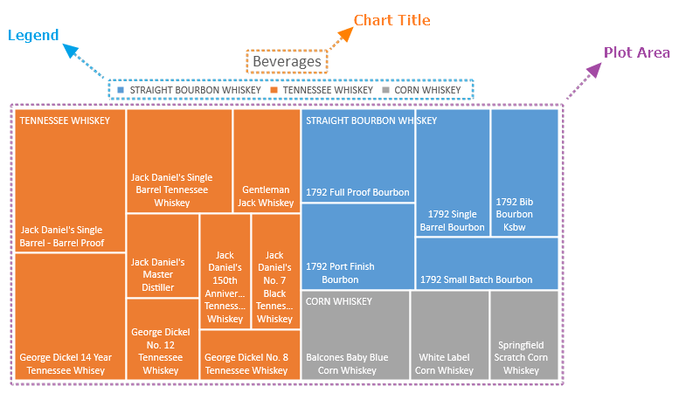

Slide 27
Histogram Vs Bar Chart

Slide 28
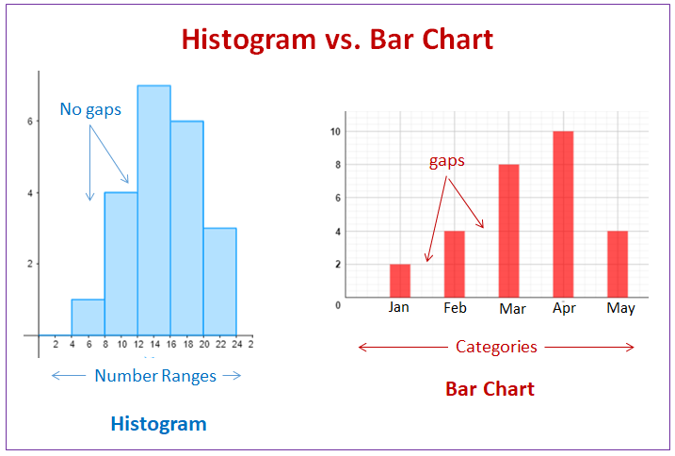

Slide 29
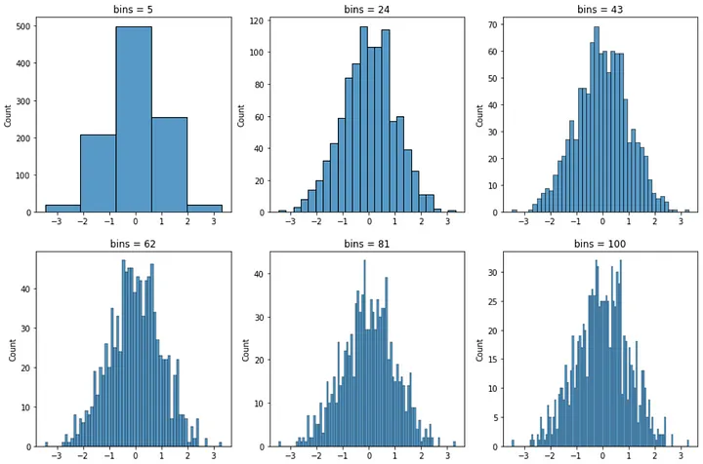

Slide 30
KDE Plot

Slide 31
Kernel Density Estimate
KDE Plot is used for visualizing the Probability Density of a continuous variable.
It depicts the probability density at different values in a continuous variable.
We can also plot a single graph for multiple samples which helps in more efficient data visualization.
It provides a smoothed representation of the underlying distribution of a dataset.

Slide 32
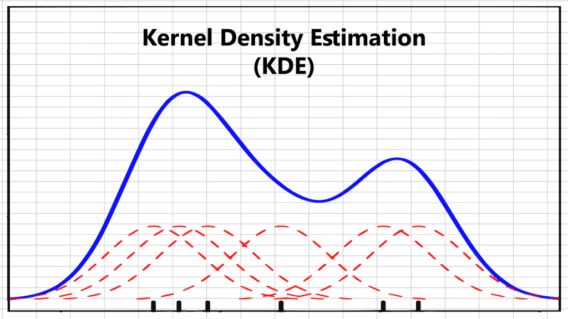

Slide 33
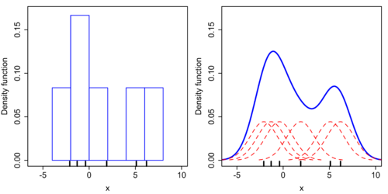
Comparison of the histogram (left) and kernel density estimate (right) constructed using the same data. The six individual kernels are the red dashed curves, the kernel density estimate the blue curves. The data points are the rug plot on the horizontal axis.

Slide 34
3d Plotting

Slide 35
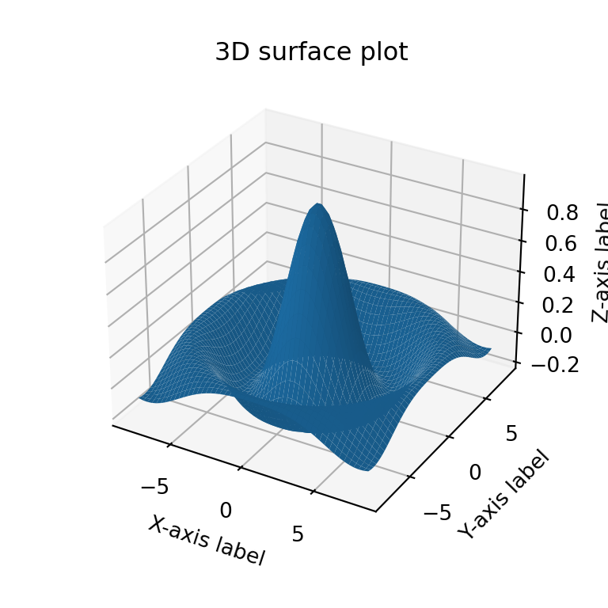

Slide 36
Point out the correct combination with regards to kind keyword for graph plotting.
a) ‘hist’ for histogram
b) ‘box’ for boxplot
c) ‘area’ for area plots
d) all of the mentioned

Slide 37
The plot method in matplotlib is __________
a) gplt.plot()
b) plt.plot()
c) plt.plotgraph()
d) none of the mentioned

Slide 38
You can create a scatter plot matrix using the __________ method
a) sca_matrix
b) scatter_matrix
c) DataFrame.plot
d) all of the mentioned

Slide 39
Which of the following graph can be used for simple summarization of data?
a) Scatterplot
b) Overlaying
c) Barplot
d) All of the mentioned

