Slide 1
Numpy
NumPy or Numeric Python is a package for computation on homogenous n-dimensional arrays.
https://numpy.org/doc/2.2/user/absolute_beginners.html

Slide 2
Numpy arrays
Mutable
Homogenous
Can be Accessed using integer position
Arrays deal with Numeric Data
High Performance in calculation

Slide 3
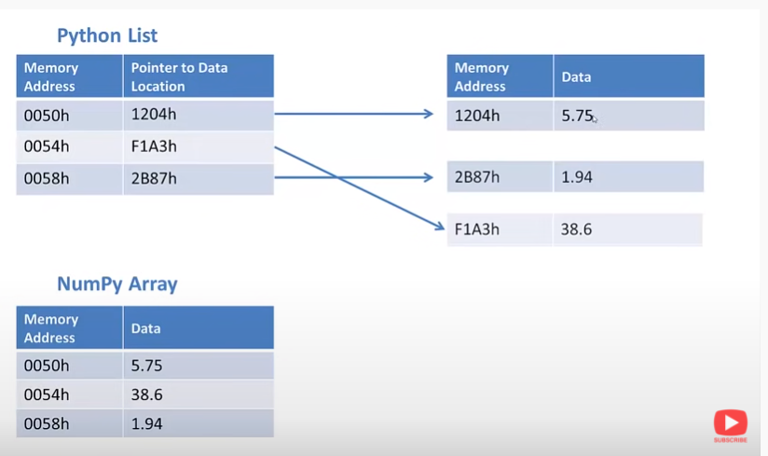

Slide 4
Python List
NumPy Array
Able to store different data types in the same list
Storing each item in random location in the memory
Good for the scenario where list can grow dynamically
Inbuilt data type.
It has more inbuilt functions
Appending will take less time in O(1) time
Can store only one data type in an array at any time
Storing each item is sequential which makes array more effective in processing.
Good for the scenario where the items are fixed size and same data time
Need to install external library NumPy
No extra functions, so it will not need more memory store.
Appending elements will take more time in O(N) time

Slide 5
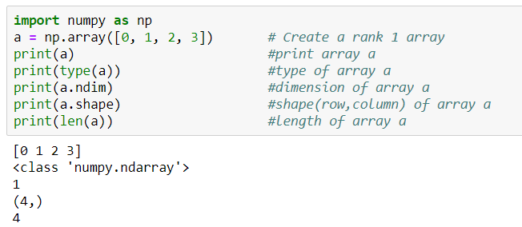

Slide 6
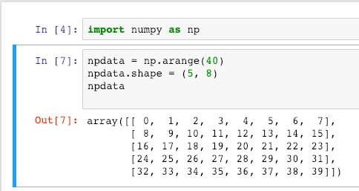

Slide 7
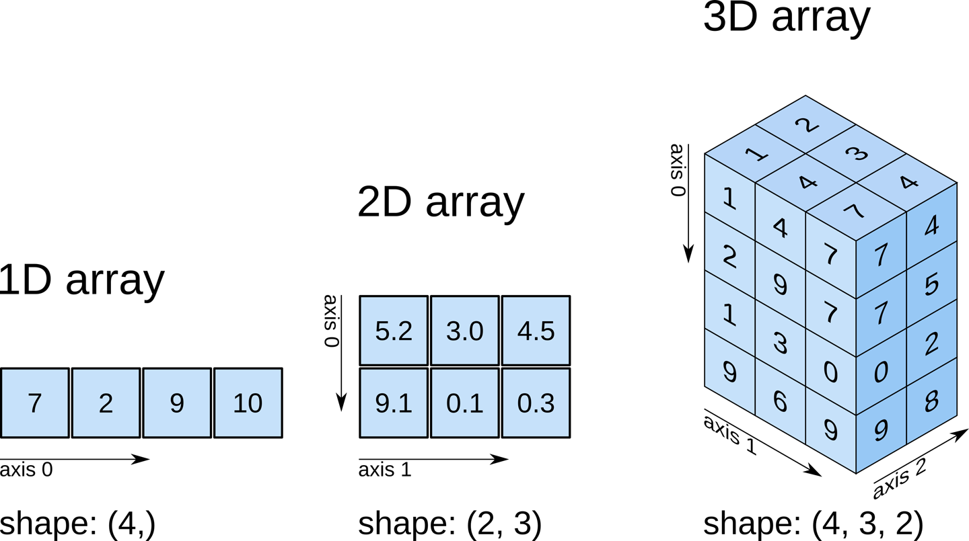

Slide 8
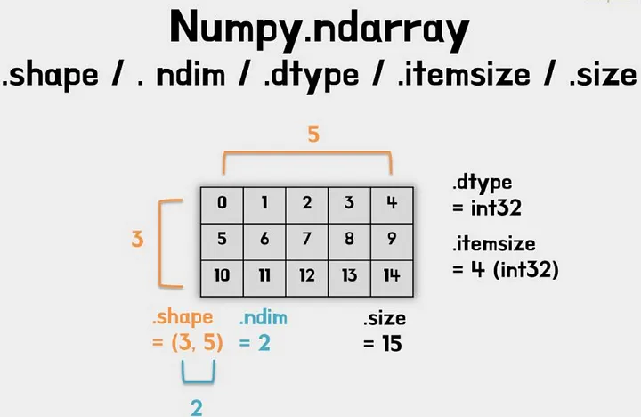

Slide 9
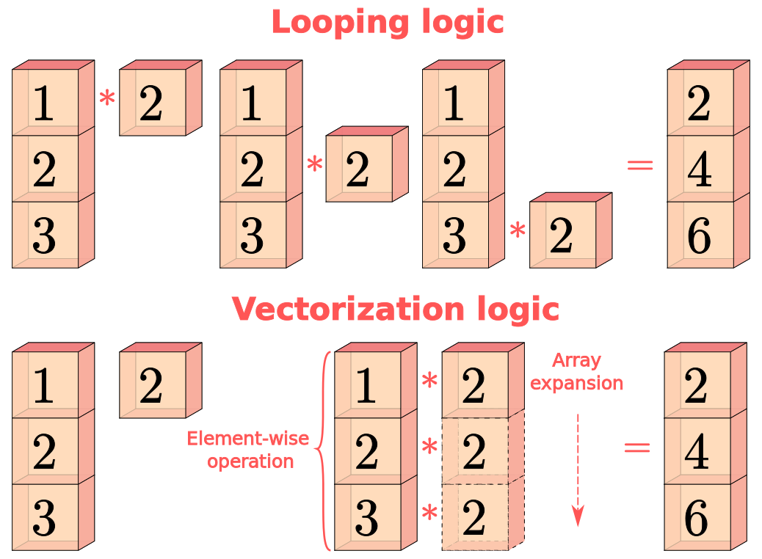

Slide 10
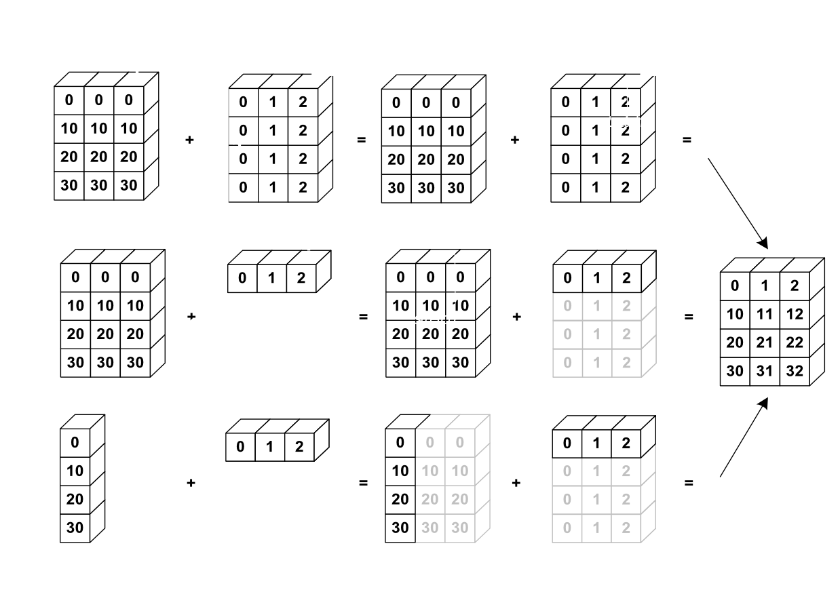

Slide 11
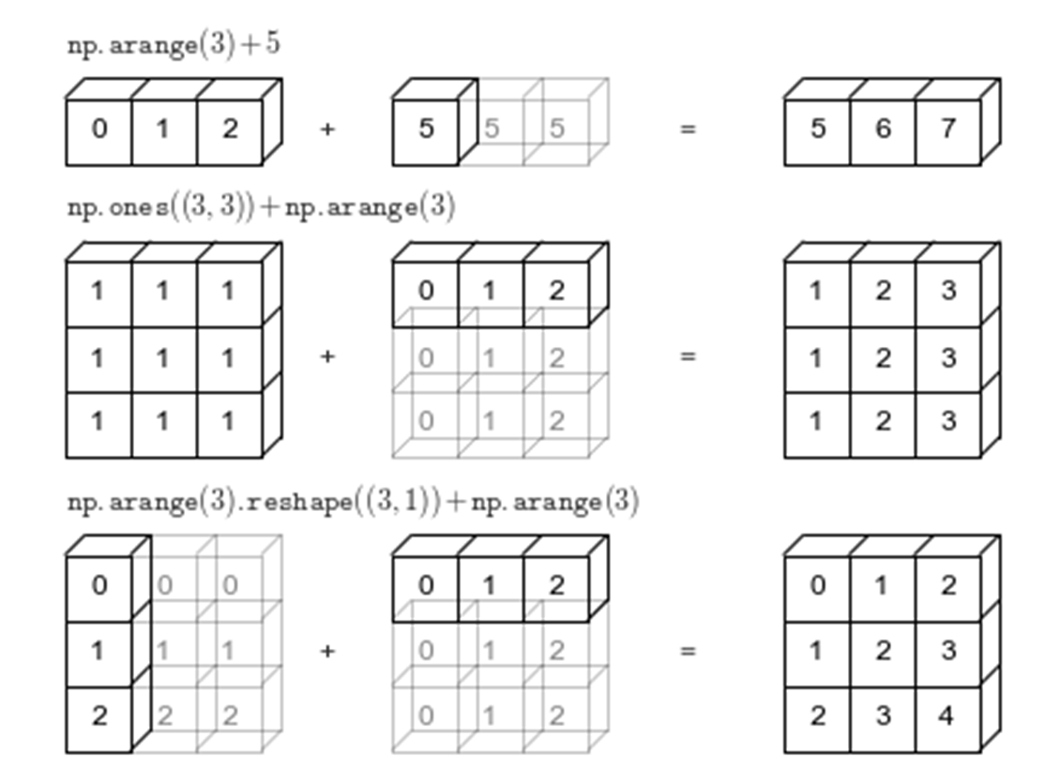

Slide 12
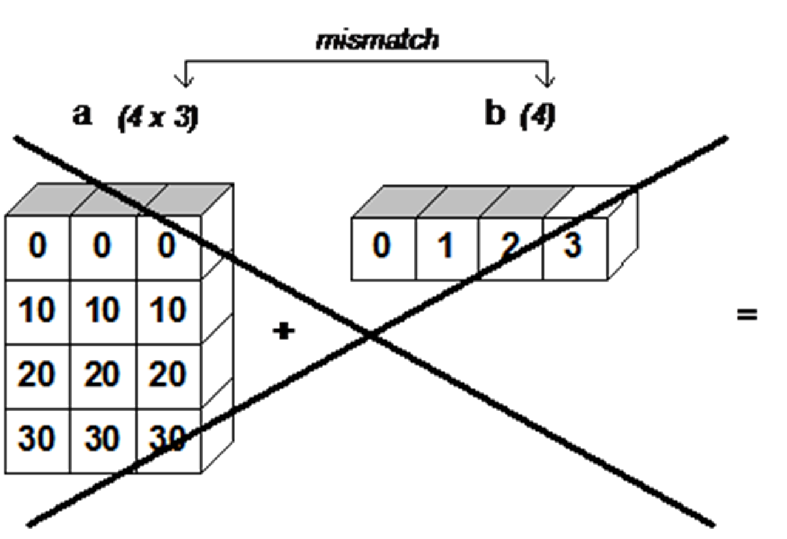

Slide 13
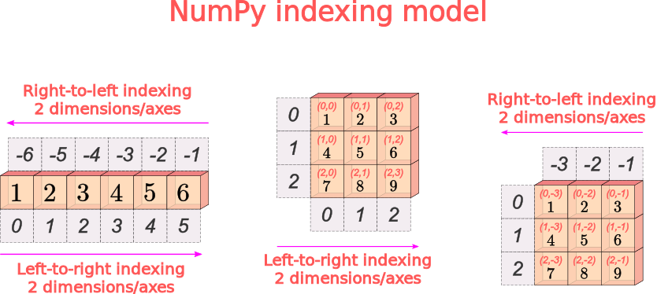

Slide 14
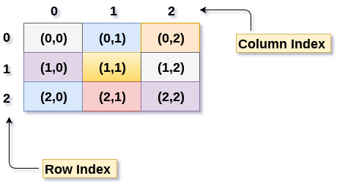
2-D Array (rows,col)

Slide 15
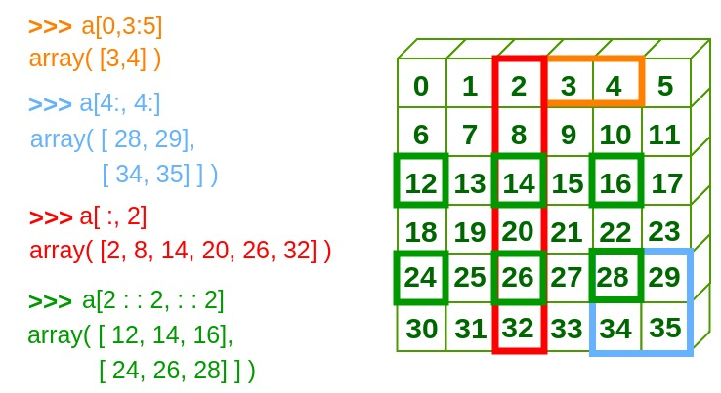

Slide 16
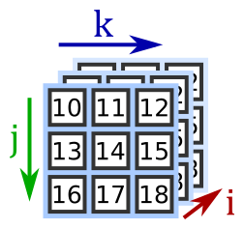
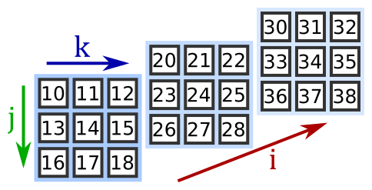
3D Array (i,j,k)
The first index, i, selects the matrix
The second index, j, selects the row
The third index, k, selects the column
import numpy as np
a3 = np.array([[[10, 11, 12], [13, 14, 15], [16, 17, 18]],
[[20, 21, 22], [23, 24, 25], [26, 27, 28]],
[[30, 31, 32], [33, 34, 35], [36, 37, 38]]])
print(a3[2, 0, 1]) # 31

Slide 17
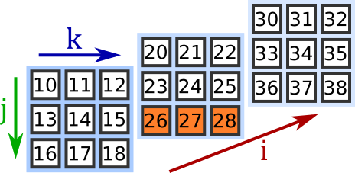
print(a3[1, 2]) # [26 27 28]
print(a3[0, :, 1]) # [11 14 17]
print(a3[:, 1, 2]) # [15, 25, 35]
print(a3[2]) # [[30 31 32]
# [33 34 35]
# [36 37 38]]
print(a3[:, 1]) # [[13 14 15]
# [23 24 25]
# [33 34 35]]
print(a3[:, :, 0]) # [[10 13 16]
# [20 23 26]
# [30 33 36]]

Slide 18
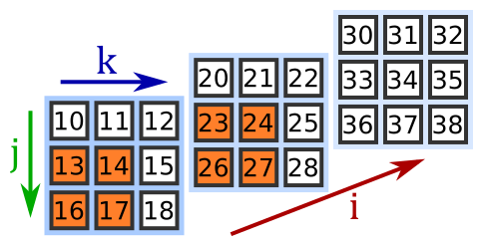
print(a3[:2,1:,:2]) # [[ [13 14] [16 17] ]
# [ [23 24] [26 27] ]]
This selects:
planes :2 (the first 2 planes)
rows 1: (the last 2 rows)
columns :2 (the first 2 columns)

Slide 19
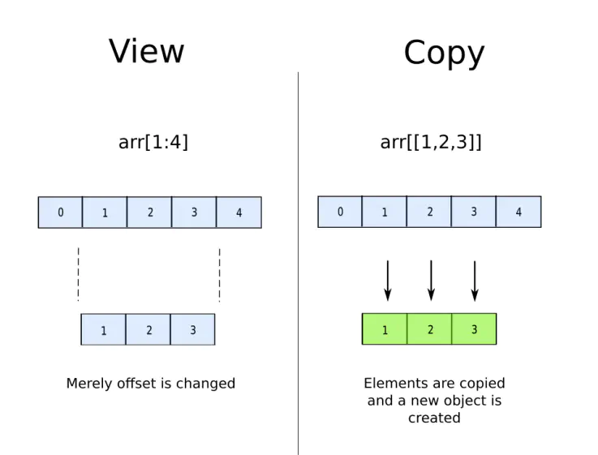

Slide 20
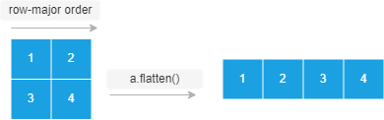


Slide 21
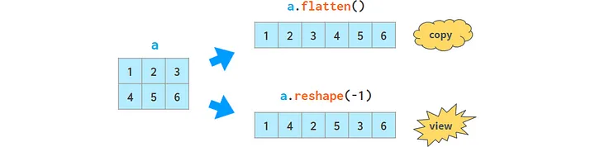

Slide 22
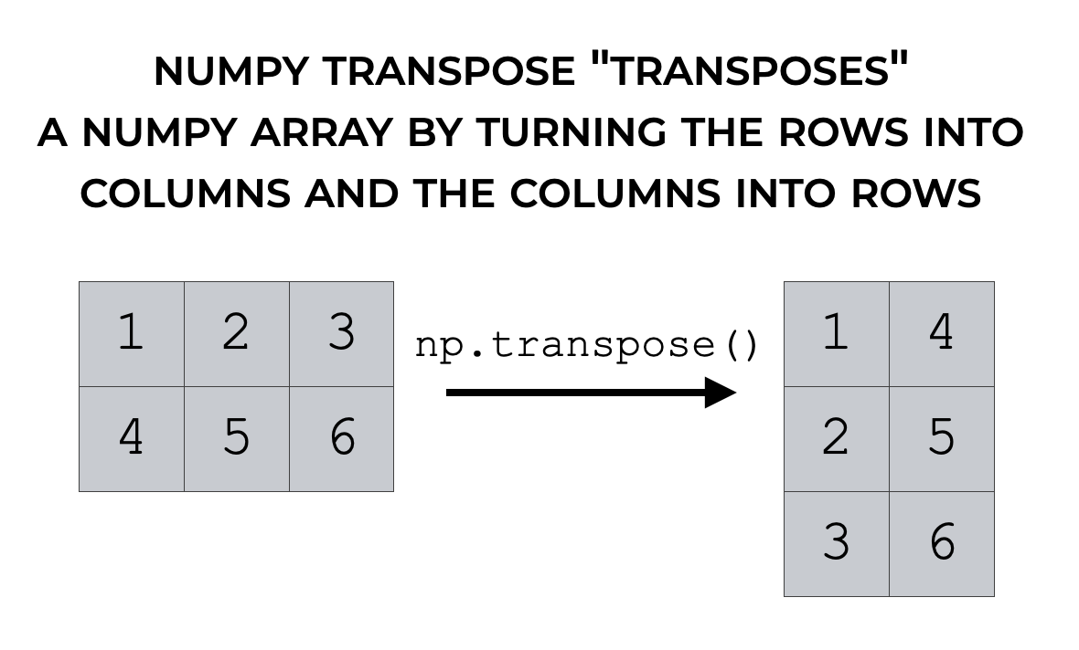

Slide 23
