Slide 1
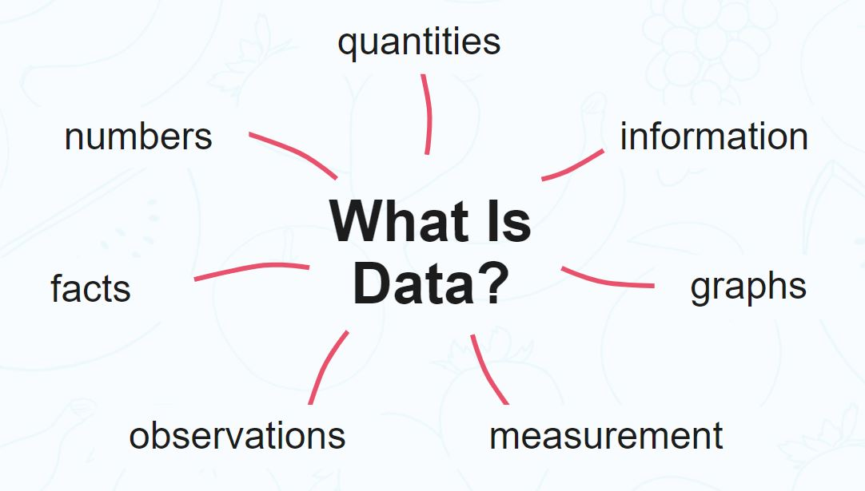

Slide 2
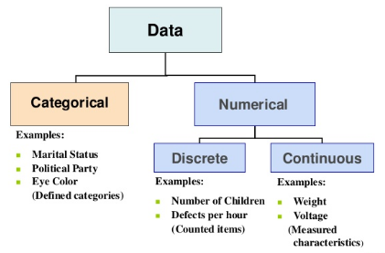

Slide 3
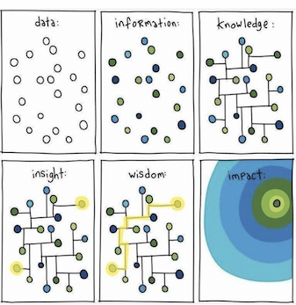
Data Science For Business

Slide 4
Case Study – Hurricane Frances
Consider an example from a New York Times story from 2004:
“Hurricane Frances was on its way, barreling across the Caribbean, threatening a direct hit on Florida’s Atlantic coast. Residents made for higher ground, but far away, in Ben‐ tonville, Ark., executives at Wal-Mart Stores decided that the situation offered a great opportunity for one of their newest data-driven weapons … predictive technology. A week ahead of the storm’s landfall, Linda M. Dillman, Wal-Mart’s chief information officer, pressed her staff to come up with forecasts based on what had happened when Hurricane Charley struck several weeks earlier. Backed by the trillions of bytes’ worth of shopper history that is stored in Wal-Mart’s data warehouse, she felt that the company could ‘start predicting what’s going to happen, instead of waiting for it to happen,’ as she put it. (Hays, 2004)”

Slide 5
Case Study – Hurricane Frances
Why in the case of natural calamity, the data-driven prediction might be useful.
People, who are in the path of a hurricane, might be interested to buy bottled water.
But this is an obvious point, why we need data science tools and techniques to discover this fact.
Wal-Mart executives might be interested in predicting how the hurricane will impact the sales so that the company can make the necessary arrangements.
There could be some coincidence whereas the sales of a particular newly released movie CD went up during the week but the impact on sales was nationwide not just the areas impacted by the hurricane.
Ms. Dillman is referring to more useful information than some general patterns.

Slide 6
Case Study – Hurricane Frances
Using data science, the data analyst team could discover the patterns that were not obvious.
By analyzing the huge volume of Wal-Mart data from prior similar situations, the analyst could identify the surge in unusual local demand for few products and rush stocks ahead of hurricane’s landfill.
In the actual scenario, the same thing happened. The New York Times (Hays, 2004) reported that: “… the experts mined the data and found that the stores would indeed need certain products—and not just the usual flashlights.
‘We didn’t know in the past that strawberry PopTarts increase in sales, like seven times their normal sales rate, ahead of a hurricane,’ Ms. Dillman said in a recent interview. ‘And the pre-hurricane top-selling item was beer.’”

Slide 7
Python

Slide 8
Who developed Python Programming Language?
a) Wick van Rossum
b) Rasmus Lerdorf
c) Guido van Rossum
d) Niene Stom

Slide 9
Which type of Programming does Python support?
a) object-oriented programming
b) structured programming
c) functional programming
d) all of the mentioned

Slide 10
What will be the output of the following Python statement?
>>>"abcd"[2:]
a) a
b) ab
c) cd
d) dc

Slide 11
What will be the output of the following Python code?
>>>str1="helloworld"
>>>str1[::-1]
a) dlrowolleh
b) hello
c) world
d) helloworld

Slide 12
Suppose list1 is [1, 3, 2], What is list1 * 2?
a) [2, 6, 4]
b) [1, 3, 2, 1, 3]
c) [1, 3, 2, 1, 3, 2]
d) [1, 3, 2, 3, 2, 1]

Slide 13
Quick Recap

Slide 14
What is data science primarily concerned with?
a) Analyzing and interpreting data
b) Collecting data only
c) Storing data in database

Slide 15
Which of the following is one of the key data science skills?
a) Data Visualization
b) Machine Learning
c) Statistics
d) All of the mentioned

Slide 16
Which of the following is the top most important thing in data science?
a) data
b) question
c) answer
d) none of the mentioned

Slide 17
Which of the following step is performed by data scientist after acquiring the data?
a) Data Integration
b) Data Replication
c) Data Cleansing
d) All of the mentioned

Slide 18
To create sequences of numbers, NumPy provides a function __________ analogous to range that returns arrays instead of lists.
a) arange
b) aspace
c) aline
d) all of the mentioned

Slide 19
Point out the correct statement.
a) NumPy main object is the homogeneous multidimensional array
b) In Numpy, dimensions are called axes
c) Numpy array class is called ndarray
d) All of the mentioned

