Slide 1
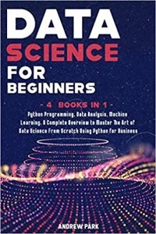
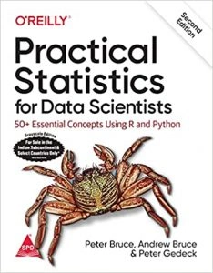
https://www.amazon.in/Practical-Statistics-Data-Scientists-Essential/dp/8194435005/ref=sr_1_3?crid=QUYJVAZMCD1K&keywords=Practical+Statistics+for+Data+Scientists&qid=1677486684&s=books&sprefix=practical+statistics+for+data+scientists%2Cstripbooks%2C263&sr=1-3
https://www.amazon.in/Data-Science-Beginners-Programming-Learning/dp/1914167503/ref=sr_1_1?crid=2L23B8P4X3HGF&keywords=Data+Science+for+Beginners%2C+by+Andrew+Park&qid=1677482450&sprefix=data+science+for+beginners%2C+by+andrew+park%2Caps%2C217&sr=8-1

Slide 2
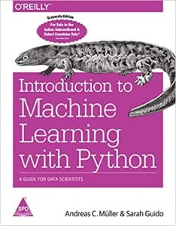
https://www.amazon.in/Introduction-Machine-Learning-Python-Scientists/dp/9352134575/ref=sr_1_1?crid=1067J0LKCZ5II&keywords=Introduction+to+Machine+Learning+with+Python%3A+A+Guide+for+Data+Scientists&qid=1677486353&s=books&sprefix=introduction+to+machine+learning+with+python+a+guide+for+data+scientists%2Cstripbooks%2C825&sr=1-1

Slide 3
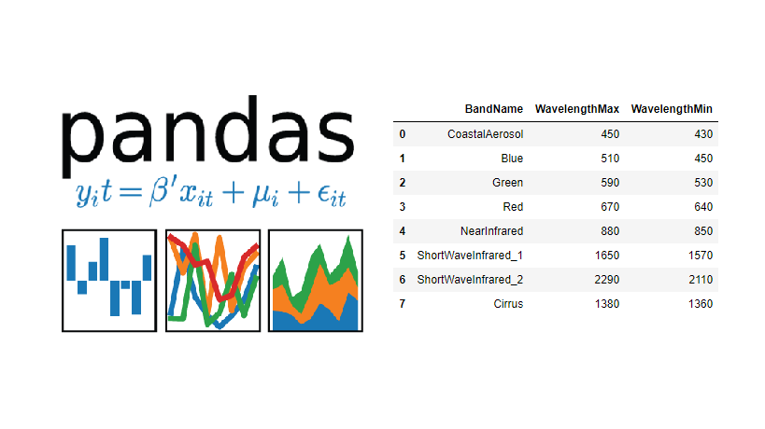
Pandas
Representation of Data in the form of Tables

Slide 4
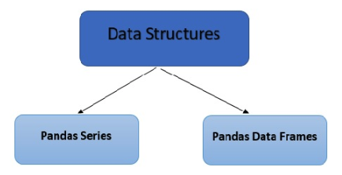

Slide 5
Different Data Structures in Pandas
Data Structure | Dimensions | Description
Series | 1 | 1D labeled homogeneous array, sizeimmutable.
Data Frames | 2 | General 2D labeled, size-mutable tabular structure with potentially heterogeneously typed columns.

Slide 6
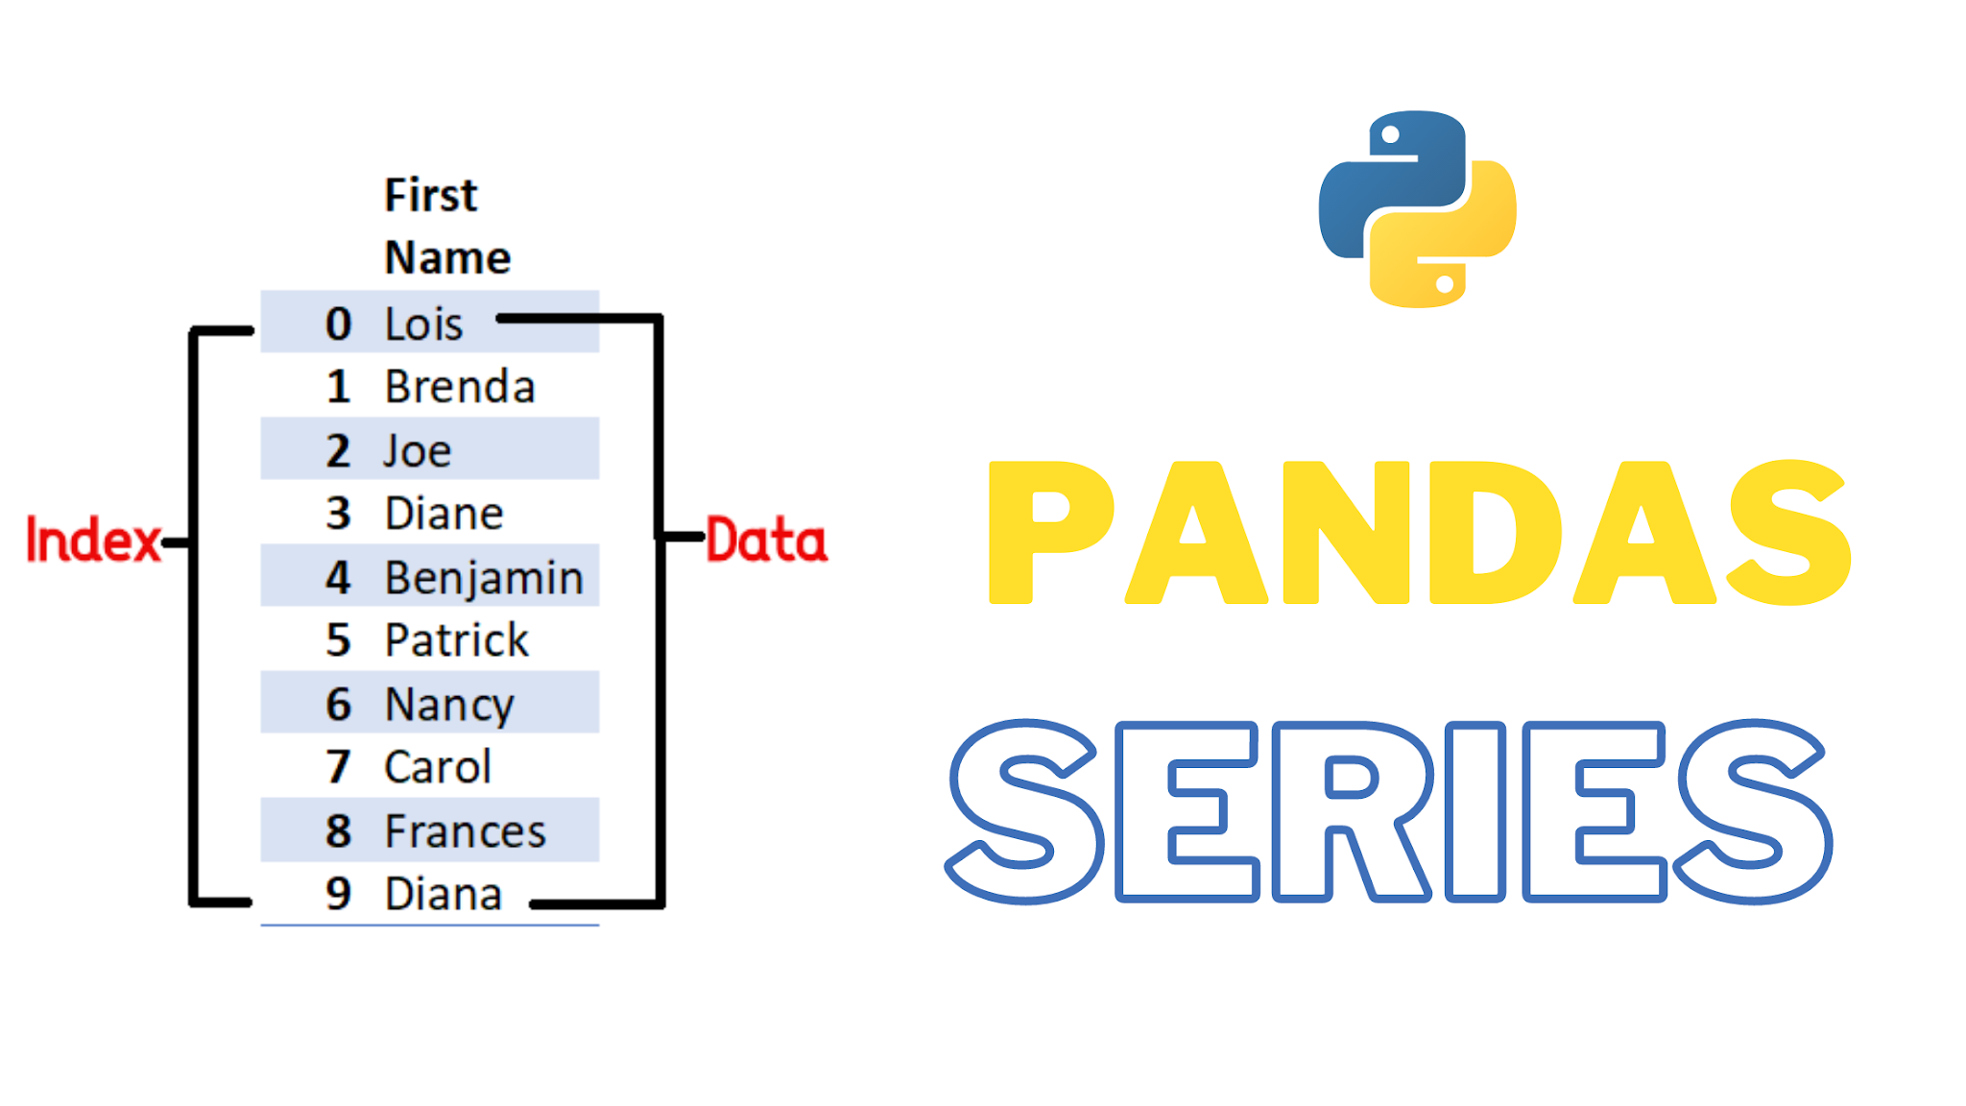
A Pandas Series is like a column in a table.
It is a one-dimensional array holding data of any type.

Slide 7
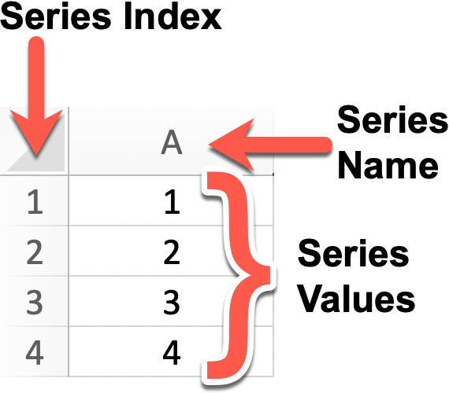

Slide 8
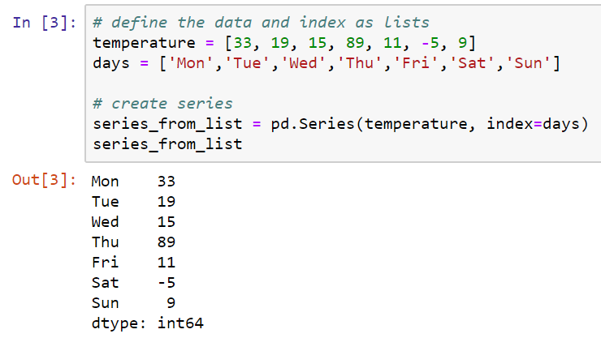

Slide 9
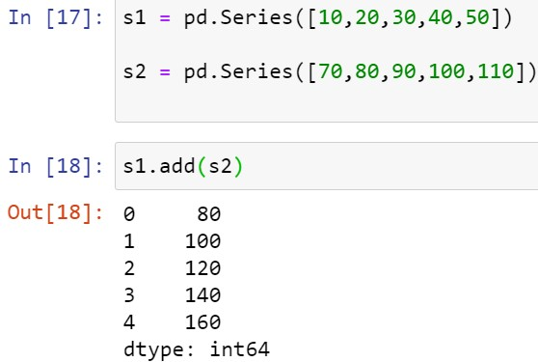
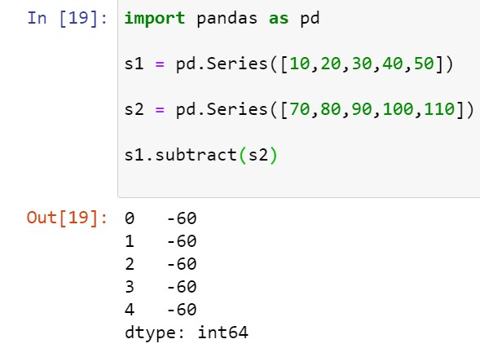

Slide 10
Data Frame
A Data frame is a two-dimensional data structure, i.e., data is aligned in a tabular fashion in rows and columns.

Slide 11
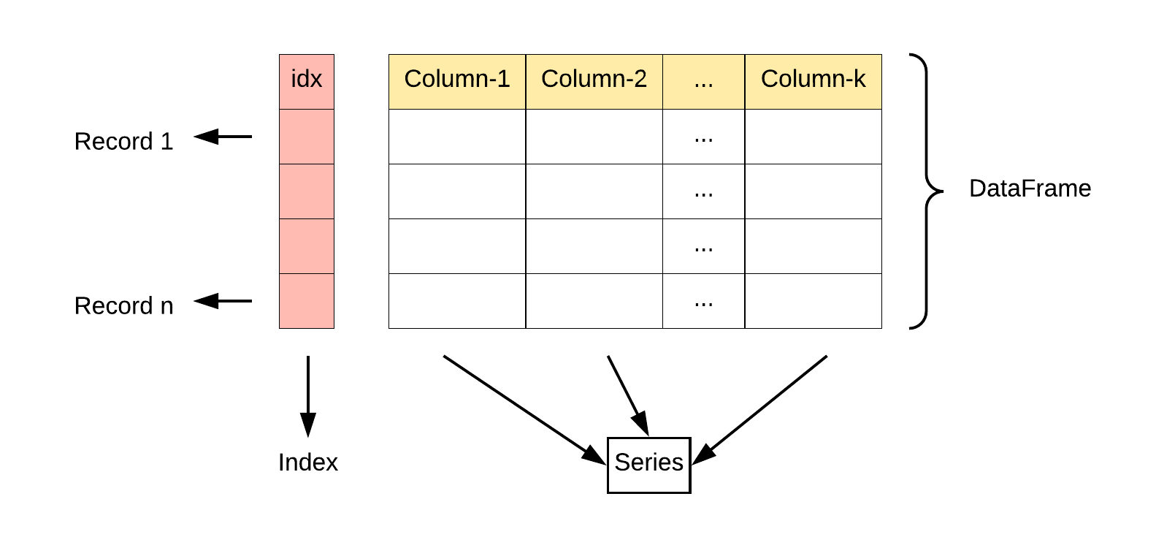

Slide 12
Features of DataFrame
Potentially columns are of different types
Size – Mutable
Labeled axes (rows and columns)
Can Perform Arithmetic operations on rows and columns

Slide 13
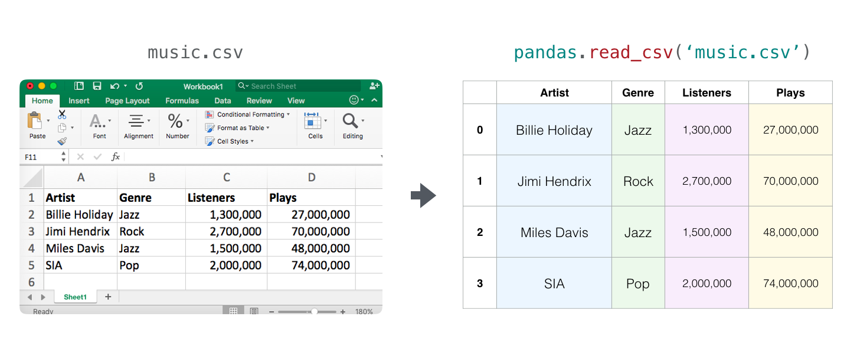

Slide 14
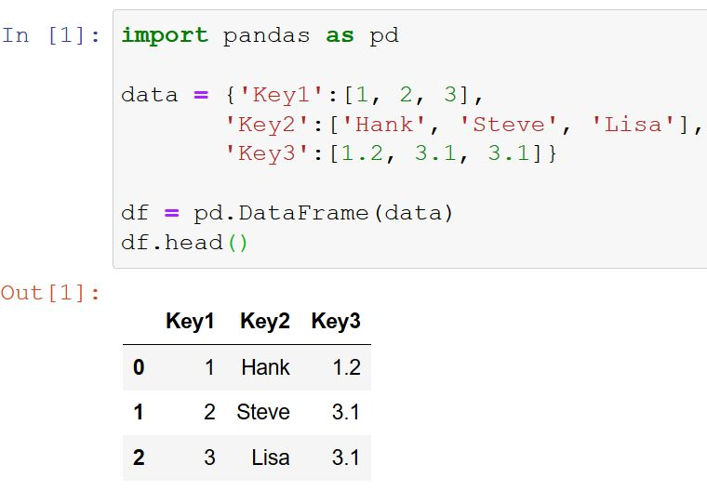

Slide 15
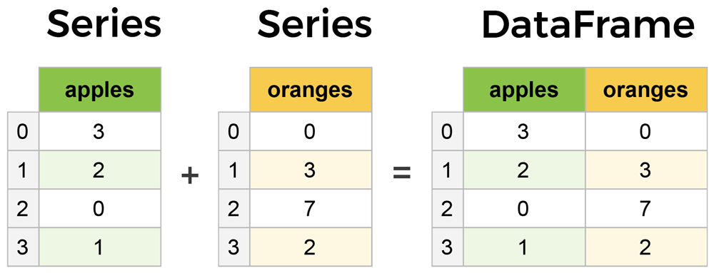

Slide 16
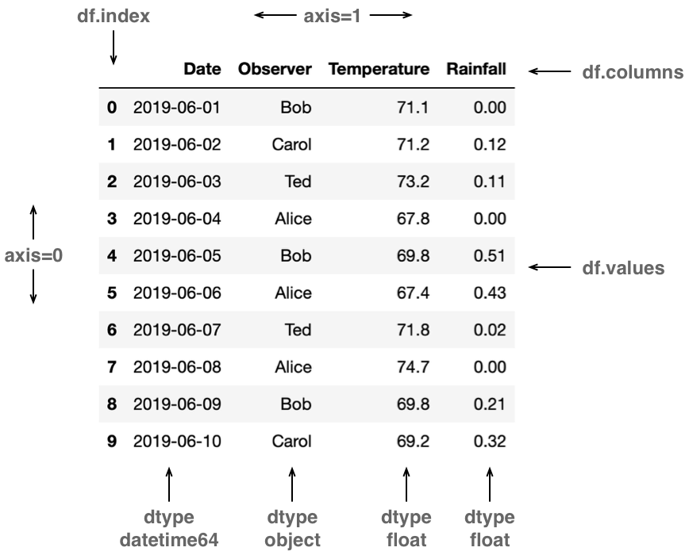

Slide 17
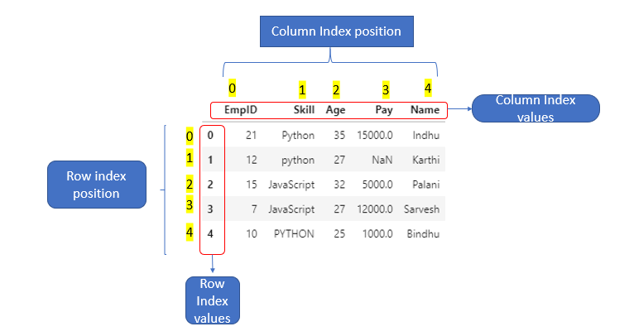

Slide 18
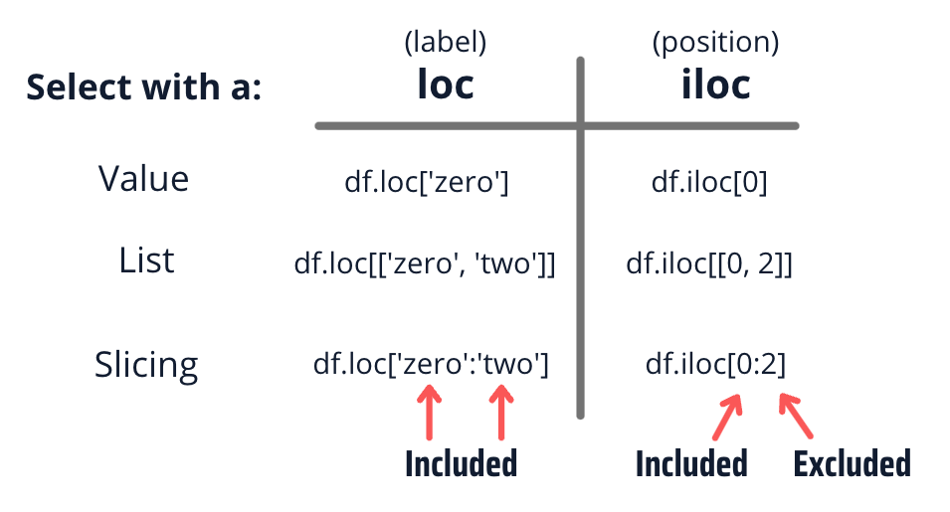
Indexing in Pandas

Slide 19
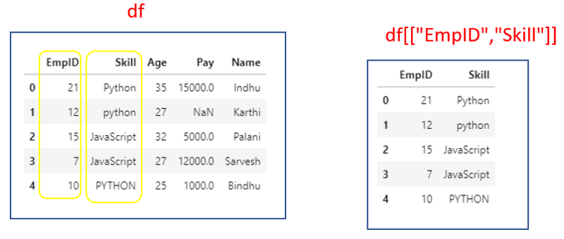

Slide 20
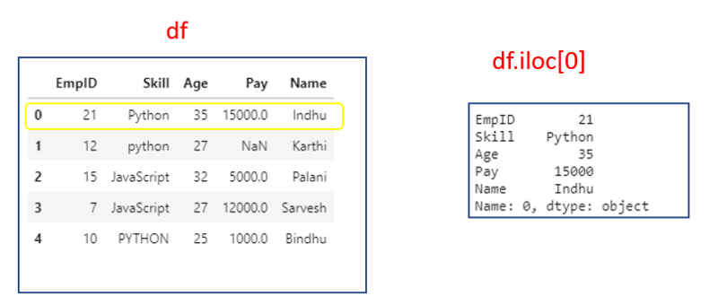

Slide 21
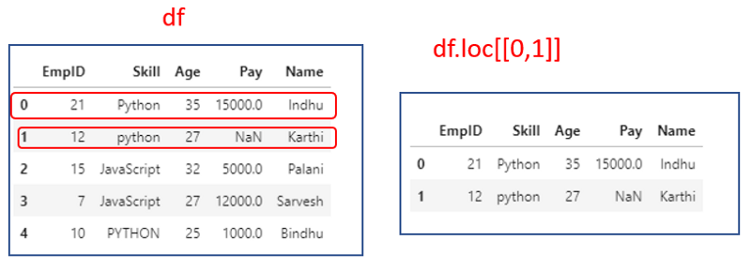

Slide 22
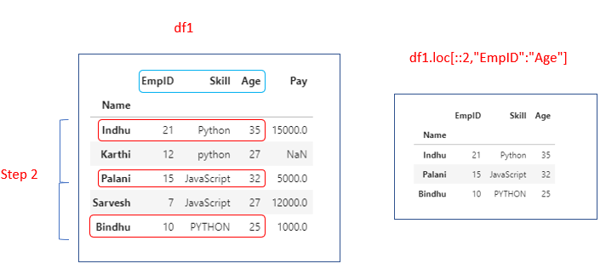

Slide 23
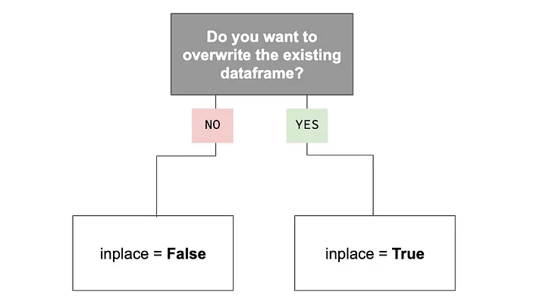
How will you over-write the existing data frame?

Slide 24
Pandas Descriptive Statistics
Sr.No. | Function | Description
1 | count() | Number of non-null observations
2 | sum() | Sum of values
3 | mean() | Mean of Values
4 | median() | Median of Values
5 | mode() | Mode of values
6 | std() | Standard Deviation of the Values
7 | min() | Minimum Value
8 | max() | Maximum Value
9 | abs() | Absolute Value
10 | prod() | Product of Values
11 | cumsum() | Cumulative Sum
12 | cumprod() | Cumulative Product

Slide 25
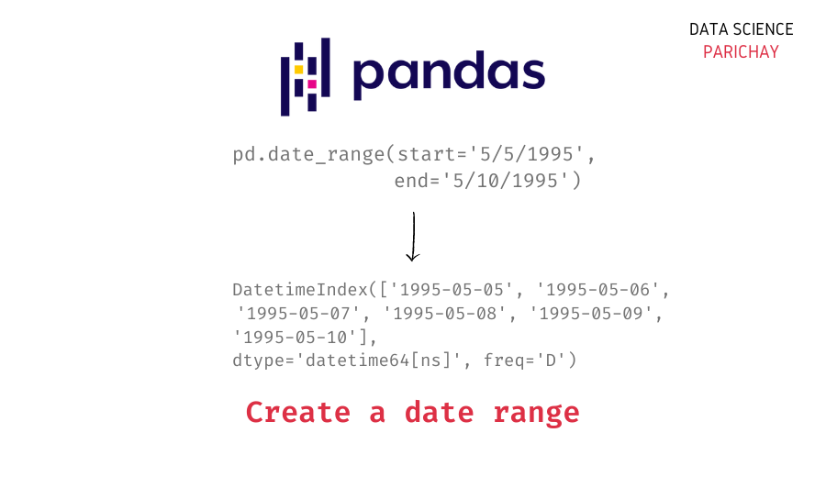

Slide 26
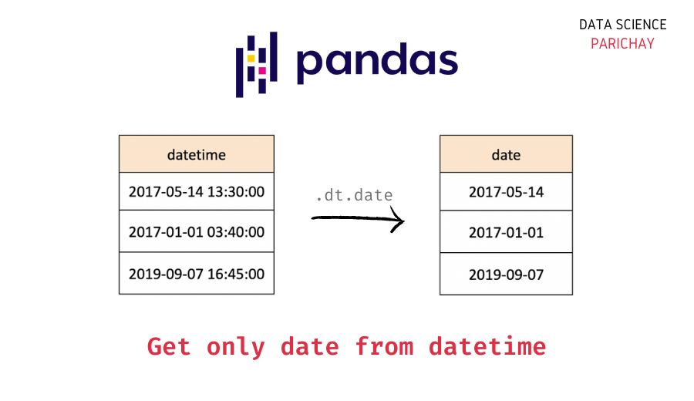

Slide 27
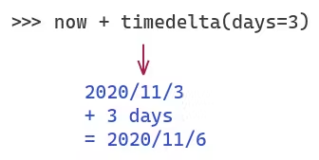
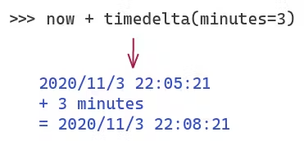
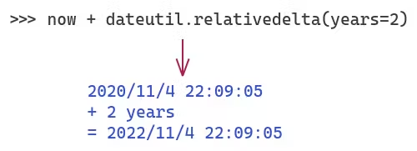

Slide 28
