Slide 1


Slide 2
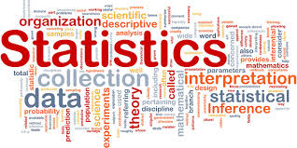

Slide 3
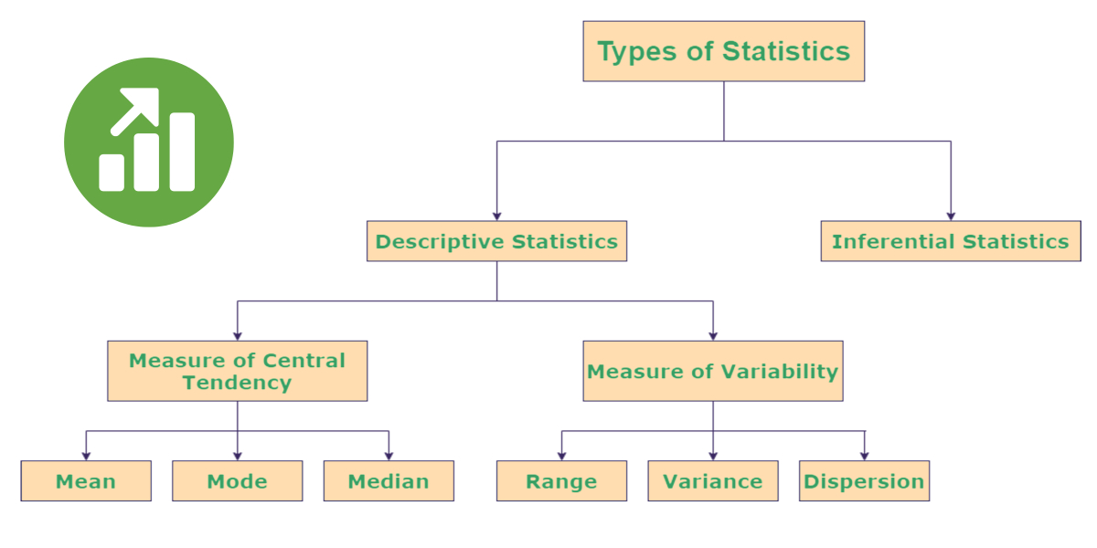

Slide 4
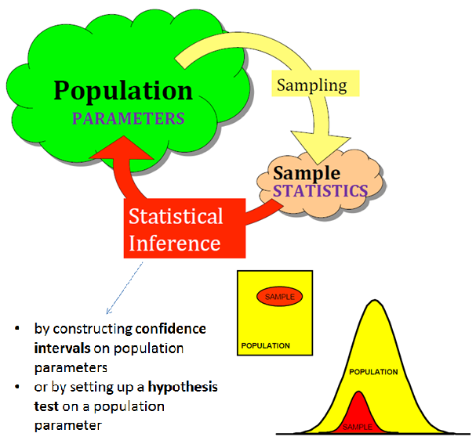

Slide 5
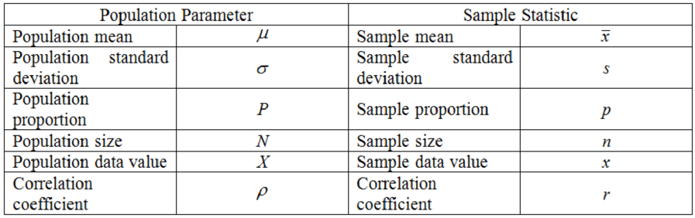

Slide 6
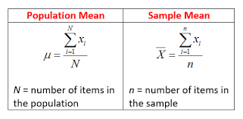

Slide 7
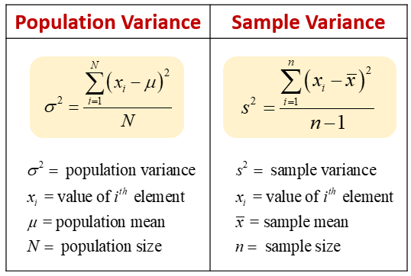

Slide 8
What’s the best measure of variability?
The best measure of variability depends on your level of measurement and distribution.
Level of measurement
For data measured at an ordinal level, the range and interquartile range are the only appropriate measures of variability.
For more complex interval and ratio levels, the standard deviation and variance are also applicable.
Distribution
For normal distributions, all measures can be used. The standard deviation and variance are preferred because they take your whole data set into account, but this also means that they are easily influenced by outliers.
For skewed distributions or data sets with outliers, the interquartile range is the best measure. It’s least affected by extreme values because it focuses on the spread in the middle of the data set.

Slide 9
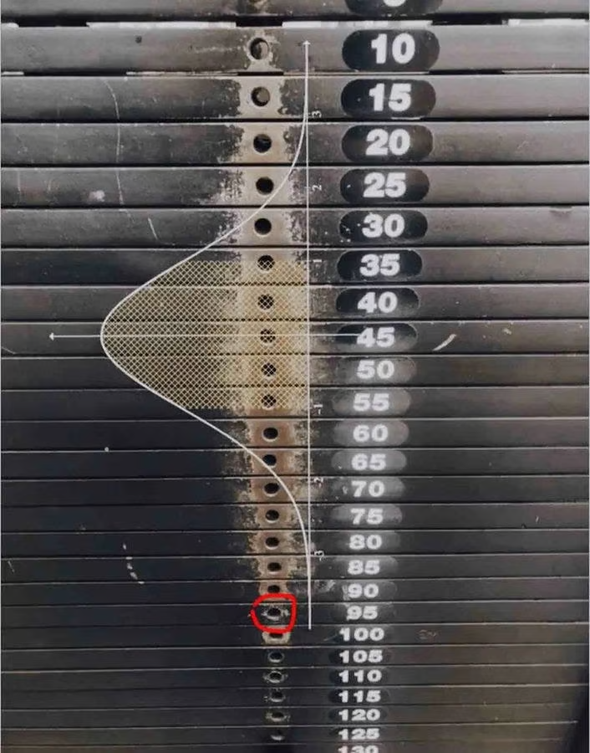

Slide 10
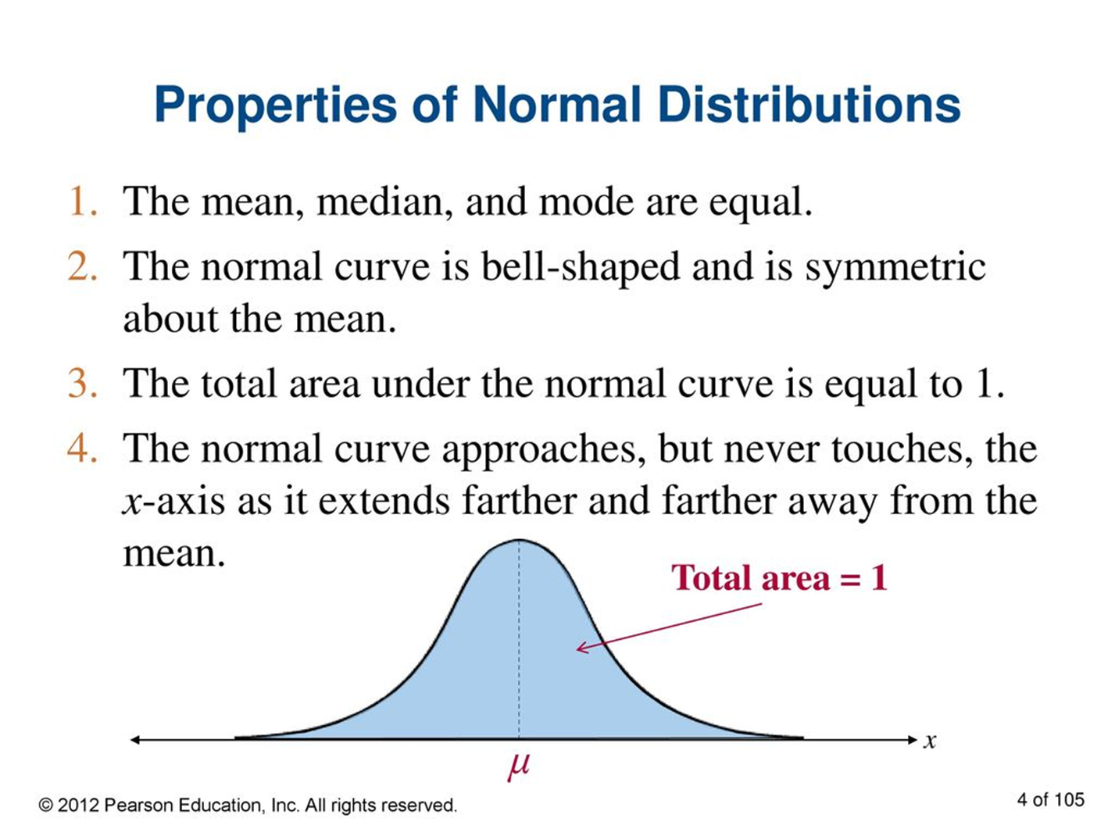

Slide 11
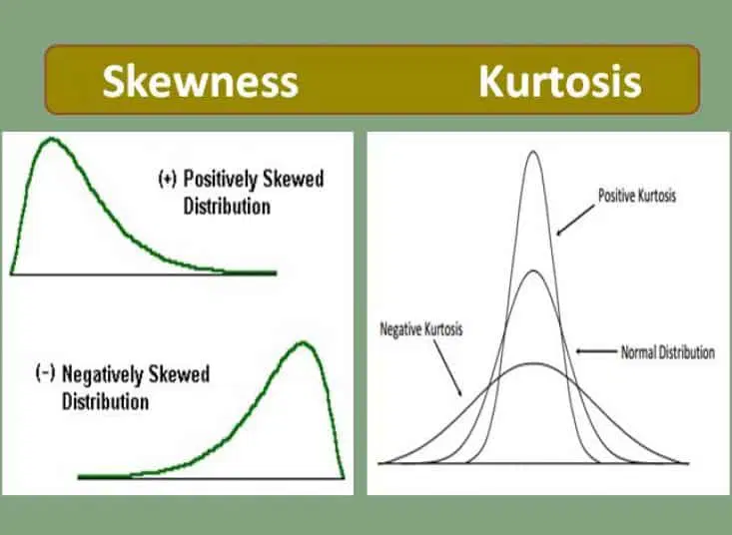

Slide 12
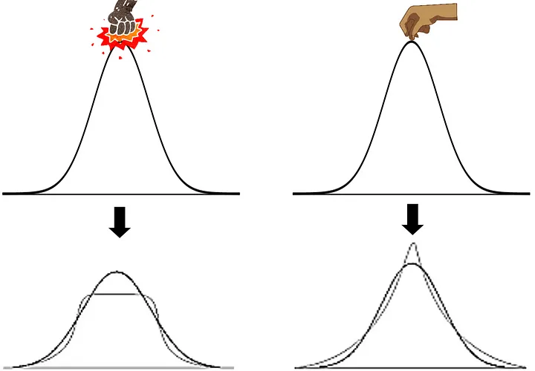

Slide 13
Use of Kurtosis & Skewness
Understanding Distribution Shape: Skewness and kurtosis provide insights into the shape and characteristics of the data distribution beyond what is captured by measures of central tendency and variability.
Assumptions for Statistical Tests: Many statistical tests (e.g., t-tests, ANOVA) assume that the data follow a normal distribution. Analyzing skewness and kurtosis helps to check this assumption.
Risk Management: In finance, skewness and kurtosis are used to assess the risk and return profiles of investment portfolios. High kurtosis indicates higher risk due to the presence of extreme values.
Quality Control: In manufacturing, skewness and kurtosis help in quality control processes by identifying deviations from the desired product specifications.

Slide 14
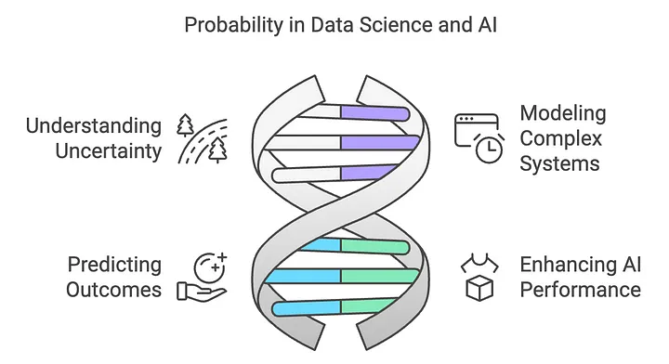

Slide 15
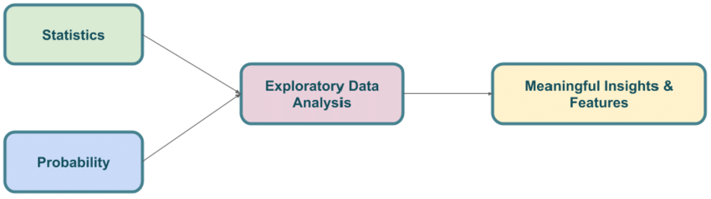

Slide 16
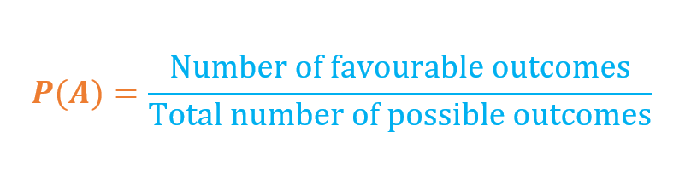

Slide 17
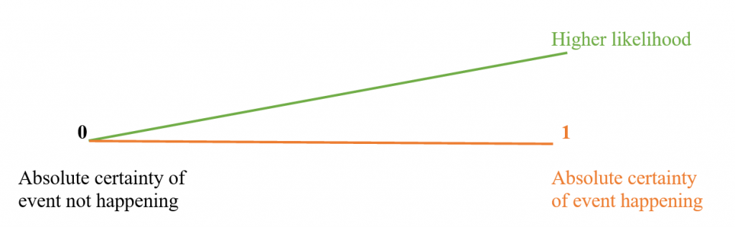

Slide 18
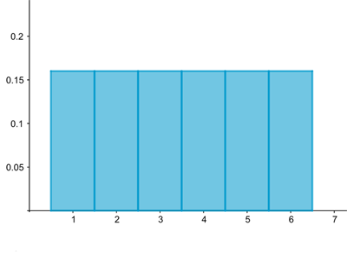
A histogram visualizing the distribution associated to rolling a die. The probability of rolling each of the six possible numbers is 1/6=0.166.

Slide 19
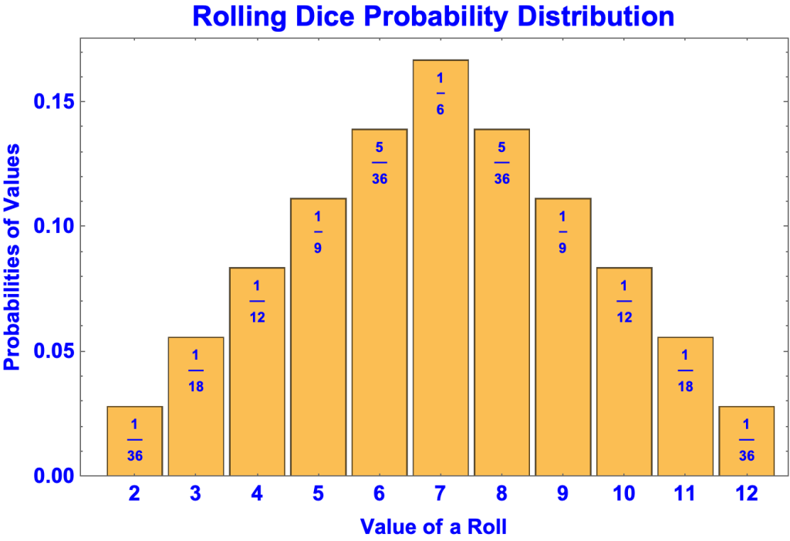

Slide 20
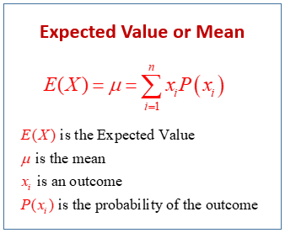

Slide 21
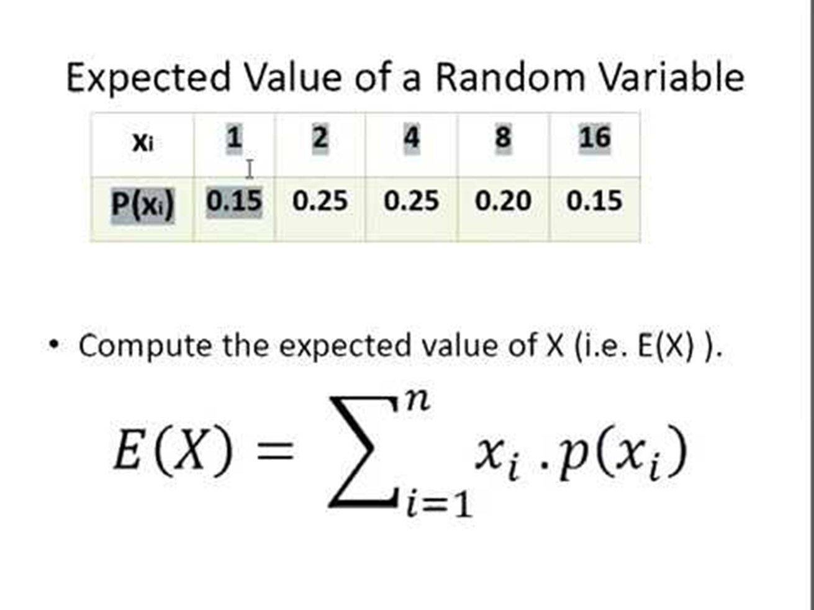

Slide 22
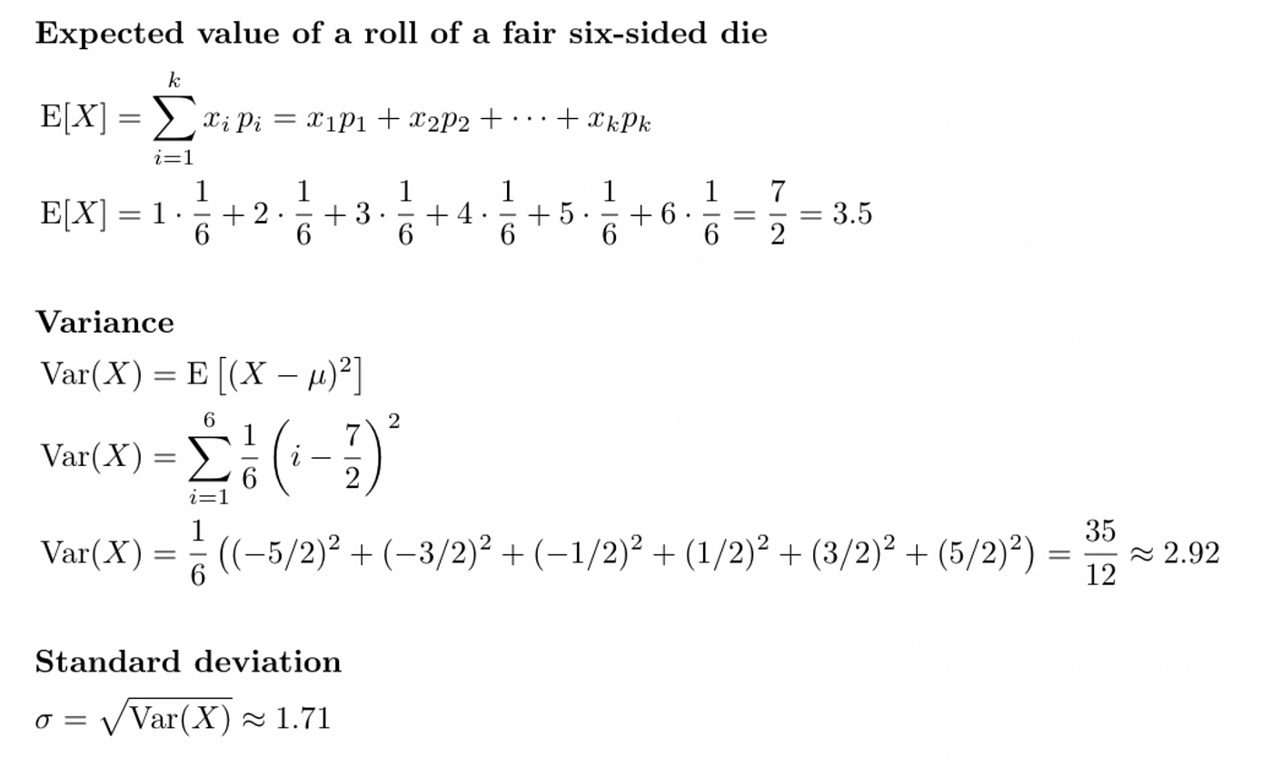

Slide 23
Which of the following is true about the arithmetic mean?
a) It is sensitive to outliers
b) It is not sensitive to outliers
c) Extreme values do not affect the mean
d) Mean of the data cannot be corrupted

Slide 24
The square root of the variance is called the ________ deviation.
a) empirical
b) mean
c) continuous
d) standard

Slide 25
Which of the following is a correct interpretation of a low standard deviation value for a data distribution?
a) Data is spread over a large range of values
b) Data points are close to the mean
c) Data points are close to the mode
d) Data points are close to the 25th percentile

Slide 26
Which of the following is not true about scatter plots?
a) It is used to identify relationship between attributes
b) It is used in the case of univariate distribution
c) It is used to identify outliers
d) It is used to identify clusters

