Slide 1
Customer Booking Prediction Model
Objective: Predict whether a customer completes a booking using machine learning techniques.
Data Preparation:
Cleaned dataset
Encoded categorical variables
Prepared features for model training
Model Used: Random Forest Classifier
Model Accuracy: 85.51%% Cross Validation Score: 50.55%
The model achieved strong test accuracy, though cross-validation results suggest performance variability across different data splits.
Key Findings:
Purchase behavior can be predicted using booking-related features.
Certain variables contributed more strongly to predictions.
Random Forest provided good interpretability through feature importance analysis.

Slide 2
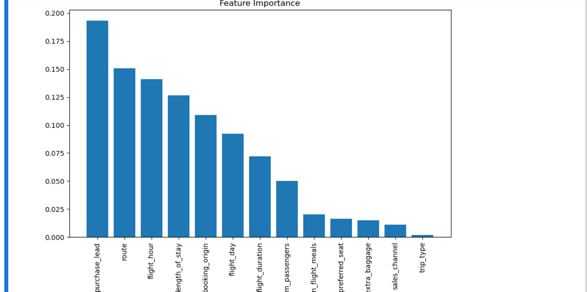
Feature Importance Graph

