Slide 1

Facebook Fake Profile Detection Using Artificial Neural Network
Team members : Team Name :
1.Akshaya Prathapagiri Akshaish
2.Aishwarya thakur
BVRIT HYDERABAD COLLEGE OF ENGINEERING FOR
WOMEN

Slide 2
ABSTRACT
In the present generation, Social networks have become an integral part of our lives. The amount of personal information unwillingly exposed on social networks is staggering. In 2019, Facebook reached a total population of 2.5 billion users making it one of the popular choice of social media. Making friends and staying in touch with them is easier now.
But with all the advancements and growth, problems like fake profiles, online impersonation have also grown. Social network platforms such as Facebook contains users details and the main intention of fake users is to hack social network database and to steal or breach user’s information. The process is to send friend request to normal users to hack their machine or to steal their data.
The Artificial Neural Network (ANN) model and Support Vector Machine (SVM) model are built and checked for accuracies on test data. The best model out of the two is used to identify if an account is genuine or fake.

Slide 3
Technologies Used
Hardware Requirements :
Operating System : Windows 10
Processor : Intel Core i5
CPU Speed : 2.30 GHz
Memory : 4 GB (RAM)
Software Requirements :
Programming Language : Python 3.6
Graphical User Interface: HTML5, CSS3 with Bootstrap, JavaScript
Dataset : Facebook Dataset
Libraries : Tensorflow, Keras, Numpy, Pandas, Scikitlearn
Framework : Django
Tool : Anaconda

Slide 4
Project Flow
Actors :
Admin
User
The admin and user can login
Training and generating the two models
Comparing the test data accuracies
Testing if the models are generating correct output when profile details are given

Slide 5
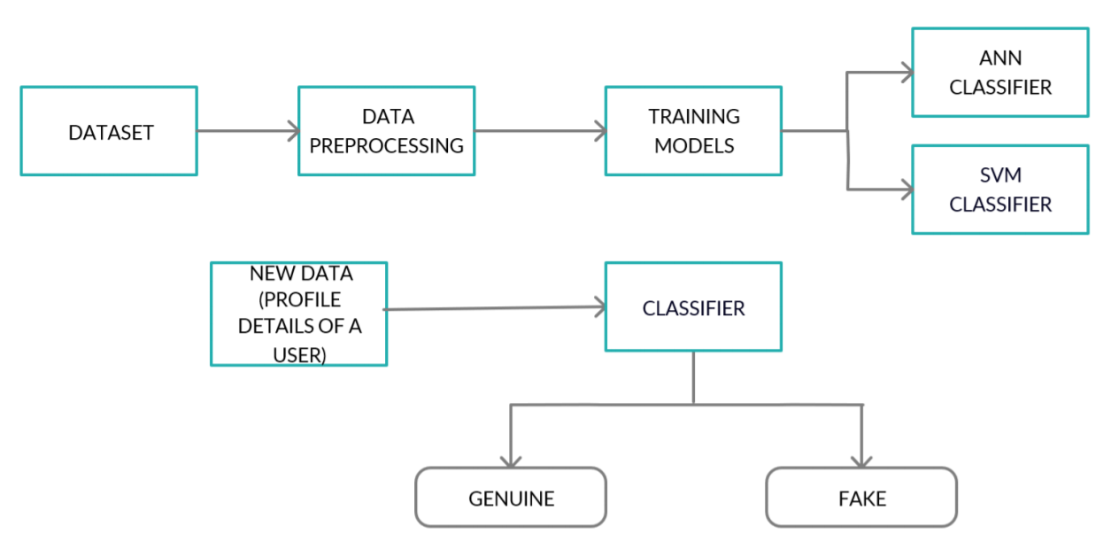
Architecture

Slide 6
APPLICATIONS
The application helps the users to identify whether the given profile is genuine or fake based on given profile details.
This may protect innocent persons from being bullied or may save them from cyber crimes.
Fake profiles are a major threat to the society, hence identifying fake profiles is a very essential task as they can cause identity theft, but their rapid and accurate identification is difficult most of the times due to lack of the necessary information.

Slide 7


