Slide 1
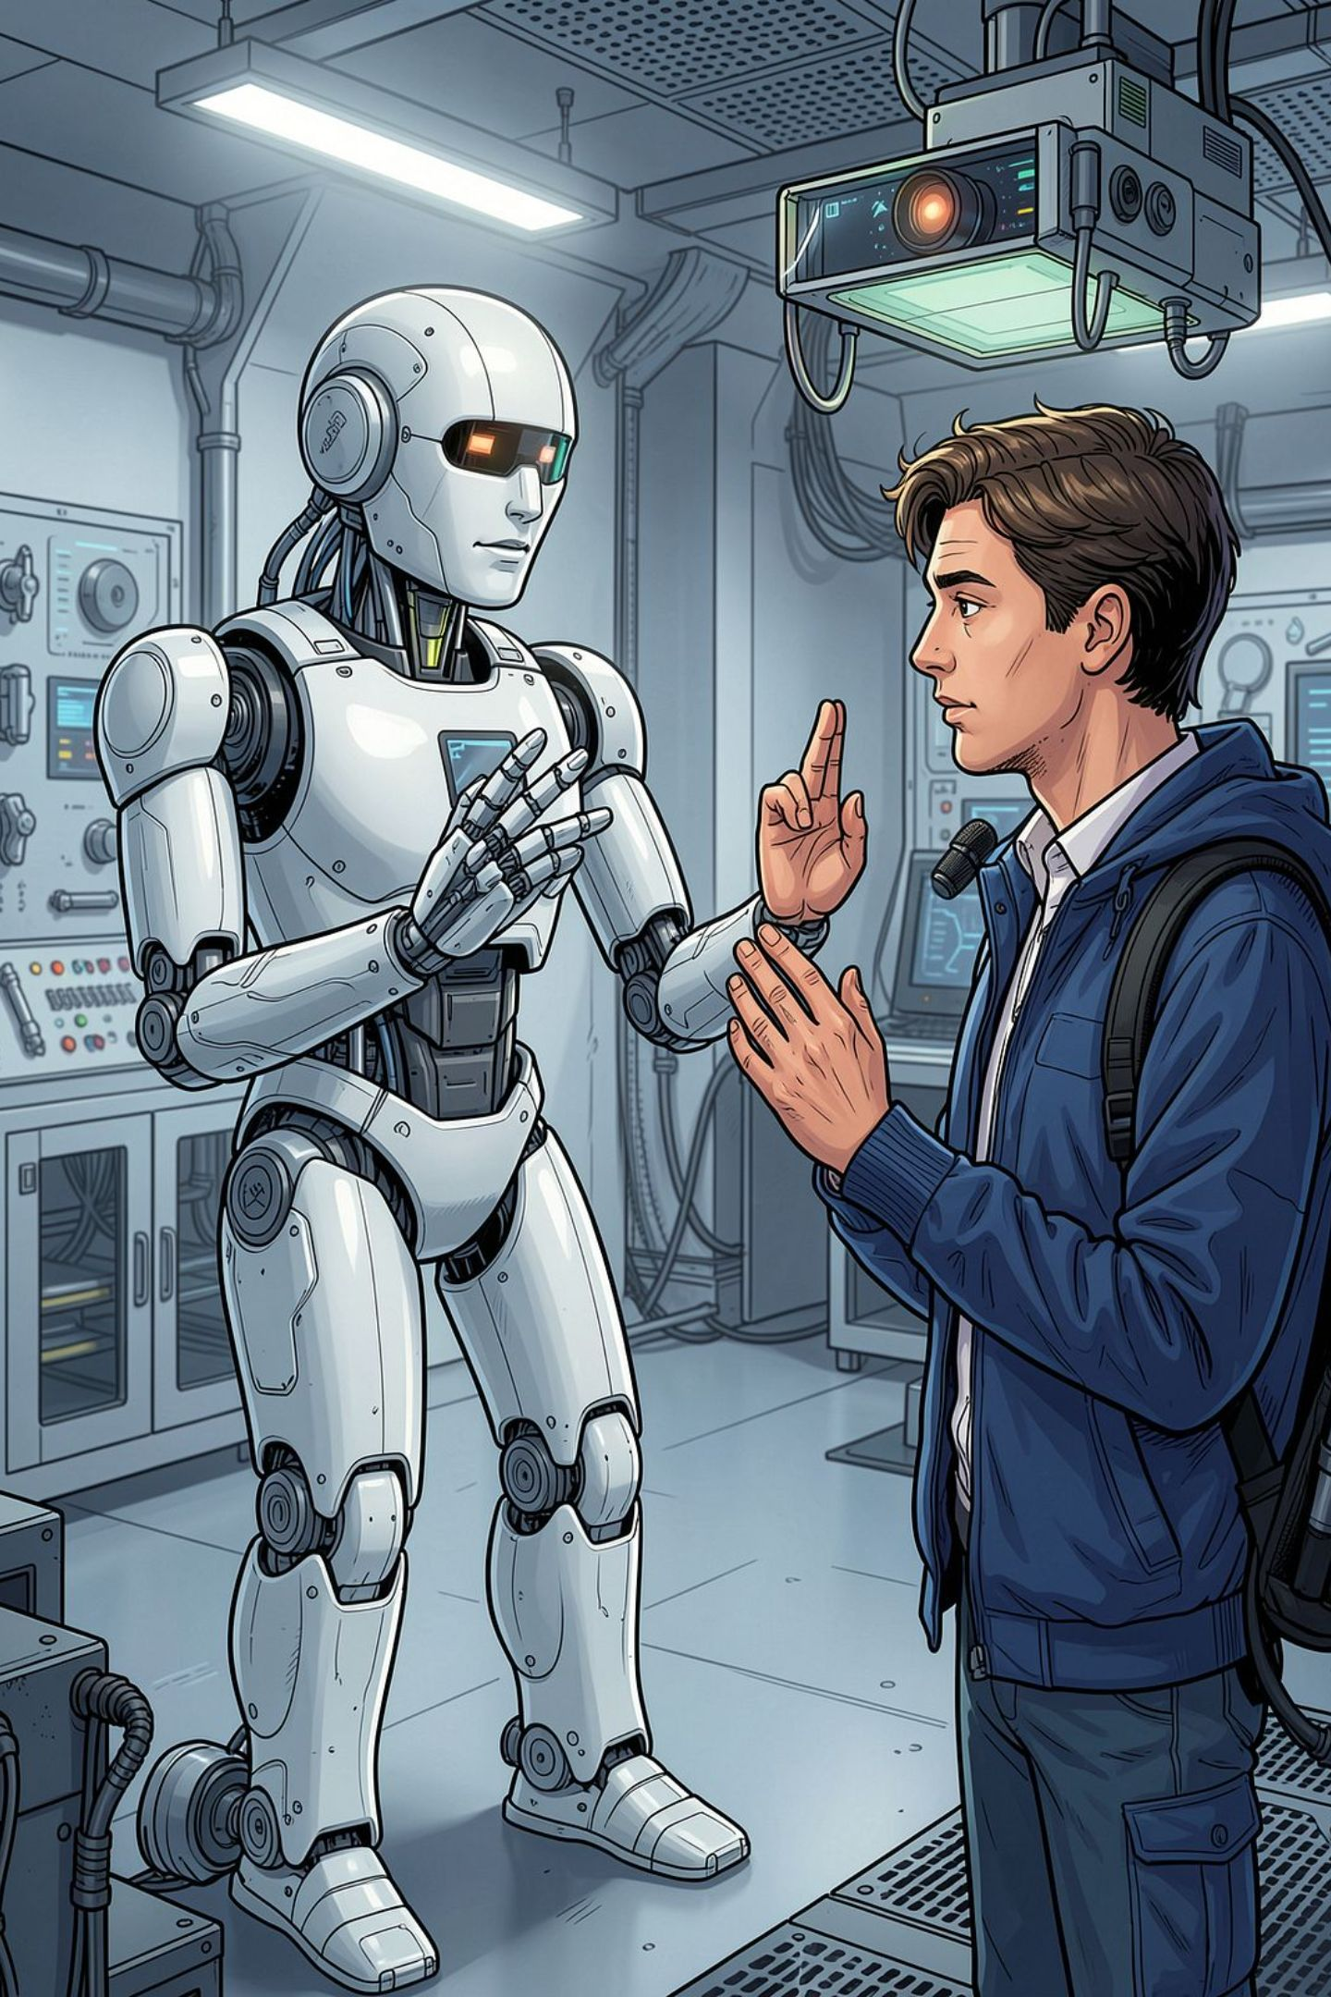
AI-Based Bidirectional Sign Language Translation Using Vision-Based Robot Perception and a Dual-Arm Humanoid Robot
An AI-based robot perception and human–robot communication system that translates between sign language and speech in real time and physically performs signing using two robotic arms.
Aishwarya V
23BRS1049
Lakshitha
23BRS1225

Slide 2
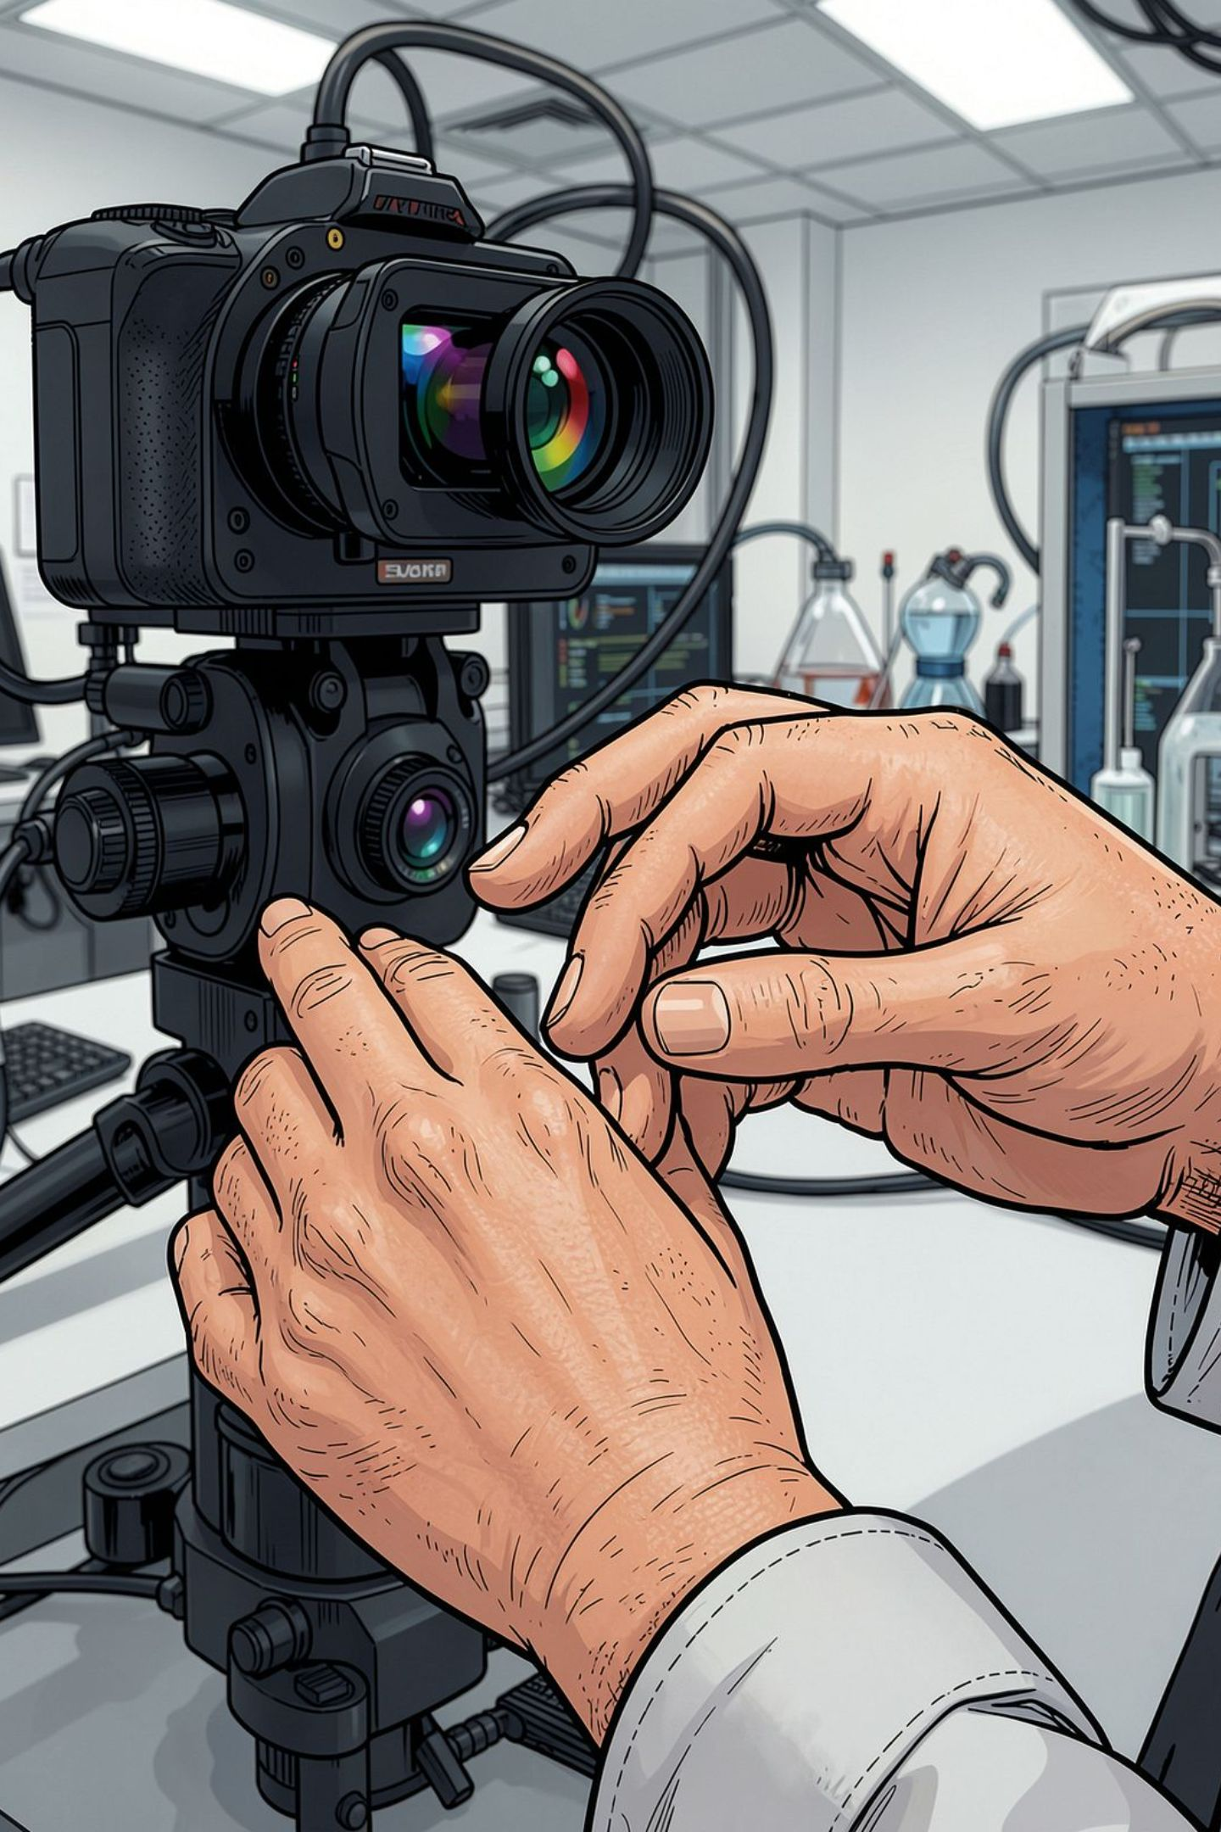
Abstract — Background & Motivation
Communication barriers persist between deaf/hard-of-hearing users and hearing persons due to limited interpreter availability, cost, and accessibility. Existing solutions (human interpreters, wearable sensor gloves, mobile apps, and virtual avatars) each have strengths but also practical limitations: intrusiveness, limited physical presence, sensitivity to environment, or lack of embodied interaction. We propose a bidirectional system that combines vision-based perception, temporal gesture recognition, natural language processing, and robotic motion generation so a dual-arm humanoid robot can both understand sign language and physically perform signed output. The platform emphasises real-time robustness, two-hand coordination, and a user-centred assistive interface, integrating computer vision, deep learning, ASR/NLP, and motion planning.

Slide 3
Significance & Existing Approaches
Healthcare
Education
Public Services & Workplaces
Improves patient–clinician communication and informed consent.
Enables classroom access, real-time translation for lectures and peer interaction.
Accessible service desks, interviews, and on-site assistive communication.
HRI & Assistive Robotics
Embodied bilingual agents improve trust, presence, and social acceptability.
Comparative summary
Approach
Advantage
Limitation
Notes
Wearable gloves
Accurate hand sensing
Uncomfortable / intrusive
Not ideal for spontaneous social use
Camera-based recognition
Contactless
Sensitive to occlusion/background
Scales easily but environment-dependent
Deep-learning recognition
Handles complex gestures
Requires large labelled datasets
Data collection costly
Virtual avatars
Easy sign generation
Not physically embodied
Less effective for social presence
Robotic systems
Physical interaction
Expensive and complex
High implementation overhead
Research gap: Few systems combine real-time visual sign perception, bidirectional language translation, and physical dual-arm sign generation in a unified platform.

Slide 4
Literature Survey (selected recent works)
The following are representative, peer-reviewed works (2020–2026) relevant to visual sign recognition, temporal models, and robotic sign synthesis.
Author
Method
Dataset
Limitation
Camgoz, N.C., Koller, O., Hadfield, S. and Bowden, R., 2020. Sign language transformers: Joint end-to-end sign language recognition and translation. In Proceedings of the IEEE/CVF conference on computer vision and pattern recognition (pp. 10023-10033).
Transformer-based sign translation
PHOENIX-2014T (German SL)
Large alignment complexity
Jiang, Z., Lin, Z. and Davis, L.S., 2013. Label consistent K-SVD: Learning a discriminative dictionary for recognition. IEEE transactions on pattern analysis and machine intelligence, 35(11), pp.2651-2664.
Limited temporal modelling for long sequences
Two-stream CNN + LSTM for gesture recognition
WLASL (subset)
Sánchez-Vicinaiz, T.J., Camacho-Pérez, E., Castillo-Atoche, A.A., Cruz-Fernandez, M., García-Martínez, J.R. and Rodríguez-Reséndiz, J., 2024. Mediapipe frame and convolutional neural networks-based fingerspelling detection in mexican sign language. Technologies, 12(8), p.124.
MediaPipe landmarks +
attention-LSTM
Dataset bias; signer variation
ASL dataset variants

Slide 5
Problem Statement & Objectives
Problem Statement
Overall Objective
Develop an AI-enabled robotic perception system that recognises sign-language gestures via vision, converts them into spoken language, and performs the reverse translation by executing physical sign-language gestures using a dual-arm humanoid robot.
Build a bidirectional AI-based robotic communication system for sign ↔ speech translation with embodied dual-arm sign generation.
1
2
3
4
Detect & track both hands and key body landmarks.
Recognise dynamic gestures using temporal deep learning (LSTM/GRU/Transformer).
Convert recognised signs into fluent spoken sentences.
Convert speech to sign gloss/sequence with NLP-aware grammar.
5
6
Generate coordinated two-arm robotic motions and articulated finger postures.
Evaluate accuracy, latency, robustness, and gesture execution fidelity.

Slide 6
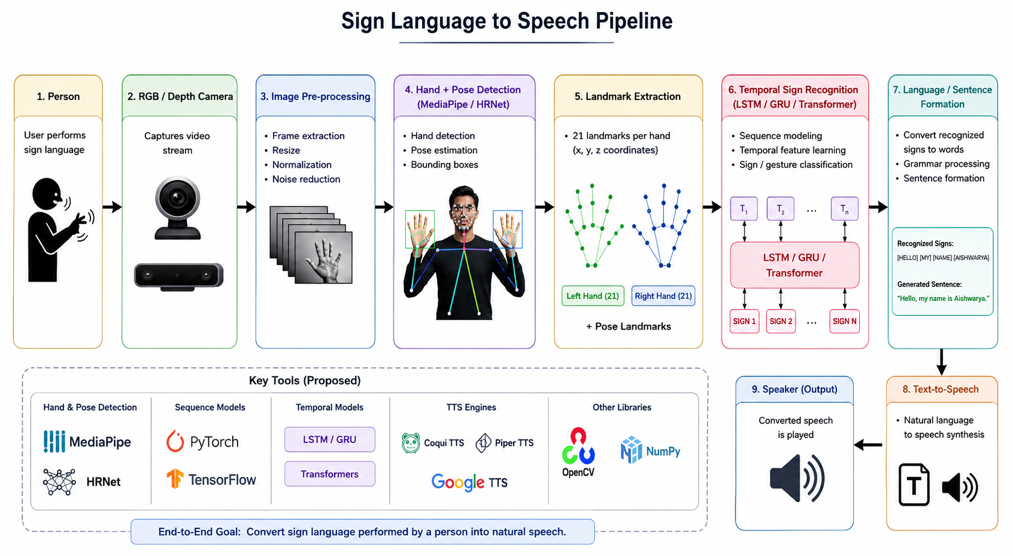
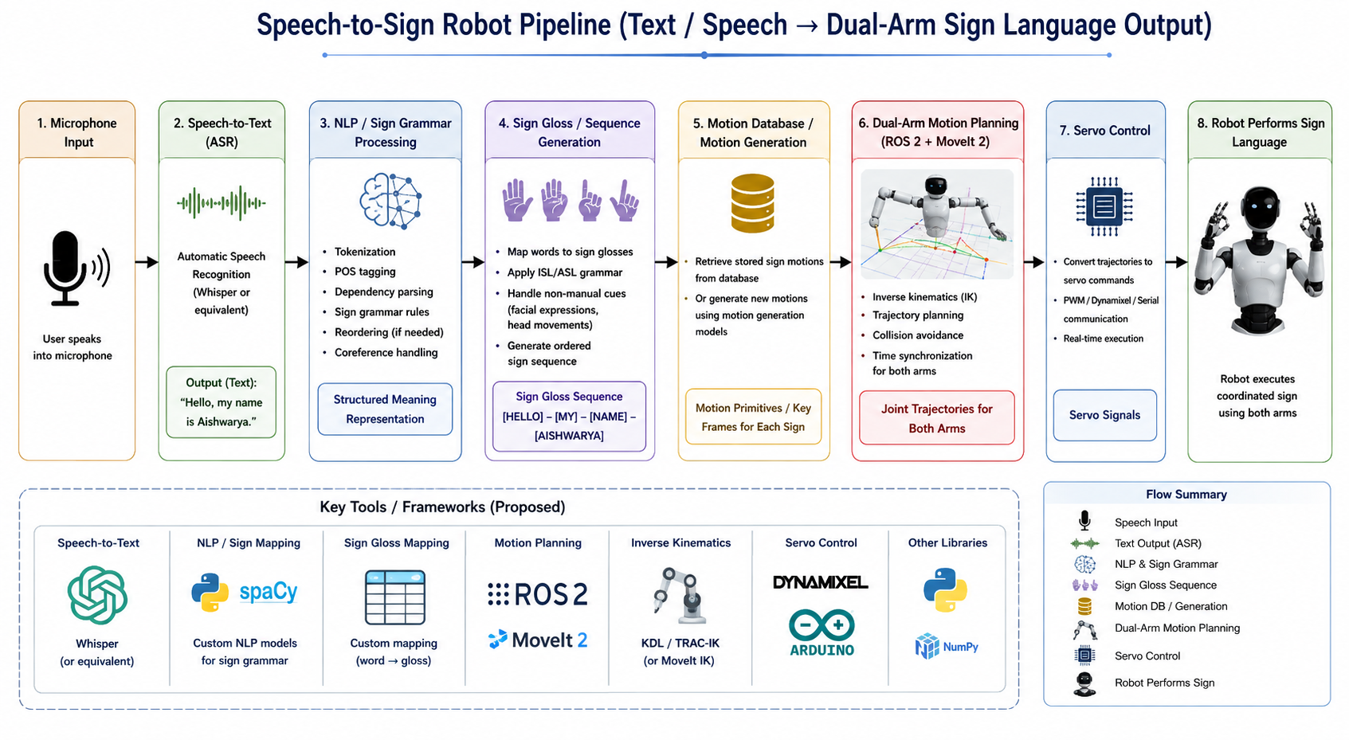
Proposed Methodology — Dual Pipelines
SIGN → SPEECH
Person → RGB/Depth Camera → Image Pre‑processing → Hand + Pose Detection (MediaPipe / HRNet) → Landmark Extraction → Temporal Sign Recognition (LSTM/GRU/Transformer) → Language/sentence formation → Text‑to‑Speech → Speaker
Key tools (proposed): MediaPipe for landmarks, PyTorch Transformers / LSTM for sequence models, TTS engines for natural speech synthesis.
SPEECH → SIGN
Microphone → Speech‑to‑Text (Whisper or equivalent) → NLP / Sign grammar processing → Sign gloss/sequence → Motion database / motion generation → Dual‑arm motion planning (ROS 2 + MoveIt 2) → Servo control → Robot performs sign
Tools: Whisper/ASR for transcription, custom NLP mapping to sign glosses, MoveIt 2 + inverse kinematics for coordinated arm control.
Proposed methods only — implementation and tuning remain future work.

Slide 7
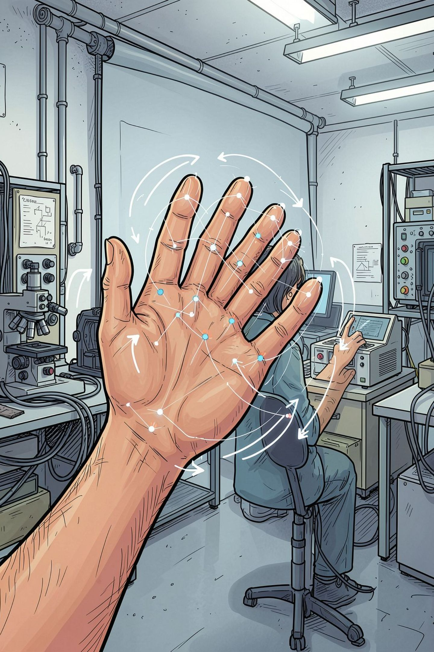
Robot Perception Pipeline — Focus on Vision
Camera → Person/Hand detection → 21 hand landmarks × 2 hands → Pose estimation → Temporal sequence formation → Feature extraction (angles, velocities, relative positions) → AI sign recogniser → Decision / language output.
01
Hand & Pose Features
Hand position, finger configuration, orientation, wrist rotation
02
Temporal Dynamics
Motion trajectory, velocity, inter-hand timing
03
Two-hand Coordination
Relative timing and spatial relation between hands
04
Challenges
Occlusion, lighting, background clutter, signer variability, continuous signing segmentation

Slide 8
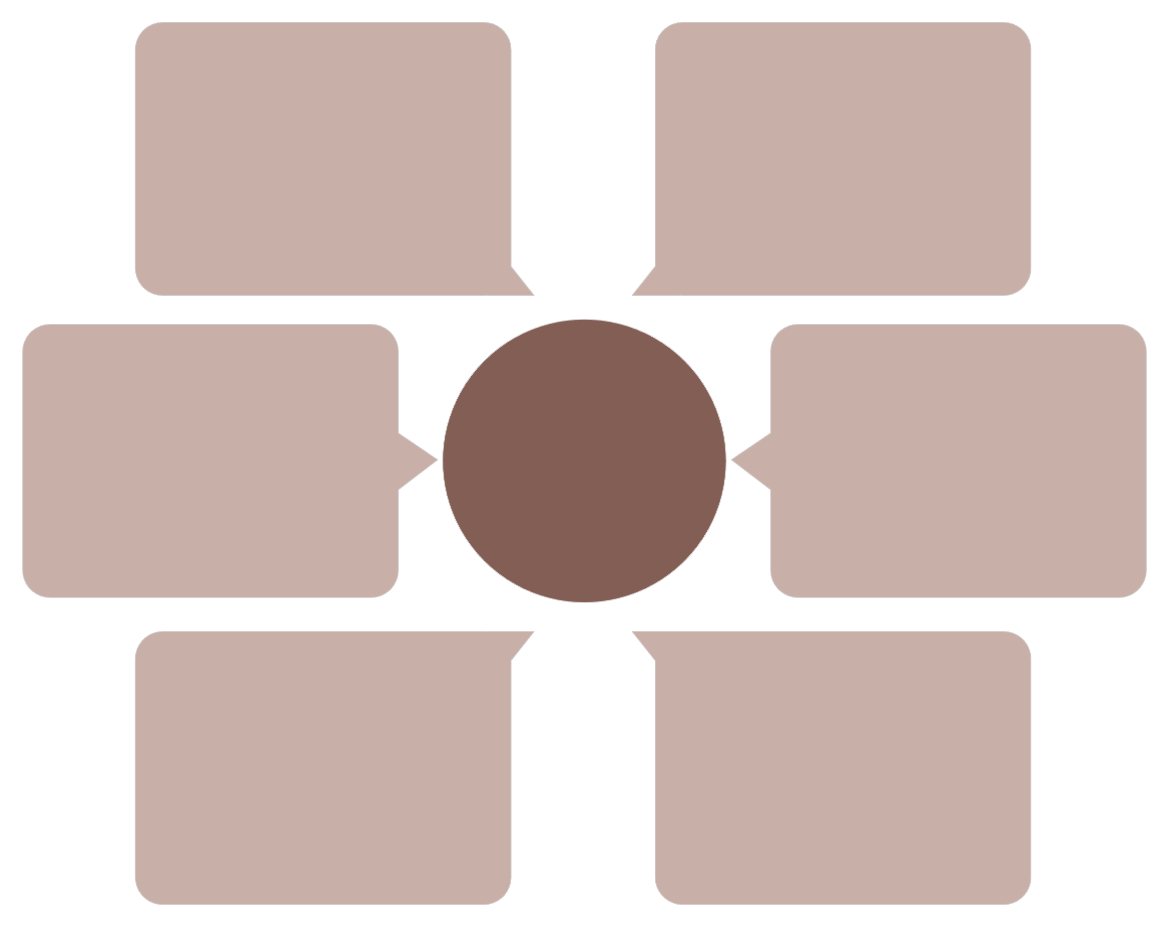
System Architecture — Engineering Block Diagram
Decision / AI
RGB / Depth Camera
Planning and control policy
Visual depth sensing
Sense–Perceive–Decide–Act Loop
Perception
Microphone
Object and scene understanding
Audio capture
Pre-processing
Data Acquisition
Filtering and calibration
Sensor synchronization

Slide 9

Hardware, Software & Dataset
Hardware
Datasets
RGB/Depth camera (Intel RealSense or Azure Kinect)
Jetson Nano / Jetson Orin Nano (edge inference)
ESP32/Arduino for low‑level motor control
Two robotic arms with articulated hands and servo/smart actuators
Microphone array, speaker, robust power supply
Public datasets (examples): WLASL, AUTSL, ASLLVD, selected ISL corpora — useful for pretraining recognition models.
Proposed custom dataset (development set):
30–50 initial signs/phrases, single- and two-hand signs
Multiple signers (diverse ages, hand sizes, clothing)
Multiple repetitions, varied backgrounds, lighting conditions
RGB + depth + synchronized audio where applicable
Software
ROS 2 + MoveIt 2 for robot control and planning
Python / C++ for perception and control stacks
OpenCV, MediaPipe for landmark extraction
PyTorch / TensorFlow for temporal models
Whisper (ASR) or equivalent, NLP framework for grammar mapping
RViz for visualization and debugging
Clearly separate public data for pretraining and curated in-house recordings for robot execution mapping and retargeting.

Slide 10
Evaluation Plan & Metrics
Recognition accuracy
Per-sign precision/recall, sequence-level BLEU/translation metrics for sign→text.
Execution fidelity
Pose similarity metrics between human reference and robot execution, temporal alignment.
Latency & real-time performance
End-to-end latency (ms) for both pipelines; frame-rate and inference time on target hardware.
Robustness
Performance across lighting, occlusion, signer variability, and background clutter.
User acceptance
Qualitative user studies with deaf/hard-of-hearing participants and hearing users for usability and understandability.

