Slide 1

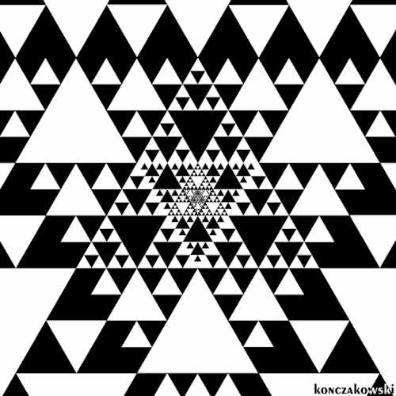
MandelBrot
Fractals Generator using different maps
Prepared By:
Aishworyann
Vibhor Mishra
Bharti Jangra
Ritika Thakur
Pradhyuman Singh
The pattern that is never ending.
01

Slide 2
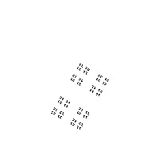

INTRODUCTION
02
1.
Defination :
Fractals are never-ending patterns.These patterns are really complex in nature and are self-similar across different scales.
2.
Use Case :
This pattern can be used for encryption
Can be used as the picture of Chaos that can be further used for encryption of images .
3.
Resources Used:
oneAPI DevCloud
SYCL and C++ - Language
Jupyter Notebook

Slide 3
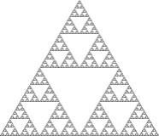

PURPOSE
Mandelbrot is a DPC++ application that generates a fractal image by initializing a matrix of 512 x 512, where the computation at each point (pixel) is entirely independent of the computation at other points. The sample includes both parallel and serial calculation of the set, allowing for a direct comparison of results. The parallel implementation can demonstrate the use of Unified Shared Memory (USM) or buffers. We can modify parameters such as the number of rows, columns, and iterations to evaluate the difference in performance and load between USM and buffers.

Slide 4
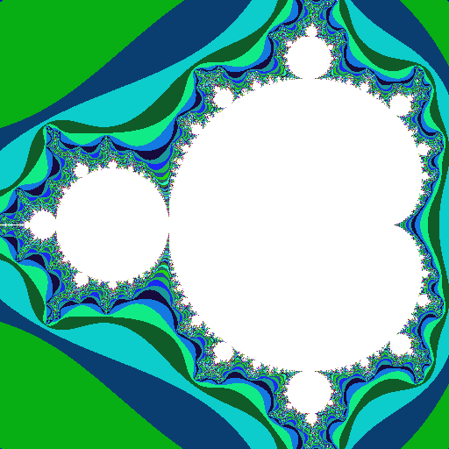
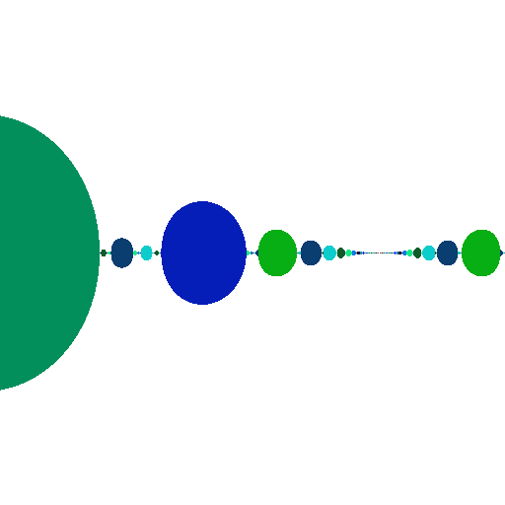
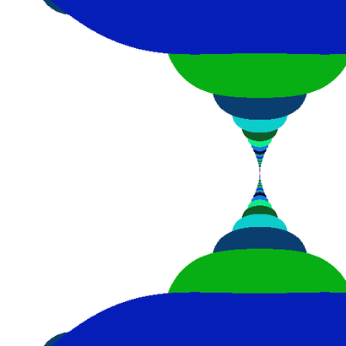
OUTPUTS
RESULTS AND OUTPUT OF THE PROJECT
MANDELBROT FRACTAL
Tan Fractal
04
Cos Fractal

