Slide 1
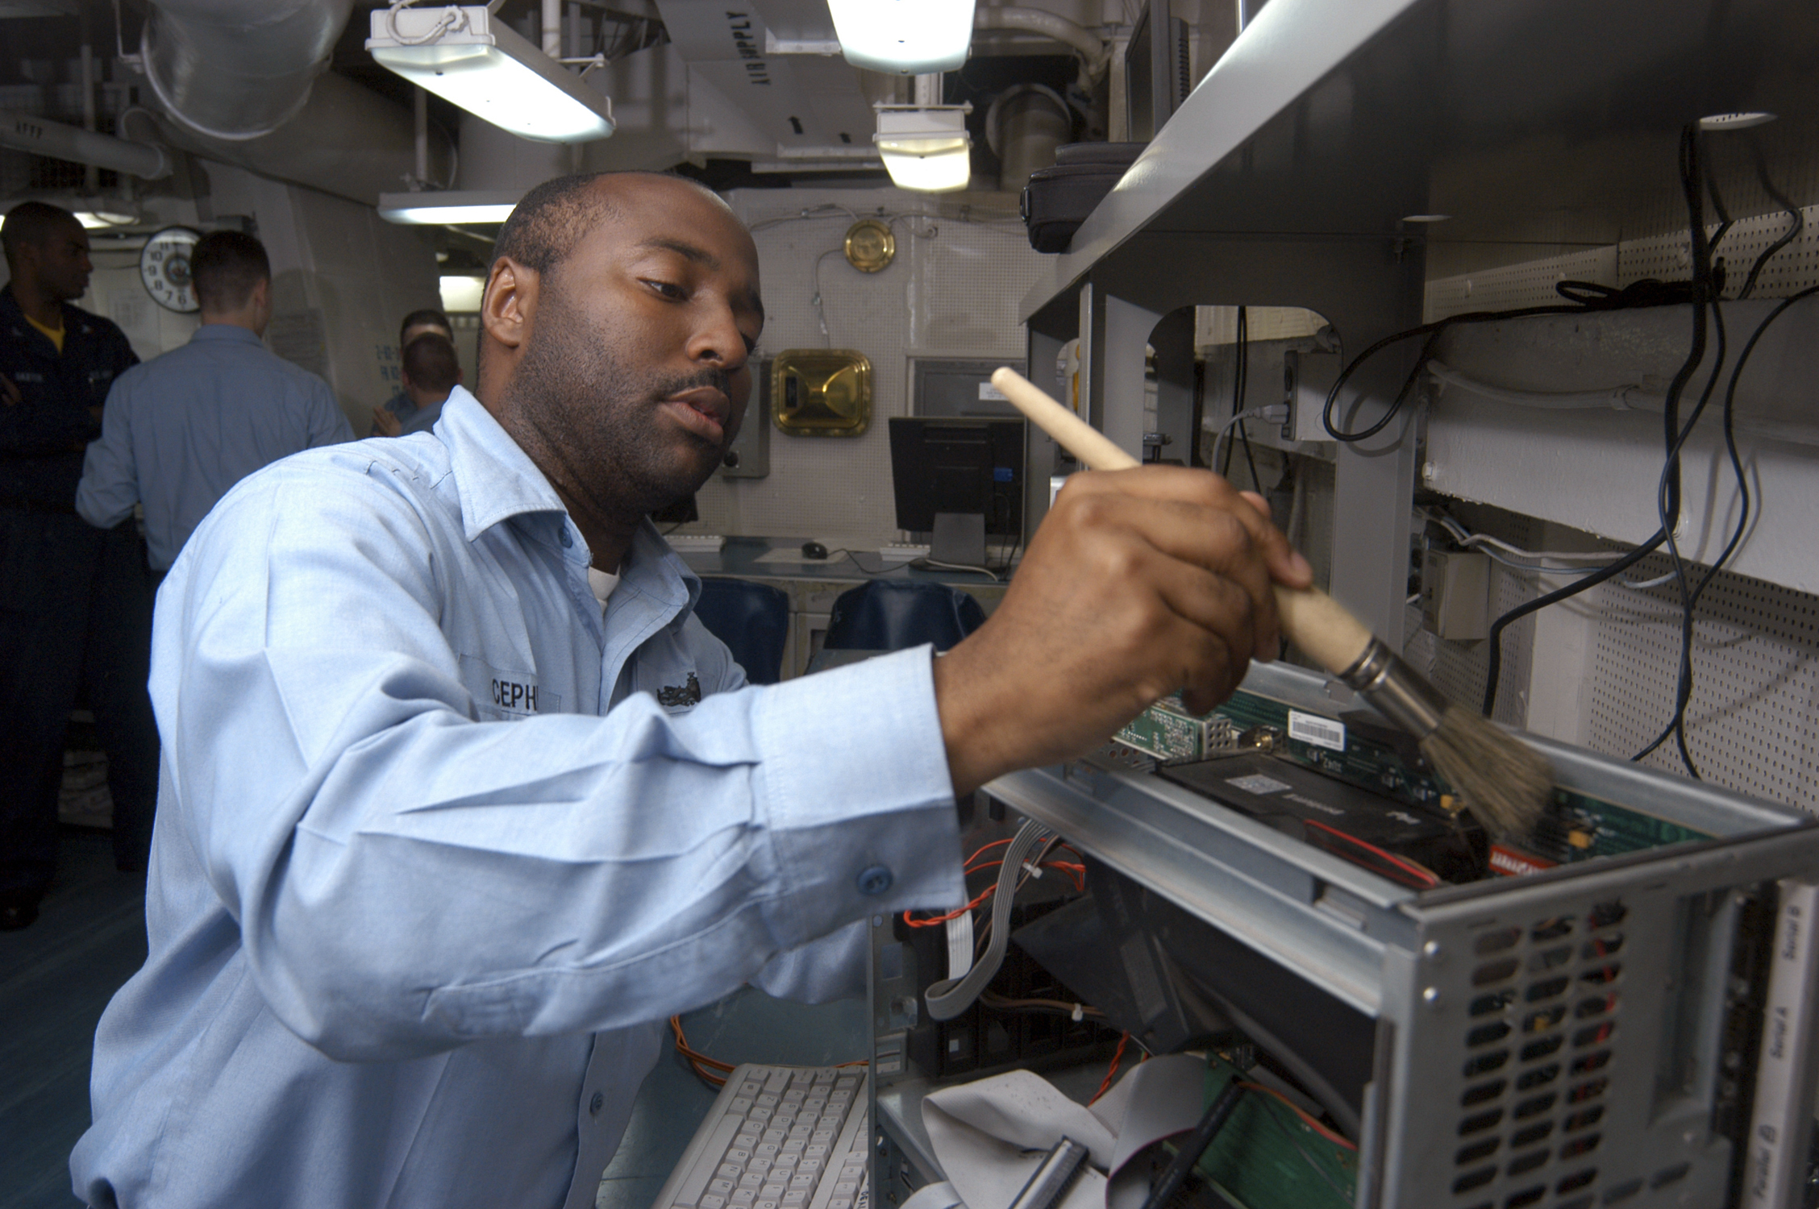
Carl Wheeter
Motivations
Frustrations
Mexican Food
Fast Service
Family
Wasting Time
Losing Focus
Age: 39
Family: Married, 1 kid
Home: Seattle
Occupation: Computer Technician
Goals
Finish first on the floor
Save money

Slide 2

Isabelle Milton
Motivations
Frustrations
Fast service
Cheap Food
Healthy
Diverse foods
Wasting Time
Grease Foods
Repetitive actions
Age: 24
Family: Single
Home: Boise
Occupation: Nurse
Goals
Help as many people as possible
Live to 100

Slide 3

Dave Flemling
Motivations
Frustrations
Productivity
Lack of Choice
Grease Food
Age: 55
Family: Married
Home: Oregon
Occupation: Manager
Goals
High company morral
Beating previous sales record

