Slide 1
CIS 389
For an A
Junxu Chen, Jie Wang, Aislan Lally

Slide 2
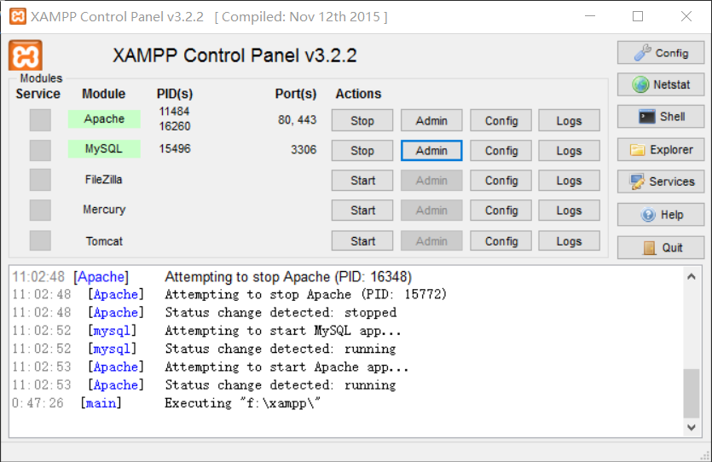
XAMPP

Slide 3

A website named JAJ: Our Goal
We want to create an image hosting website. Users can create an account on our site and then proceed to vote on popular images uploaded by fellow users.
Website incorporates initials of it’s creators names.

Slide 4

What we have right now
<?php
print "hello";
?>

Slide 5
JOKING!
<?php
print "hello";
?>

Slide 6
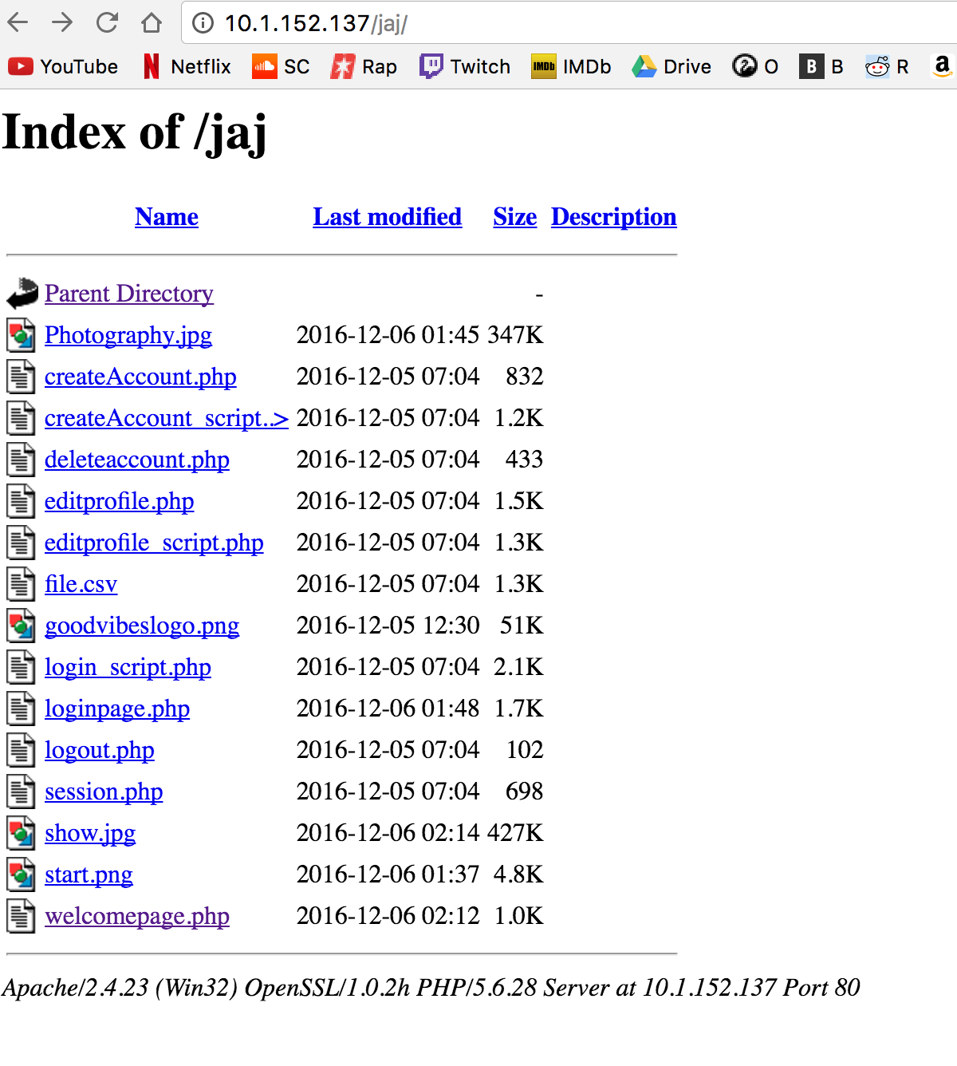
Our Progress
We created a rich file of php pages that link together to form a fluid website.
The site has a welcome page, a login page, and a create account page.
The localhost works off of a database created in phpmyadmin.
It is secured by the mightiest security system with the password: password.

Slide 7
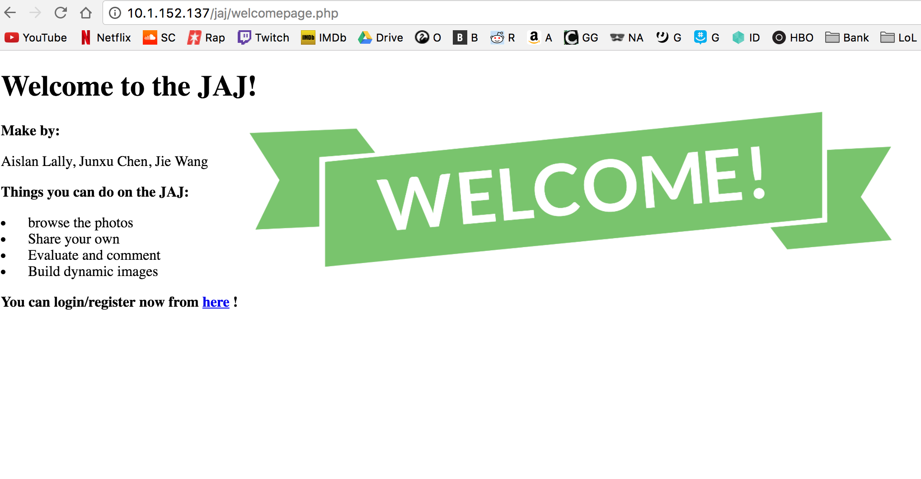
Our Homepage
You can access our site right now off of Junxu’s localhost on Air Orange X
Simply enter: http://10.1.152.137/jaj/
http://localhost/jaj/wlcomepage.php

Slide 8
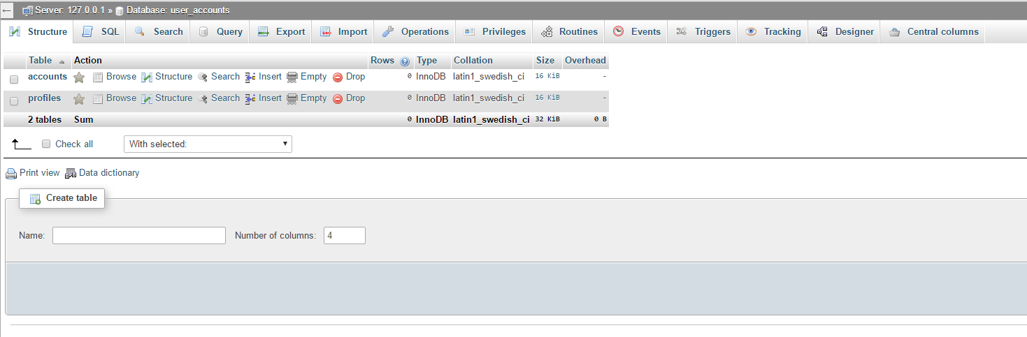
Our Database
Our site works off of a small database called user_accounts we created in phpmyadmin.
It contains the user account & profiles being generated on site.

Slide 9
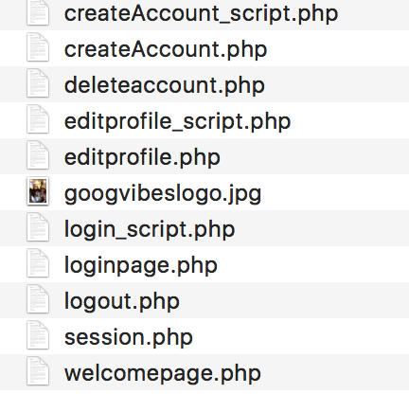
THE JAJ FOLDER
NOOOOOO!
Basicly we need a login page, create account, the main webpage, upload page etc.

Slide 10
Our Goals
Update and improve on existing code to make the website friendlier.
Create a more functioning userprofile.
Create a homepage and upload feature.

Slide 11

The End.
Notes:
?wwhat

