Slide 1
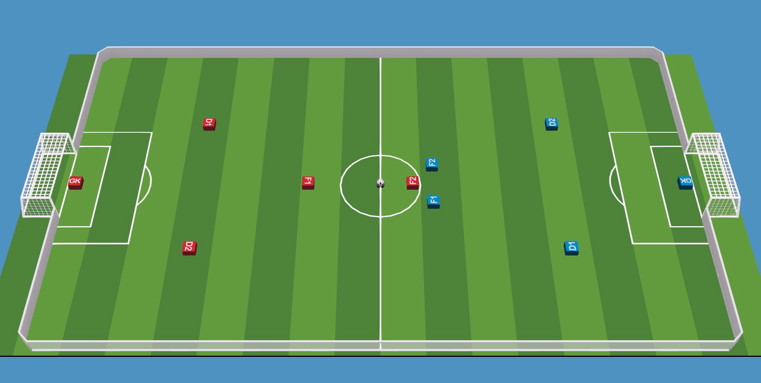



Field information
Own side
Opponent side
Ball
Out
Area
Ball
Out
Area
$$y$$
Field
Area
Field
Area
Penalty
Area
Goal
Area
Goal
Area
Penalty
Area
$$O$$
$$x$$
Ball
Out
Area
Ball
Out
Area

