Slide 1
Creation of interactive explanations of ML algorithms in Python using Plotly
PyCon Austria
Apr 6-7, 2025
Alfarabi

Slide 2
Intro message
Thanks for joining
Briefly about me

Slide 3
0. Agenda
Examples of interactive tutorials [5’]
Plotly: overview [5’]
Plotly: building blocks for today’s workshop [5’]
Plotly: quick practice [15’]
KNN: preparation for build time [5’]
Build time of K-nearest neighbors [40’]
Deployment options [10’]
Next steps? [5’]

Slide 4
1. Examples of interactive tutorials

Slide 5
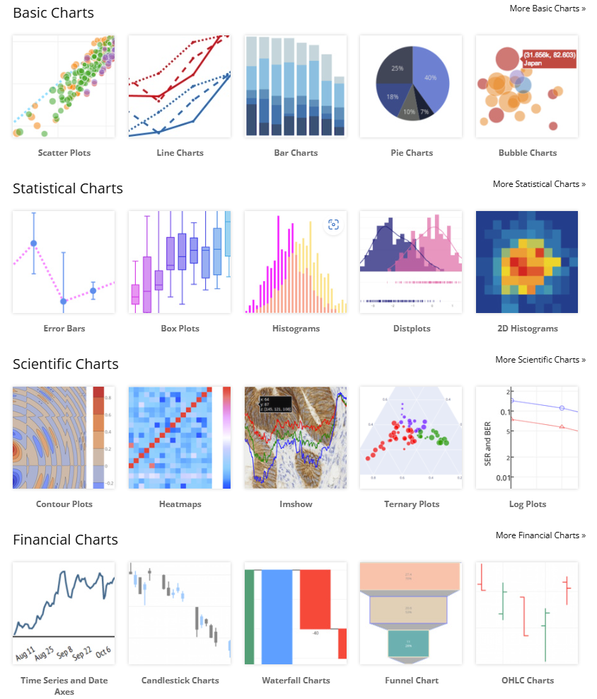
plotly.com/python
Basic charts
Statistical charts
Scientific charts
Financial charts
Maps
AI/ML
3D Charts
Subplots
Interactions with end-user
Custom controls
Animations

Slide 6
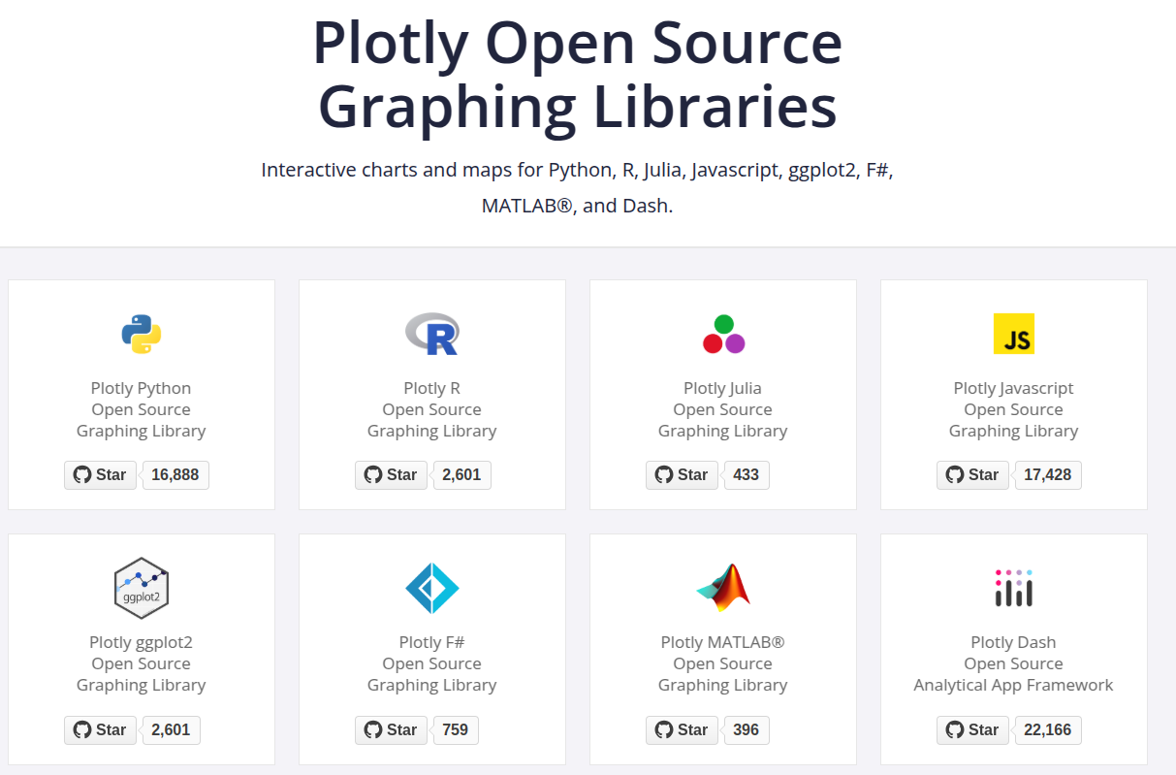
2. Plotly: overview

Slide 7
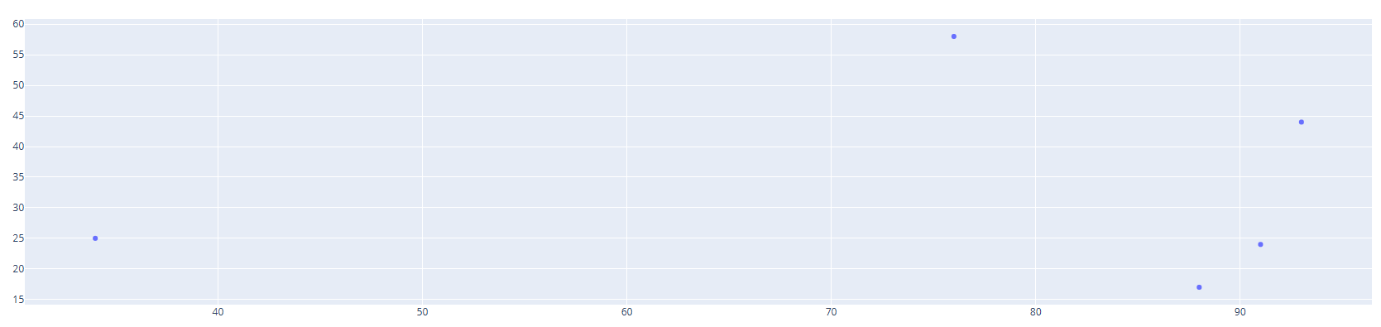
3. Plotly: building blocks for today’s workshop
What is Figure?
Data structure in Plotly, that refers to any graphical figure
Can be created using class plotly.graph_objects.Figure
Figure has 3 top-level attributes:
Data
Where you specify data, how to visualize it (scatter/bar/etc.)
Layout
Where you specify layout of non-data parts
Frames
Where you specify animations to your figure

Slide 8
3. Plotly: building blocks for today’s workshop
What is Frame?
Used in the attribute “frames”
Can be created using plotly.graph_objects.Frame
Frame has several parameters, but 2 below will be relevant for today:
Data
Traces
P.S. Layout

Slide 9
3a. Plotly: quick practice

Slide 10
4. KNN: preparation for build time
Create dataset with N classes
N traces
Create random undefined point
+1 trace
Calculate distances (or draw line one by one)
We want to see these lines 1 by 1
+1 invisible dummy trace
Choose K minimum distances (or draw K lines)
We want to see K lines at the same time
+K invisible dummy traces
Identify the majority class among minimum distances
Undefined point corresponds to class from (5)

Slide 11
5. Build time of K-nearest neighbors

Slide 12
6. Deployment options
Pyscipt
Plotly JS
Django
Google Colab

Slide 13
7. Next steps?
Let’s connect! (find me on Linkedin: Alfarabi Issakhanov)
Ping me if you:
want to consult about your idea
want to build something together
visit Salzburg

Slide 14



2. Plotly: overview
Notes:
images:
https://d3js.org/
https://www.khronos.org/webgl/wiki/Main_Page
https://plotly.com/graphing-libraries/
Useful to read:
https://www.youtube.com/watch?v=nNrsoSNx8E4

