Slide 1
Segmentation of brown cells using Voronoi-Otsu-Labeling approach

Slide 2
Agenda
Introduction
High-level approach
Programming approach
Example
Way forward

Slide 3
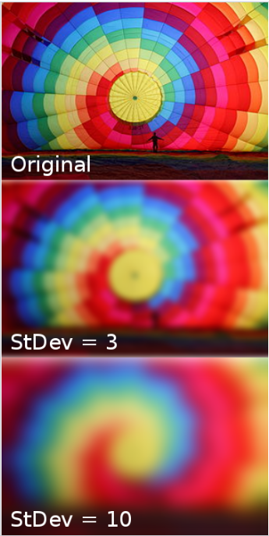
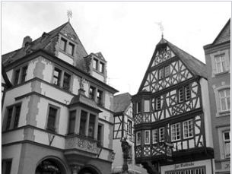
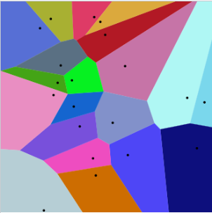
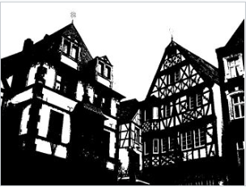
Introductory concepts
Gaussian blur
Otsu’s method
Voronoi diagram

Slide 4
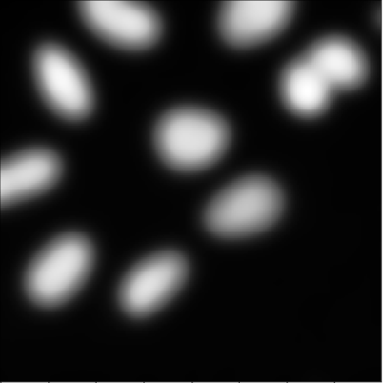

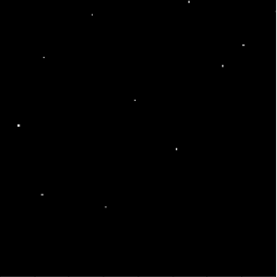
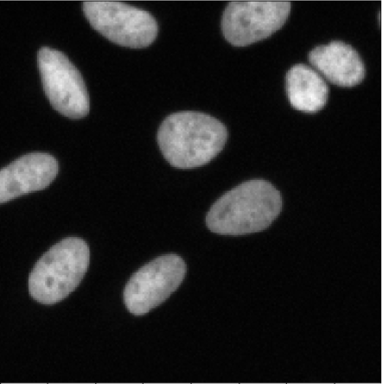


High-level approach
Local
maxima
AND operation
Gaussian blur
Voronoi diagram using binary as a mask
Otsu
threshold

Slide 5
Detailed programming approach
Using pyclesperanto_prototype package in Python
gaussian_blur(image, spot_sigma)
detect_maxima_box(1)
gaussian_blur(image, outline_sigma)
threshold_otsu(3)
binary_and(2,4)
masked_voronoi_labeling(5,4)
voronoi_otsu_labeling
(image, spot_sigma, outline_sigma)

Slide 6
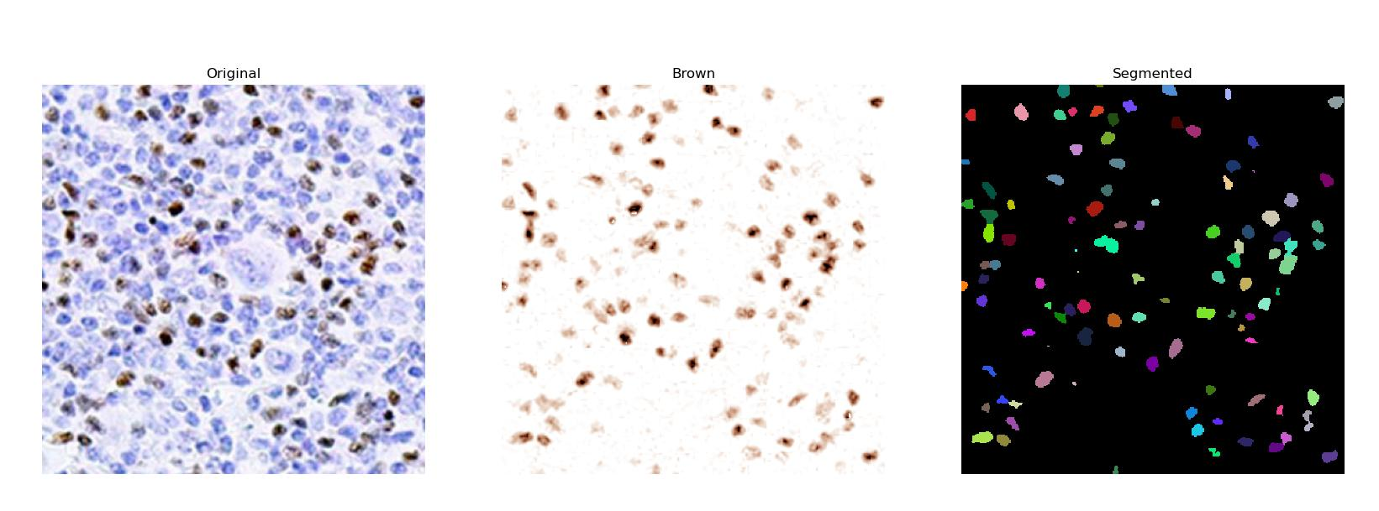
Example

Slide 7
Way forward
Test on the dataset from laboratory
Check other algorithms and compare effectiveness

