Slide 1




REQUIREMENTS
RiskLab user experience requirements
How RiskLab users work today, and what the dataset checkout design has to fit around.
01
02
One workspace for everything
MEG Studio extension already in place
Users usually have only one VSCode workspace, used both for exploring multiple datasets and for building their applications.
RiskLab VSCode already has a MEG Studio extension that provides exploration of Dev MEG datasets.
03
04
Query and join across datasets
Slow, manual workspace launch
Users want to query multiple datasets and join them together.
Launching a RiskLab VSCode workspace is a manual process led by human instructions, and takes 2 to 5 minutes.
MEG Marketplace | User experience requirements
1
Notes:
Four observations about how RiskLab users work today. The checkout design on the next slide is built to fit these.

Slide 2





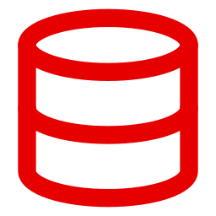



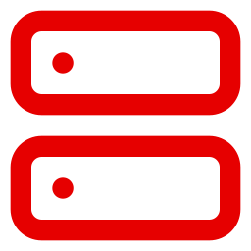
SYSTEM DESIGN
MEG Marketplace: dataset checkout to RiskLab
Datasets checked out in the web portal are saved by the backend and exposed to RiskLab VSCode as an MCP server.
meg-marketplace / datasets
RiskLab VSCode
MEG Marketplace
Datasets Slices My checkouts
MEG STUDIO EXTENSION
analysis.py
Search datasets / dataset slices
CHECKED-OUT DATASETS
FX Spot Rates
Step 4
FX Spot Rates
Checkout to RiskLab
Step 1
Credit Spreads
Consume checked-out datasets
Market data | daily
Credit Spreads
Checkout to RiskLab
Checkout a dataset
Equity Prices
Market data | end of day
1
import meg_marketplace as meg
Equity Prices
Checkout to RiskLab
2
Market data | intraday
3
fx = meg.load("fx_spot_rates")
Counterparty Exposures
Checkout to RiskLab
4
cs = meg.load("credit_spreads")
Risk data | daily
5
fx.head()
Step 2
Saving checked-out datasets
Step 3
Expose checked-out datasets as MCP server
PROBLEMS OUTPUT TERMINAL
MEG Marketplace Backend
[MEG] MCP: 3 datasets available
Stores each user's checked-out datasets
RiskLab
MEG Studio: 3 datasets
MEG Marketplace | System design
2
Notes:
Step 1: the user finds a dataset or slice in the MEG Marketplace portal and clicks Checkout to RiskLab. Step 2: the portal sends the checkout to the MEG Marketplace Backend, which saves it against the user. Step 3: the backend exposes the user's checked-out datasets as an MCP server. Step 4: the MEG Studio extension in RiskLab VSCode connects to that MCP server so the datasets can be used directly in code.

