Slide 2
Differentiate SDLC Automation vs MDLC Automation
Software Development Lifecycle (SDLC) and Machine Learning Development Lifecycle (MDLC) automation share similar automation process terms; However, their definition may differ slightly, Also, MDLC has additional automation concepts that is specific to ML Model training, selection and monitoring.
Key Concepts in SDLC automation
Continuous Integration (CI): GitLab provides a built-in CI pipeline configuration that allows users to define stages, jobs, and scripts for automating tasks such as compiling code, running tests, and generating artifacts.
Continuous Deployment (CD): GitLab CD supports continuous deployment by automating the process of deploying software applications to various environments, including development, testing, staging, and production.
Automated Testing: Automated testing frameworks such as Selenium (for web Aptos (Body) Aptos (Body) applications), JUnit (for Java), pytest (for Python) enable automated execution of various types of tests, including unit tests, integration tests, and end-to-end tests on the software code quality.
Version Control: GitLab offers robust version control capabilities with Git repositories on code version management, enabling developers to track changes, collaborate on code, code review, manage branches and merge requests effectively. The software artifacts are versioned and stored in Nexus.
Code Quality and Security: GitLab offers built-in code quality and security scanning capabilities on software code, such as code quality report, SAST, DAST and dependency scanning that help automate the identification and remediation of code issues.
Key Concepts in MDLC automation
Continuous Integration (CI): CI involves integrating new data and model updates into the development pipeline frequently. This includes automating the process of data preprocessing, feature engineering, hyperparameter tuning, and experiment management.
Continuous Deployment (CD): MDLC often involves two separate artifacts, ML Applications and ML Models. ML Applications can be continuously deployed using SDLC CD best practices. ML Models often require additional CD steps to be packaged and uploaded to a model registry and deployed from the model registry. Often ML Models are re-trained, validated, and re-deployed in an automated manner, requiring more automated CD steps.
Continuous Training (CT): CT in MLDC refers to the automated retraining of machine learning models using new data or model updates. This ensures that ML models remain up-to-date and continue to perform optimally as new data becomes available.
Continuous Monitoring (CM): CM in MLDC involves continuously monitoring deployed machine learning models in production to detect any performance degradation or concept drift. This includes monitoring model metrics, data quality, and business KPIs to ensure that the model's predictions remain accurate and aligned with business objectives.
Data Versioning: ML Models are data products, often data are stored inside the neural network of model artifact. ML Model required to be trained and tested with versioned production datasets.
Automated Model Scoring and Testing: In addition to SDLC testing frameworks, machine learning models need to be evaluated and assessed to quantify the performance of a trained ML model on unseen data, using popular processes such as training/validation data split, prediction scoring, and metric evaluation.
Version Control: There are new versioning concepts when it comes to ML models. ML model experiments require version control in an experiment tracking system, and the best performing model requires version control in an ML Model Registry. Traditional SDLC version control tools such as Git Repository are used to version control ML model training pipelines and ML Application code, as well as Nexus, which is used to version control ML Application software artifacts.
ML Security and MLSecOps: Machine Learning Security Operations is a set of practices, processes, and tools aimed at ensuring the security and integrity of machine learning systems throughout their lifecycle. It aims to prevent security threats such as model serialization attacks, prompt injection attacks, as well as secure data leakage and govern model bias and fairness.
Machine Learning Bill of Materials (MLBOM / AIBOM): MLBOM enumerates and documents all the elements and dependencies required to develop, deploy, and maintain a machine learning project to track key ML metadata on data sources, data processing, foundational models and dependencies, ML lifecycle status, hyperparameters, training configuration, evaluation metrics, deployment configuration, model monitoring, and compliance and governance.

Slide 3
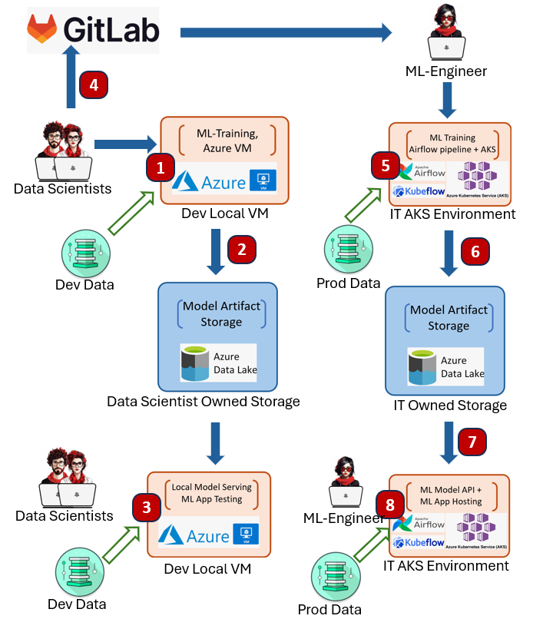
MDLC in Practice: Case 1: IT Centric Training and Inference on AKS
In this example, Observed from two separate ML teams within UBS, Data Scientists develops ML Training pipeline on its Local VM, then hands over to IT for the model to be trained on IT maintained AKS based infrastructure.
Data scientists develop ML training pipelines and experiment scoring/selection modules in private UBS VMs or Azure VMs accessing development datasets.
Data scientists either manually run the training pipeline using a variety of ML frameworks, with model artifacts generated and persisted into the data scientist-owned Azure storage, for example, ABFS.
Data scientists can optionally pull those artifacts from storage and host the ML inference API locally for endpoint testing and ML app testing.
Data scientists check in ML training pipelines and experiment scoring/selection modules to GitLab.
IT ML engineers check out the training and selection pipeline and schedule the model training in an IT-maintained AKS cluster having production data access. Often, an open-source pipeline framework is used, for example, Apache Airflow or Kubeflow pipeline.
The training and experiment scoring/selection pipeline will automatically select the best-performing model and store it in the IT-owned cloud storage.
ML engineers can deploy the ML API on AKS cluster real-time serving or cluster-based batch inferencing.
ML engineers can follow the SDLC process to deploy ML applications on IT AKS clusters consuming the ML API endpoints. For batch inferencing, often the workload is scheduled by Apache Airflow or Kubeflow. There are commercial solutions such as Seldon, but they have not been adopted within UBS.
Advantages:
Container based training and inference solution based on popular open-source framework Kubeflow / Airflow.
Better IT involvement in Model inference API and ML App deployment and hosting.
Low up front cost setup.
Disadvantages:
Data Scientists does not have a ML platform for easier model development environment setup, and Production data access.
Does not leverage experiment tracking server and model registry, Difficult to maintain model version and model security.
Difficult for IT to track ML Bill of Materials and ML model lifecycle status. Thus difficult for model governance
Training, Evaluation and Inference pipeline tends to be open-source vendor locked-in. For example, Kubeflow / Airflow pipeline, Higher IT maintenance cost.
No clear strategy for Continuous Integration, Continuous Training, Continuous Monitoring automation.
No MLSecOps process to check for ML Model vulnerability.

Slide 4
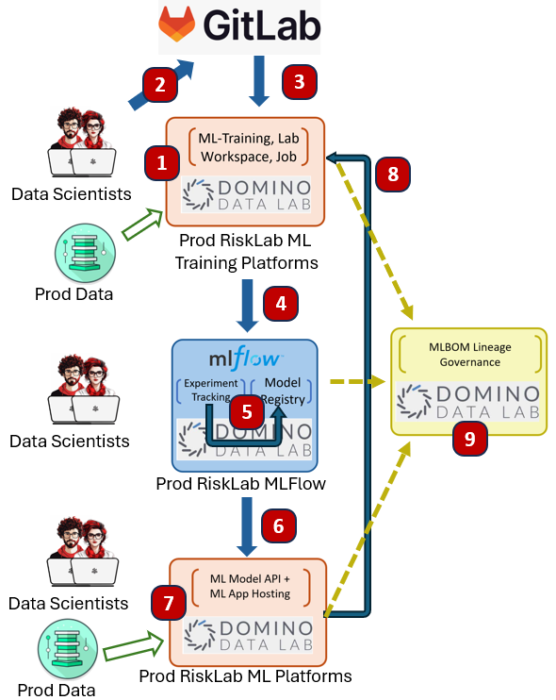
MDLC in Practice: Case 2: Data Scientist Centric Training and Inference on ML Platform
Another pattern within UBS is that divisional analytic Lab environment leverages end to end ML platform such as Domino Data Labs, CDWB, Dataiku and Databricks. ML Platform tends to provided federated eco-system for data scientist centric MLOPS. However, those ML Platform tends to encourage vendor environment / library lock-in, In below example on Domino Data Lab, RiskLab tends draw a balance to leverage open-architecture technology to avoid strong vendor lock in.
Data Scientists develops ML training pipeline (Kedro) in Production model development environment with direct production data access, RiskLab opt for open-architecture Kedro training pipeline vs Domino own training pipeline library to avoid vendor technology lock in.
Data Scientists checks in ML training pipeline to GitLab.
Data Scientists schedule Domino Jobs, which checks out training pipeline from GitLab and starts executing the training pipeline within Domino AKS.
Training pipeline generates one or more experiments and each experiments has model artifacts created and stored within MLFlow experiment tracking.
Data Scientists can optionally register an experiment run’s artifacts to MLFlow model registry for Lab model publishing
Data scientists publishes ML model as a Domino Model API for batch or real time inferencing.
Data scientists can also develop ML application (for example, Streamlit, Dash, ReactJS) and publish the ML App to Domino App. RiskLab can support EUA ML applications inference with production data.
Domino can setup your model to be continuous monitored and define scheduled check to alert on drift and programmatically retrain model.
Domino Data Lab tracks ML Bill of Materials information for end-to-end Model governance (Preview)
Advantages:
Better environment management for workspace, jobs and ML application inference. Quicker time to market.
Good GIT integration, able to directly checkout ML Training pipeline directly to workspace or jobs.
Access to production data in model development environment. Does not need retrain in IT maintained environment.
Fully integrated platform provided MLFlow experiment tracking server + MLFlow model registry.
Some platform, such as Domino Data Lab, provides end to end ML Bill of Materials tracking (Preview)
Great for hosting End User Application ML Apps (EUA) directly by Data scientist.
Good support to CICD, and CTCM, Domino Job can be scheduled to run period job training.
Disadvantages:
Vendor specific Federated MLFlow experiment tracking, Model registry, Model cannot be tracked and registered centrally.
MLBOM tracking is vendor specific. Thus restrictive.
Data Scientists owned process cannot fulfil SDLC for IT to deploy ML Model and ML App to IT environment.
No strong support for CICT from GitLab events (for example, runs pipeline upon merge)
No MLSecOps process to check for ML Model vulnerability.

Slide 5
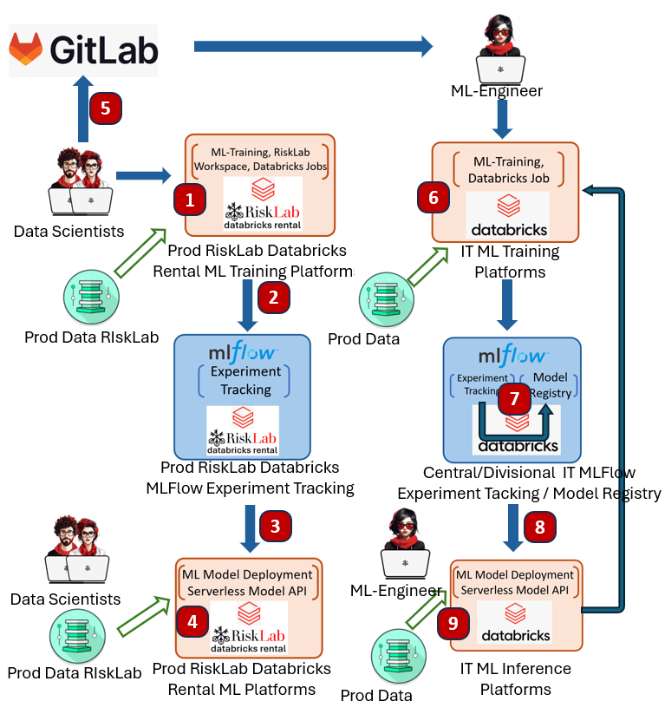
MDLC in Practice: Case 3: Best of both world, Data Scientist ML Platform transits into IT owned ML Platform
To address the issues and disadvantages in Case 1 and Case 2, RiskLab also support a hybrid approach to leverage the advantage of both approaches. The work is currently WIP and will be completed by Q2 2024. Key improvements:
Extends RiskLab Databricks Rental to Machine learning model development, allowing Data Scientist to develop ML training in containerized workspaces with GitLab integration.
Introduce the concept of centralized / divisional MLFlow model registry, allowing Model sharing with RBAC roles.
Allowing IT to train and publish production model by running training / model registry / Inference in IT owned ML platform.
Data Scientists develops ML training pipeline and experiment scoring / selection module in RiskLab Databricks rental workspace (MLFlow Pipeline / Kedro) in production tier model development environment with direct product data access.
Data Scientists either manually runs the pipeline or schedule databricks ML training jobs. Training pipeline generates one or more experiments and each experiments has model artifacts created and stored within Risklab Databricks Rental MLFlow experiment tracking sever
Data scientists can optionally manually publish ML model onto Databricks serverless Model serving API (UBS curated End of Q2, 2024)
Data Scientist can optionally develop and hosting ML Application in RiskLab Databricks Rental Lakehouse App (Private Preview, no UBS curation date) , or hosting in an external solution.
Data Scientists checks in ML training pipeline and experiment scoring / selection module to GitLab
IT ML Engineer checks out training and selection pipeline and schedule the model training in an IT environment having production data access.
The training and experiment scoring, and selection pipeline will auto select the best performing model and registry it with Central / Divisional MLFlow model registry.
ML Engineer can deploy the ML API for Serverless real time serving or Cluster based batch inferencing.
ML Engineer can follow SDLC process to deploy ML application within Lakehouse App or from an external IT maintained Application hosting.
Advantages:
Data Scientists can leverage Databricks ML platform whilst still developing the ML Model in their favourite workspace environment, As Databricks notebooks is insufficient for Library based model development.
Centralized MLFLow model registry with RBAC access control for models.
IT able to execution GitLab training pipeline and have full control of model generation lineage, and able to productionized model independently from data scientists.
Disadvantages:
Databricks yet to offer end-to-end MLBOM tracking solution.
Continuous integration and Continuous Training are Databricks platform centric. And could not be triggered from GitLab.
Databricks MLFLow model lifecycle tracking is inadequate to track Corporate complex lifecycle status.
Databricks does not offer MLSecOps process to check for ML Model vulnerability.

Slide 6
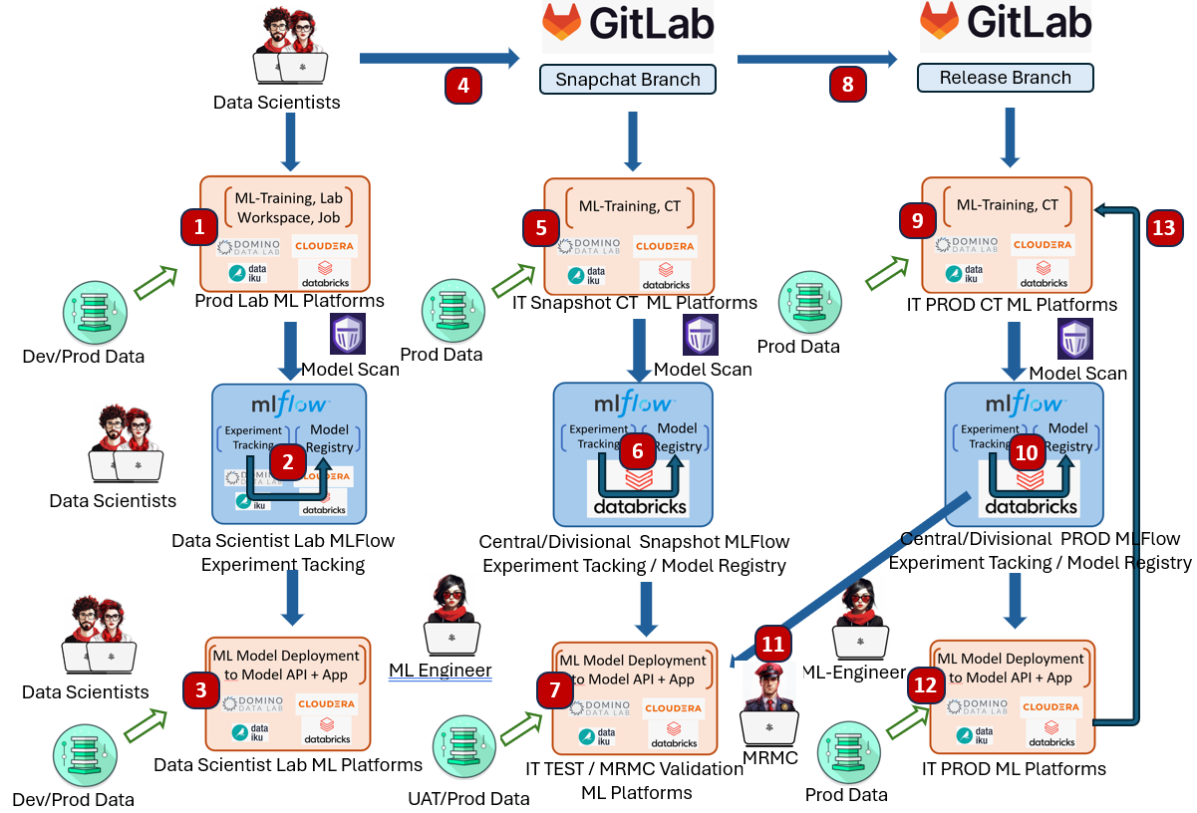
Future “End-Game” MDLC Architecture.
Data Scientists uses their preferred ML model development platform (Domino Data Lab, Databricks, CDWB, AML, Dataiku) to develop their ML training pipeline and model selection module. The platform may or may not have production data access. The generated experiment model artifacts can be security scanned by PROTECT AI Guard to ensure the model artifacts generated is secure.
Data Scientists can optionally register an experiment run’s artifacts to MLFlow model registry for Lab model publishing
Data scientists may want to publishes ML model as Model and hosting ML app for development inferencing.
Data scientists merge the training and evaluation pipeline into a snapshot branch in Gitlab, and Gitlab triggers the Continuous Training pipeline.
Since GitLab does not perform ML training environment yet, the continuous training has to be delegated to IT maintained ML training ML platform by calling APIs in Domino Data Lab, Databricks, CDWB, AML, Dataiku)
GIT pipeline triggers model evaluation and registers best performing Model(s) to snapshot model registry
ML Engineer can deploy to IT maintained ML testing platform to perform model testing.
Once model is tested, Data scientists can merge snapshot branch to release branch, trigger GitLab CT pipeline
As in Step 5, training is delegated to separate ML 7. platforms,
As in step 6, Best performing model is auto selected and published to production model registry.
Production ready model can be either deployed to IT Test ML platform or MRM Validation ML Platform for model testing and validation.
ML engineer could deploy the model into production for real time or batch inferencing.
ML Platform such as Databtricks and AML could trigger additional Continuous Monitoring.
To address the inefficiency in Case 3. A future ML landscape could be defined as below.
Federated ML Platforms and centrally MDLC coordinated through GitLab CI pipeline. GitLab CI triggers ML Platform Continuous Training workload (CT)
Centralized Snapshot / Release MLFLow Model Registry, with integration of PROTECT AI Gurdian Model Security scan.
Production Model trained on GitLab triggered Production ML Platform, tested and validated by IT and MRMC .
Below design does not offer any options to track ML Bill of Materials, it will be discussed in depth in the next 2 slides.

Slide 7
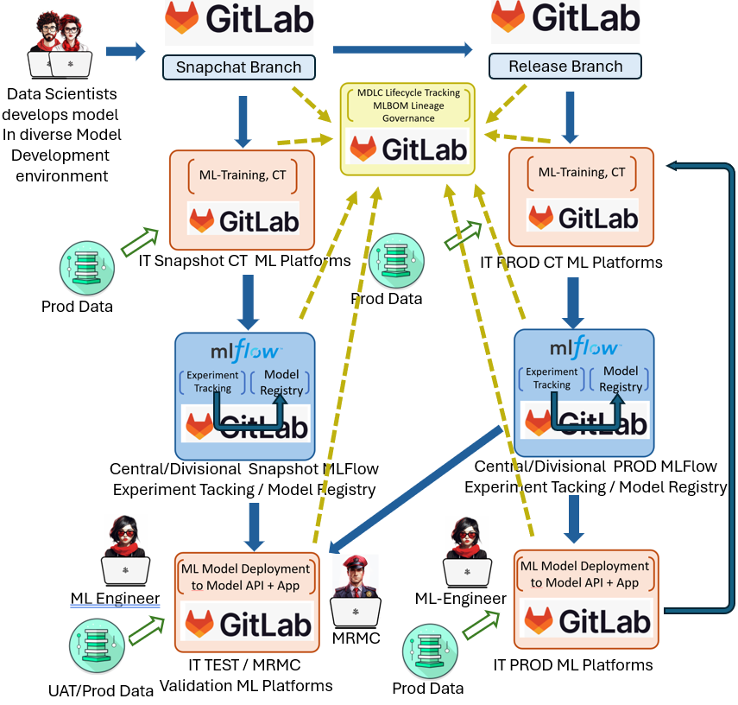
Future “End-Game” MDLC Architecture Variant 1 to support MLBOM: GitLab centric
As of 2024, ML Bill of Materials are mainly supported in federated ML Platforms. Since GitLab is the bank’s SDLC implementation platforms, and GitLab is working toward a complete end to end ML Solution. We would ideally want GitLab to provide the following functionalities in order to capture the complete MLBOM
GitLab pipeline and AKS cluster could support Continuous Trainings to machine learning models. i.e. not limiting GitLab for artifact building job, but for ML model training jobs.
GitLab Model registry could allow Central / Divisional model registry management and access control.
GitLab Model registry provide ML lifecycle status that can be customized according to client definition.
GitLab AKS cluster could provide ML Model API hosting for real time and batch inferencing.
GitLab AKS cluster could provide ML App hosting.
A GitLab central panel could see the complete MLBOM information.
However, GitLab only started MLOps development since 2022, and their product has not matured yet, We see the described landscape might be potentially fulfilled in 2026/2027. The challenges are:
GitLab Model registry are only limited to Project scope. Does not provide central model registry management and access control.
GitLab needs to provide product roadmap in support ML pipeline including advanced multi-cluster ML trainings
GitLab needs to provide product roadmap in ML model API hosting similar to HuggingFace space, and the SLA needs to be production grade.
As above, the same would also apply to ML Application hosting.
We would put this design as a target vision that we egerly awaits GitLab to deliver.

Slide 8
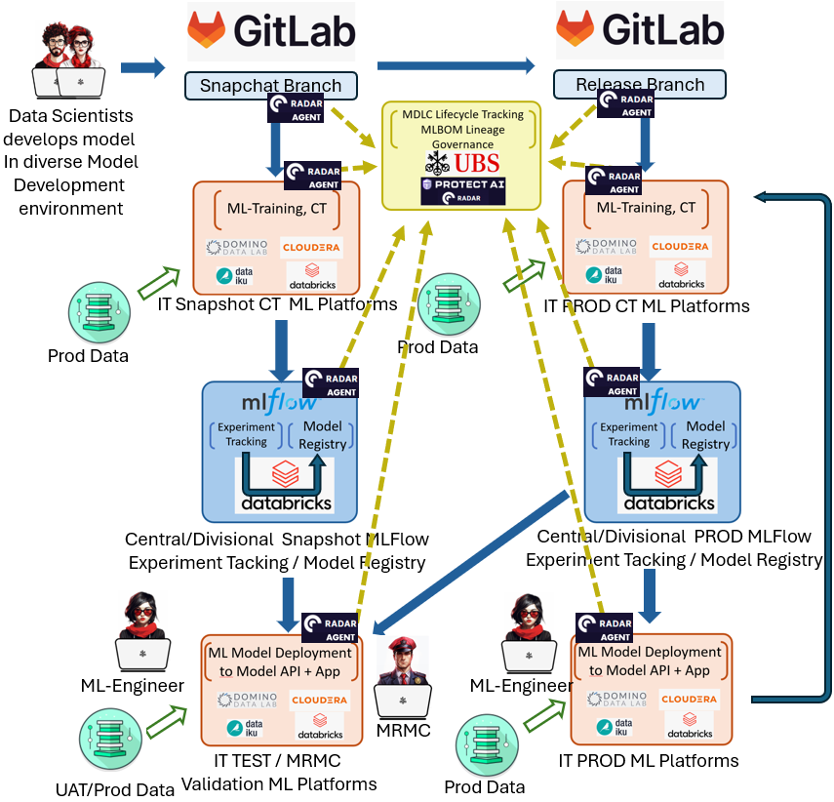
Future “End-Game” MDLC Architecture Variant 2 to support MLBOM: Federated ML Platforms with centralized MLBOM and Lifecycle tracking.
Whilst await GitLab to deliver the complete end-to-end MLOps and MLBOM solution. UBS could still leverage diverse choice of ML Platforms for ML CT, CD and CM.
Protect AI is the industry leading MLSecOps company, and its RADAR product offers complete observability of “tamper-proof” ML Bill of Materials (MLBOM) for comprehensive list of components and dependencies of your ML model. It recognizes that corporation often leverages diverse range of ML Platform, rather for impose close coupling to individual ML Platform, The MLBOM information is extracted by deploying RADAR agent through the lifecycle of ML model at different ML platform for CT and CM, and GitLab for CI and CD.
A UBS in-house built MDLC lifecycle Tracking application can be built on top of the PROTECT AI gathered MLBOMs. As ML lifecycle stages is a key MLBOM for Protect RADAR to track.
GCTO Big Data team, RiskLab and GCRG Model methodology has done a PoC on UBS MDLC lifecycle application during the 2023 Hackathon to support the ML model lifecycle tracking from diverse range of ML Training and Inference platform. This PoC could be leverage PROTECT AI RADAT framework to also offer additional observability of ML Model Bill of Materials information.
Advantage of the Variant 2:
Quick Time to Market for end of end ML CICDCTCM solution.
Allowing Diverse range of ML Platform to be supported.
UBS custom in house lifecycle application with MLBOM tracking.

