Slide 1
Understanding AI: How it Works and Why it Fails
An introduction for beginners
Dr. Wei-Fan Chen Language and Information Research Team
Artificial Intelligence Research Center
National Institute of Advanced Industrial Science and Technology @Tokyo, Japan
2026.04.22

Slide 2
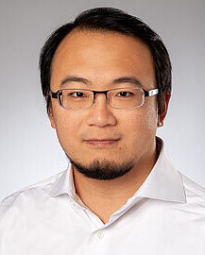
About Me
Dr. Wei-Fan Chen
PhD in Computer Science, Paderborn University, Germany (2024)
Postdoctoral Researcher, University of Bonn, Germany (2023 – 2025)
Researcher at AIST, Japan (2026 – present)
Research Interests
Natural Language Processing / Natural Language Generation
Media Bias
AI Safety
Computational Argumentation
I believe NLP research should be driven by human needs and dedicated to solving real-world problems.

Slide 3
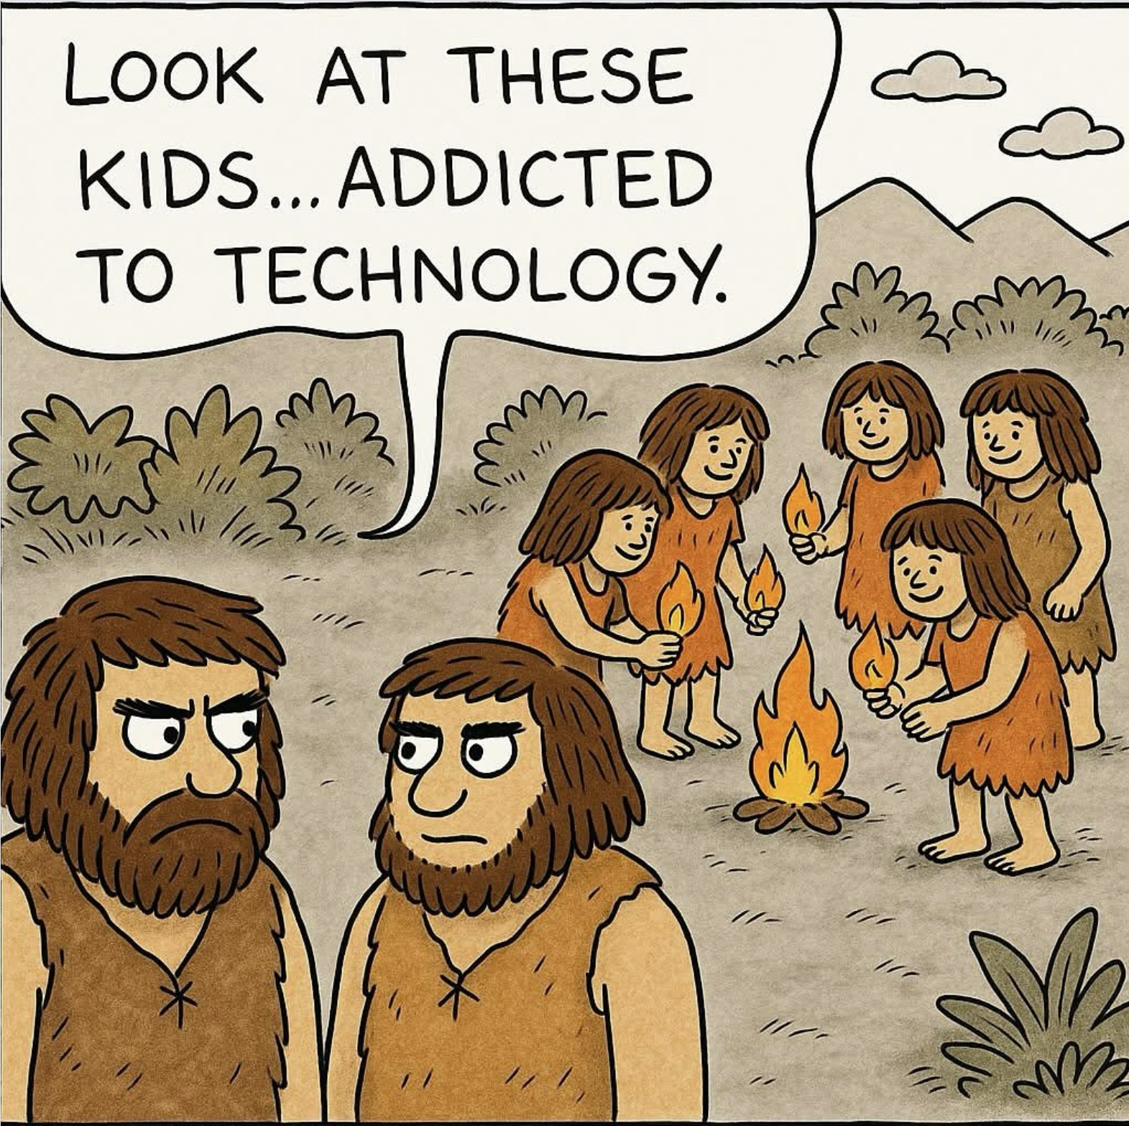
AI: What do We Mean?
In this talk, we discuss AI in terms of
Large Language Models (LLMs)
Chatbot-like assistants (ChatGPT, Alexa, Gemini, ...)
Some LLM-based tools (text2img, open-claw, Copilot, ...)
We will learn
basic concepts of (large) language models,
why and why not it works, and
the future of AI.
But not
mathematics of language models,
how to identify AI generated texts or photos, and
whether TSMC is going to achieve higher price.
https://www.instagram.com/p/DJo7M2iN8Iz/

Slide 4
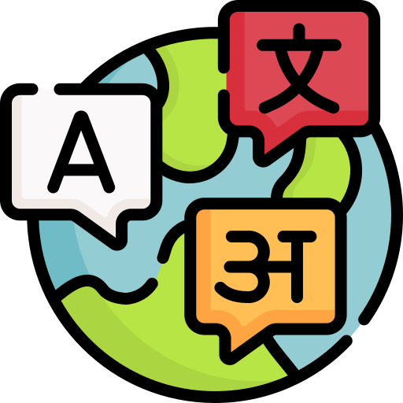
Language Model and Large Language Model
Model Languages
Predict the next word given previous words: “That is X” -> a/an/the
Known as tri-gram (given two, predict next one)
Application: typing systems (next word suggestions), speech recognition
Need huge data to record all the possible combinations + probabilities
Impossible to guess the probabilities of unseen/rare words
Need to remember/search all possible next words
Largest statistical n-gram model: 6-7 (20+ years ago)
Fails when continuous 10+ words
https://www.flaticon.com/

Slide 5
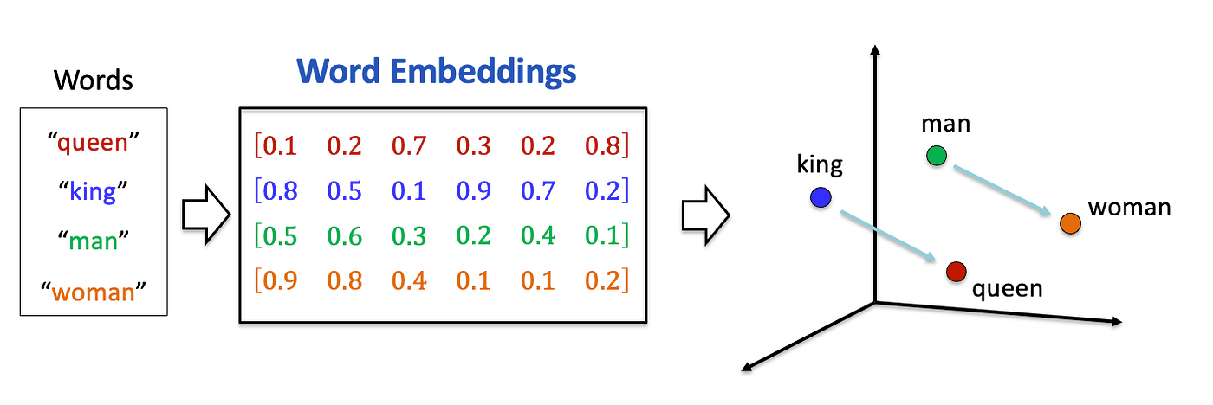
Large Language Model (Deep Learning)
1st generation (2013): word vectors
Breakthrough: presenting words into semantic space
Word analogies
man : woman = ? : queen
v(man) - v(woman) + v(queen) ≈ v(king)
Location & distance have meanings
2nd generation (2014): Recurrent Neural Networks
I have the word vectors of “that” & “is,” can I compute the probabilities of the next word?
p(x) = f(“is”, “that”, “that is”)
Approximates n-gram models (n ~ 10)
Faster, smaller, better
https://medium.com/@lmpo/the-evolution-of-word-embeddings-da81552e9c92

Slide 6
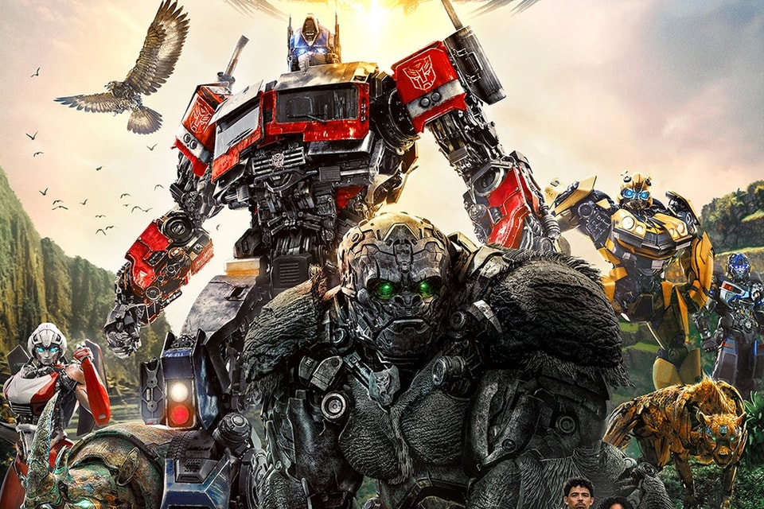
Large Language Model (Deep Learning)
3rd generation (2017): Pre-trained Language Models (Transformers)
If we can learn words as vectors (numbers), can we learn sentence as vectors?
The models compress world knowledge & long-term semantic into a transferable data.
Approximates n-gram models (n ~ 20+)
4th generation (2022): ChatGPT
Scale-up to article-level (n > 50)
Learn anything available on the Internet
Huge amount of human feedback
Unknown size (100K ~ 1M)
Released to the public
https://hypebeast.com/zh/2023/6/transformers-rise-of-the-beasts-final-trailer
Yes, but not me

Slide 7
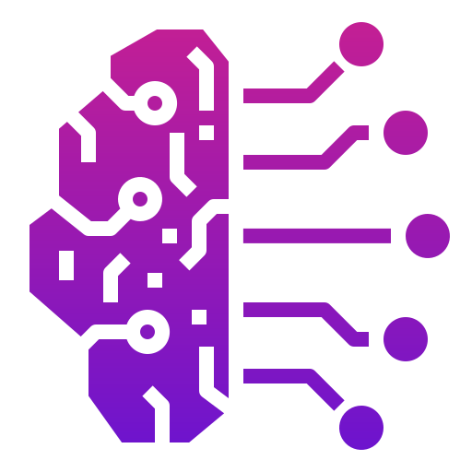
Artificial “Intelligence”
Next word(s) prediction means intelligence?
1 + 2 = ? (do we really count or we just remeber?)
What is intelligence of human?
Tell you what’s known (~next words prediction)
Create something not there yet
Write an article / copying and pasting different piece of text?
Draw a picture / learn the painting style of Van Gogh
The limitation of intelligence
AI can answer questions has been widely answered.
AI can have an educated guess what you want.
AI cannot learn logics and then generalize them.
If you have learned the meaning of +, 1+2 and 456467+19985 have no difference.
https://www.flaticon.com/

Slide 8
Hallucination: What and Why
Hallucination (Both can exist, and it can be factually correct and faithful wrong)
Faithful hallucination (outcome has something different)
Factual hallucination (outcome has something contradicted)
Ex: summarize a news article about Trump won the election in 2024
Summarization about Trump’s first election -> faithful hallucination
Summarization about Trump lose his election -> factual hallucination
But why?
Predicting next word is probabilistic, not deterministic
E.g., What’s the day of the week on January 1st, 2000?
You may find the answer already on the Internet because a lot of people may ask already
E.g., What’s the day of the week on January 1st, 324658?
No knowledge available. Educated guess of all January 1st: Monday: 25%, Tuesday 17%, ...

Slide 9

Hallucination: How to Resolve
OK, but I still don‘t like hallucination...
Introducing strong logic
Call assistants for day check, math check, fact check
Some hallucination is not checkable
Once Prof. Chen said, “I love my students.” -> could be true, but no one knows
What we should be aware of
Don’t fully trust AI responses.
It may not have the intention to lie, but it has the intention to answer your questions.
Forcing giving an answer regardless
It has world knowledge via texts, but not physical knowledge
It knows birds can fly in the air (texts), but it may not know air cannot support things.
https://life.tw/?app=view&no=524504
Sharingan’s hallucination...

Slide 10
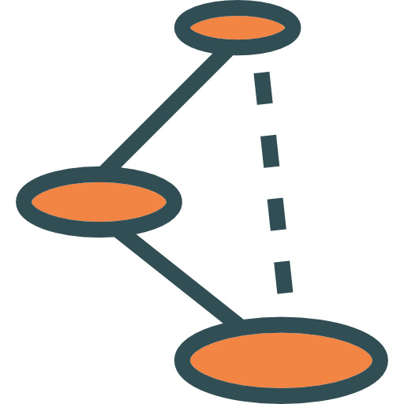
Logics and Reasons in AI
What we scientists know
AI doesn’t really “know,” it just guesses.
It can answer with reasons, but they seem to be post hoc justification.
It doesn’t learn/follow hard logics.
We have some observations
Longer reasoning, better answers
Deeper, larger model performs better
It develops its own tricks (shortcuts) to achieve the goals
Models improve after we tell models what we want and what we don’t want.
What we are not sure
Why and how AI learns
Is the whole model working? If not, which parts and why?
https://www.flaticon.com/

Slide 11
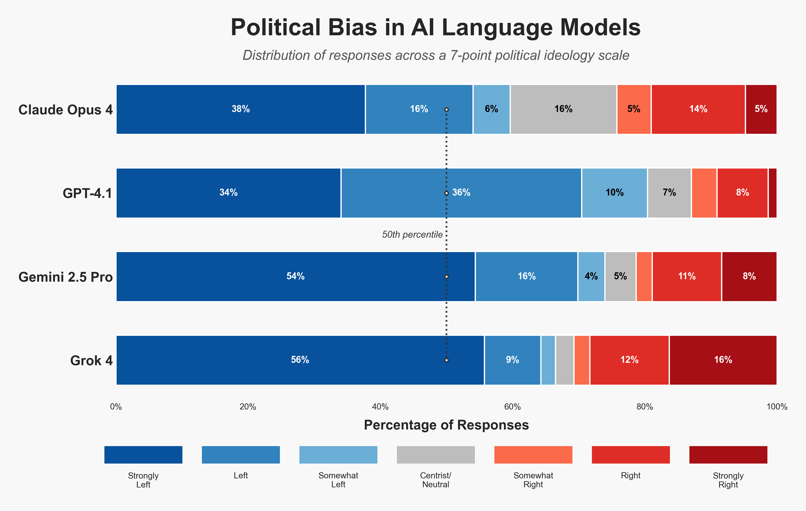
AI is Biased
Humans are biased, so the AIs
They are biased because of
the training data (corpora), mostly texts on the internet
company policies
human feedback
AI may have stereotypes of
Different social groups (gender, nationality, ...)
What and how you would like to be answered
We should be aware of
AI companies develop AIs based on their own ideologies.
AI researchers aim to present a more objective world.
Awareness is the first step to reducing misunderstandings between people.
https://www.promptfoo.dev/blog/grok-4-political-bias/

Slide 12
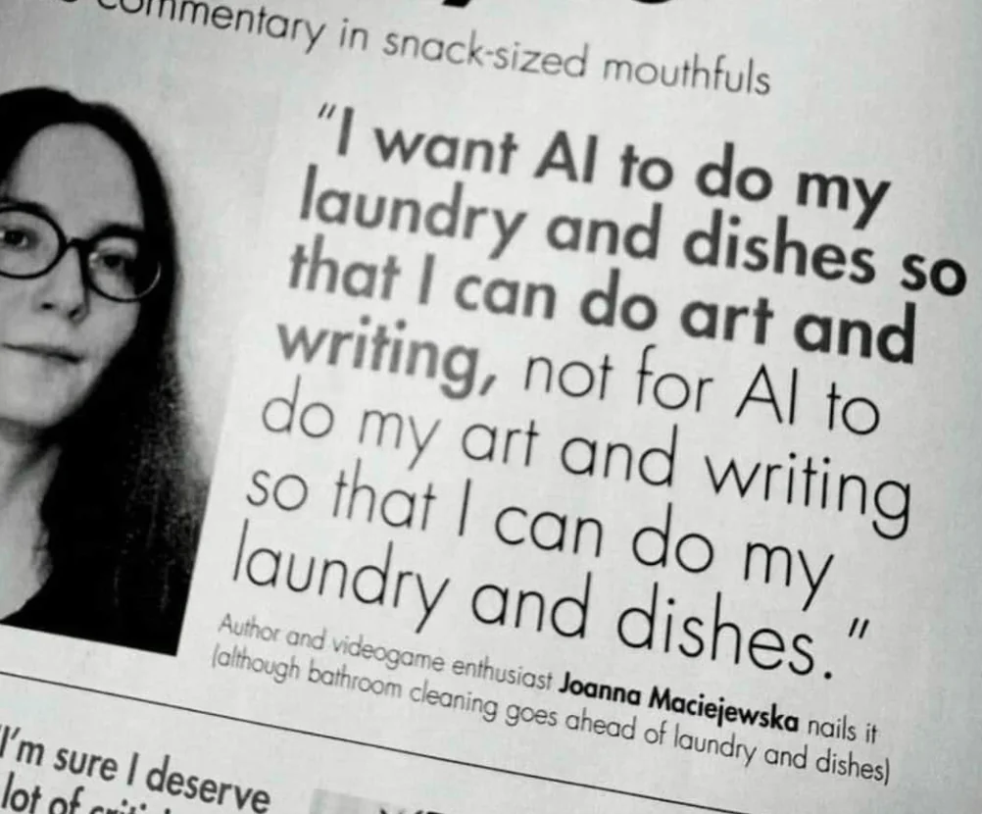
What’s Next?
We develop AIs to make the world better, not to take your jobs.
AI Safety
If films have ratings, AIs should have ratings.
General, Protected, Parental Guidance, Restricted
who can use which AIs, and which access level
The general regularization of AI assistants is on its way.
Knives do not kill people, but human holding knives could.
AI in Education
Learn how to use it correctly.
Using AI to assist learning, not to replace it.
End-users (not the ChatBots and the AI companies) should be responsible for the outcome.
https://www.reddit.com/r/ChatGPT/comments/1d8j9su/i_want_ai_to_do_my_household_chores_and_i_can_do/

Slide 13
Thanks for your attention!
ご静聴ありがとうございました
感謝參與

Slide 14
Questions?
https://www.pinterest.com/pin/squirrel-huh-sticker-squirrel-huh-what-discover-share-gifs--850547079638123073/

